Slide 1
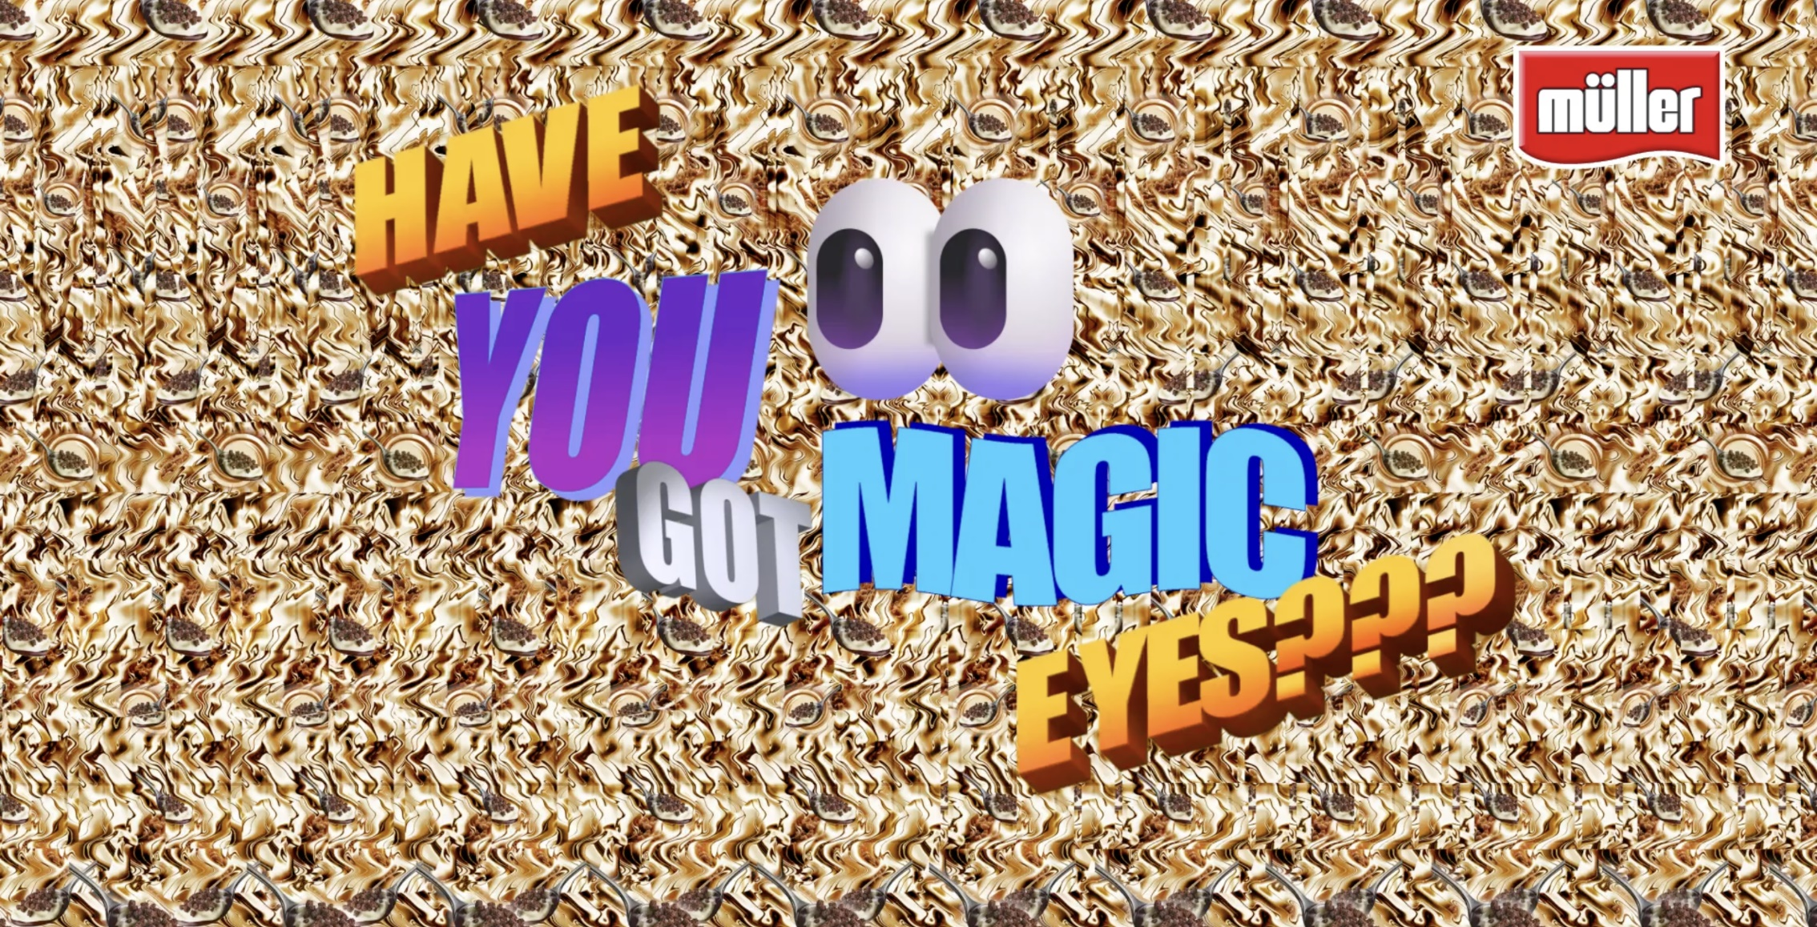
Müller corner
Have You Got Magic Eyes?
SECTOR | TARGET AUDIENCE | PACKAGE | MEDIA AGENCY | COPY LENGTH
FMCG | ABC1 Adults | ABC1 Adult AGP | EssenceMediacom | 10”,20”
BACKGROUND
Despite being the current leader in their own market, Müller Corner wanted to expand their sales and drive perceptions of being an ‘everyday treat’ by launching a nostalgia driven ad campaign. The cinema experience is engaging, immersive and ultimately associated with snacking, so Muller Corner knew that this would be the most effective way to reach their target audience to reinforce their product as a casual snack option.
PLAN
Wanting to grab the attention of its audience, the creative copy used the Magic Eye technique, with a 2D kaleidoscope-style image of a Müller Corner yoghurt concealing a hidden 3D Mud Pie. Here, the audience is encouraged to engage with the ad to decipher the hidden word, utilising cinema’s distraction-free offering. Müller Corner bought into an ABC1 Adult AGP giving them access to films such as Kingdom of the Planet of Apes, Ghostbusters - Frozen Empire, Back to Black, and Godzilla x Kong - The New Empire. These films aligned with the campaign’s core themes by tapping into nostalgia during the 80s, 90s and 2000s.
RESULTS
This campaign was a remarkable success, with the strategic integration of cinema was instrumental in achieving Muller Corner’s key campaign KPIs from across the full funnel of metrics.
+16%
+16%
Source: DCM Awards: Muller Corner Case Study 2024. Uplifts = relative uplifts

