Slide 1
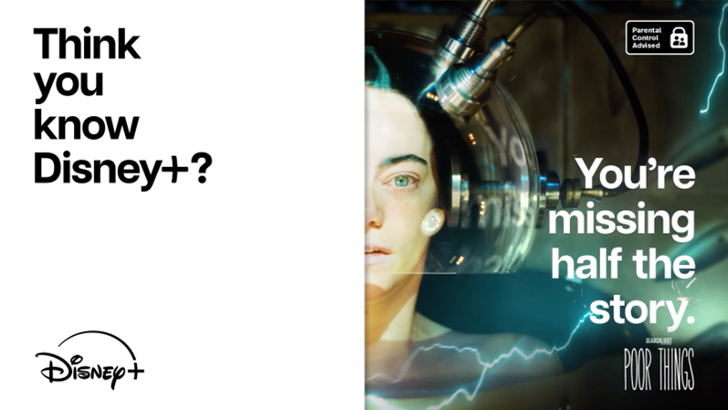
Disney+
Think You Know Disney+?
SECTOR | TARGET AUDIENCE | PACKAGE | MEDIA AGENCY | COPY LENGTH
Ents & Leisure | ABC1 Adults | Film Packs/Blipverts | Publicis | 10”,30”
BACKGROUND
Whilst being synonymous with family friendly entertainment, Disney+ struggled to break away from the perception that the streaming service is solely for children’s content. Wanting to reach more mature audiences to emphasise the plethora of mature content available to stream, Disney+ aimed to drive a change in perception, boost sales and improve the brands position in the SVOD market.
PLAN
Wanting to primarily associate themselves with non-family titles to help challenge the existing perception, Disney+ creatively showcased a standout ad to disrupt the reel, running Blipverts across a range of films to reach parents and mature audiences. Live during the Easter period, Disney+ accessed an array of titles across numerous genres such as Godzilla v Kong: The New Empire and Ghostbusters Frozen Empire, The First Omen, Monkey Man, Immaculate, Civil War and Back to Black.
The Blipvert ads alternated between juxtaposing Disney+ titles e.g. Ratatouille and The Bear to show the variety of their content, emphasising the campaigns slogan “If you’re only seeing half the story, you don’t know what you’re missing”. The copy also aimed to provide shock value by playing the iconic Disney audio intro sound adjacent to crude and graphic lines from adult films, such as Poor Things when Emma Stone states, “I must go punch that baby!”, building on the perceptions of the departure from only family friendly entertainment.
RESULT
The campaign was a phenomenal success, especially in disrupting perceptions of the streaming service. Cinema was integral in effectively engaging with hard-to-reach audiences, with their ‘content for adults’ brand health metrics significantly increasing before the end of the final quarter of Disney's financial year.
“The disruptive creative for the Easter campaign was perfectly complimented by cinema …we are delighted we were able to push creative boundaries in all areas, and our cinema presence across the Easter period was key to the success of the campaign and has aided the job we need to do to tell people that we have content for them (and not just their kids!)”
- Nicole Evangeli, Brand Marketing Manager Disney+
Source: DCM Awards: Disney+ Case Study 2024. Uplifts = relative uplifts

