Slide 1
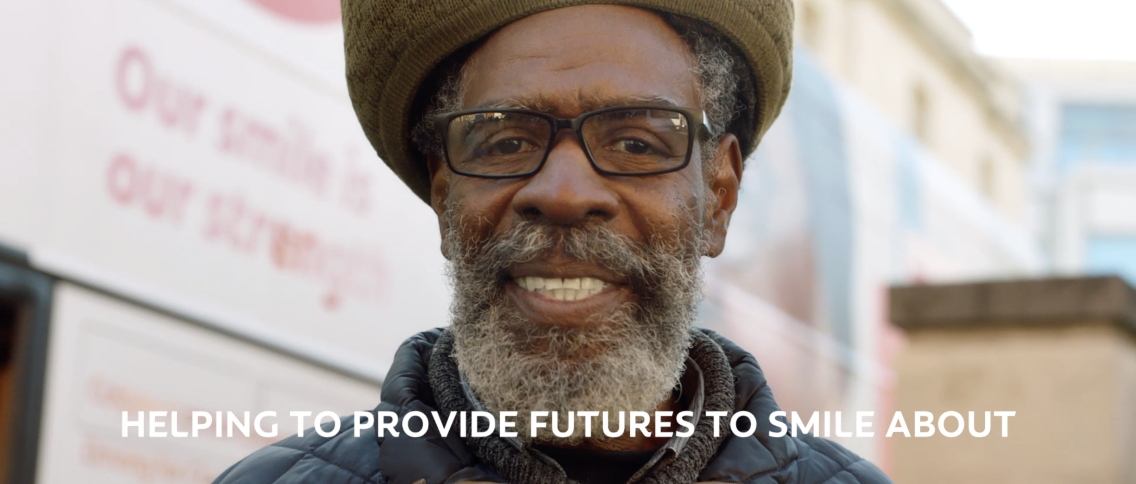
Colgate
SECTOR | TARGET AUDIENCE | PACKAGE | MEDIA AGENCY | COPY LENGTH
Personal Care | ABC1 Adults | Film Packs | Wavemaker | 30”
‘Futures to Smile About’
BACKGROUND
Brushing our teeth is something that many of us take for granted and it is a habitual part of our everyday life, but sadly, this is not the case for all. When we think of the issues facing the homeless, we may think of drugs, crime, hunger, the cold but the startling reality is that without access to oral hygiene, the majority of rough-sleepers experience mouth pain. This major issue led Colgate to partner with the Change Please, an award-winning social enterprise to improve the oral care for the homeless. Historically, Colgate’s focus has been communicating product efficacy and value, with heavy weight TV plans designed to drive awareness and effective conversion to sales. That was not the aim of this campaign, this activity had an arguably much deeper and more important message to convey.
PLAN
To cement this partnership, a 30” emotionally charged film was created focusing on the plight of Raphael, who experienced homelessness when he was 17 but was helped by Change Please three years ago and is now a vital part of the organisation. Whilst in the past, cinema had been an untapped channel for Colgate, they knew connection and awareness were needed for this campaign to dial up on the emotion and drive positive change & perceptions. Colgate utilised cinema to reach the emotive side of their target audience, using the shared collective experience, relaxed environment, and immersive viewing that cinema offers. Colgate bought into film packs themed full of family moments and positivity, running across 8 key films that aligned with optimistic sentiment, including Trolls Band Together, The Marvels, Aquaman and the Lost Kingdom, Bob Marley: One Love and Wish.
RESULTS
Cinema was pivotal in helping to raise awareness of the ‘Futures to Smile About’ initiative, in addition to boosting positive associations with Colgate as a brand. But the real success is helping those in need, those, who without Futures to Smile About would be living day to day in excruciating pain. Already this year, Colgate and Change Please have seen 433 patients, with 191 needing specific dental help in the mobile dental service bus.
+19%
+13%
Cinema drove incremental impact on front of mind saliency
Cinema drove associations that Colgate is a caring brand
Source: DCM Awards: Colgate Case Study 2024.

