Slide 1
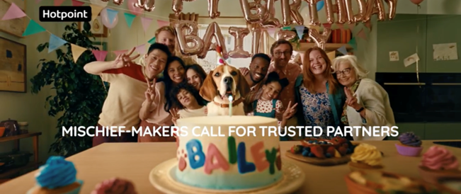
Beko Hotpoint
‘The Feeling of Home Since 1911’
DCM Awards Nominee
Best Use of Cinema (Large)
SECTOR | TARGET AUDIENCE | PACKAGE | MEDIA AGENCY | COPY LENGTH
Household Products | ABC1 Adults | Gold+Silver Spots & AGP | T&Pm | 60” & 30”
BACKGROUND
Despite being an already salient brand within its own market, Hotpoint struggled to convert its strong brand awareness into consideration and preference. Knowing that consumers are increasingly prioritising value for money, innovative home improvements and energy efficiency due to the cost-of-living crisis, Hotpoint was presented with a unique opportunity to resonate emotionally with its audience – aiming to establish the brand as synonymous with reliability & care to ultimately drive consideration & preference.
PLAN
Creatively, Hotpoint wanted to illustrate 'The Feeling of Home' by telling the story of a mischief maker, symbolising household mishaps, and showcasing Hotpoint as the reliable partner that ensures everything runs smoothly. Knowing that cinema offers an immersive environment that delivers impactful attention, Hotpoint introduced cinema within the wider AV media plan for the first time to maximise the emotional impact of the new narrative among the target ABC1 audience. Hotpoint ran a 30” version of the copy across AGP titles, while the full 60” version ran in the Silver Spot (Furiosa) & Gold Spot (If) to maximise engagement.
RESULTS
Cinema helped to significantly improve several of Hotpoint’s core brand metrics, with the campaign improving perceptions that ultimately helped drive the desired mid-funnel consideration and purchase intent metrics.
RECALL – Test respondents delivered a +64% uplift in recall vs. those not exposed to cinema.
CONSIDERATION – Just over half of those exposed to the ad in cinema agreed they were very likely to consider Hotpoint, jumping up to 60% for exposure to the Gold Spot a +36% significant uplift vs. those not exposed to cinema.
INTENTION TO ACT – 4 in 5 of exposed cinemagoers intend to take some form of action, including (24%) intending to purchase a Hotpoint appliance.
‘Hotpoint is the UK's most trusted major domestic appliance supplier’
‘Hotpoint shares the feeling of home’
‘Hotpoint is a
brand I trust’
+86%
+71%
+48%
Source: DCM / Beko Hotpoint Conducted by; Differentology May 2024.
Uplifts are control (not exposed to ad in cinema) vs test (exposed to ad in cinema)

