Slide 1
DCM 2024 cinema UPDATE
Latest industry news, trends and forecasts

Slide 2
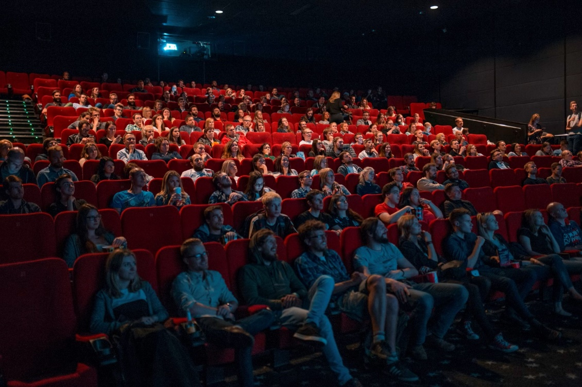
2023 was a great year with an increase in releases, box office and admissions
2023 box office surpassed £1bn for the first time since the pandemic and admissions continued to grow back (+5%)
£1.06bn
Total box office revenue (+8% YOY)
1,013
New releases (+9% YOY)
174
Blockbuster releases – only 12 short of 2019’s peak
123.6m
Total UK admissions (+5% YOY)
Source: Comscore Movies. Box offices stats are UK & Ireland, Admissions UK only.
Blockbuster releases as defined here by Comscore are ‘saturation releases’ that play in 250+ cinemas

Slide 3
2023 highlights: HUGE BLOCKBUSTERS, THRILLING HORROR & SOUTH ASIAN SUCCESS
Success of original, exciting blockbusters
The consistency of the horror genre
The growth of South Asian cinema
2023 was a stellar year for original, exciting and high-quality blockbusters bringing audiences into the cinema.
From the phenomenal success of Barbie and Oppenheimer, to the ingenuity of Spider-Man: Across the Spider-Verse, and excellent auteur driven cinema including Killers of the Flower Moon, Napoleon and Saltburn.
Horror continues to be one of the most consistent genres for delivering hits with its fans (heavily 16-24 skewing) and delivering profit for the studios.
In 2023 alone, Five Nights At Freddy’s was a huge break-out hit, Insidious: The Red Door was the biggest film of the franchise so far, and Scream VI, M3GAN, The Nun II, Saw X, and Evil Dead Rise all proved popular.
2023 saw an incredible growth in the success of South Asian cinema at the UK box office. First driven by Pathaan back in January – which became the biggest South Asian film of all time in the UK.
A consistent slate of hits followed including Jawan, Tiger 3, Rocky Aur Rani Kii Prem Kahaani, and Dunki showcasing the genre’s credentials as real must-see cinematic events for its audience.

Slide 4
2023 saw dcm continue to rebuild and outperform the market
Despite a challenging AV market (c. -8%), DCM revenues were up +5% - driven by the likes of Barbie, Oppenheimer and Super Mario Bros. Admissions also continued to recover, up +5% on 2022
+5%
DCM Revenue YOY
+5%
DCM Admissions
YOY
Source: DCM

Slide 5
uk cinema audience ARE CONTINUING TO RETURN with growth forecast again for 2024
Cinema admissions continue to grow back towards pre-pandemic levels in the coming years
+3%
Source: Comscore. 2024: DCM Forecast

Slide 6
AUDIENCE: 2024 uk cinema admissions forecast
An incredible summer of cinema lies ahead with blockbusters for every audience and we’re expecting a strong finish to the year too
Source: DCM. Dottted line = average monthly admissions (2020-2023)

Slide 7
An exciting FILM SLATE ahead for 2024
JAN
Feb
Mar
APR
MAY
JUN
JUL
AUG
SEPT
OCT
NOV
DEC

Slide 8
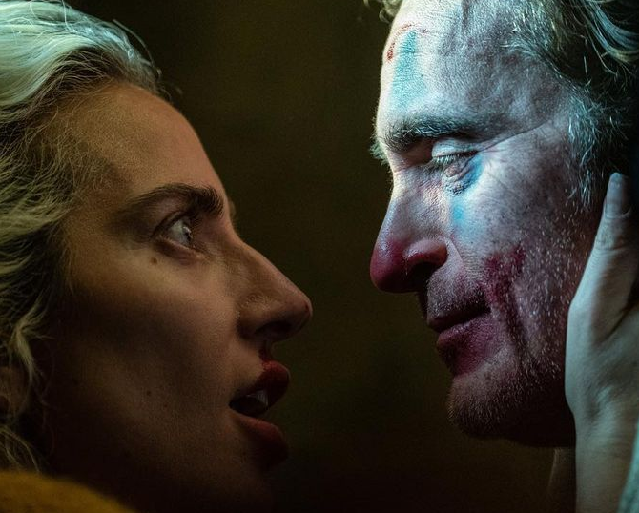
2024 top 10 16-34 BLOCKBUSTER forecasts
These will be the big hitters for reaching young ads on cinema across 2024…
 | Industry Admissions | 16-34 TVRs
Joker: Folie A Deux October | 4.4m | 19
Deadpool 3 July | 3.4m | 16
Despicable Me 4 July | 5.6m | 11
Inside Out 2 June | 5.0m | 10
Mufasa: The Lion King December | 3.7m | 9
Sonic The Hedgehog 3 December | 3.2m | 9
Furiosa May | 2.1m | 9
Dune: Part II March | 2.6m | 8
Wicked December | 4.0m | 8
Untitled Venom Sequel November | 1.7m | 7
Source: DCM, January 2024. Based on industry admissions forecasts and comparative film profiles

Slide 9
2024 TRENDS: A BIG YEAR AHEAD FOR MOVIE STAR BLOCKBUSTERs, MUSICALs & FAMILY FILMS
Renaissance of the star-led blockbusters
Another big year for the musical
The best family film slate of the last 5 years
In recent years IP/characters have been a key driving force behind many of the biggest films, however it appears we’re about to enter a renaissance of the movie star vehicle.
Gosling and Blunt in The Fall Guy, Johansson and Tatum in Project Artemis, and Clooney and Pitt in Wolfs show signs the big Hollywood studios trust star power as a pull for audiences over known story properties.
Wonka has exceeded its lofty expectations becoming a phenomenal c.£60m hit at the UK box office.
Its success sets the scene for what should be another big year for the musical (and music biopic) with the likes of Mean Girls, Bob Marley: One Love, Back To Black, Mufasa: The Lion King, and Wicked to come - with several of our exhibitors predicting the latter to be the biggest release of the year.
It’s been a slower build back for family audiences since the pandemic – with the occasional high point (the huge Super Mario Bros Movie and Minions) but lower frequency of quality family releases.
This is all set to change in 2024 with an excellent slate that includes the return of beloved characters including Kung Fu Panda, Garfield, and Paddington; the behemoth that is the Despicable Me franchise and
the long-awaited sequel to Inside Out.

Slide 10
We have lots to shout about in 2024 with further growth predicted
The wider AV market will likely recover with predicted growth of +2% in 2024, and we expect DCM revenue to again outperform the market with growth of +7% driven a particularly strong Q4 slate.
+7%
DCM Revenue YOY
+3%
DCM Admissions
YOY
Source DCM Forecast revenues and Admission
Market predictions taken from various industry opinions

Slide 11
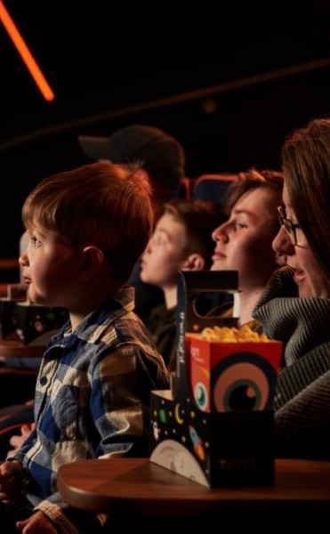
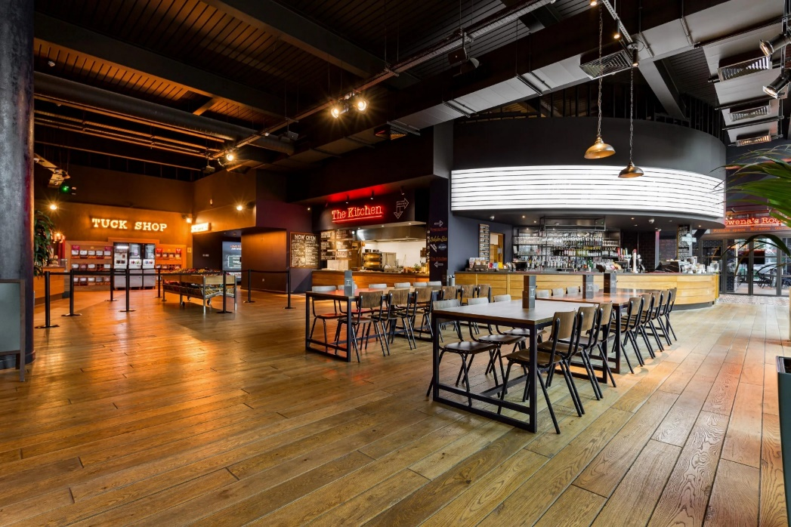
Dcm estate WIN: the light HAS JOINED from JANUARY 2024
The Light, one of the UK’s leading independent cinema chains, has appointed DCM to grow its ad revenue and build brand partnerships across its portfolio.
The Light have 13 venues across the UK including Bolton, Bradford, Cambridge, Redhill, Sheffield, Stockport and Walsall.
The Light combines the very best elements of independent and multiplex cinema, including an IMAX screen at Cambridge and sites with other exciting leisure activities including axe throwing, bowling, and climbing walls.
The new partnership will expand DCM’s growing estate, with The Light representing 2% of the UK cinema market.
As of Q1 2024, DCM now represent 80.73% of the UK cinema market.
Market share source: Comscore, based on Q4 2023 admissions.

Slide 12
THANKS
See dcm.co.uk for more information

