Slide 1

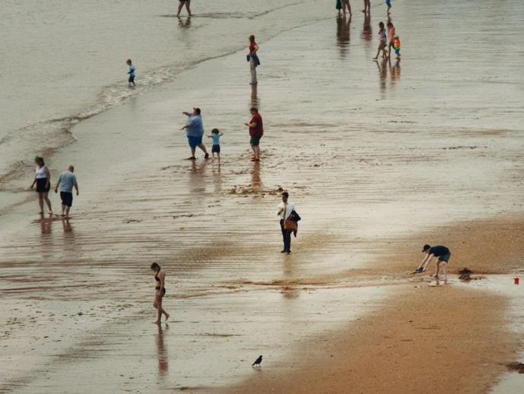
CROSSCOUNTRY
DCM AWARDS NOMINEE
Best Long-Term Use of Cinema
Background
CrossCountry wanted to defy the impersonal advertising prevalent in the rail industry from competitors. Cinema was chosen to amplify the ‘Take Us On Your Journey’ brand messaging.
Plan
The campaign featured both 60” and 30” copies and the brand bought into film packs for Gladiator II, Wicked and Deadpool & Wolverine to make most of the scale and buzz of these blockbuster releases.
Results
Econometric data identified that ROI for cinema alone came to a strong £7.90 for CrossCountry
The impact on brand awareness encouraged CrossCountry to extend the campaign from the initial 3-month period to 5 months overall.
Notes:
Source: DCM Awards 2025 CrossCountry Entry

Slide 2

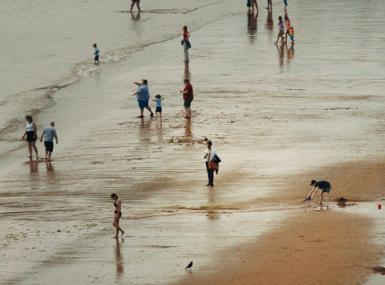
CROSSCOUNTRY
DCM AWARDS NOMINEE: Best Long-Term Use of Cinema
MEDIA AGENCY | TARGET | BUYING ROUTE | COPY LENGTH
UM Central | Adults 16+ | Film Packs and AGP | 30” & 60”
“Take us on your journey”
BACKGROUND
CrossCountry and cinema forged a powerful partnership, defying impersonal advertising prevalent in the rail industry. Cinema was chosen in order to amplify the ‘Take Us On Your Journey’ brand messaging. Cinema was strategically chosen for the launch because it provides the time and memorability for audiences to truly connect with the CrossCountry story.
PLAN
The campaign featured both 60” and 30” length copies, to blend maximum reach and storytelling impact.
CrossCountry bought into film packs for some of the year’s biggest releases; Deadpool & Wolverine, Gladiator II and Wicked, to make most of the scale and buzz surrounding these blockbuster releases.
RESULTS
By leveraging cinema to build brand awareness, drive consideration, and foster emotional connections, CrossCountry achieved remarkable results.
DELIVERED ROI
Econometric data identified that ROI for cinema alone came to a strong £7.90 for CrossCountry.
ENCOURAGE SUSTAINED ACTIVITY
The impact on brand awareness encouraged CrossCountry to extend the campaign from the initial 3-month period to 5 months overall.
Notes:
Source: DCM Awards 2025 CrossCountry Entry

