Slide 1
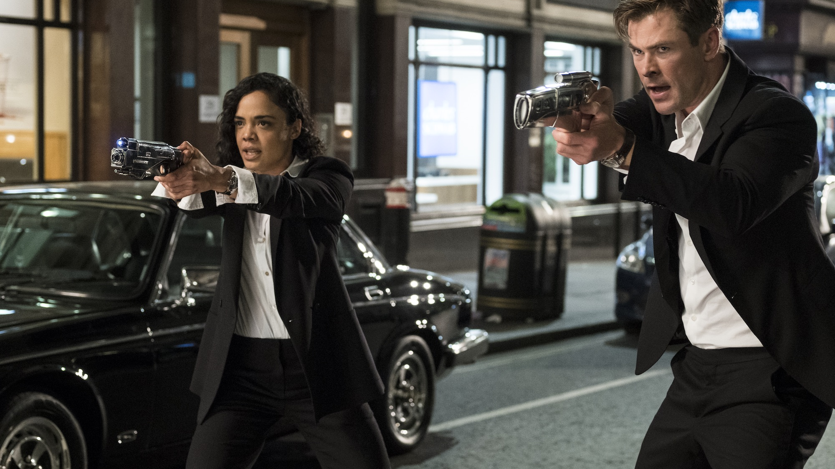

Long Term Brand Partnership Opportunity
CINEWORLD UNLIMITED
2021
Notes:
All elements on this page (not including the logo) need to be 1cm apart

Slide 2
SPOILER ALERT!
UNLIMITED POSSIBILITIES FOR YOUR BRAND!
Notes:
All elements on this page (not including the logo) should be 1cm away from each other

Slide 3

CINEWORLD UNLIMITED
THE UK’s LONGEST RUNNING AND LARGEST CINEMA LOYALTY SCHEME IS READY TO WORK WITH YOUR BRAND…
With a Cineworld Unlimited Card all roads lead to adventure, and magic. And romance. Action. Comedy. To anywhere the customer decides… because a subscription to Unlimited means a dedication to the world of film in all its incredible excitement and film.
Paying £17.90 per month (£20.40 inc. London’s West End sites), customers are able to enjoy unlimited films – any film, as many times as they wish. Members enjoy exclusive access to monthly preview screenings of the best selected films across the year, as well as added benefits such as discounted concessions and money off at partner restaurants such as Yo! Sushi, Café Rouge, Bella Italia, Las Iguanas, La Tasca and Belgo.
The 12 month Cineworld Unlimited Partnership offers a brand the unrivalled chance to reach the UK’s biggest group of cinema lovers, film buffs and movie experts. The desire is to create a deep ingrained partnership between Cineworld, its members and the partner brand – creating a long term, lasting positive effect for the exclusive partner.
Notes:
The line underneath the header should be 0.50cm away from the header
The sub header is 0.50cm beneath the line
The copy should then be 1cm away from the sub header

Slide 4






12 months of incredible film
Award winners, box office smashes and entertainment for all the family.
TOY STORY 4
JOKER
KINGSMAN 3
ONCE UPON A TIME IN HOLLYWOOD
STAR WARS: THE RISE OF SKYWALKER
BOND 25
Notes:
The line underneath the header and the body copy should be 0.50cm away from each other

Slide 5







THE CINEWORLD AUDIENCE
Demographics
Lifestyle
Media habits
Younger-skewing affluent audience.
Tech savvy and early adopters
Subscriptions & broad entertainment channels
 | Regular Cineworld cinemagoer | Average UK adult profile
15-34 | 41% | 31%
35-54 | 37% | 32%
55+ | 23% | 38%
ABC1 | 56% | 56%
> £40k HHC Inc. | 33% | 28%
I make sure I have the most up-to-date mobile on the market (Index: 148)
I like to buy new gadgets & appliances (Index: 110)
Currently own a smart home speaker, smart watch or 4K TV (Index: 124)
Source: GB TGI March 2021 + IPA TouchPoints 2020
Cineworld = Cinema most visited often
Index vs. average GB adult

Slide 6
ALIGN YOUR BRAND WITH THE UK’S BIGGEST FILM LOVING AUDIENCE
Cineworld Unlimited Members quick facts
53% under 35
Tech savvy
Active on social media
50/50 gender split
55% visit with a partner or friend(s)
90% would recommend to a friend.
55% book their tickets in advance on mobile.
X10 visit the cinema 10 times more than the average
Source: Cineworld 2019

Slide 7
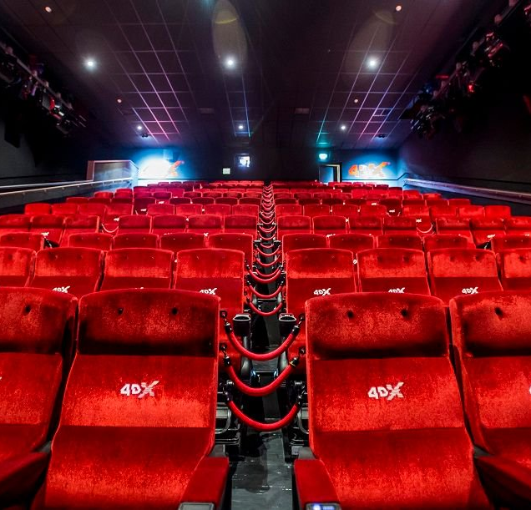
YOUR BRAND & THE UK’S BIGGEST CINEMA CHAIN
Unlimited possibilities…
Cineworld is the UK’s largest exhibitor by admissions, and is indeed part of a global network of cinemas spanning Eastern Europe, the UK and the US.
Combining huge customer numbers and a global approach, Cineworld is using its expertise to pioneer technology in its UK-wide estate. Through new and exclusive development of the in-auditorium screen experience as well as their foyer spaces, a trip to Cineworld is a trip to the cutting edge of cinema.
In screen, Cineworld has exclusive distribution rights of two cutting edge technologies; 4DX and Screen X, two technologies that look to enhance film-viewing beyond the traditional already immersive cinema environment.
On top of this, Cineworld’s foyers are some of the most visually striking in the country with a heightened sensory experience delivered through impressive large format digital screens, panels & rotundas as well controlled lighting all combining to help drive excitement for customers before, during and after the film.

Slide 8
THE PACKAGE

Slide 9
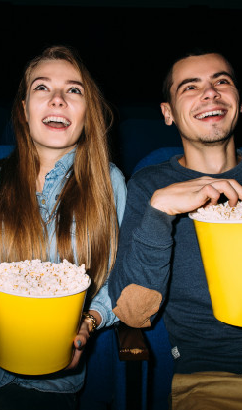
ON SCREEN
BRAND AV
60” BRAND AD
Plays out before all Cineworld Unlimited preview screenings.
Circa 12 handpicked titles across the partnership, offered exclusively to Cineworld Unlimited Members.
30” Brand Ad – ADDED VALUE
Up to 15m admissions to be used during the package (outside of Q4) by the brand in Cineworld cinemas during the sponsorship period.
Screentime to be used in reel only.
Element offered as added value.
5” co branded end card added to Cineworld Unlimited Ad
Runs in outside of standard reel, in Cineworld marketing section of the reel around the trailers.
Scheduled across ALL Cineworld admissions across during the sponsorship period.
Cineworld to produce, working with brand on guidelines.
Notes:
The line underneath the header should be 0.50cm away from the header
The sub header is 0.50cm beneath the line
The copy should then be 1cm away from the sub header

Slide 10
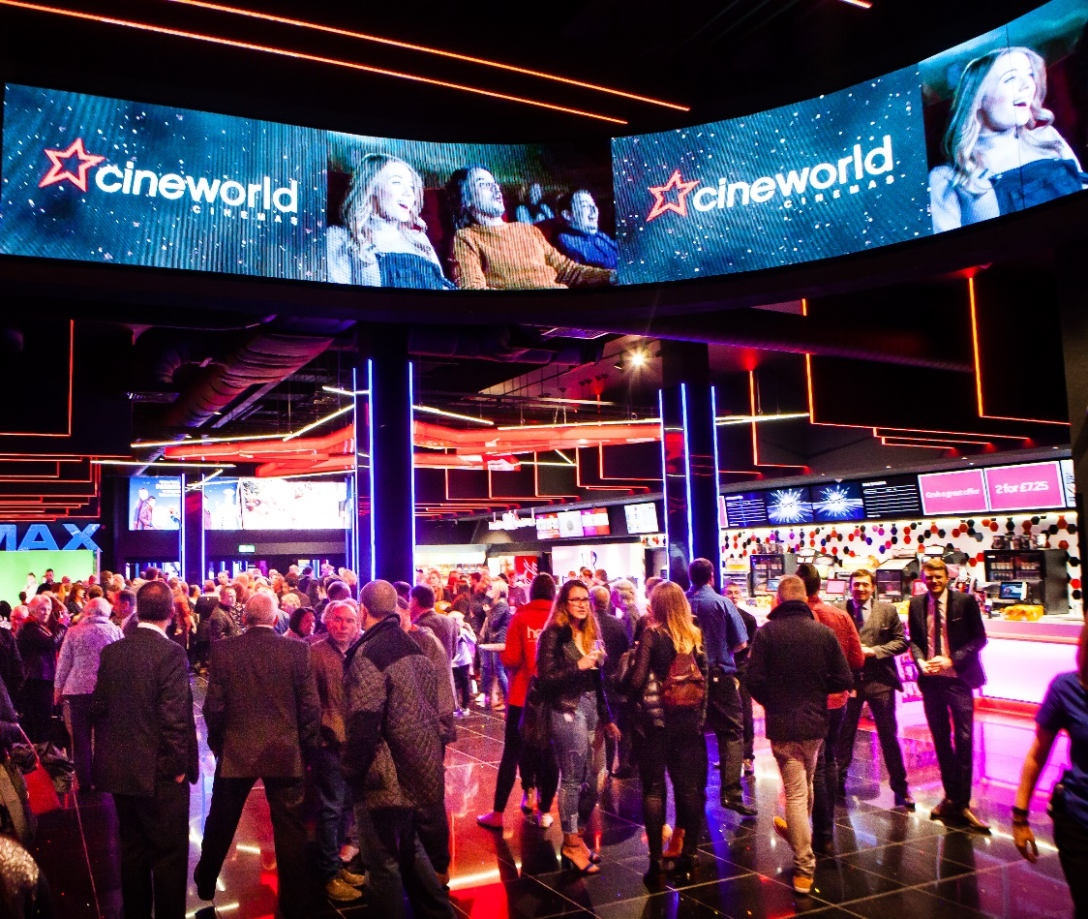
FOYER
Brand led, and co-branded ownership of some of the UK’s most futuristic cinema spaces.
DIGITAL OOH
Largest format digital outdoor creative in UK cinema.
60” Brand creative running across ceiling rotundas.
Co-branded 30” Cineworld Unlimited
Co-branded Cineworld Unlimited posters on 6 sheets.
PRINTED QUADS
Co branded Cineworld Unlimited quad posters across other non digital assets.
Further opportunities around permanent signage available on request.
Notes:
The line underneath the header should be 0.50cm away from the header
The sub header is 0.50cm beneath the line
The copy should then be 1cm away from the sub header

Slide 11
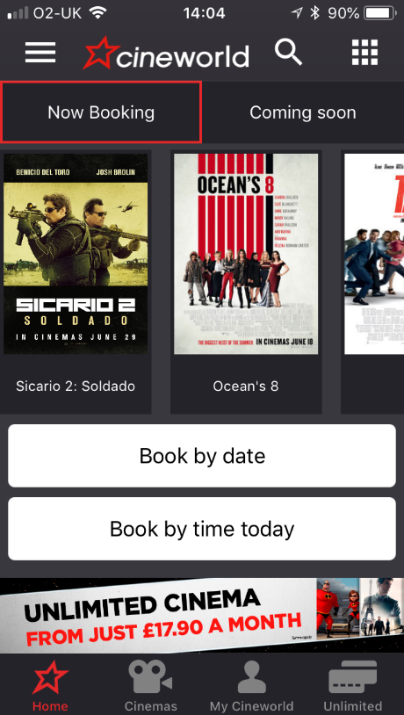
ONLINE
Far reaching ownership of Cineworld online channels,
Cineworld Home Page
Co-branded Cineworld Unlimited banner across desktop, mobile and app.
Unlimited Home Page
Co-branded Home Page banner and brand content on page welcoming customers to Unlimited.
ECRM
Co-branded banner included in 2 x emails sent per month to database of circa 1.5m.
Notes:
The line underneath the header should be 0.50cm away from the header
The sub header is 0.50cm beneath the line
The copy should then be 1cm away from the sub header

Slide 12
ADDED VALUE / PR

Slide 13
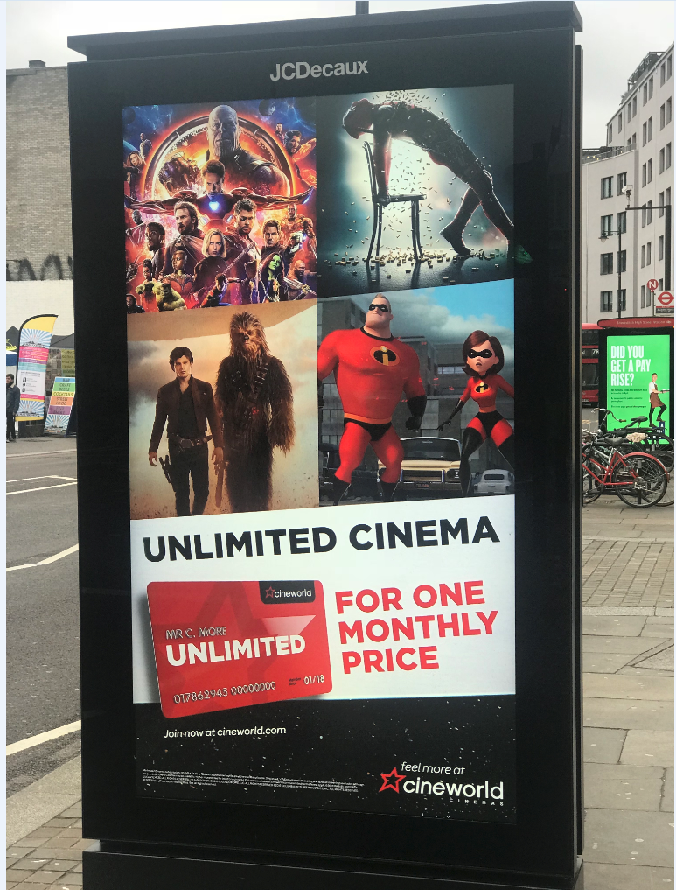
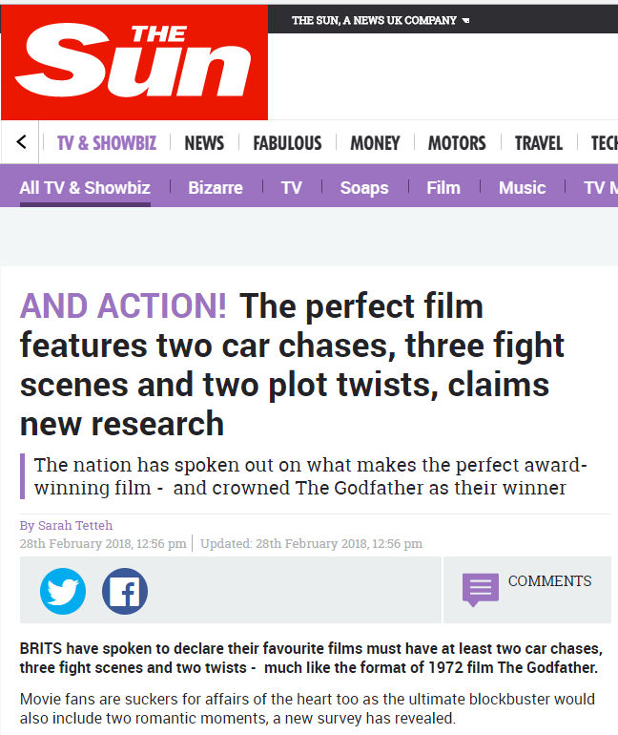

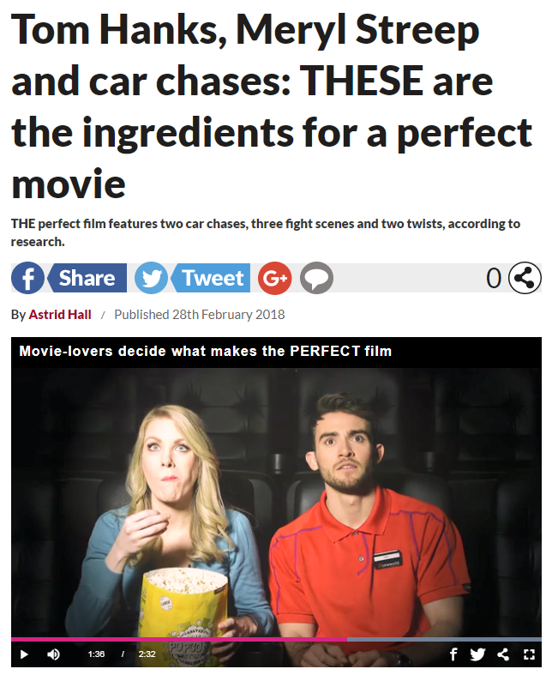
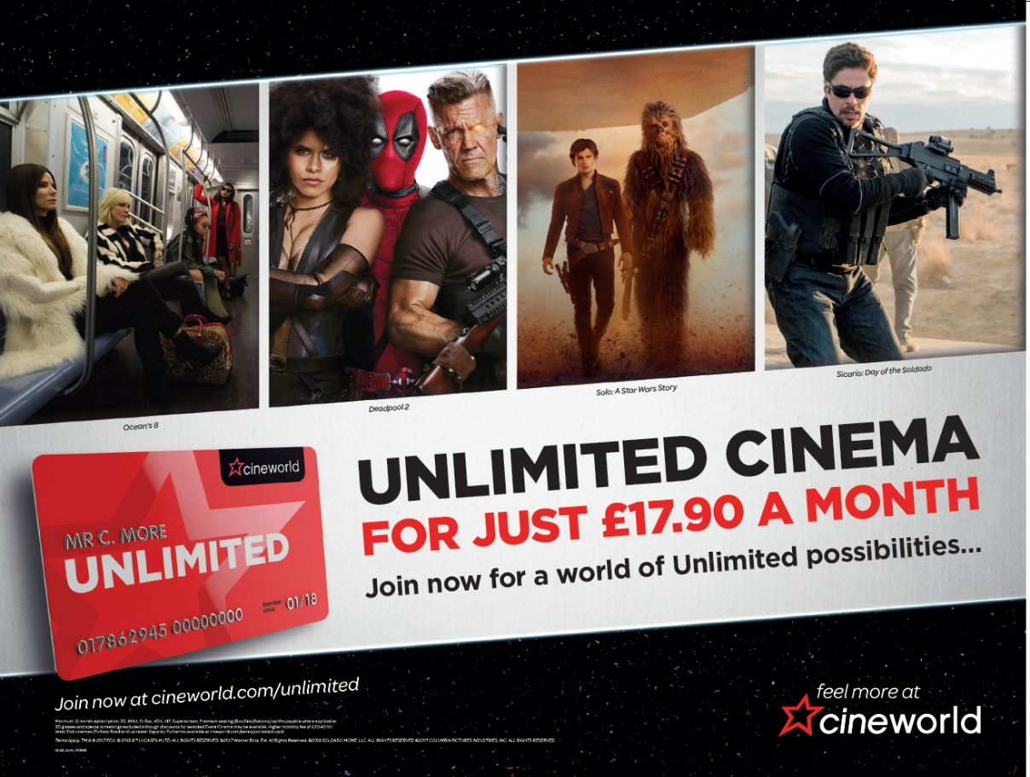
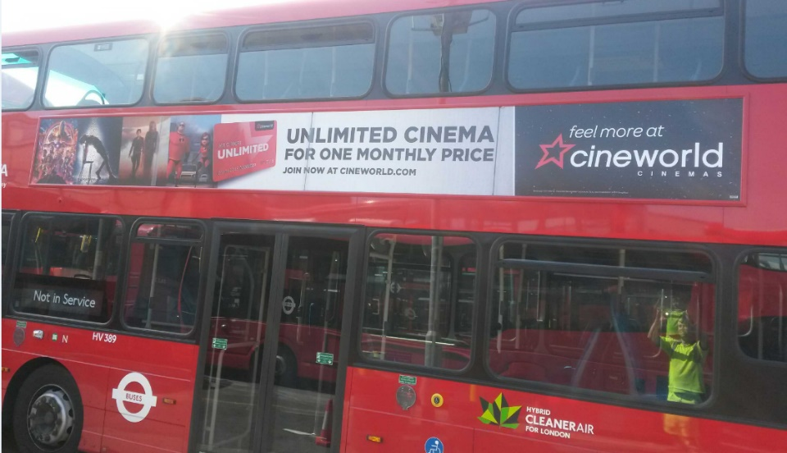
UNLIMTED MARKETING/PR
Brand will gain access to circa £1m above the line spend across various formats including:
London Tube & Buses
National Rail
DOOH/OOH
National print
Time Out partnership
Notes:
The line underneath the header should be 0.50cm away from the header
The sub header is 0.50cm beneath the line
The copy should then be 1cm away from the sub header

Slide 14
THANK YOU!
Notes:
All elements on this page (not including the logo) need to be 1cm apart

