Slide 1
FAMILY TICKET PARTNERSHIP OPPORTUNITY
CINEWORLD: BE MORE CHILDISH
2021
Notes:
All elements on this page (not including the logo) need to be 1cm apart

Slide 2
BRING OUT YOUR INNER CHILD AT CINEWORLD
Notes:
The line should be 1cm below the statement text and never placed above the statement text

Slide 3
CINEWORLD BE MORE CHILDISH
A MULTI TOUCHPOINT OPPORTUNITY FOR BRANDS TO REACH FAMILIES ENGAGED IN THE MAGICAL MOMENT OF FILM.
In a year of unrivalled family titles, CINEWORLD presents an opportunity for a brand to become part of the whole exciting cinemagoing experience, with access to this valued target audience across screen, online and foyer.
At CINEWORLD it is simple - adults pay child’s prices – a ‘family’ of four can be any kind of combination of adult or child - offering incredible value for everyone. But more importantly, beyond the price, adults are encouraged to lose their inhibitions and engage with a number of activities pre and post film – all designed to enhance the overall experience at Cineworld. It’s time to BE MORE CHILDISH…
Notes:
The line underneath the header should be 0.50cm away from the header
The sub header is 0.50cm beneath the line
The copy should then be 1cm away from the sub header

Slide 4
YOUR BRAND & THE UK’S BIGGEST CINEMA CHAIN
Unlimited possibilities…
Cineworld is the UK’s largest exhibitor by admissions, and is indeed part of a global network of cinemas spanning Eastern Europe, the UK and the US.
Combining huge customer numbers and a global approach, Cineworld is using its expertise to pioneer technology in its UK-wide estate. Through new and exclusive development of the in-auditorium screen experience as well as their foyer spaces, a trip to Cineworld is a trip to the cutting edge of cinema.
In screen, Cineworld has exclusive distribution rights of two cutting edge technologies; 4DX and Screen X, two technologies that look to enhance film-viewing beyond the traditional already immersive cinema environment.
On top of this, Cineworld’s foyers are some of the most visually striking in the country with a heightened sensory experience delivered through impressive large format digital screens, panels & rotundas as well controlled lighting all combining to help drive excitement for customers before, during and after the film.

Slide 5
REACHING THE ENTIRE FAMILY AUIDIENCE THROUGH CINEMA…

Slide 6
Technology has changed the family home
Family time is precious and technology has changed it for better and for worse…
Notes:
The line underneath the header should be 0.50cm away from the header
The sub header is 0.50cm beneath the line
Copy should be 0.50cm away from images

Slide 7
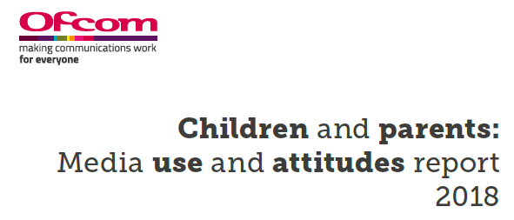
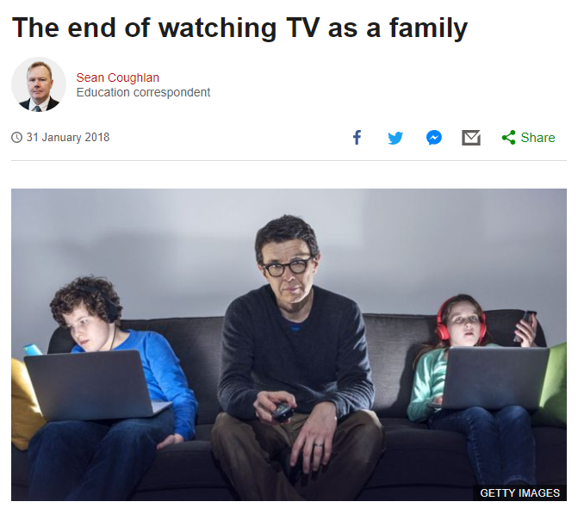
VIEWING HABITS ARE CHANGING DRAMATICALLY TOO
Proliferation of children’s content has seen a marked decrease in time spent watching traditional TV and the rise the streaming services and devices in the home has led to a change in viewing habits.
TV sets and tablets dominate device use but time spent watching TV on a TV set (broadcast or on demand) is decreasing
The viewing landscape is complex with half of 5-15s watching OTT television services like Netflix, Amazon Prime Video and Now TV
YouTube is becoming the viewing platform of choice with rising popularity particularly among 8-11s.
-18.2%
Across the last 10 years Kids impacts on TV
have dropped significantly
Notes:
The line underneath the header should be 0.50cm away from the header
The sub header should line with the top of the image box
The copy should then be 1cm away from the sub header

Slide 8
RECREATIONAL OUT-OF-HOME ACTIVITES REMAIN IMPORTANT
Affordable recreational activities are still important for families – despite other expenditure plateauing in tougher times they’ve continued to seek treats outside the home that everyone can enjoy.
Source: Family spending in the UK, ONS

Slide 9
FAMILIES CONTINUE TO CHERISH cinema
There has been substantial growth in the number (and success of) family films over the last decade – UK box office figures for family/animation titles has almost doubled from £160m in 2007 to £317m in 2018.
Notes:
The line underneath the header should be 0.50cm away from the header
The sub header is 0.50cm beneath the line
The copy should then be 1cm away from the sub header

Slide 10
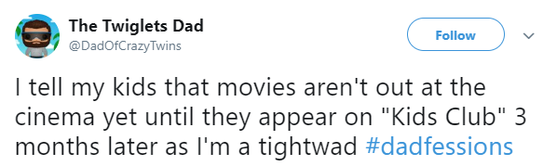
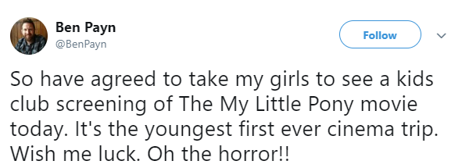
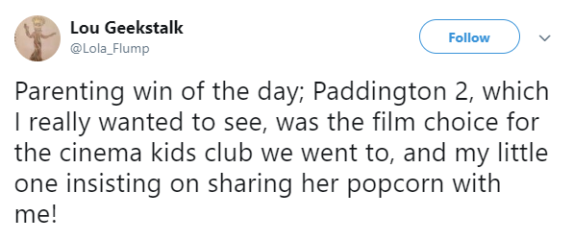
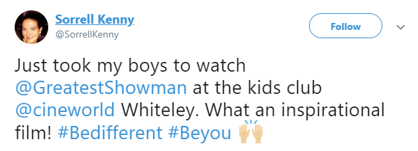
…and LOVE THE SHARED EXPERIENCE
An area where we notice the importance is social media, with many of the parents who attend kids club taking to platforms like Twitter to express the value it has to them.

Slide 11
THE PACKAGE

Slide 12
ON SCREEN
Brand ad runs in family titles across the Cineworld estate.
Co-branded ident promoting ‘family ticket offer, brought to you by brand’ (produced by Cineworld using brand guidelines)
Always on

Slide 13
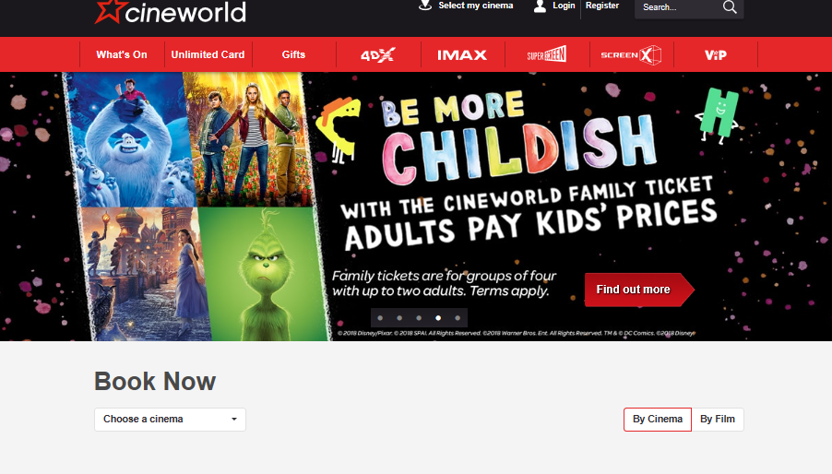
ONLINE
Co-branded assets placed across Cineworld website, including Home Page and dedicated Family pages.
Co-branded banner across 1 x monthly email sent to full Cineworld database, aligning brand to latest exciting family releases.
Co-branded inclusion on organic social posts mentioning Be More Childish/Family Ticket offer.
Switch on during 15 weeks of Half Term Time.

Slide 14
FOYER
Co-branded collateral switched on during school holiday period (15 weeks) across the 12 month partnership.
Large format digital rotunda screens as well as other digital foyer assets.
Opportunity to reach customers in foyers through sampling/activations.

Slide 15
THANK YOU!
Notes:
All elements on this page (not including the logo) need to be 1cm apart

