Slide 1
The cinema marketplace

Slide 2
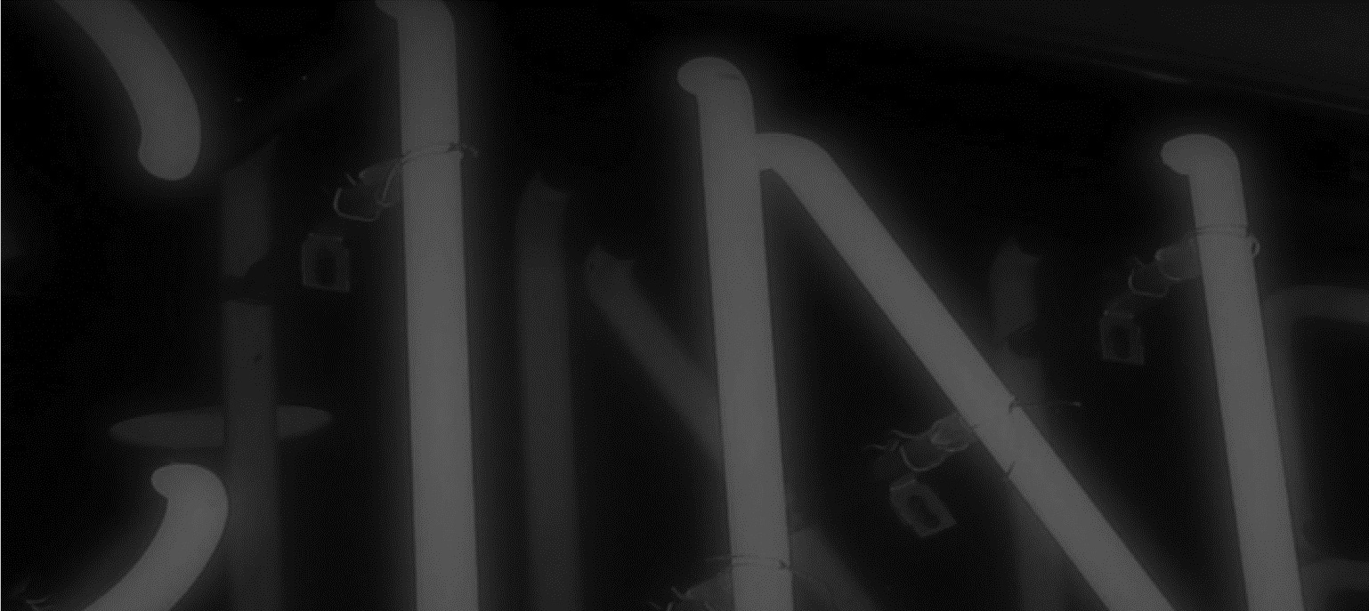
Uk cinema – A BILLION DOLLAR BOX OFFICE
Box office in the UK has consistently been delivering across the last 5 years
2000 – £639 million
2006 – £762 million
2016 - £1.3 billion
2017 - £1.3 billion
2018 - £1.3 billion
2019 - £1.3 billion
Source: Comscore UK & Ireland data.

Slide 3
Cinema admissions
177m
176m
Source: CEA Admissions 2012 – 2018

Slide 4
CINEMA ADMISSIONS & AD REVENUE
Source: Admissions: CAA
Ad spend: WARC
Notes:
And our ad revenue growth has massively outperformed admissions over the last two years.

Slide 5
Our cinemas

Slide 6




DCM’S PARTNERS
PLUS 160+ INDEPENDENT CINEMAS

Slide 7
Uk cinema - the numbers
All UK
4,399
811
    screens
    sites
Source: UK Cinema Association, IHS, CAA

Slide 8
DCM REPRESENTS 80% of the uk marketplace
Digital Cinema Media 80%
P&D 20%
Pearl & Dean
is the only other
major competitor
3,412
528
    screens
    sites
DCM/P&D share of industry admissions source: Comscore

Slide 9
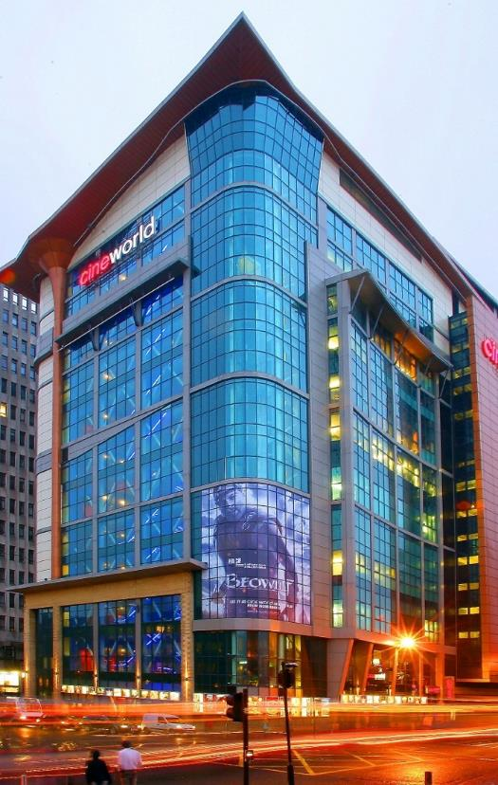
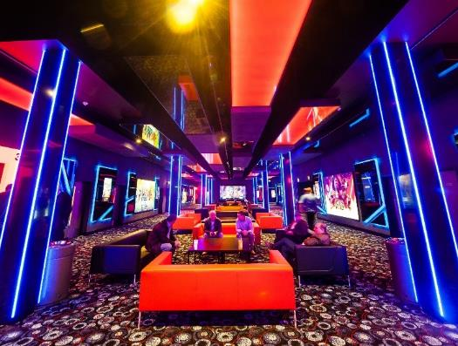
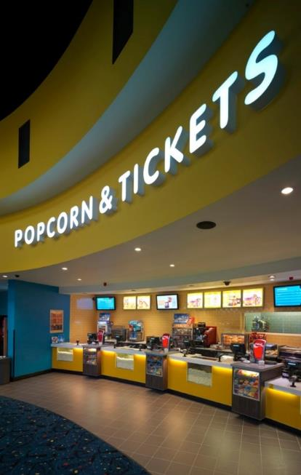
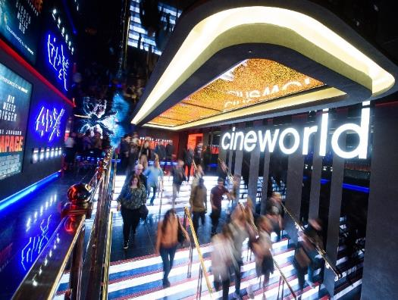

Cineworld
97
Cinemas
1011
Screens
Admissions: Full Year 2018.

Slide 10

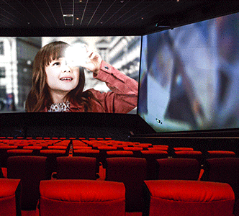




28 (+2)
15 (+5)
5

Slide 11

Cineworld Screen X SCREENS (14)
Basildon
Castleford
Crawley
Didsbury
Edinburgh
Leeds (White Rose)
London - O2
London - Wandsworth
Milton Keynes
(Newcastle Upon Tyne)
Rushden Lakes
Sheffield
Speke
Watford

Slide 12
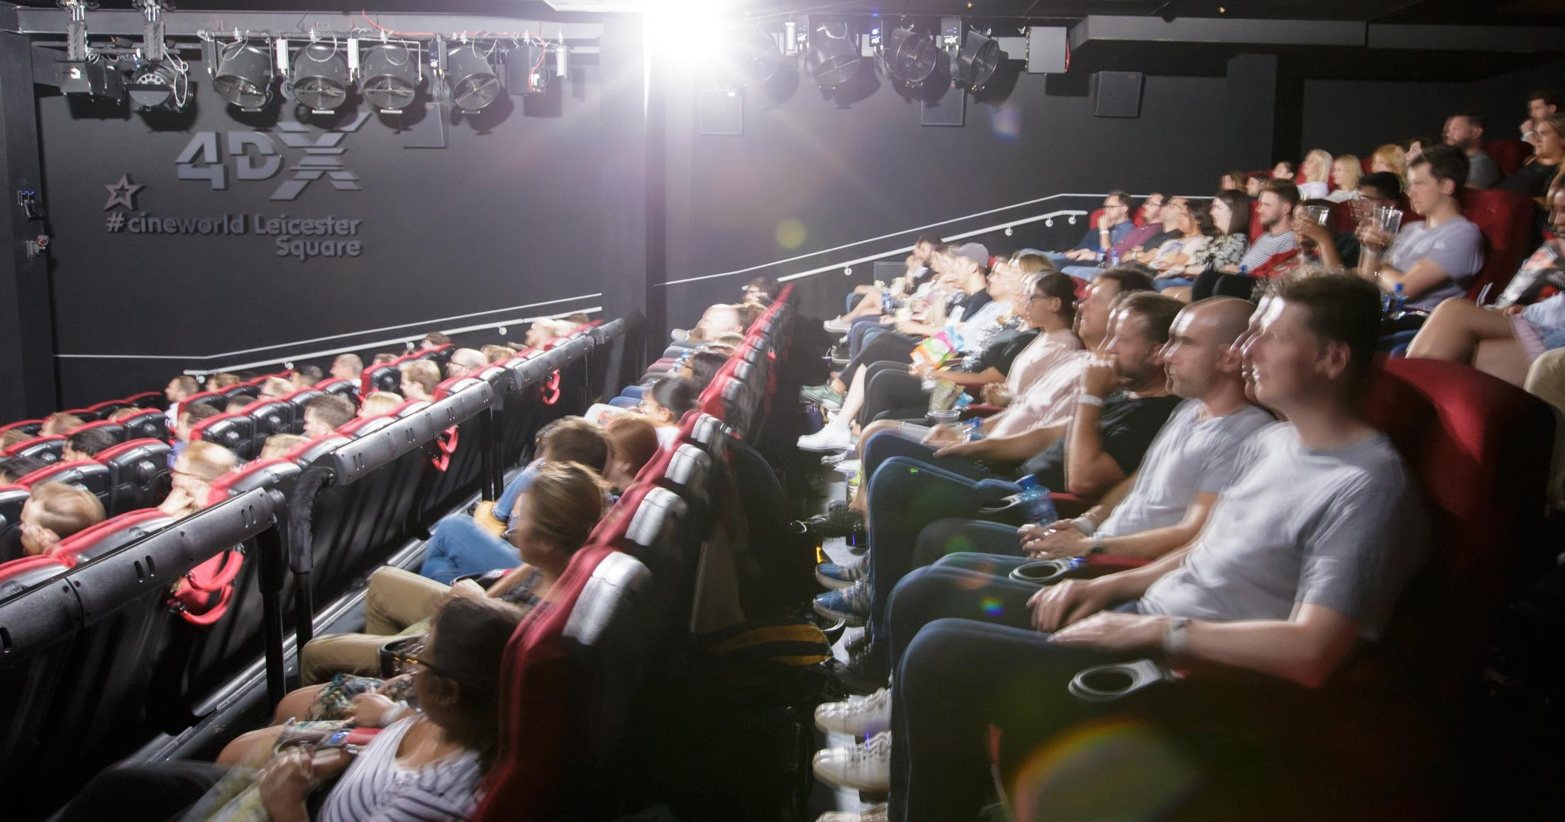
4dx CINEMAS
Aberdeen Union Square
Basildon
Birmingham - Broad Street
Bracknell
Cardiff
Castleford
Crawley
Didsbury
Edinburgh
Glasgow Renfrew St.
Ipswich
London - Enfield
London - Leicester Square
London – O2
London - Wandsworth
Middlesbrough
Milton Keynes
(Newcastle Upon Tyne)
Rushden Lakes
Sheffield
Stevenage
Telford

Slide 13
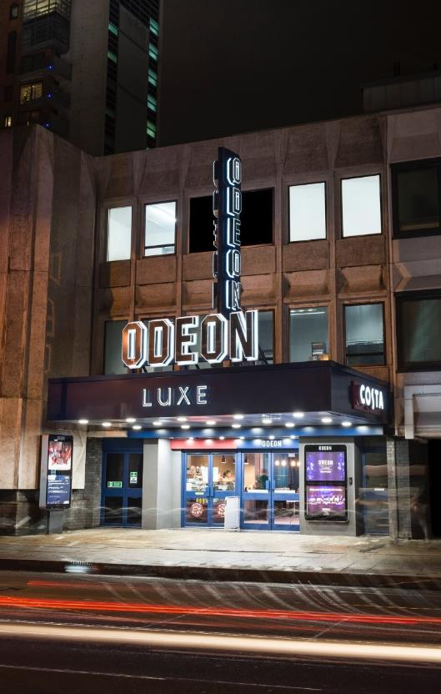
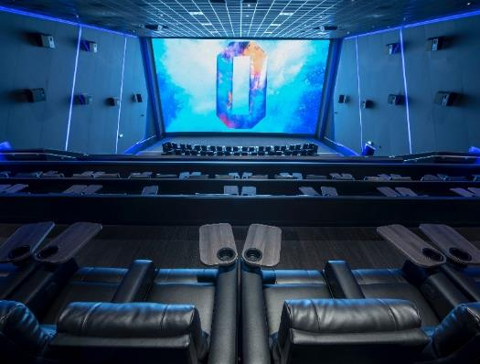
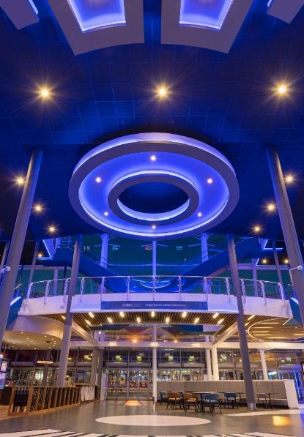
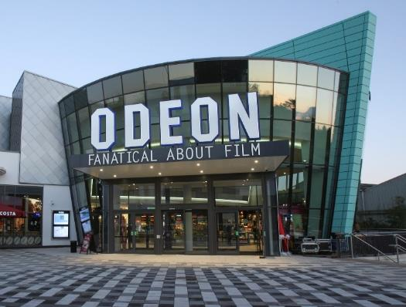

Odeon
110
Cinemas
884
Screens
Admissions: Full Year 2018.

Slide 14
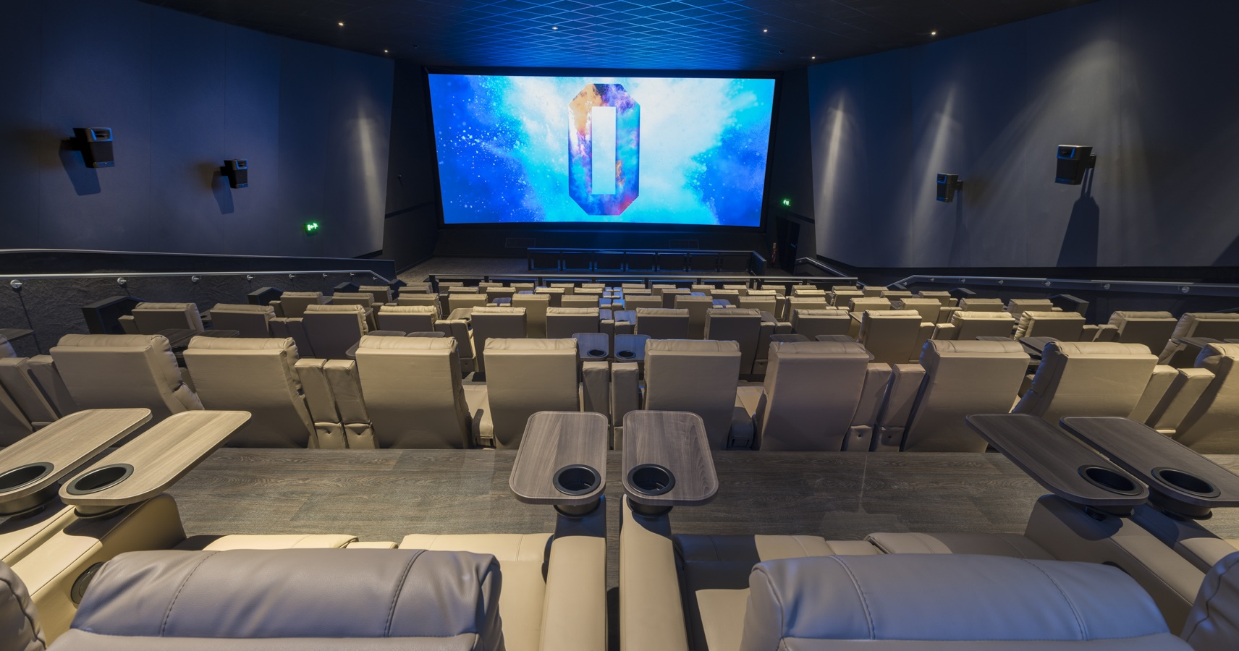
Odeon luxe
Birmingham Broadway Plaza
Derby
Durham
East Kilbride
Edinburgh West
Glasgow Quay
Hull
Lee Valley
Leeds - Bradford
Leeds – Thorpe Park
Liverpool Switch Island
London - Haymarket
London – Leicester Sq.
London – Putney
London - Swiss Cottage
Maidenhead
Sheffield
Stafford
Telford
Warrington

Slide 15
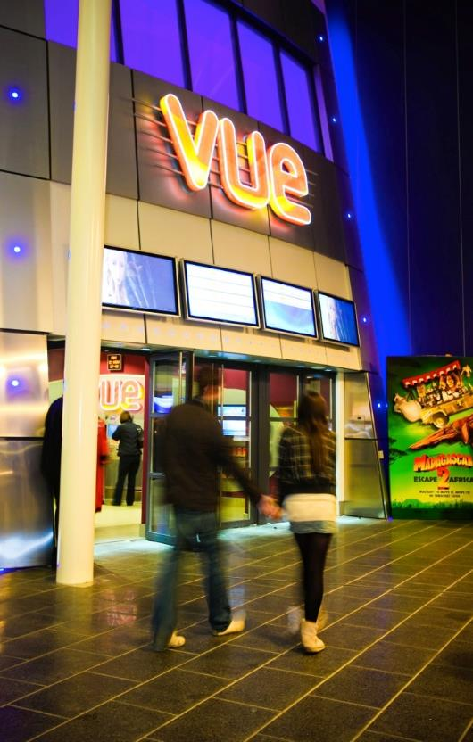
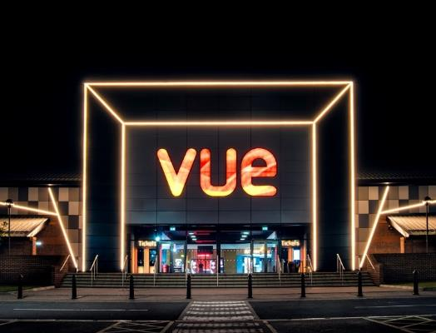
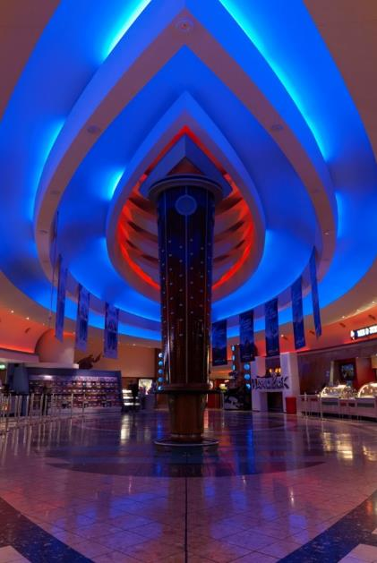
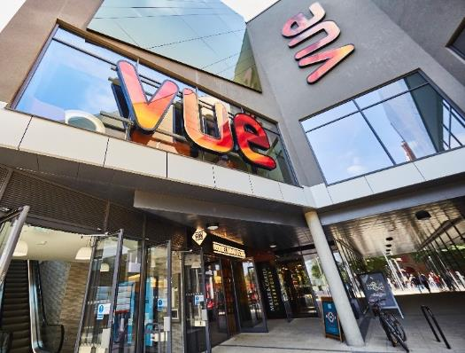

vue
88
Cinemas
840
Screens
Admissions: Full Year 2018.

Slide 16
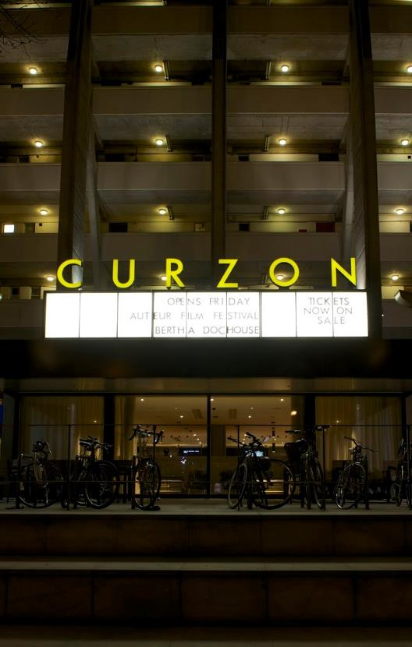
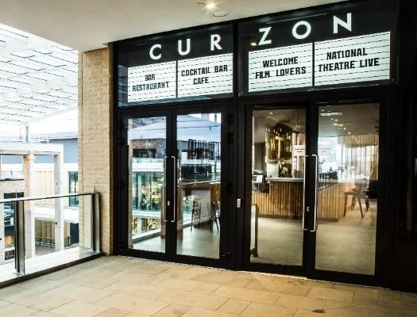
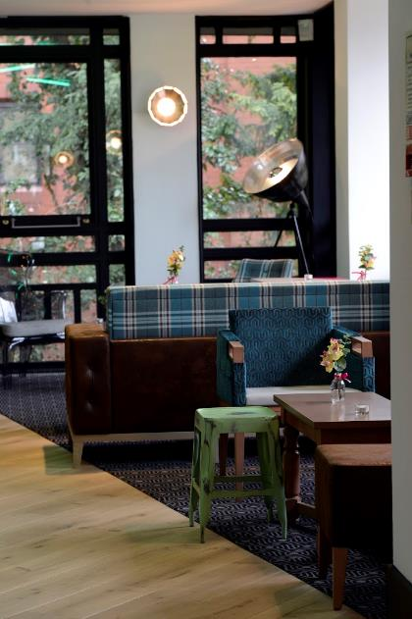
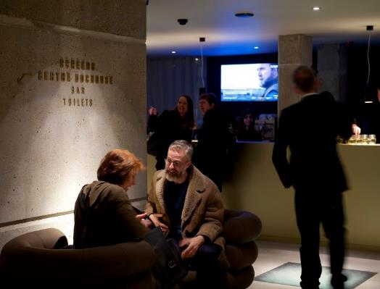

CURZON
15
Cinemas
45
Screens
Admissions: Full Year 2018.

Slide 17

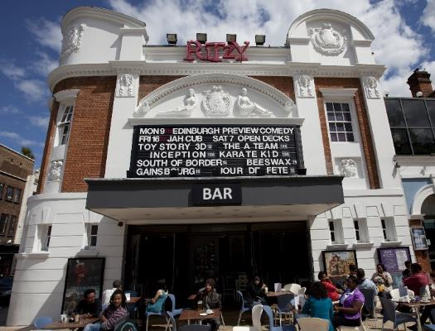

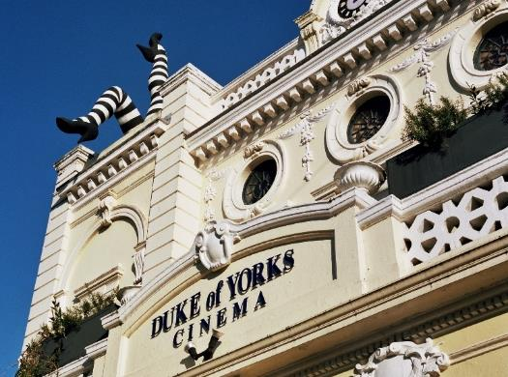

picturehouse
25
Cinemas
85
Screens
Admissions: Full Year 2018.

Slide 18
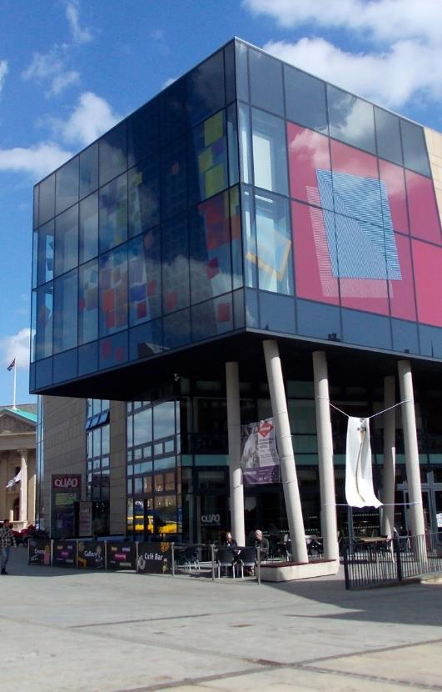
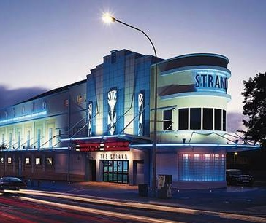
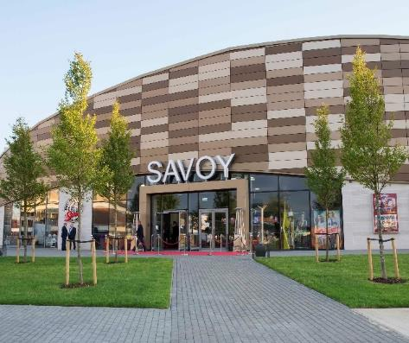
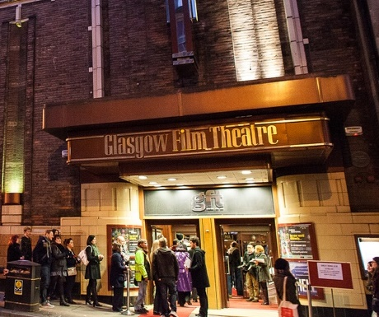

independents
166
Cinemas
460
Screens
Admissions: Full Year 2018.

Slide 19
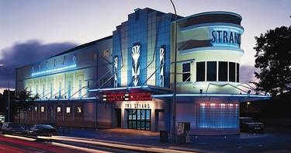
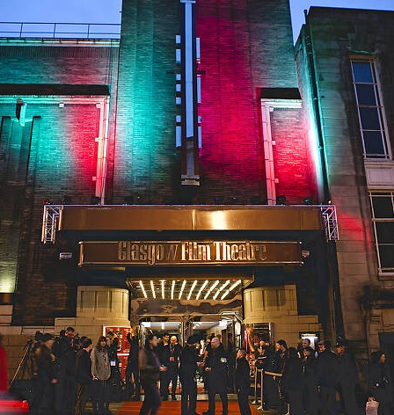
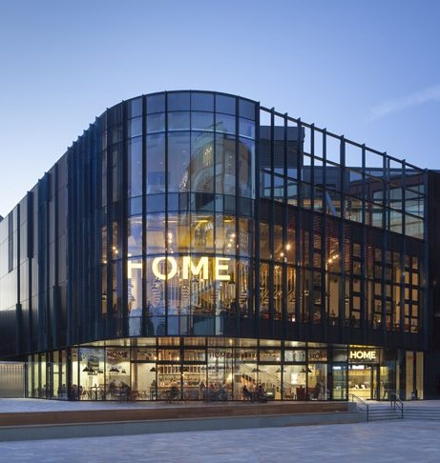
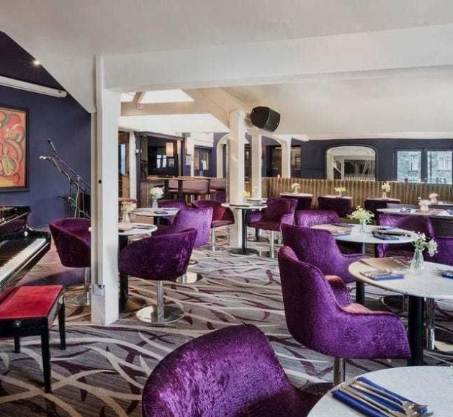
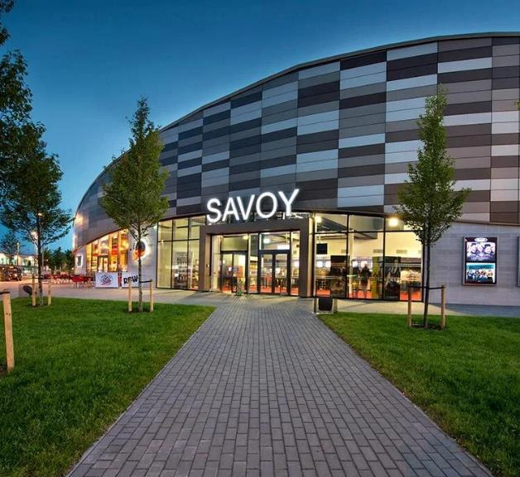
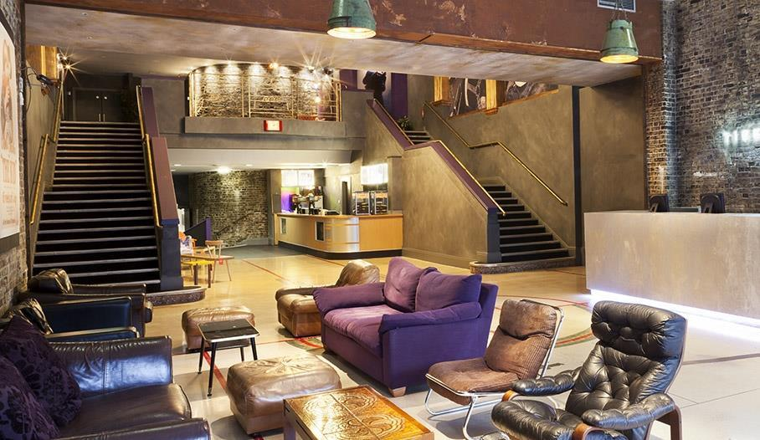
independents
Notes:
Strand Belfast
Glasgow Film Theatre
Home Manchester
Zeffirellis Ambleside
Savoy Corby
Mile End Genesis

Slide 20




CINEMAS ARE continually INVESTING IN new TECH
41 sites
40 sites
22 sites
14 sites

Slide 21
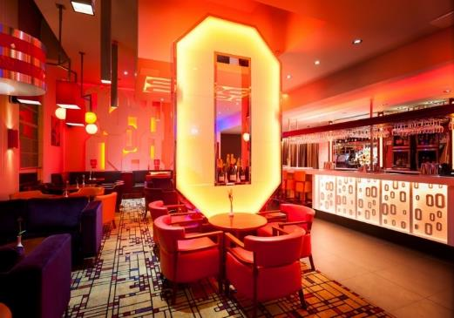
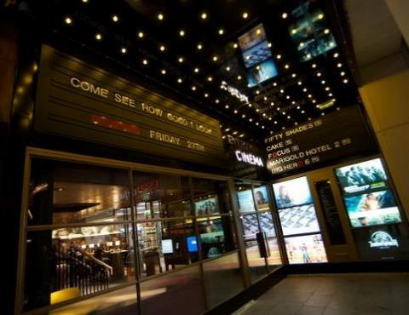
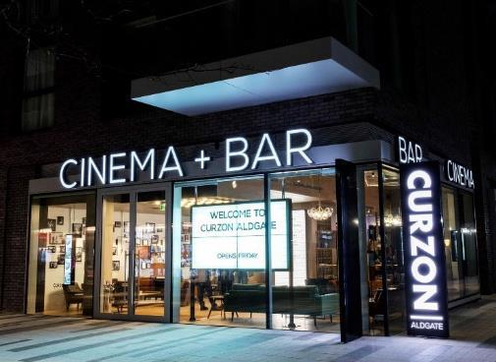

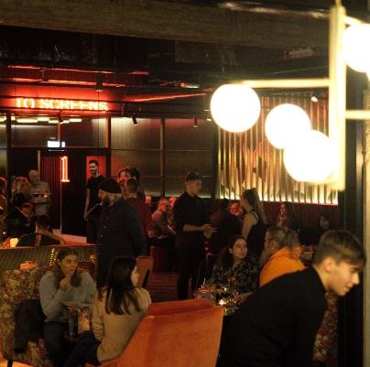
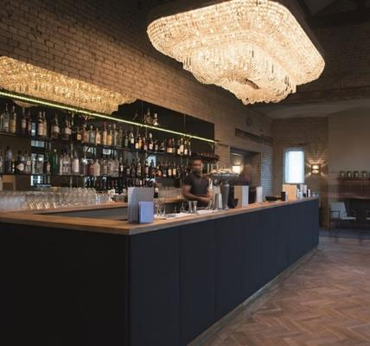
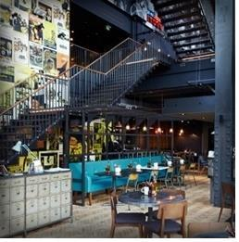
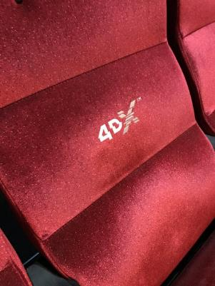
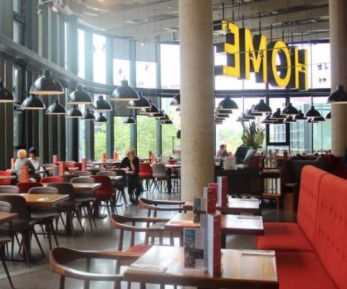
Cinema experience IS more than just the film

Slide 22
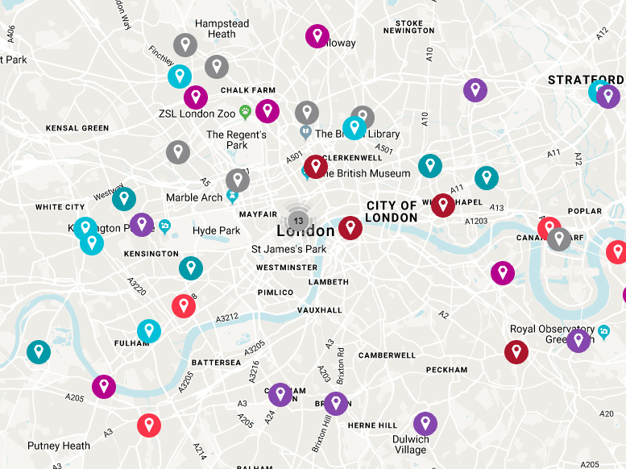
+100 new screens COMING IN 2020/2021
Including the below in London alone…
ODEON Leicester Square (3)
Marble Arch (5)
Cineworld Hounslow (10)
Picturehouse Ealing (8)
Finsbury Park (9)
Curzon Hoxton (3)
Kingston (5)
Independents Battersea (3)
Dalston (2)
Hammersmith (2)
White City (3)

