Slide 1

CINEMA ADVERTISING 101
An overview of the UK cinema marketplace, why cinema should be on the plan and how to buy cinema advertising with DCM

Slide 2
AN INTRODUCTION TO CINEMA
THE
CINEMA MARKETPLACE
WHY
CINEMA?
HOW TO BUY CINEMA ADVERTISING

Slide 3

THE CINEMA
MARKETPLACE

Slide 4
In the UK CINEMAGOING REMAINS A VALUED AND POPULAR ACTIVITY
% of people who have done activity in the last 12 months
Source: GB TGI January 2024. Activities done in the last 12 months

Slide 5
The uk cinema landscape: 20% INCREASE IN NUMBER OF SCREENS OVER THE LAST DECADE
Cinema and sites in the UK, 2012-2022
Source: Cinema UK

Slide 6
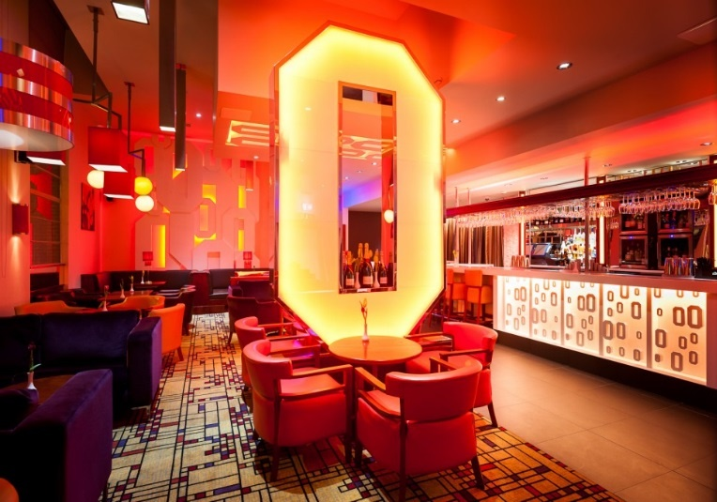
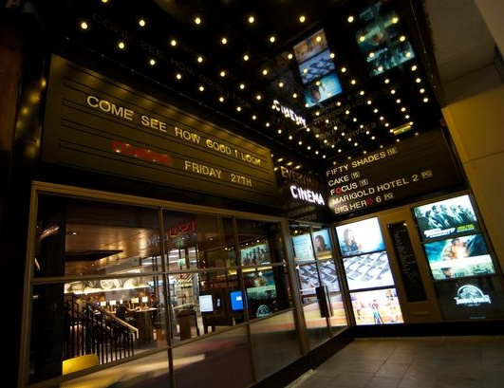
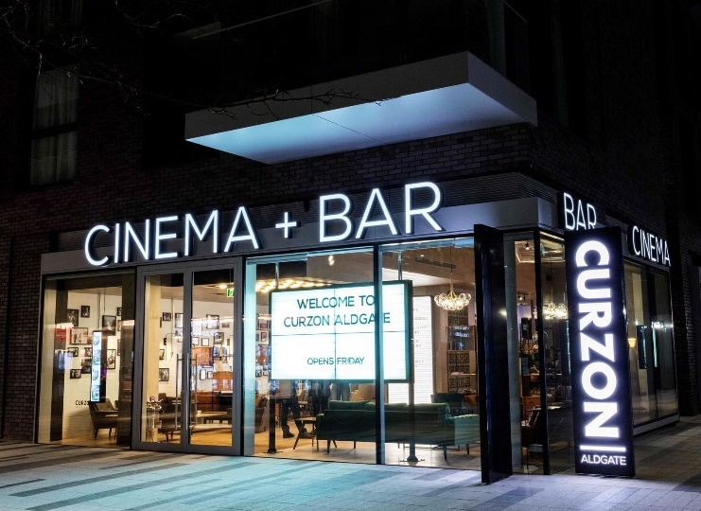
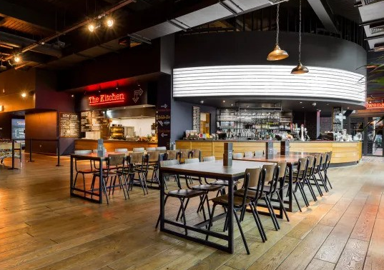
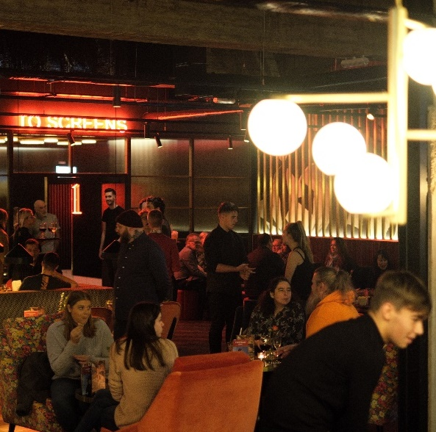
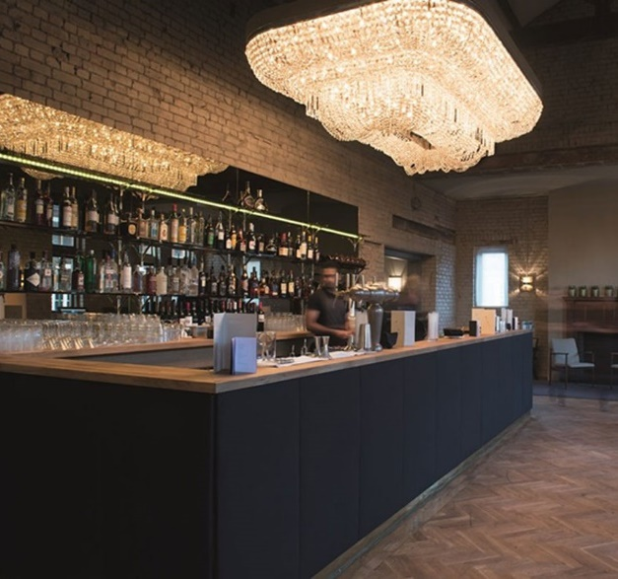
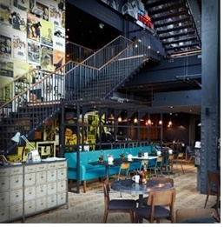

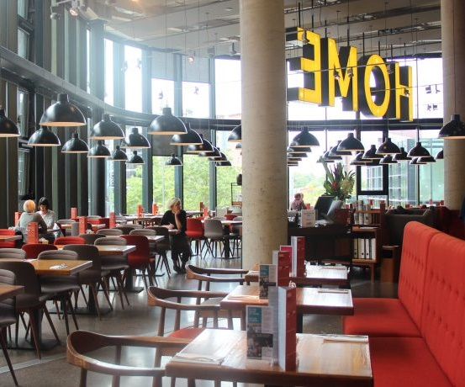
CinemaS ENSURE THE GREAT experience EXTENDS BEYOND just the film
UK exhibitors lead the way in ensuring their cinemas provide a luxurious and innovative experience for audiences.

Slide 7
CINEMA REMAINS AN AFFORDABLE FORM OF ESCAPISM AND SOCIAL ACTIVITY
Relative to other ‘out of home entertainment’ options cinema remains an affordable option with the average ticket price remaining around the same level since 2017
Source: Cinema UK / IHS Screen Digest from CAA/comScore

Slide 8
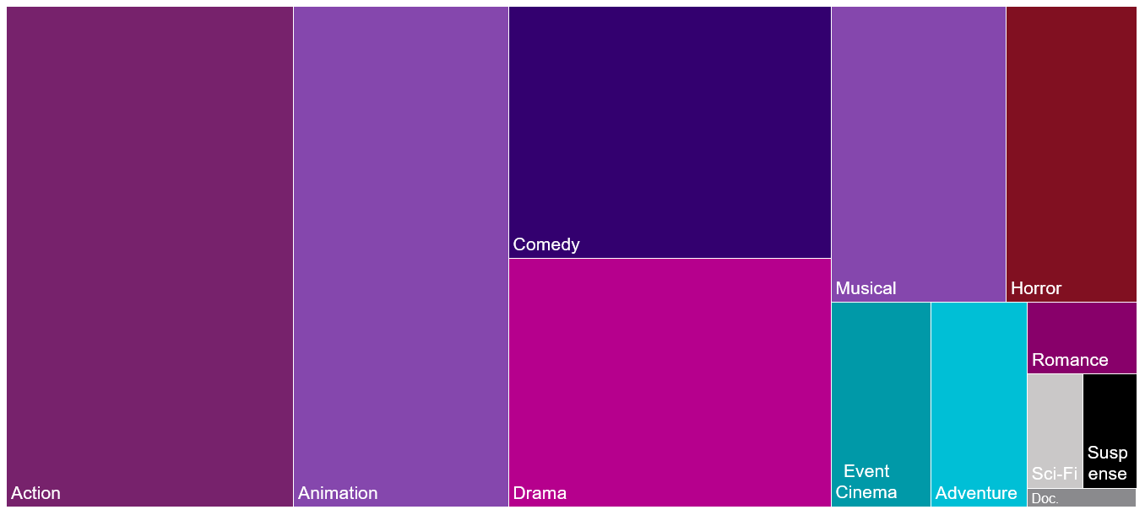
CINEMA OFFERS SOMETHING FOR EVERYONE
With over 1000 theatrical releases cinema offers something for everyone from the huge blockbusters to event cinema and documentaries
Source: Comscore Movies. Treemap based on % of UK Box office 2023, ’Primary Genre’

Slide 9










THE EXPERIENCE & COMPELLING STORIES ENSURE CINEMA STANDS THE TEST OF TIME
In the UK this provides a strong foundation for recovery from the impact the Covid-19 pandemic has had on the industry
Admissions source: Comscore, except 2023 forecast by DCM

Slide 10
Why cinema?

Slide 11
CINEMA PROVIDES THE ULTIMATE AV EXPERIENCE for brands
Full
(big) screen
Sound
(always) on
Viewed by humans
Shared
viewing
Brand safe quality content &
pre-cleared advertising
Robust reporting

Slide 12

CINEMA CREATES
CULTURAL MOMENTS

Slide 13





THE STRENGTHS OF CINEMA
Industry evidence shows how cinema advertising excels when it comes to cutting through, connecting and delivering positive impact for brands
Best for triggering a positive emotional response
Best for getting your ads noticed
Best for guaranteeing a safe environment
Best for delivering attention to advertising
Happiest mood of any media occasion
Most trusted media for advertising
Don’t just take it from us: the strengths of cinema have been well documented by trusted industry bodies…
Most receptive ad format for Gen Z
Biggest impact per person on Awareness, Love, Difference, Consideration
Brand impact increases when cinema included compared to AV mixes without it
Using cinema delivers strong cost/financial signal for brands
Cinema delivers more predictable ROI returns than Online Video and Social Media

Slide 14


TV and cinema offer strongest signals for younger audience (16-34)
Industry evidence shows how cinema advertising excels when it comes to cutting through, connecting and delivering positive impact for brands
Social Signal
Fitness Signal
Source: Burst Your Bubble / EssenceMediacom, January 2024

Slide 15
TAP INTO THE EMOTIONAL EXPERIENCE & PLAN FOR POSITIVITY USING CINEMA
Going to the cinema is a positive experience for people and as Hearst’s research has shown reaching people in a positive mindset can have a significant benefit for brands
% of time spent in a good mood
Impact of positive mindset on response to advertising
18%
35%
Increase in brand favourability
Increase in purchase intent
Source: IPA TouchPoints 2023 Superhub. Good mood = 7+ on ten point scale | Hearst – Power of Positivity

Slide 16

FOR BRANDS LOOKING TO CONNECT EMOTIONALLY, CINEMA is king
Ebiquity’s ‘Re-evaluating media’ report, commissioned by Radiocentre, found that based on available industry evidence cinema scores the highest of all channels for its ability to trigger a positive emotional response for brands
Chart compares score for each medium against ‘ability to trigger a positive emotional response’ attribute, scored out of 10.
Source: Re-evaluating Media conducted by Ebiquity, other attributes also measured

Slide 17
“Emotional advertising is twice as efficient as rational, and delivers twice the profit”
BINET & FIELD (The Long and the Short of it, 2012)

Slide 18

Emotion requires ATTENTION

Slide 19

24 SECONDS OF A 30” AND 48 SECONDS OF A 60” ARE VIEWED IN CINEMA
A far greater proportion of your ad will be watched in cinema vs. views on other channels
LUMEN NORMS
Cinema Source: Lumen Attention Research Project April 2022 / Onscreen Ad Impressions: Cinema Ads = 1,347
Other Channel 2023 Norms: TV data = Tvision / YouTube, Facebook, OOH, Display data = Lumen Research
Notes:
As you can see Cinema is really the stand out media when it comes to driving engagement – on average 24 seconds of a 30” ad are watched, and 48 seconds of a 60”. The level of attention provided by exposure to the ad in cinema far surpasses what is achievable in other formats and really allows for deep engagement with the brand and the message.
By comparison TV on average delivers a solid 15.5 seconds attention to a 30” ad, and there’s a decreasing tail of attention available across other formats e.g. 4 seconds of a 15-20” bumper on YouTube and 1-1..5 seconds attention paid to Facebook and Instagram Infeed advertising.

Slide 20
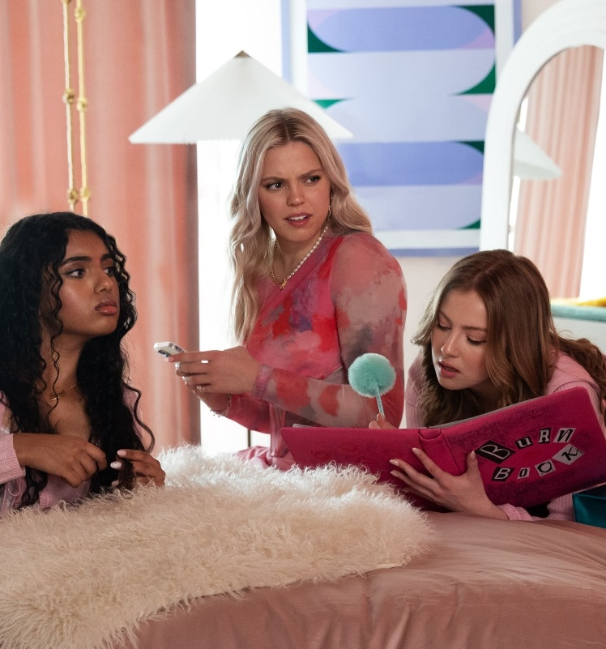



Cinema ads are the advertising format 16-34s are most RECEPTIVE towards
Independent research from Kantar found that traditional AV ad formats are preferred by all generations but specifically cinema rates well amongst young audiences.
Gen Z
16-19 year olds
Gen Y
20-34 year olds
Gen X
35-49 year olds
Cinema ads | 44% | 34% | 31%
TV ads | 14% | 23% | 33%
Video ads (laptop/PC) | -24% | -20% | -33%
Video ads (mobile) | -26% | -26% | -33%
Source: Kantar – AdReaction Study
‘How would you describe your attitude towards each of the following formats of advertising? - % net positive ’

Slide 21




BIG VISUAL IMPACT MEDIA ACHIEVE AFFINITY
Magnetic’s own work with Kantar demonstrates cinema’s strength at contributing to brand love
% Uplift in metric post exposure
Cinema
OOH
Magazines
+3.62%
+1.89%
+1.53%
Source: Magnetic/Kantar
Notes:
Magnetic’s (the magazine trade body) own work with the Kantar CrossMedia team has shown how cinema delivers the most significant contribution towards brand love of all media measured.
Highlighting the transparency and robustness of our Building Box Office Brands work – whoever commissions Kantar to analyse their results databank will find the same results.

Slide 22
CINEMAGOERS PROFILE YOUNGER VS. GENERAL POPULATION
34% of those who have been to the cinema in the last 12 months are 16-34 (Index: 121 vs GB population). This youth heartland audience makes cinema a great addition to any AV schedule to drive reach amongst this key demo.
Age profile of those who have been to the cinema in last 12 months
Source: CAA Film Monitor Q4 2023
Cinemagoers – reported visiting the cinema in the last 12 months
Notes:
Cinema has always had a high penetration of 16-34’s, but the post-pandemic audience is profiling younger with FAMILY a significant growth area too. With TV struggling to deliver Family and 16-34 Adult campaigns, cinema is proving to be a ‘must have’ not a ‘nice to have’ on media plans.

Slide 23
CINEMA PROFILES YOUNGER AND MORE UPMARKET VS. TV & ONLINE VIDEO
Cinema is a great complement to TV & online video campaigns providing a more affluent, younger skewing audience
% of audience who are ABC1
GB Population
% of audience who are 16-34
Source: GB TGI Jan 2024 (Dec 2022 – Nov 2023)- ‘Been to the cinema in the last week’ /
Channels watched in the last week’ / Instagram, Facebook, TikTok & YouTube = Used in last 7 days

Slide 24
ADDING CINEMA TO YOUR PLAN CAN MAXIMISE AV REACH
Redistributing weight from linear TV into cinema can increase total campaign weight for key audiences, particularly 16-34s
90% HPCH REACH
48% 1634 REACH
93% HPCH REACH
59% 1634 REACH
= HPCH UPLIFT: 3 PTS
= 1634 UPLIFT: 11 PTS
Source: IPA TouchPoints Channel Planner, Informed by ‘typical’ channel shares & pricing. Precise reach subject to final channel mix & spend.
Notes:
Something we’re very confident of is the effectiveness of cinema to be able to deliver cost efficient incremental reach within the AV mix.
Using various tools and models, we’re able to forecast AV campaigns that can deliver significantly greater uplift when compared against AV plans that have excluded cinema.
The chart on the left shows a typical heavyweight AV mix working to a total budget of £2.6m, with the inclusion of only TV, VOD, and OLV.
On the right, you’ll see the addition of cinema into the mix, while keeping the total budget the same, we can deliver an uplift of 3 percentage points vs. Housepersons with Children, and 11 percentage points vs. 16-34s.
It’s worth noting, if you wanted to achieve these uplifts in linear TV alone, you’d expect to need to increase your budget by millions of pounds, but also worth noting your frequency against heavy TV viewers would exceed diminishing returns.

Slide 25
CINEMA OCCUPIES A UNIQUE ROLE IN THE WORLD OF AV
Cinema resonates with young audiences as a quality, high attention experience that is shared with others – and this makes it unique in how they perceive its role alongside other AV channels.
Top 3 associations by platform
LIVE TV
Fill time | 30%
Background viewing | 26%
Comforting | 18%
VOD
Binge viewing | 27%
Fill time | 25%
Quality content | 19%
YOUTUBE
Fill time | 43%
Helps me escape | 28%
Binge viewing | 27%
SOCIAL VIDEO
Fill time | 38%
Low Attention | 27%
Spontaneous | 20%
CINEMA
Shared experience | 37%
High attention | 34%
Quality content | 31%
Q. Which of the following words and phrases do you associate with […]?
Bold text indicates where a phrase was most frequently associated
Base: 1000 ‘16-34s’
Notes:
Across the first two qual phases we collated a list of different phrases and descriptions of the different viewing experiences people had with the different AV media. In the survey to 1,000 16-34s we asked them to select which descriptors they most associated with viewing content on each of the AV platforms.
This slide highlights the Top 3 phrases selected for each AV platform and showcases the unique position that cinema occupies in the AV landscape.
At a basic level, Live TV, VOD, YouTube and videos on social are broadly seen as ways to fill time with some slight differences for each platform:
Live TV provides a comforting accompaniment.
VOD is the place to binge on favourite shows.
YouTube is a temporary escape from other tasks (e.g. popping to YT for a quick video to distract yourself from work)
Videos on Social Media are far more spontaneous and often given less attention.
Whereas, Cinema is perceived as a shared experience, highly attentive and providing quality content – offering something unique to audiences and highlights why cinema remains in such strong health with the 16-34 audience.

Slide 26
TRUSTED ENVIRONMENT: Cinema IS KEY FOR LAUNCHING WITH TRUST
Cinema is the AV channel that audiences trust the most in terms of advertising – offering brands a positive environment and inferred sense of quality, where audiences are receptive to brand messaging
‘I trust the advertising in…’ scores indexed vs cinema
Source: IPA Touchpoints 2023 Superhub. Base: All Adults 15+
‘I trust the advertising in…’ - % agree

Slide 27
Ultimately trust is critical for business growth
Since 2006 brands who have above average levels of trust have seen a 170% increase in brand value, whereas brands with below average trust have seen value decrease by 13%
+170%
Brands with
above average trust
-13%
Brands with
below average trust
Source: Kantar
BrandZ : Change in Brand Value since 2006
Notes:
The importance of trust is particularly clear when Kantar compared the value of brands with above average trust vs those with below average trust. Since 2006 brands who have above average levels of trust have seen a 170% increase in brand value, whereas brands with below average trust have seen value decrease by 13%.
Now let’s look at a couple of examples of brands and the role trust has played in their recent success…

Slide 28




The strengths of cinema drive effectiveness
The strengths of cinema drive effectiveness
These factors are particularly influential for campaigns where you may be starting something new – e.g. new campaigns, new products & new messages
These factors are particularly influential for campaigns that focus upon New Campaigns, New Products & New Messages
Cinema delivers unrivalled attention;
a necessity for story-telling
Cinema delivers exclusive reach; particularly for 1624,1634 and family audiences
Cinema is Impactful; a huge screen, immersive sound, trusted & premium environment
Cinema is the place for co-viewing; particularly as this declines in some Linear AV environments

Slide 29

CINEMA delivers for brands
Independently run campaign effectiveness studies have shown that cinema delivers significant uplifts on key brand metrics
AD AWARENESS +22%
BRAND PERCEPTION STATEMENTS +23%
CONSIDERATION+18%
RECALL
+46%
BETTER BRAND IMPRESSION
+18%
INTENTION TO ACT
+18%
Source: Differentology, databank of 60+ cinema campaign effectiveness studies
Relative uplifts between those exposed to the ad in cinema vs. those not exposed to ad in cinema (Demographically matched groups)
Top 3 agree scores reported for perceptions, consideration and brand impression
Notes:
Since 2015 DCM have been working with Differentology to measure the effectiveness of cinema advertising for brands, and they have now built up a databank of 60+ campaigns from across 18 different product categories that we can tap into to understand the impact cinema can have as part of the media mix.
Comparing the results of those exposed to the cinema ad vs. those not exposed to the ad in cinema we can see that a highly attentive view of your ad in cinema delivers significant uplifts across important metrics including recall, awareness, brand perceptions, consideration and intention to act.

Slide 30








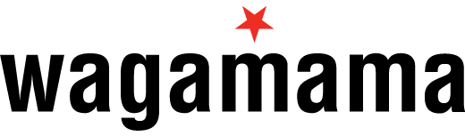
CINEMA CAN DRIVE SHORT TERM SALES RESPONSE & LONG-TERM ROI
Across a range of sectors brands have seen cinema deliver significant business effects in both the short & long term.
    Max Factor
Healthy Skin Harmony saw 3.5% value sales growth & Max Factor was the No.1 selling self-select cosmetics brand in Boots in December
    IKEA
      “Cinema is responsible for significant incremental sales and delivered ROI of £18 for every £1 spent”
    Audi
      Cinema was the top performing above-the-line channel during the campaign – with a ROI of £50 for every £1 invested
    Just For Men
      Across the ten day period where only cinema was live sales jumped by 249%
    DFS
      Cinema delivered ROI of more than £6 for every £1 spent – nearly a third higher than that seen for TV in this campaign
    ENO
      The cinema campaign helped Madame Butterfly exceed its “lofty sales target” by over 10%
    Toni & Guy
      There was a 44.9% uplift in sales during the month that cinema activity was live
    eBay
      Sales in the test region increased by 2.6% as a result of the cinema activity
    wagamama
      Across the 11 week period that cinema was live UK like-for-like sales increased by 12%
Source: DCM case studies

Slide 31
DCM CAN SUPPLY YOU WITH DETAILED SPOT REPORTS TO HELP Pinpoint cinema roi
Econometrics
DCM can supply detailed spot data for every ad in a campaign by site and showing
Data is overlaid with longitude/ latitudinal or postcode information for our cinemas
Your econometrics team can then better pin point cinema admissions delivery vs. store uplifts in sales to provide an accurate ROI figure
Notes:
Cinema spot data for econometrics analysis can now be pulled and provided at the touch of a button, making it easier than ever to identify and quantify cinema’s effectiveness as part of your media mix.

Slide 32
CINEMA IS A PREMIUM, BRAND SAFE AND TRUSTED ENVIRONMENT
Since becoming a fully digital operation in 2012 we offer an accountable and transparent process that ensure brands can trust cinema.
1. INFORMED
FORECASTS
2. DAILY
UPDATES
3. TICKET SALES REPORTED
We forecast admissions for each film, forming the basis of our buying routes. Over 4 years’ worth of admissions data is used to inform average footfall by site and screen predictions
Cinemas update us daily on what movies they plan to show over the 7-14 days, by site, date and time so we can schedule adverts against them
Box office ticket sales are delivered directly from the cinema’s in house POS system or web portal to our Data Warehouse
4. ACCOUNTABLE REPORTING
5. INDEPENDENT CORROBORATION
If a film starts outside of its allocated time band, is cancelled, or is shown without our prior knowledge, these admissions are automatically detected and discarded. We only report admissions for films that have a live and accountable playlist and then allocate these to campaigns.
Each week, ComScore who independently measure 95% of worldwide box office data, collect admissions and report these to our campaign management team. This data is used to corroborate our own admissions, ensuring transparency

Slide 33
How to buy cinema

Slide 34








The cinema advertising landscape
Digital Cinema Media - 516 cinemas - 80% of UK cinema admissions
+ OVER 150 INDEPENDENT CINEMAS
Pearl & Dean - 20% of UK cinema admissions
+ OVER 200 INDEPENDENT CINEMAS
Source: DCM/P&D share of industry admissions = Comscore

Slide 35
PLANNING A CINEMA CAMPAIGN IS EASY AND FLEXIBLE
Campaigns can be run broadly or incredibly targeted down to individual showings if so desired
PLAN BY AUDIENCE
PLAN BY FILM
PLAN BY GENRE
PLAN BY CINEMA
PLAN BY WEEK
PLAN BY
DAY
PLAN BY
TIME
PLAN BY SHOWING
Notes:
What all that really means though is that we can be dynamic with our scheduling
We can schedule by film, region, day, audience and individual cinema.
We can also run different copy dependent on the outcome of a result. The Arctic Monkeys used this with the Brit Awards with a winner and nomination copy that was scheduled to run dependent on the result of the awards.

Slide 36
CINEMA ADMISSIONS BY MONTH
While admissions breakdown will vary depending on each year’s film slate, cinema typically has strong months linked to school holidays and ‘awards season’ releases driving a strong start to the year
Awards Season &
Half-term
Easter
Summer holidays
Half-term
Christmas
Avg. monthly adms
Source: Comscore, 5-year average excluding closed/partial months due to Covid

Slide 37
CINEMA NATURALLY UPWEIGHTS CAMPAIGNS OVER THE WEEKEND
On an average week, 57% of DCM admissions are delivered across the weekend - naturally upweighting campaigns on the key retail days for brands
% of DCM admissions delivered by day
Source: DCM Campaign Management, Jan-August 2022

Slide 38
The cinema playlist
1.
DCM
OPENING IDENT
2.
BRAND
ADS
3.
BRONZE
SPOT
4.
DCM
CLOSING
IDENT
5.
SILVER SPOT
6.
FILM
TRAILERS
7.
GOLD
SPOT
8.
FILM
Average amount of brand advertising in reel: 11 minutes

Slide 39
The Gold, Silver & Bronze spots
Take advantage of the most prestigious positions in advertising
1.
DCM
OPENING IDENT
2.
BRAND
ADS
3.
BRONZE
SPOT
4.
DCM
CLOSING
IDENT
5.
SILVER SPOT
6.
FILM
TRAILERS
7.
GOLD
SPOT
8.
FILM
92%
of cinemagoers seated when Bronze Spot begins
+15% rate card
94%
of cinemagoers seated when Silver Spot begins
+30% rate card
100%
of cinemagoers seated when Gold Spot begins
+60% rate card

Slide 40
The Gold spot
The most impactful position in advertising
7.
GOLD
SPOT
+60% rate card
1.
DCM
OPENING IDENT
2.
BRAND
ADS
3.
BRONZE
SPOT
4.
DCM
CLOSING
IDENT
5.
SILVER
SPOT
6.
FILM
TRAILERS
8.
FILM
‘The most valuable few seconds in cinema advertising’ – Media Week
The Gold Spot is the premium position, helping brands to become an integral part of the cinema experience.
The Gold Spot is the last commercial message after the trailers and sits, on average, six minutes away from any other advertising.
To book into any premium spots, or find out more, contact your DCM rep.
This 60” or longer spot offers standout outside the main ad reel and offers the perfect opportunity to be up close to the
main event.
  100% of cinemagoers are seated when the Gold Spot begins*
  Guaranteed admissions
*Source: Assosia

Slide 41

CINEMA OFFERS A RANGE OF BUYING OPTIONS FOR BRANDS
Audience Guarantee Pack
Premium / 16-34 Adults / 16-34 Men / 16-34 Women / ABC1 Adults AGP
Family
Alcohol
Independents
Geo Targeting
Film Package
Regional / Site by
site

Slide 42
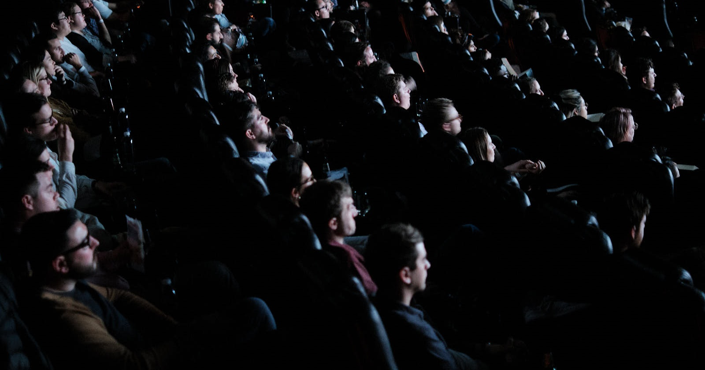
Audience guarantee pack (agp)
Cinema’s most popular buying route.
Guaranteed industry admissions
The broadest and most cost-effective way of reaching the whole cinema audience in any given campaign period - offering the best opportunity to achieve mass reach
Runs across the variety of films showing over your selected dates
Can be bought on a national or regional basis
There are Adult, 1634, Male/Female and Premium AGP options available if campaign requires a more targeted audience approach.
30” Ratecard CPT: £60
(+10% in Q4)

Slide 43

16-34 / 16-34 MEN / 16-34 WOMEN / Premium AGP
These four audience guarantee packages are more targeted than our AGP – selecting films that are forecast to skew towards a specific audience.
For example, our Premium AGP is more targeted towards an upmarket audience, predominantly incorporating films profiling 68%+ ABC1.
Similarly, a 16-34 Women / 16-34 Men AGP predominantly incorporate films that respectively profile 58%+ female/male.
Minimises unwanted wastage and allows for closer audience targeting
Guaranteed industry admissions p/w
16-34 Adult, 16-34 Men & 16-34 Women AGP - £70 ratecard CPT
Premium AGP - £75 ratecard CPT
(Ratecard costs are +10% in Q4)
Notes:
Features
1. Extra film filter allows closer audience targeting
2. Minimises unwanted audience wastage
3. 2.3m guaranteed industry admissions per week
4. £70 fixed CPT

Slide 44

Alcohol/gambling agp
The Alcohol/Gambling AGP allows you to be confident you are only advertising in films that profile over 75% 18+, with all films approved by the Cinema Advertising Association (CAA).
Comic book/superhero releases are not typically included in this AGP
CAA panel reviews and votes on any ‘borderline’ films based on the forecast audience profile of each title (based on recent comparative title)
Can be bought on a national or regional basis
Bar sponsorships and sampling are available, with 30% of our sites featuring a bar on the premises
30” Ratecard CPT: £70
(+10% in Q4)
Notes:
Features
1. Extra film filter allows bespoke audience targeting
2. Can be bought on a national or regional basis
3. Bar sponsorships are available, with 30% of our sites
featuring a bar on the premises
4. Comic book / action hero type releases will not be
included in these packages regardless of profile
5. £65 fixed CPT

Slide 45

Family pack
The Family Pack allows an advertiser to have presence with all family releases over a given period and utilise the rare opportunity to hit a captive family when they’re all together.
As family films are predominantly released across school holiday periods, admissions will be much more buoyant across these periods.
Family admissions are available on a national or regional basis
Creative must be ‘U’ certification
HFSS regulations apply
30” Ratecard CPT: £34
Notes:
Features
1. Most successful film genre
2. Unique housewives and kids audience
3. Releases fall in school holidays
4. £34 - £100 CPT

Slide 46

HFSS agp
Responsibly advertise your food or drink products on the big screen.
In the UK, an HFSS product may only be advertised with feature films achieving a national audience profile of <25% under-16s
The category of a film does not necessarily determine the profile of the audience it may attract. The CAA uses comparative film profiles to review and then vote on the suitability of titles for carrying HFSS advertising.
This package will only include films that are forecast to profile 75%+ 16+.
It is an advertiser's responsibility to inform the Cinema Advertising Association (CAA) if the product or brand they wish to advertise is HFSS.
£65 ratecard CPT
(Ratecard costs are +10% in Q4)
Notes:
Features
1. Extra film filter allows bespoke audience targeting
2. Can be bought on a national or regional basis
3. £65 fixed CPT

Slide 47
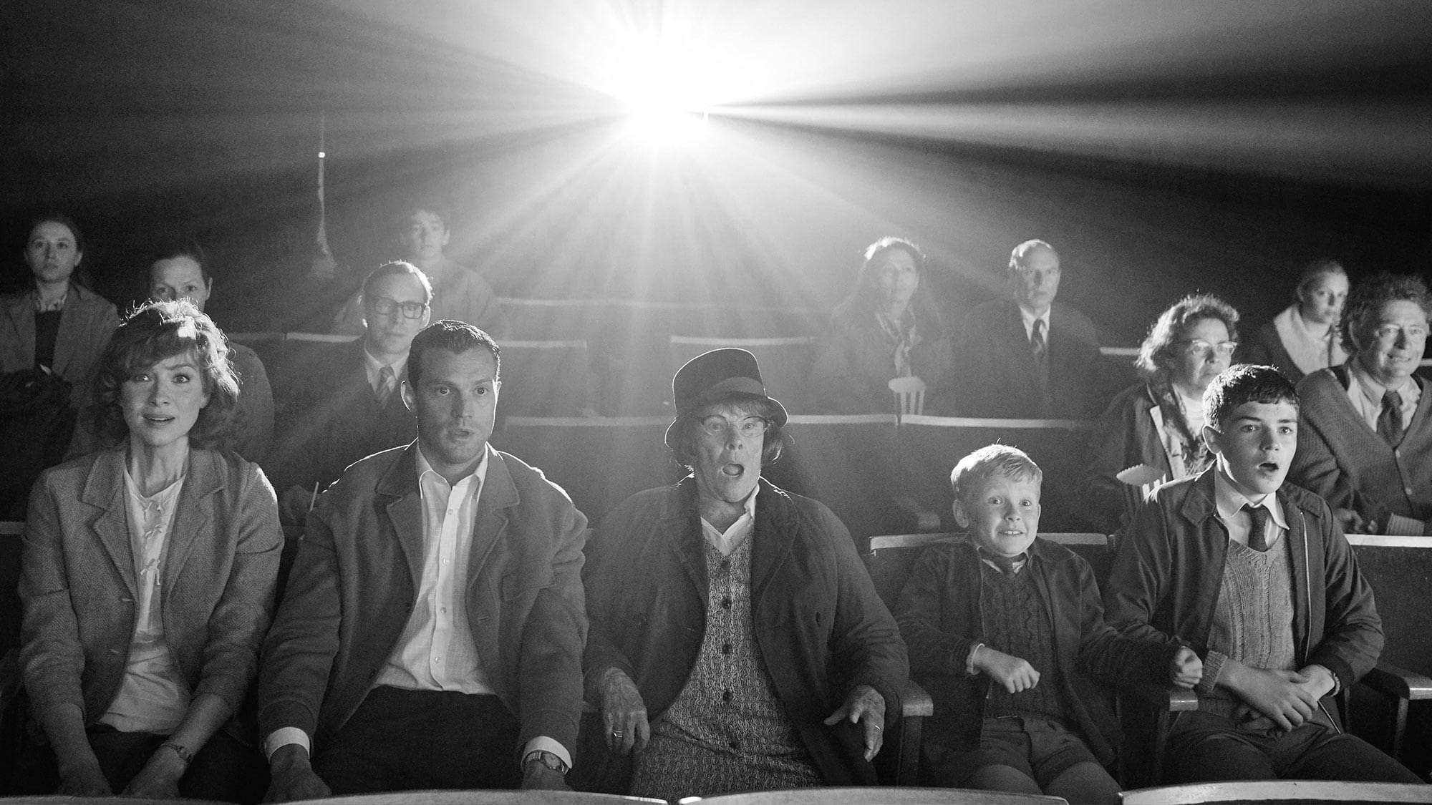
Film pack
Choose which specific films you’d like to buy to reach cinemagoers
Film packages allow you to select individual films that profile well against your target audience.
Booking a film pack is the only way to ensure exhibition with a specific film
You can choose national or regional targeting
Film packages offer estimated admissions
30" Ratecard CPT: £80/£100/£120
(major release / blockbuster / super-blockbuster)
(Ratecard costs are +10% in Q4)
Notes:
CHANGE PICTURE

Slide 48

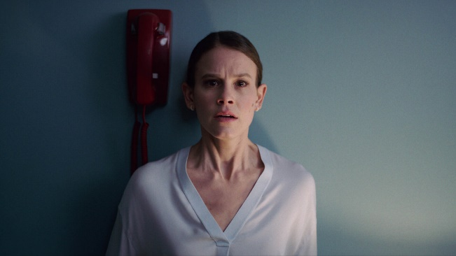
how WE identify the right films for your campaign
Using audience profile data from the CAA Film Monitor survey, DCM can help you identify which films are the best fit for the campaign’s target audience
FILM MONITOR
COMPARATIVES FOR UPCOMING RELEASE
EXAMPLE: 16-34 WOMEN
Film Monitor is an online face-to-face survey independently run by Kantar on behalf of the Cinema Advertising Association
Bi-weekly survey will amass a nat.rep sample of c.24,000 respondents (aged 7+) across a calendar year
Presented with a list of c.20 recent cinema releases and asked which they have seen in the cinema recently.
Film Monitor will collect audience profiles for c.100 theatrical releases that account for c.90% of all UK admissions
Every new major theatrical release is given a ‘comparative title’.
This will be a film released in the last couple of years (that has a robust Film Monitor audience profile) that is a good proxy for the upcoming release and its likely audience demographics.
For films that are sequels/part of a franchise selecting a comparative is quite obvious (e.g. Joker is the comparative for Joker 2). For others, the selection of a comparative will be based on the BBFC certificate and influenced by genre and factors including director, lead actor/actress and audience trends.
Using comparatives helps inform which buying routes a film will be part of and allows DCM advise brands on which upcoming films best suit their needs -e.g. for brands targeting 16-34 women The Fall Guy and Smile 2 are perfect picks.
The Fall Guy
Comparative: The Lost City
22% 16-34 Female
16-34 Female Index: 168
Untitled Smile Sequel
Comparative: Smile
29% 16-34 Female
16-34 Female Index: 222

Slide 49
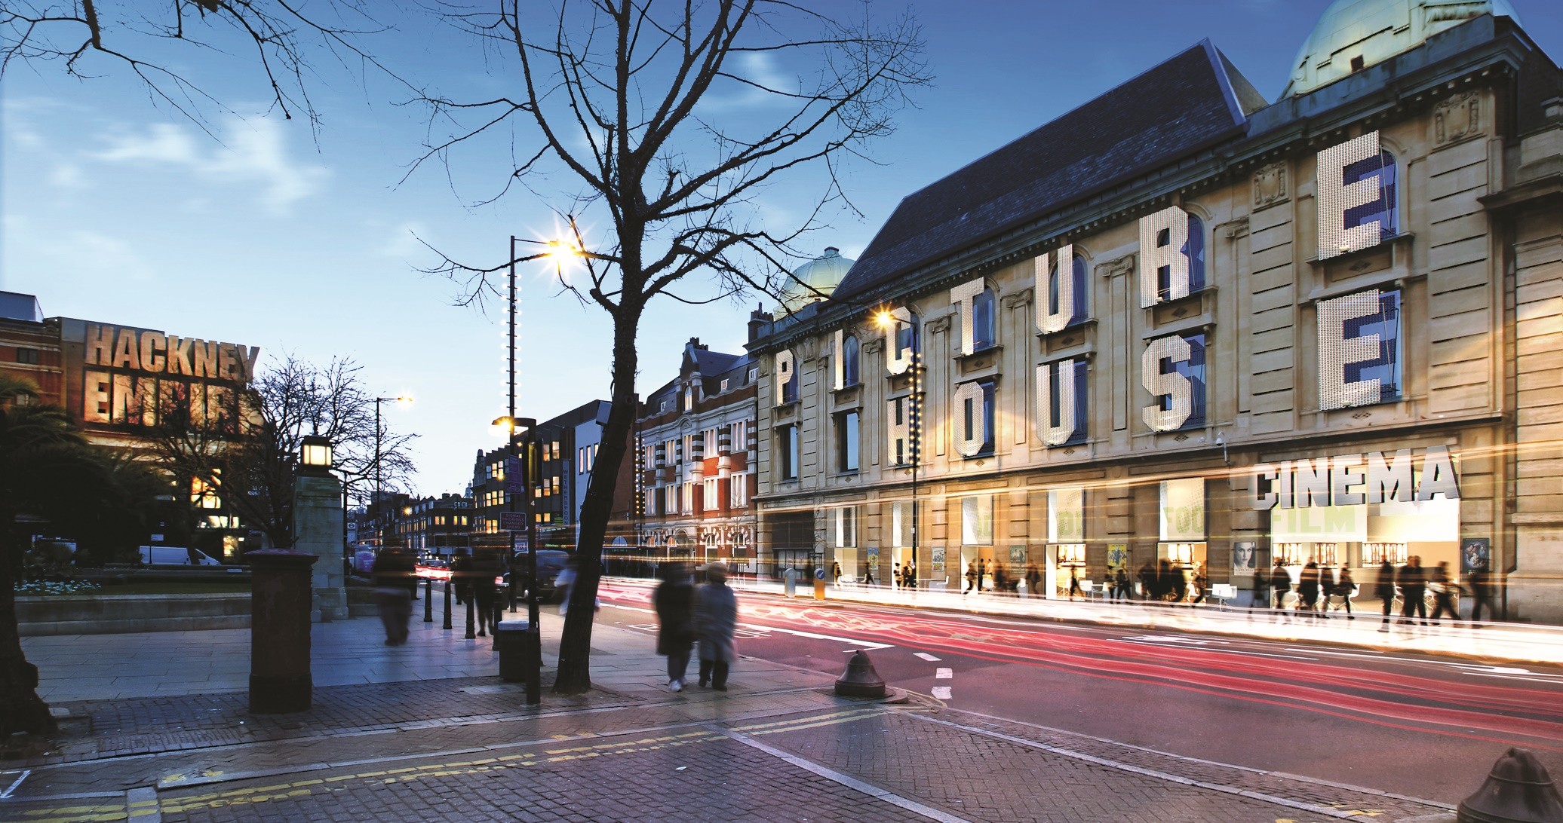
Dcm independents
This package only includes DCM’s Independent cinema portfolio, representing c.12m admissions annually.
The venues are spectacular community hubs, often with private members clubs and bars, underpinned by diverse and immersive programming.
The core independent audience is older and more affluent than the average cinemagoer: 61% ABC1 and 53% over 45
22% of the core independent audience are heavy cinemagoers
27% of the core independent audience is based in London
£100 ratecard CPT
(Ratecard costs are +10% in Q4)
Notes:
Features
18.7m admissions
613 screens
224 cinemas
21% of UK cinemagoers
61% ABC1
53% over 45
22% Heavy cinemagoers
27% London
5. £100 ratecard CPT

Slide 50

Regional and site by site targeting
Opportunity to buy cinema nationally or regionally
Also offer cinema on a site by site basis
Regions split same as ISBA TV regions
Ratecard price on application
Notes:
Features
1. Highly targeted audiences
2. Ensured exhibition with a specific film
3. Estimated admissions
4. £80-100 CPT

Slide 51

GEO-TARGETING PACK
Using Cinemapper, DCM’s cinema proximity planning tool, you can run national campaigns with a local spin for every region, city, town or cinema across the UK.
All DCM sites can be bought on an individual basis if required
Pricing will be subject to location and size of venue
Talk to DCM about mapping your locations to our sites
Multiple end frame messaging directs consumers to their local store, dealership, location or franchise.
Notes:
1. All DCM sites can be bought on an individual basis
2. Regions split same as ISBA TV regions
3. Pricing will be subject to location and size of venue
4. Multiple end frame messaging offers a way of
directing consumers direct to their local store,
dealership, location or franchise

Slide 52


Cinemapper can help your brand target more efficiently using cinema
Local targeting & End frame technology
We map a client’s catchment area, branches, stores, local stockist and audiences…
Brands can also add a tailored 5” end frame to their main ad, delivering a national message with a local touch. For example…
Skoda: showing the nearest dealership
Counter Terrorism Policing: Targeting key locations with tailored messaging
To their nearest cinema sites based on their postcode(s) and distance in miles, drive time or walk time
Notes:
These 100 films account for 89% of UK admissions

Slide 53

Bespoke end frames and geo-targeting can drive great results for advertisers
RNLI
wagamama
Drawn to cinema’s engaging and immersive qualities, RNLI utilised wanted to use cinema to target young men in key locations. DCM’s Cinemapper tool was used to pinpoint cinemas near rivers and seas. Activity was upweighted in these cinemas to ensure the message was being driven home in the right place, to the right people.
The campaign, with cinema as an integral contributor, was hailed as a significant success, delivering an uplift in total campaign awareness of 36% and a 33% uplift in correct message takeout amongst 16-39 males, and ultimately has helped save lives.
In an effort to ensure its cinema launch drove footfall alongside brand impact, wagamama used DCM’s Cinemapper tool to locate cinemas in close proximity to its restaurants – allowing wagamama to buy selected sites that were within 10-15 minute drive of its restaurants to deliver close proximity and minimise wastage.
The ‘Bowl To Soul’ brand film ran in a total of 97 DCM cinemas across eight key cities. Using cinema to target key restaurants allowed wagamama to test cinema’s effectiveness at driving sales and across an 11 week period like-for-like turnover increased by 12%.

Slide 54
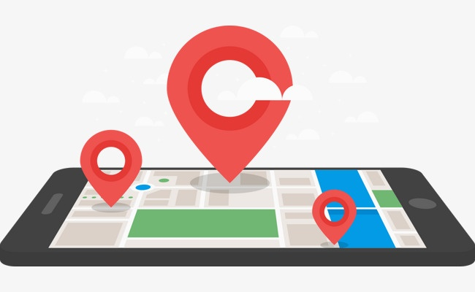



RE-TARGETING AFTER THE CINEMA
DCM can supply your agencies with the information required to amplify your campaign by retargeting cinemagoers on mobile.
How It Works
DCM can provide the Media Agency/Re-targeting agency with the longitude and latitudes of all DCM cinemas showing the upcoming cinema campaign with weekly screen and showing lists available.
This allows your mobile agency to set up a geo-fence around the cinema and then using people’s device data to identify those people who are most likely to have been exposed at those sites.
These people will then be re-targeted with mobile display advertising (within a specified timeframe) to create a truly cross-media campaign.

Slide 55
Welcome to
DCM STUDIOS

Slide 56
WE USE OUR KNOWLEDGE OF THE
CINEMA AUDIENCE, FILM SLATE AND
LATEST TECHNOLOGY TO CREATE
CONTENT, EXPERIENCES AND PARTNERSHIPS
FOR BRANDS LOOKING TO ENHANCE THE
CINEMA EXPERIENCE.

Slide 57
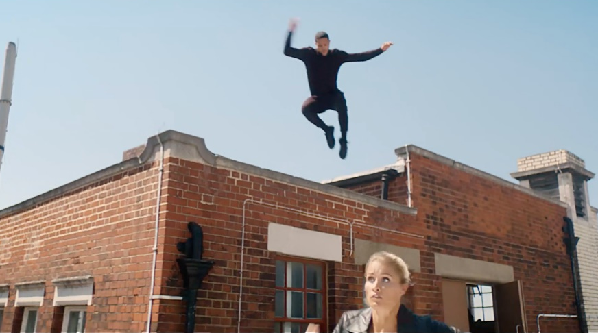


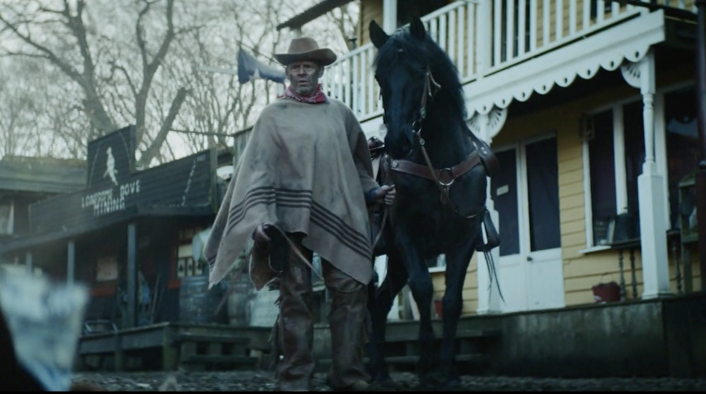





Bespoke content
SUMMARY
There is a wealth of cultural stimulus and emotion for brands to riff off with bespoke and contextually relevant content. Not only does the cinema audience have an open mindset, but cinema provides the best viewing experience - it has been custom designed to deliver a quality viewing experience, unrivalled by any other media format.
Whether it’s utilising existing content or creating brand new content for the cinema audience – DCM Studios have the expertise and capabilities to tailor your brand story to the most engaging audience.
KEY BENEFITS:
BRAND OBJECTIVES – AWARENESS
Gives brands an equal chance to tell their story
Cinema’s ability to grab and hold attention is unmatched
Cinema ads are just as engaging as movie trailers – so entertain the audience!
CLICK HERE FOR CASE STUDIES
CLIENTS:
PRODUCTION | LENGTH | PREMIUM RATE
8-12 weeks (est) | TBC | Position Dependent

Slide 58
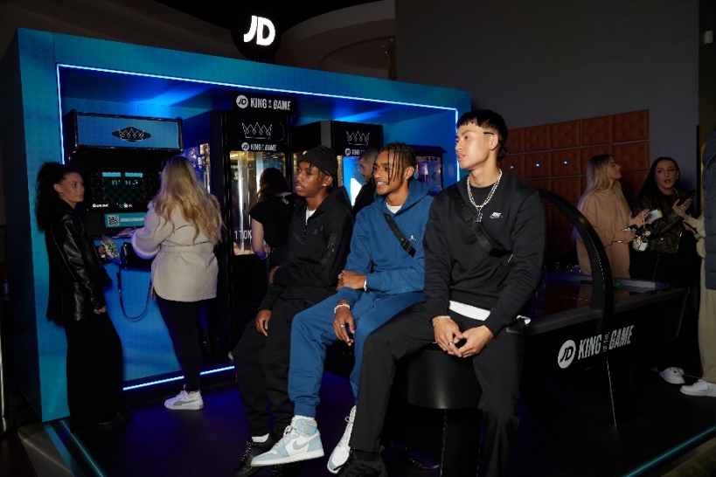
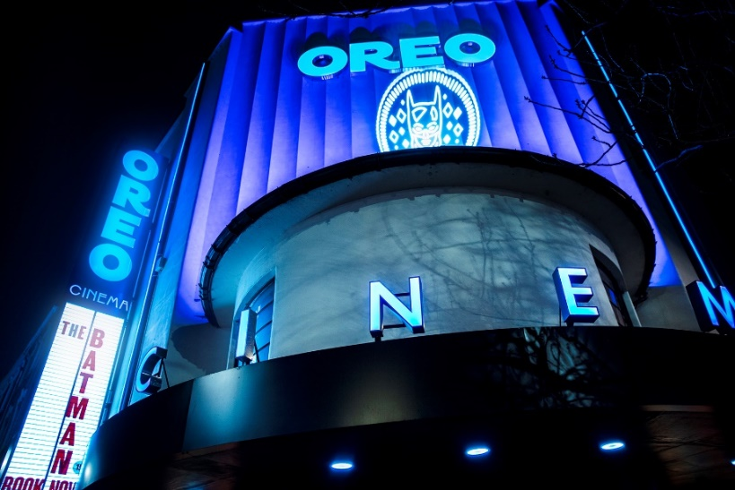
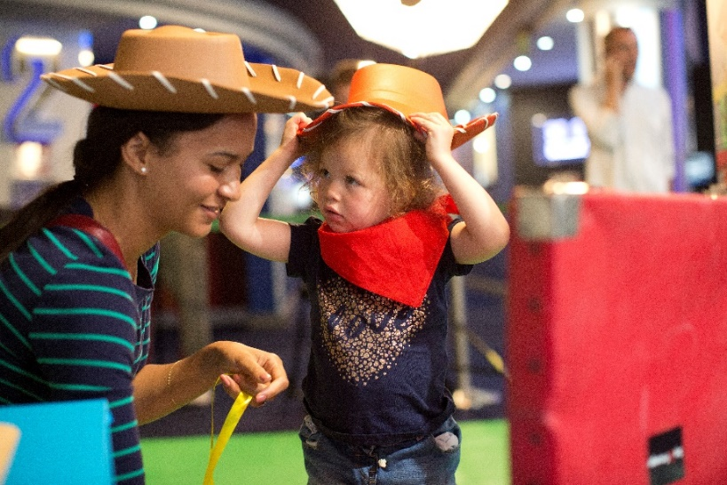
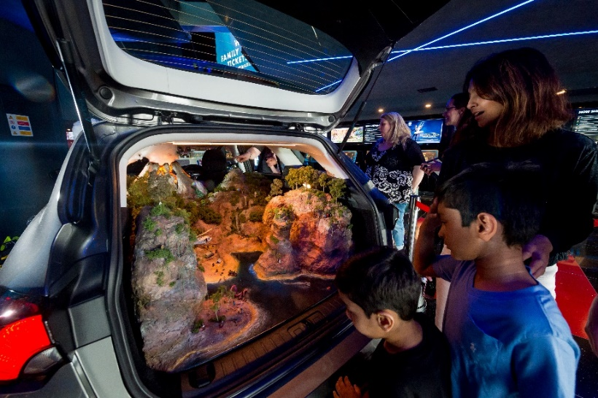








Activations
Immersive activations will create a truly impactful and unforgettable cinema trip.
SUMMARY
DCM Studios partner with cinemas across the country to enhance a typical cinema trip into an immersive journey with your brand. By utilising the cinema space more effectively, we have opened up new touch points for brands to explore with their customers being at the forefront of it all.
KEY BENEFITS:
BRAND OBJECTIVES - ACTION
Brand activation provides a unique, memorable experience to increase brand awareness and brand loyalty.
Through a multi-touch brand experience with several interactive and engaging elements, cinema has proven to be a unique medium for brands to immerse their audience and bring their brand to life.
CLICK HER FOR CASE STUDIES
CASE STUDIES:
Audience | Min Spend
Activation Dependent | £100k (£50k Media & £50k Activation)

Slide 59
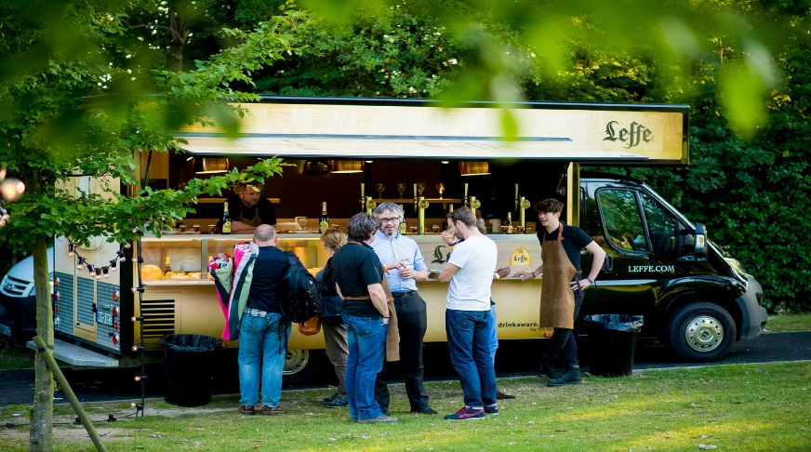
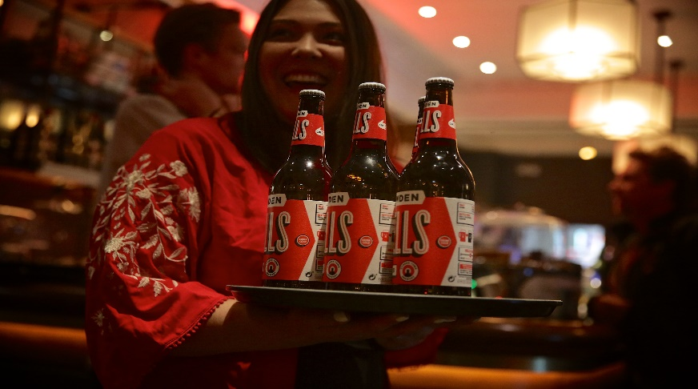
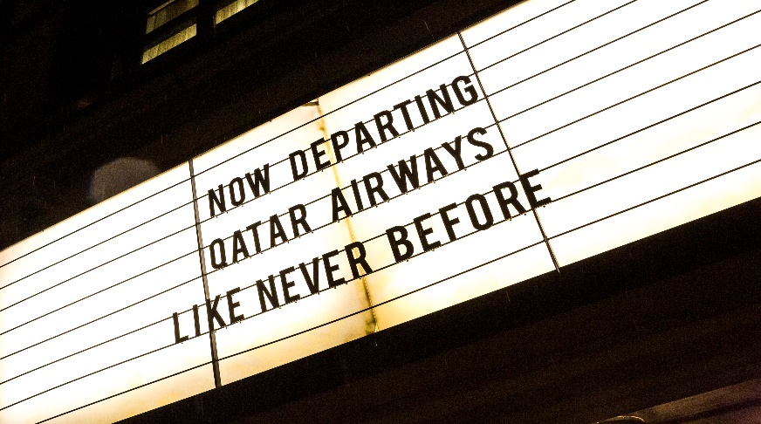
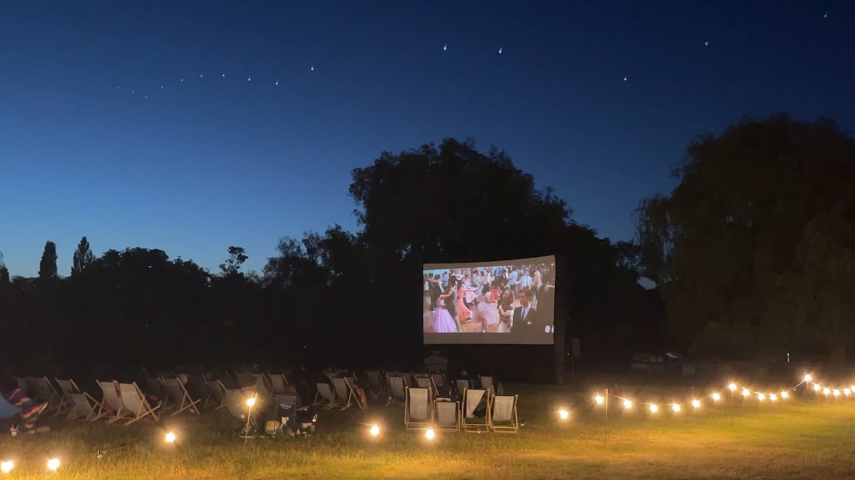



events
Reward your customers with a night to remember.
SUMMARY
Make your brand much more accessible to your customers with an immersive event in one of our boutique sites. We can transport guests into a first-class flight lounge or give cinemagoers a makeover worthy of the red carpet.
DCM’s flagship boutique cinemas not only give brands the space to bring their story to life, they also offer an unrivalled premium experience for guests for a night (or day!) like no other.
When capturing the hearts and attention of consumers becomes ever increasingly more difficult, this unique experience offers brands the chance build credibility and spark lasting connections.
KEY BENEFITS:
BRAND OBJECTIVES – AFFINITY & ACTION
Build a deeper connection with your brands audience
Uplift your brands consideration in customers
An opportunity to bring your brand to life with a PR-able event, which will further your brands reach and awareness.
CLICK HERE FOR CASE STUDIES
CASE STUDIES:
Audience | Min Spend
Event Dependent | £50k

Slide 60

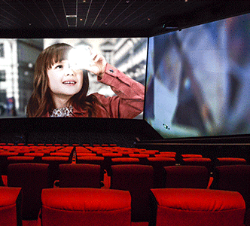
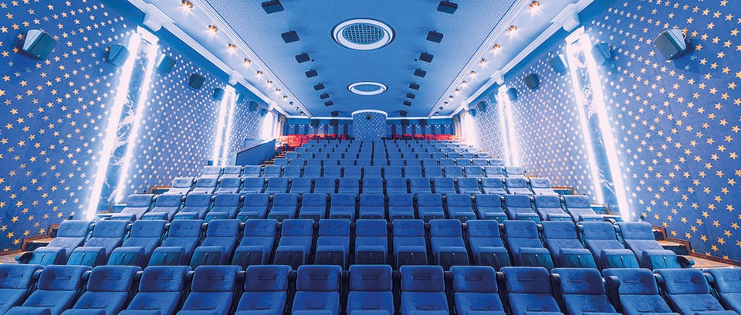



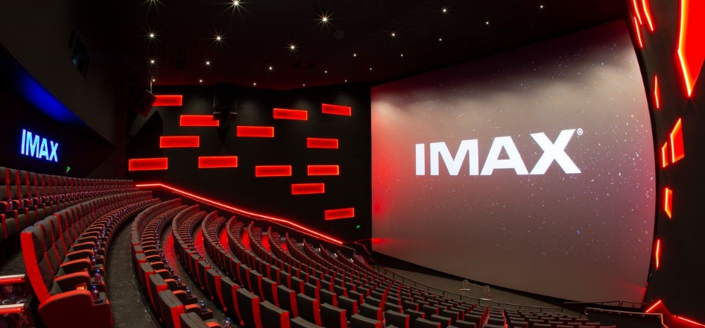
CINEMAS ARE ALWAYS LOOKING To invest in new TECH to enhance the experience
Dolby Atmos expands on existing surround sound systems by adding height channels, allowing sounds to be interpreted as three-dimensional objects – fully enveloping audiences in the soundscape of the film. Installed in over 40 cinemas so far, brands can upgrade their ad to take advantage of this stunning audio in cinema.
4DX is extreme sensory cinema. With stimulating effects like water, wind, scent and strobe lighting, that thrill you in your moving seat 4DX is the most exhilarating way to watch a film.
4DX screens can be found in 37 Cineworld sites across the UK with plans to continue rolling out more in future.
Brands can ‘4DX’ their own ads to fully immerse the audience in the ad and maximise the impact of creative amongst a young thrill-seeking audience.
Case study from the British Army available on dcm.co.uk
Screen X is a state-of-the-art atmospheric experience that uses twelve additional projectors to extend the film out onto the side walls of the screening room and surround the audience in their seats with 270° projection. Extending the film beyond the audience’s peripheral vision brings them closer to the action than ever before.
Screen X can be found in 23 Cineworld sites across the UK with plans to increase this further. Brands can showcase their own ads in Screen X format – see a case study from Halifax on dcm.co.uk
IMAX screens stretch from floor to ceiling and from wall to wall, creating a picture so big it feels like you’re inside the film but yet still being able to see every detail in stunning high-resolution. Available for brands to upgrade their ads to IMAX and showcase in over 40 cinemas.

Slide 61
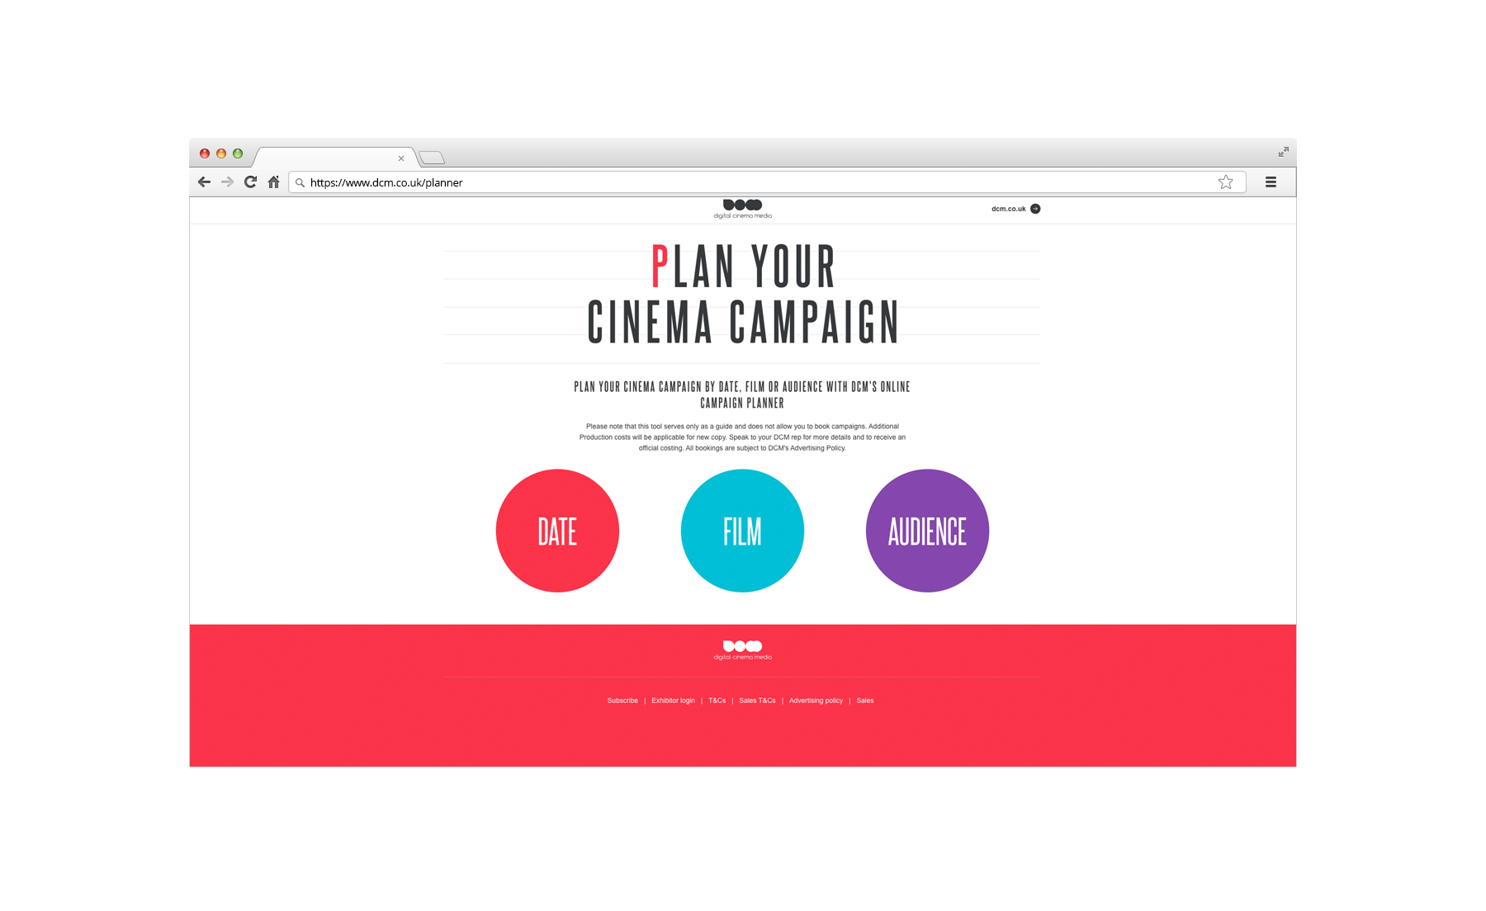
LATEST FORECAST ADMISSIONS ARE AVAILABLE ON DCM’S WEBSITE

Slide 62
CINEMA 101: SUMMARY
LOVED BY AUDIENCES
SIMPLE & FLEXIBLE
TO BUY
DELIVERS A POSITIVE IMPACT FOR BRANDS

Slide 63


