Slide 1
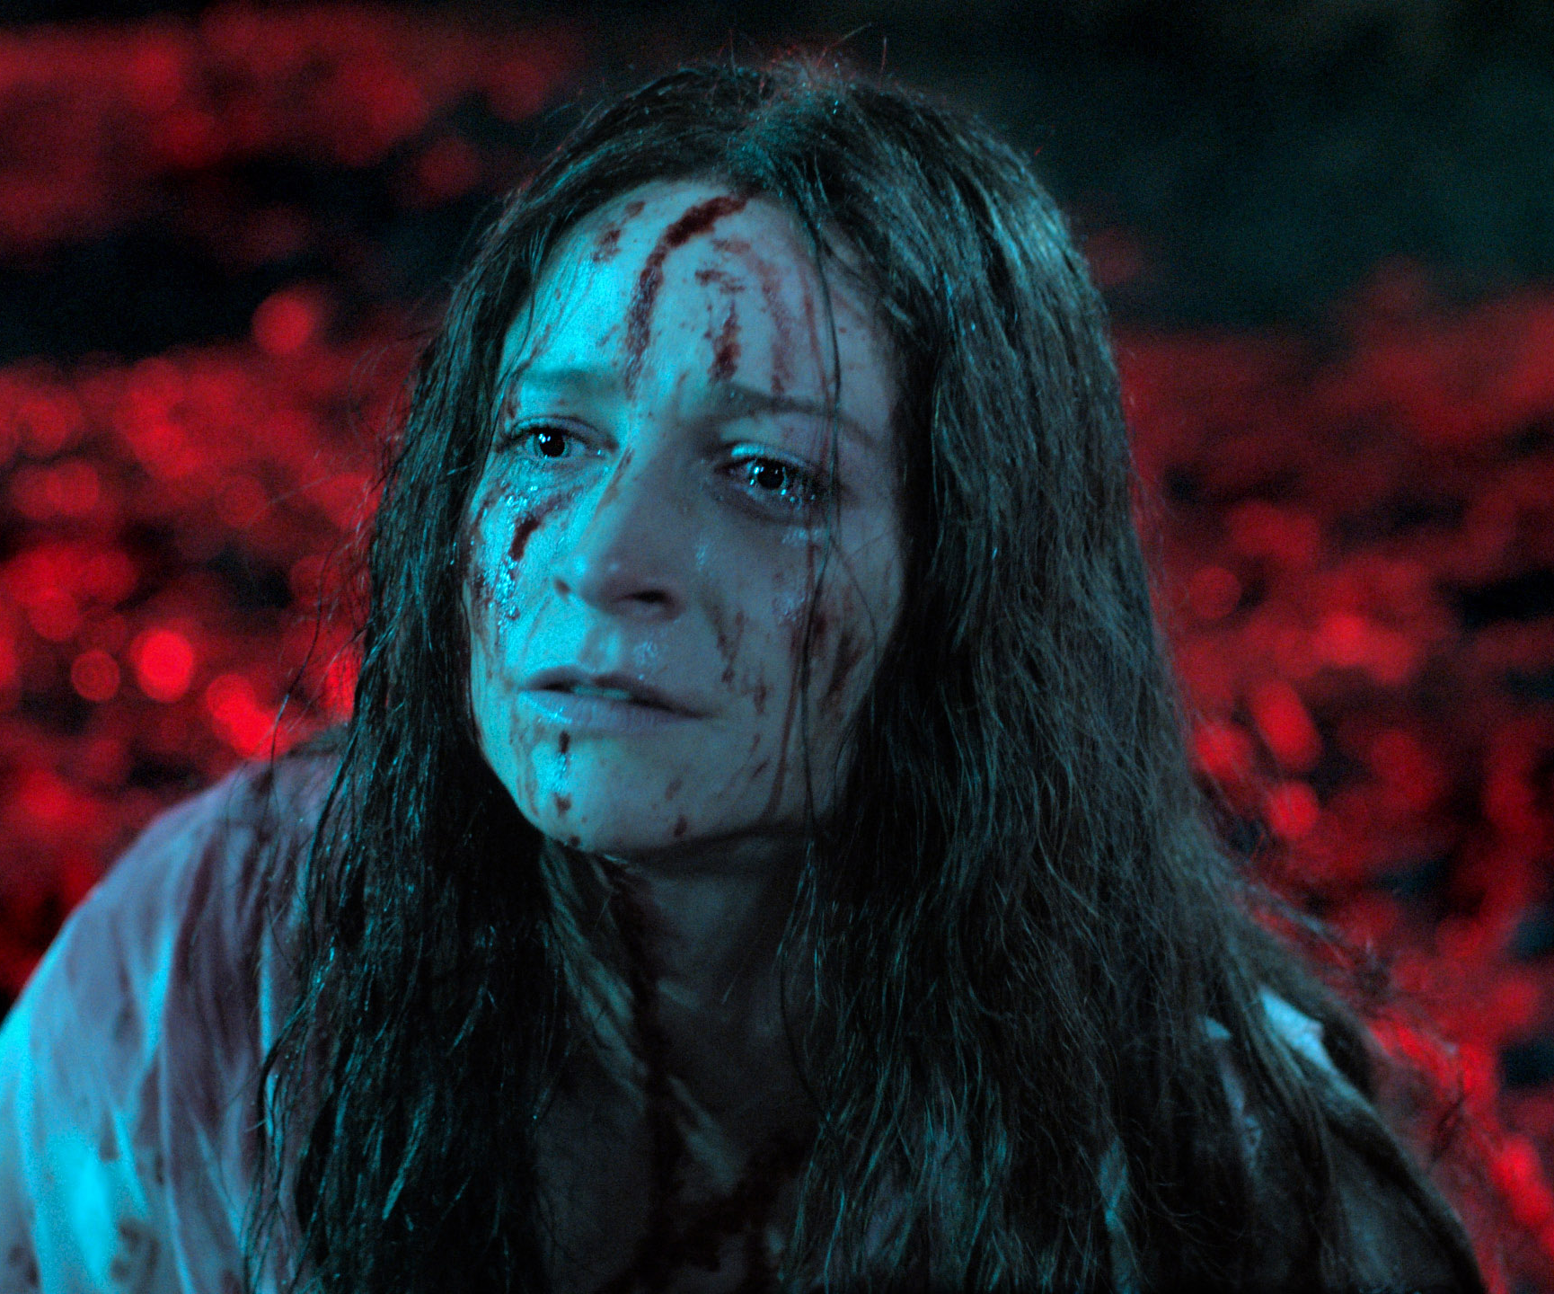
Censor
A new name in British horror emerges!
Release Date
30 August 2021
Cast
Niamh Algar, Michael Smiley, Nicholas Burns
Director
Prano Bailey-Bond (Feature debut)
Recommended if you like
Saint Maud
Reasons to buy into
Prano Bailey-Bond’s lightly satirical feature debut made waves at the Sundance film festival and looks to establish her as a new icon of British horror.
Key audience info
16-34 Index:
Est. DCM admissions
A film censor working during the height of the video nasties scare of the 1980s investigates a filmmaker – the journey leads her on a strange and disturbing journey.
Plan your campaign

