Slide 1
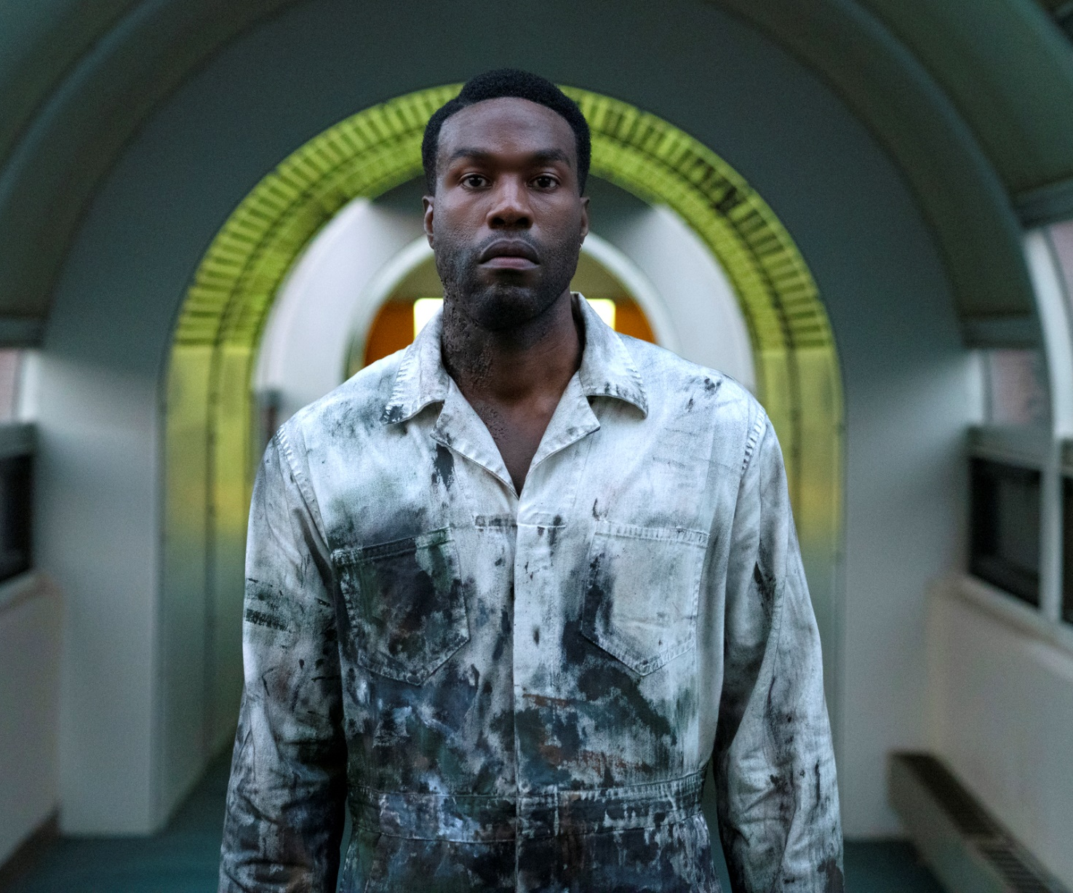
candyman
A horror icon is reborn!
Release Date
27 August 2021
Cast
Yahya Abdul-Mateen II, Teyonah Parris, Nathan Stewart-Jarrett
Director
Nia DaCosta (Little Woods)
Recommended if you like
Halloween, Get Out
Reasons to buy into
Nia DaCosta and Jordan Peele turn their exciting and thought-provoking styles to the return of the legendary Candyman saga.
Key audience info
16-34 Adults index: 265
Est. DCM admissions
468k
A “spiritual sequel” to the horror film Candyman (1992), which returns to the now-gentrified Chicago neighbourhood where the legend began.
Plan your campaign

