Slide 1
BUILDING
BOX OFFICE
BRANDS
VOLUME III
PROVING CINEMA’S UNIQUE VALUE AS PART
OF ADVERTISERS’ AV SCHEDULES
Notes:
BUILDING BOX OFFICE BRANDS is our brand new research project in conjunction with Millward Brown. The aim of the research is to help advertisers better understand cinema’s role within the media mix and the value it delivers on key brand metrics.
People understand the basics of cinema and what it brings – the big screen, the dark room, the undistracted audience – but I think what we’ve been lacking is conclusive proof of what all of these things actually mean for advertisers, and what they deliver as part of the campaign. That’s why we commissioned Millward Brown to delve into their databank to help us better understand cinema’s role in the media mix. Hopefully, by sharing these results with you today, you’ll agree we’ve found it.
Today we’ll take you through a quick bit of background on the methodology before revealing how media (and cinema) can help build powerful brands.

Slide 2





WHAT IS ECONOMETRICS?
INGREDIENTS INCLUDE:
Advertising
PR
Pricing
Brand Awareness
Competitor Marketing
Seasonality
Economic change
If sales are a cake, econometrics determines the recipe, identifying and quantifying ALL key drivers/ingredients.
The technique assigns a weight to each ingredient. Once the ‘recipe’ is known, we can reproduce the cake by combining the weighted ingredients together, with an understanding of which ones are adding the most to the mix.
Notes:
What exactly is econometrics?
Econometrics is a form of quantitative research that essentially takes a mountain of data and turns it into actionable information.
Sally at Benchmarketing likes to use a cake analogy to explain econometrics to people…
Econometrics is essentially a way of determining the recipe of a cake by identifying and qualifying ALL of the key ingredients that have gone in to making it what it is. Econometric analysis assigns a weight to each ingredient – once you know what the recipe is you can then reproduce the cake knowing exactly which ingredients are adding the most to the mix.
In this context, ingredients are all the things that can impact the money that a brand makes – advertising, PR, awareness, competitor activity and seasonality etc. Econometric analysis allows advertisers to understand how each of these plays a role and from an advertising POV understand which channels are paying back the most.

Slide 3

The methodology
Notes:
So how did Benchmarketing go about this project?

Slide 4

META-ANALYSIS
OVER 500 UK ECONOMETRIC MODELS FROM 2011-2016
Meta-analysis, which is common in pharmaceutical research, is essentially the detailed evaluation of hundreds of different cakes and recipes to determine which ingredients work best.
In this case we want to understand how each media channel works for advertisers in different sectors and the return on investment it delivers.
ROI FOR EACH CHANNEL
SIX KEY PRODUCT CATEGORIES
Notes:
Benchmarketing tapped in to their campaign databank which contains over 500 econometric models measured between 2011 and 2016 in the UK.
To understand the impact of cinema they undertook a ‘meta-analysis’ of all of those campaigns. To bring back the cake analogy, this is just essentially a detailed evaluation of hundreds of different cakes and recipes to determine which ingredients work best. It gets used a lot in medical research because obviously you need to be sure of your findings – hundreds of tests are required for that, rather than just one or two.
The aim of the analysis was to a) understand the ROI delivered by cinema, and other paid media channels and b) investigate if optimising spend in cinema would mean advertisers see bigger returns from their total ad campaigns.

Slide 5

RETAIL
Notes:
Now on to the results and up first is Retail…

Slide 6
RETAIL – RETURN ON INVESTMENT
For retail advertisers, cinema delivers an average Revenue ROI of £13.51 for every £1 spent
Source: Benchmarketing Results Vault – 2011 to 2016 data.
All figures are Revenue ROI, for every £1 spent.
Notes:
For retail brands, cinema on average delivers a Revenue ROI of £13.51 for every £1 spent. This comes in slightly ahead of TV, which returns £12.63 for every £1 invested.
The strongest channels in terms of ROI are Radio and VOD. Retail is radio’s second biggest product category in terms of money spent – the reason why radio works well for retail is its ability to deliver a tactical message, at a relevant times of the day to an core audience of Main Shoppers.
VOD comes out really strongly here – the reasons for this could be a) VOD works really well for clothing retail brands who can advertise their products and offer a direct link to their website for purchase or b) it could be that the VOD campaigns measured here are for brands who sell high-ticket price items (e.g. sofas and fridges), so they don’t need to convert as many sales for the media to pay back.
It’s obviously important for advertisers to assess the effectiveness of any one channel – and this proves that cinema can deliver a return for retailers. But what’s really important for advertisers is having an effective media mix. We wanted to understand how does cinema, within the mix, impact on advertiser’s returns. This is where the tertile analysis comes in to play...

Slide 7

TOYS, GAMES & CONSOLES
Notes:
The third of the five sectors is Travel & Transport.

Slide 8
TOYS, GAMES & CONSOLES – RETURN ON INVESTMENT
Toys, games and console brands see an average return of £6.24 for every £1 spent on cinema advertising
Source: Benchmarketing Results Vault – 2011 to 2016 data. Based on 19 UK cases.
All figures are Revenue ROI, for every £1 spent.
Online video incl. VOD.

Slide 9

TRAVEL & TRANSPORT
Notes:
The third of the five sectors is Travel & Transport.

Slide 10
TRAVEL & TRANSPORT – RETURN ON INVESTMENT
On average, Travel & Transport advertisers see a bigger ROI from cinema than TV and online video
Source: Benchmarketing Results Vault – 2011 to 2016 data.
Across 59 UK cases. All figures are Revenue ROI, for every £1 spent.
Online video includes VOD.
Notes:
On average cinema delivers a return of £6.02 for every £1 spent – putting it ahead of TV at £4.78 and streets ahead of VOD which delivers on average £0.93 for advertisers.
The story is very clear here - Display, Newspapers, Radio and Cinema are key channels for travel advertisers – and when it comes to AV, travel advertisers should definitely be thinking cinema.

Slide 11

TELECOMS
Notes:
The 4th sector is Telecoms.

Slide 12
TELECOMS – RETURN ON INVESTMENT
On average, cinema delivers a better ROI for telecoms advertisers than TV and online video
Source: Benchmarketing Results Vault – 2011 to 2016 data.
Data from across 57 UK cases. All figures are Revenue ROI, for every £1 spent.
Online video includes VOD.
Notes:
On average, Telecoms brand see a return of £3.29 for every £1 spent on cinema.
This is the second biggest return of all channels, behind only Magazines at £5.68.
From an AV perspective, cinema delivers £1.75 more than VOD and almost a £1 more than TV per pound invested.

Slide 13

ALL SERVICES
Notes:
The last category Benchmarketing analysed as ‘All Services’ – this is a catch-all category that includes advertisers from across different sectors including Charity, Entertainment and Leisure, Finance, Gambling, Retail, Telecoms and Travel.

Slide 14
ALL SERVICES – RETURN ON INVESTMENT
On average, cinema delivers a return of £7.73 for every £1 spent by Services advertisers
Source: Benchmarketing Results Vault – 2011 to 2016 data.
All figures are Revenue ROI, for every £1 spent
Across 491 UK cases from Charity, Entertainment & Leisure, Finance, Gambling, Retail, Telecoms and Travel & Transport sectors
Notes:
For this broad-ranging category we see that on average cinema delivers £7.73 for every £1 spent – very similar to the return delivered by TV.
Radio and VOD both come out strongly here thanks to the big Retail ROIs that these channels can drive, which are included in the pot here.

Slide 15
HOW CAN DCM HELP?
Post campaign spot report
Notes:
DCM understand how the importance advertisers place on econometrics and discovering how the media channels they put on their plan payback.
With this in mind we have created a new post campaign spot report that delivers all the information that econometrics agencies need to more accurately pinpoint cinema ROI.

Slide 16
for successful MEASUREMENT you need
QUALITY
VARIATION
CONTEXT
Granular data
Right metric
Over time
Across space / regions
Over creative messaging
Objective of campaign
Media landscape
Measuring against the right KPI
Source: Gain Theory

Slide 17
Historical data supply FROM DCM
Challenges
Admissions data supplied by week either regionally or Nationally
No data by day of week
No data by site
Difficult for econometric teams to pin point exactly where admissions have been delivered and the sales impact they’ve had.
Source: DCM Insight

Slide 18
Pinpointing cinema roi
Econometrics
Since 2015 we have been able to supply a post-campaign spot report for every ad in a campaign by site and showing
Data is overlaid with longitude/ latitudinal or postcode information
The econometrics team then pin point cinema admissions delivery vs. store uplifts in sales to provide an accurate ROI figure

Slide 19
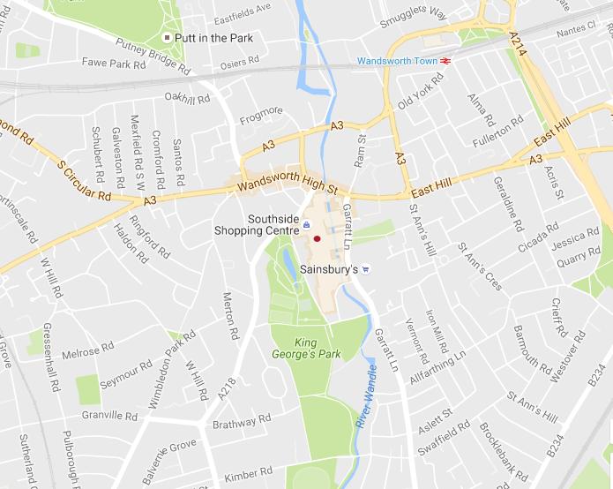
What is a post-campaign spot report?
Cineworld Wandsworth
Screen No. | Date | Time | Actual | Movie
1 | 15/10/16 | 11:40 | 40 | Storks 2D
1 | 15/10/16 | 14:00 | 85 | Storks 2D
1 | 15/10/16 | 16:15 | 123 | Storks 2D
1 | 15/10/16 | 18:30 | 104 | Storks 2D
1 | 15/10/16 | 20:50 | 177 | Inferno
2 | 15/10/16 | 10:10 | 10 | Kubo And The Two Strings 2D
2 | 15/10/16 | 12:40 | 25 | American Honey
2 | 15/10/16 | 16:10 | 32 | American Honey
2 | 15/10/16 | 19:40 | 157 | Girl On The Train, The
2 | 15/10/16 | 22:20 | 69 | Girl On The Train, The
3 | 15/10/16 | 22:30 | 18 | Bridget Jones's Baby
3 | 15/10/16 | 10:15 | 72 | Ice Age: Collision Course
3 | 15/10/16 | 12:30 | 15 | Storks 3D
3 | 15/10/16 | 14:50 | 92 | Storks 2D
3 | 15/10/16 | 17:10 | 30 | Storks 3D
3 | 15/10/16 | 19:30 | 105 | Bridget Jones's Baby
Source: DCM Insight
Notes:
REGION
CINEMA SITE, SCREEN, FILM
SHOWING DATE AND TIME
ADMISSIONS
BRAND AND NAME OF CREATIVE EXECUTION
LONG AND LAT CO-ORDINATES AND POST CODE

Slide 20
Pinpointing cinema roi
Econometrics
Since 2015 we have been able to supply spot data for every ad in your campaign by site and showing
Data is overlaid with longitude/ latitudinal or postcode information
The econometrics team then pin point cinema admissions delivery vs. store uplifts in sales to provide an accurate ROI figure

Slide 21
this data is quick
to run and readily available so please ensure you request it post each campaign

Slide 22
BUILDING
BOX OFFICE
BRANDS
VOLUME III
PROVING CINEMA’S UNIQUE VALUE AS PART
OF ADVERTISERS’ AV SCHEDULES
Notes:
So to summarise, cinema can deliver return on investment, a lot of advertisers are currently underinvesting in the channel and ultimately cinema is measurable within econometrics. Please make sure you request the post-campaign spot report from us for campaigns that are going to be measured by econometrics agencies – it will make their job of pinpointing cinema’s impact on ROI so much easier.

