Slide 1
BUILDING
BOX OFFICE
BRANDS
VOLUME III
PROVING CINEMA’S UNIQUE VALUE AS PART
OF ADVERTISERS’ AV SCHEDULES
Notes:
BUILDING BOX OFFICE BRANDS is our brand new research project in conjunction with Millward Brown. The aim of the research is to help advertisers better understand cinema’s role within the media mix and the value it delivers on key brand metrics.
People understand the basics of cinema and what it brings – the big screen, the dark room, the undistracted audience – but I think what we’ve been lacking is conclusive proof of what all of these things actually mean for advertisers, and what they deliver as part of the campaign. That’s why we commissioned Millward Brown to delve into their databank to help us better understand cinema’s role in the media mix. Hopefully, by sharing these results with you today, you’ll agree we’ve found it.
Today we’ll take you through a quick bit of background on the methodology before revealing how media (and cinema) can help build powerful brands.

Slide 2
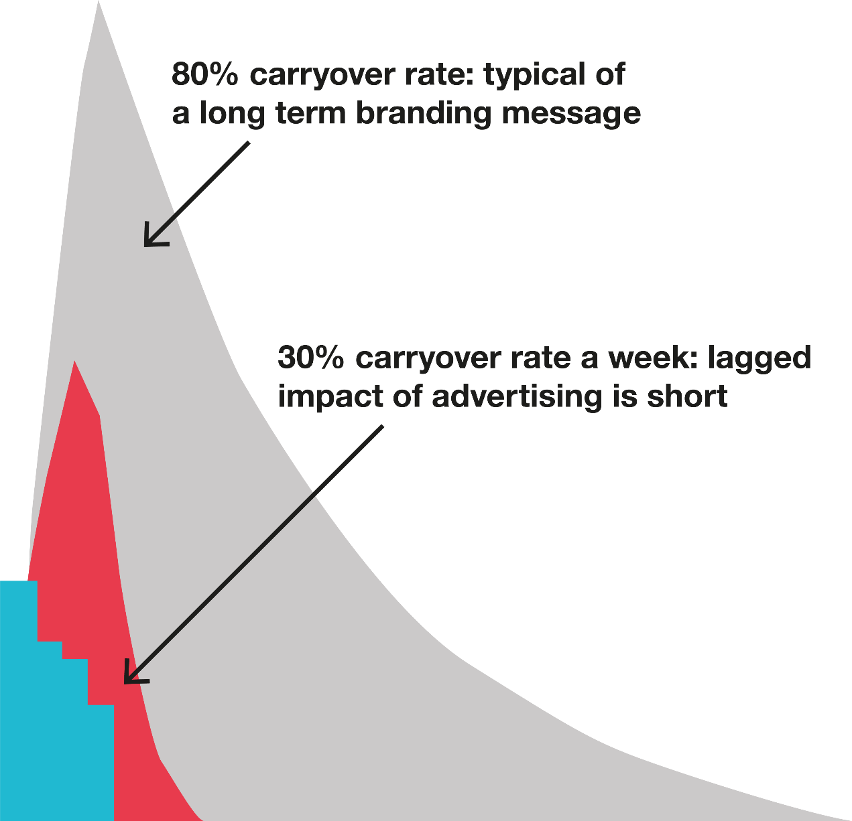
UNDERSTANDING ADSTOCKS
A simple way of thinking about advertising adstock levels is that they essentially measure how memorable an exposure is and help brands understand what impact advertising on different channels has on sales over time.
The higher the adstock level, the longer the media’s effect on sales will be – and ultimately this can greatly influence the total return delivered by each channel.
For example, if a channel’s adstock level is 75% this means that sales will on average retain by 75% each week after launch. So, if the channel helped drive 100 sales in the first week, it would drive 75 in its second week,
56 in its third week, 42 in its fourth and so on.
Notes:
What exactly is econometrics?
Econometrics is a form of quantitative research that essentially takes a mountain of data and turns it into actionable information.
Sally at Benchmarketing likes to use a cake analogy to explain econometrics to people…
Econometrics is essentially a way of determining the recipe of a cake by identifying and qualifying ALL of the key ingredients that have gone in to making it what it is. Econometric analysis assigns a weight to each ingredient – once you know what the recipe is you can then reproduce the cake knowing exactly which ingredients are adding the most to the mix.
In this context, ingredients are all the things that can impact the money that a brand makes – advertising, PR, awareness, competitor activity and seasonality etc. Econometric analysis allows advertisers to understand how each of these plays a role and from an advertising POV understand which channels are paying back the most.

Slide 3

RETAIL
Notes:
Now on to the results and up first is Retail…

Slide 4
RETAIL – AV ADSTOCK LEVELS
Cinema and TV deliver longer term memorability for grocery retailers compared to online video/VOD
Source: Benchmarketing Norms, 2011-2016.
TV: 136 | Cinema: 17 | Online Video (incl. VOD): 19

Slide 5
RETAIL – ADSTOCK LEVELS
Cinema, magazines and TV deliver the highest carry over rates for retailers
Source: Benchmarketing Norms, 2011-2016.
Based on 168 UK cases across the channels

Slide 6
GROCERY RETAIL – AV ADSTOCK LEVELS
Cinema and TV deliver higher carryover rate for grocery retailers compared to online video/VOD
Source: Benchmarketing Norms, 2011-2016.
TV: 108 | Cinema: 13 | Online Video (incl. VOD): 18

Slide 7
GROCERY RETAIL – ADSTOCK LEVELS
Cinema, magazines and TV deliver the best adstock levels for grocery retailers
Source: Benchmarketing Norms, 2011-2016.
Based on 130 UK cases across the channels

Slide 8
NON-GROCERY RETAIL – AV ADSTOCK LEVELS
TV and cinema deliver longer term memorability for non-grocery retailers compared to online video
Source: Benchmarketing Norms, 2011-2016.
Dash border represents small base size
TV: 28 | Cinema: 4 | Online Video (incl. VOD): 1

Slide 9
NON-GROCERY RETAIL – ADSTOCK LEVELS
High adstocks levels for TV, cinema, magazines and search for non-grocery retail advertisers
Source: Benchmarketing Norms, 2011-2016.
Based on 38 UK cases across the channels

Slide 10

TRAVEL & TRANSPORT
Notes:
The third of the five sectors is Travel & Transport.

Slide 11
TRAVEL & TRANSPORT – Av ADSTOCK LEVELS
Cinema delivers a longer-lasting effect on sales for travel and transport brands compared to TV and online video
Source: Benchmarketing Norms, 2011-2016.
TV: 32 | Cinema: 17 | Online Video (inc. VOD): 4
Dash border represents small base size

Slide 12
TRAVEL & TRANSPORT – ADSTOCK LEVELS
Cinema delivers the strongest adstock levels for travel and transport advertisers
Source: Benchmarketing Norms, 2011-2016.
Based on 59 UK cases across the channel
Dash border represents small base size

Slide 13

TELECOMS
Notes:
The 4th sector is Telecoms.

Slide 14
TELECOMS – AV ADSTOCK LEVELS
TV and cinema deliver longer lasting effect on sales for telecoms brands compared to online video
Source: Benchmarketing Norms, 2011-2016.
TV: 48 | Cinema: 26 | Online Video (inc. VOD): 21

Slide 15
TELECOMS – ADSTOCK LEVELS
Radio, TV and cinema deliver the best longevity of message for telecoms advertisers
Source: Benchmarketing Norms, 2011-2016.
Based on 44 UK cases across the channels

Slide 16

ALL SERVICES
Notes:
The last category Benchmarketing analysed as ‘All Services’ – this is a catch-all category that includes advertisers from across different sectors including Charity, Entertainment and Leisure, Finance, Gambling, Retail, Telecoms and Travel.

Slide 17
ALL SERVICES – AV ADSTOCK LEVELS
TV and cinema deliver longer term memorability for services advertisers compared to online video
Source: Benchmarketing Norms, 2011-2016.
TV: 404 | Cinema: 72 | Online Video (inc. VOD): 51

Slide 18
ALL SERVICES – ADSTOCK LEVELS
TV and cinema deliver the best adstock levels for services advertisers
Source: Benchmarketing Norms, 2011-2016.
Based on 472 UK cases across the channels

Slide 19

SUMMARY

Slide 20
Maximising av memorability
How can brands maximise how memorable their AV campaigns and drive longer-lasting effects on sales? Benchmarketing recommend considering the following factors for your next AV campaign.
1. MAXIMISE CREATIVE OPPORTUNITY
2. EMOTIONAL ADVERTISING CAN BE KEY
3. STRIKE THE RIGHT BALANCE IN MESSAGING
To prolong the impact of your AV advertising, the creative needs to stick in the mind of the audience so that when the time comes for the audience to enter a purchasing mind-set your brand remains front and centre.
From a cinema perspective, capitalise on what is arguably the most immersive creative experience on offer. This could be through longer-form creative or bespoke copy that’s designed specifically for the big screen & technology to help elevate the memorability of the campaign.
The role of emotion is often central to delivering stronger adstock levels for campaigns. While rational price led messaging will tend to dominate short-term effects, evoking an emotional reaction
from the audience can be key
to delivering longer-term effects.
Cinema can play a valuable role here for brands by maximising the emotional impact of the creative. IPA research demonstrates that when brands appeal to customers’ emotions this can have the biggest influence on factors including loyalty and price perception.
Adstock rates for brand activity are often found to be significantly higher than those found for promotional/ tactical activity – in part due to brand activity proving to be more emotionally led and memorable than
price-led rational messaging.
It’s therefore crucial for brands to strike the right balance between brand and tactical activity. While the latter will help drive short-term sales, emotional led brand activity is crucial for long-term growth

