Slide 1
BUILDING
BOX OFFICE
BRANDS
VOLUME III
PROVING CINEMA’S UNIQUE VALUE AS PART
OF ADVERTISERS’ AV SCHEDULES
Notes:
BUILDING BOX OFFICE BRANDS is our brand new research project in conjunction with Kantar. The aim of the research is to help advertisers better understand cinema’s role within the media mix and the value it delivers on key brand metrics.
People understand the basics of cinema and what it brings – the big screen, the dark room, the undistracted audience – but I think what we’ve been lacking is conclusive proof of what all of these things actually mean for advertisers, and what they deliver as part of the campaign. That’s why we commissioned Kantar to delve into their databank to help us better understand cinema’s role in the media mix. Hopefully, by sharing these results with you today, you’ll agree we’ve found it.
Today we’ll take you through a quick bit of background on the methodology before revealing how media (and cinema) can help build powerful brands.

Slide 2

The methodology
Notes:
So how did we do this study?
We commissioned Kantar to analyse their CrossMedia database (more on that very shortly) to unearth what individual media channels deliver as part of the media mix.

Slide 3
How the study was done
Kantar have a comprehensive databank of European CrossMedia case studies – with half of these coming from the UK.
Notes:
So what is Kantar’s CrossMedia solution?
CrossMedia was created to better measure the contribution that media channels were making towards key brand metrics and it’s fast becoming seen as the global industry standard in multi-media brand measurement. So far Kantar have conducted over 225 CrossMedia studies across Europe, with the UK contributing 108 case studies to their databank so far.
Throughout the presentation today we’ll be referring to European data as this allowed us to have robust sample sizes for all media channels across all of the key metrics.

Slide 4
Unpicking BRAND IMPACT delivered by advertising
MEDIA
BRAND METRIC
Brand Metric
First, Kantar takes a brand metric for a specific brand.
BASE
The Base (Non-Media) Contribution
Kantar then identify any underlying involvement factors and ongoing influences that can influence a consumer’s view of a brand and control for these within the modelling:
– Category interest
– Media bias
– Brand involvement
– Purchase behaviour
– Previous campaigns
– News coverage
– Word of mouth
The Media Contribution
Finally, Kantar identify the actual campaign influence of the media channels on top of these other factors through sophisticated modelling based on:
– Detailed media consumption habits – Viewership, listening, readership habits etc.
– Online behaviour
Notes:
How does CrossMedia work? Well it’s designed to evaluate how paid media (such as TV, Cinema, Online display etc.) impact key brand metrics such as awareness, recommendation and consideration.
The CrossMedia approach factors in that there are a lot of other variables beyond media that actually affects the way we think and feel about brands. A brand’s awareness or consideration isn’t solely the result of their advertising. It’s often the culmination of lots of factors. So when measuring the impact of a campaign Kantar control for all these non-media contributions first – aka. all the stuff that’s going on underneath the bonnet.
(CLICK TO REVEAL)
These things include category involvement, whether you’ve previously purchased the brand before, previous campaigns that have run, positive or negative WOM or news coverage.
(CLICK TO REVEAL)
The aim is then to see what influence the media campaign has had on top of all of these other factors. These proportions are all hypothetical – but Kantar do tend to measure for well-established advertisers and it isn’t uncommon to see each media campaign they measure only significantly contributing a small % to the overall brand metric. This is why, as we go through the presentation, the majority of contributions will be between 0-5% – it’s all about what the individual channels are contributing beyond these underlying factors.

Slide 5
The metricS – impact per person
Creating a level playing field to compare the contribution of different media channels
Total Channel Impact
Channel Reach
Impact Per Person
Total contribution to a key metric delivered by a media channel
Reach of each amongst the brand’s target audience
Performance of each media channel among those who have been exposed
Notes:
The metric that we’ll be referring to throughout the rest of the presentation is IMPACT PER PERSON.
Obviously each media channel has different reach and it’s therefore not fair to compare the cumulative impact of channels such as TV and OOH to cinema, where weekly reach tends to sit around 5-7%. So to level the playing field, Kantar have analysed the data at a ‘per person reached’ level - aka looking at each metric among those who have actually been exposed to the campaign on the individual channels.
CrossMedia is a very detailed methodology which accounts for both when the marketing activity was running and what the media habits of consumer were, so Kantar are able to assess the impact among individuals who have actually been exposed to the activity on each media channel.

Slide 6
CORE BRAND-BUILDING METRICS
BRAND
SALIENCE
BRAND
LOVE
BRAND
CONSIDERATION
BRAND
DIFFERENCE
BRAND
RECOMMENDATION
Notes:
We’ll be exploring the contributions that each media channel, including cinema, is making across the five key brand metrics – Salience, Love, Consideration, Difference and Recommendation.

Slide 7

Cinema makes brands memorable
“You remember the last time I saw you?” – Moonlight
Notes:
Metric #1 is Brand Salience aka Awareness.
Awareness, and it kind of goes without saying, is a key ingredient for brands who want to grow and be successful. After all, you can’t be a powerful brand if no-one knows who you are. It’s therefore crucial that campaigns and the brand name cut through.
In this study Kantar combined 3 awareness elements - unaided brand awareness, aided brand awareness and total brand comms awareness – to create one awareness KPI. We can then look to see what each media channel contributes to overall awareness…

Slide 8
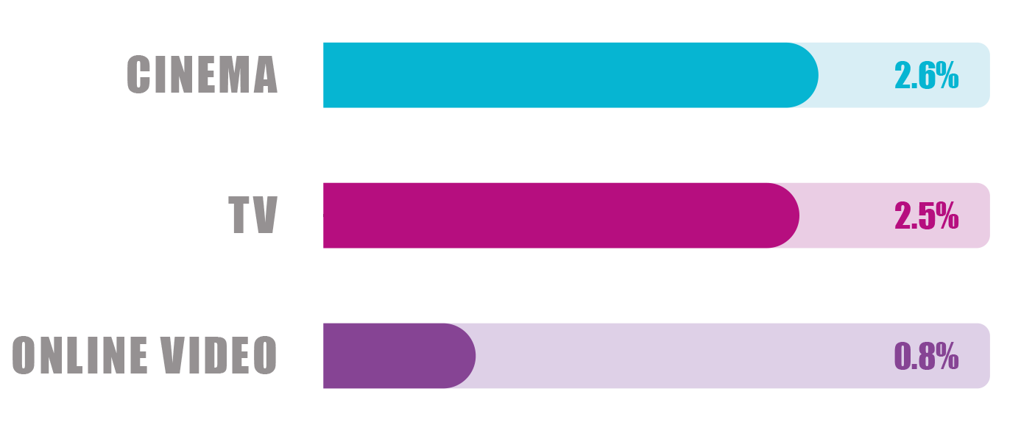
BRAND SALIENCE
Cinema and TV are most valuable AV media contributors to awareness per person reached.
AV Contribution to Brand Salience
AV Channel
Impact
per person
Average
Spend (£m)
Average
Frequency
0.41
1.8
1.89
10.0
0.37
5.0
Source: Kantar CrossMedia Database, European data
Awareness KPI: Top of mind, prompted brand awareness, communications awareness
Cinema: 68 | TV: 262 | Online Video: 112
Notes:
Analysis of the CrossMedia databank reveals a very positive story for advertising via paid media, with all channels making contributions to brand and campaign awareness.
Cinema and TV have the most significant impact on awareness, delivering average impact of 2.9% and 2.6% per person reached respectively. Unsurprisingly, TV is strong here thanks to its ability to quickly build frequency.
Cinema, as a low frequency channel, obviously doesn’t work in the same way but results indicate here that there is real value in the quality of the exposure delivered by advertising on the big screen. This makes cinema a key addition alongside TV on any AV plan to maximise campaign and brand cut through.
Factor in that cinemagoers are also notoriously lighter TV viewers too and this also enables cinema to deliver incremental reach above the mass audience reach delivered by TV.

Slide 9

Cinema CREATES A BRAND LOVE STORY
“Only love will truly save the world” – Wonder Woman
Notes:
The second key metric is BRAND LOVE.
Love is an important ingredient for brands which are looking to grow – when there is often little separating products in a functional sense, a brand that is more lovable is more likely to be chosen.
When we talk about love – we’re not simply talking about making the brand fuzzy and friendly – that’s fine but it’s actually about trying to build an emotional bond between the brand and the audience. This means that consumers are not only more likely to choose the brand but are actually more willing to pay a price premium for it too.
Think about the way that brands like IKEA and John Lewis have cultivated a culture of ‘love’ around their brand, creating emotional connections with audiences who are now more willing to go to do their shopping there.

Slide 10
The importance of brand love
In a world of myriad choice, loyalty is no longer guaranteed so it’s essential for brands to stand out by winning over the hearts and minds of their customers.
Kantar’s BrandZ™ work has consistently proven across the last decade that brands that are loved grow most rapidly in value.
Creating an emotional connection with their audiences is huge business for brands. Those brands who have scored highest in ‘love’ over the last 10 years have increased in value 8x more than brands who scored low on ‘love’.
By building affinity with audiences, it means they are not only more likely to choose the brand but they’re also more willing to pay a price premium for it. So how can AV media help brands build and foster this all-important brand love?
BrandZ Global Top 100 - 10-Year Value Change
+182%
+52%
+22%
Top Third ‘Love’
‘Love’ Index - 121
Middle Third ‘Love’
‘Love’ Index - 104
Bottom Third ‘Love’
‘Love’ Index - 97
Base: 95 brands valued in the BrandZ Global Top 100 in both 2006 & 2016.
Source: Kantar BrandZ

Slide 11
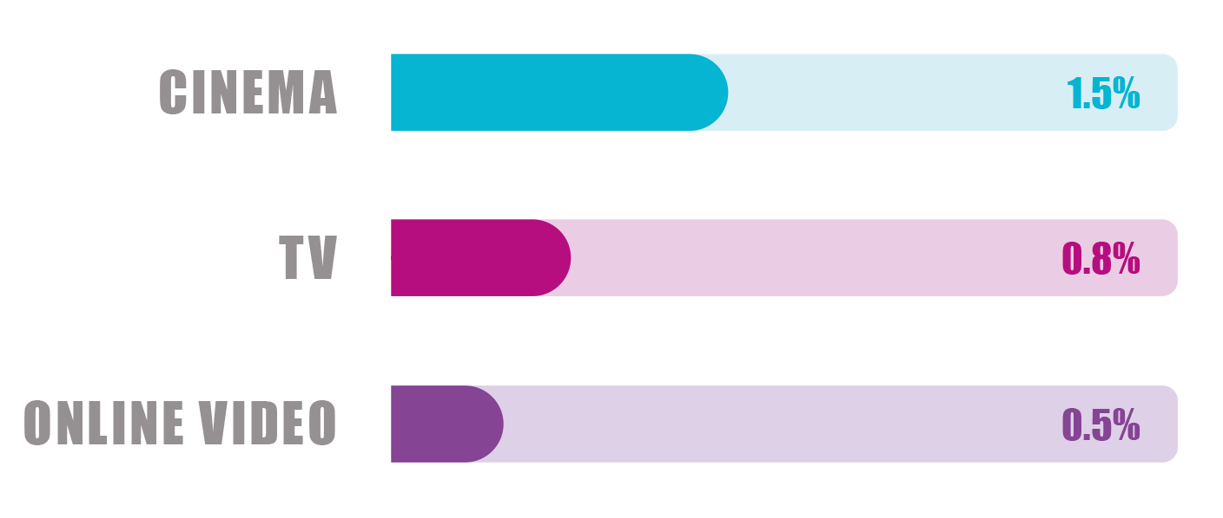
BRAND LOVE
Cinema delivers 3x the impact of online video on brand love and delivers almost twice the contribution of TV per person reached.
AV Contribution to Brand Love
AV Channel
Impact
per person
Average
Spend (£m)
Average
Frequency
0.41
1.8
1.89
10.0
0.37
5.0
Source: Kantar CrossMedia Database, European data
Love metric: Love, meets needs
Cinema: 42 | TV: 122 | Online Video: 55
Notes:
So which channels are best placed to shift this hugely important brand metric?
As you can see all channels can contribute but it’s AV channels and in particular Cinema and TV that are the clear leaders in helping grow brand love.
Nothing is more emotional than great AV content and both channels provide advertisers the chance to tell compelling stories that emotionally engage audiences and create this sense of ‘love’. Factor in the well-targeted audience, high quality experience and positive mind-set you’re in when you’re about to watch a new film and you can understand why cinema is so well placed to drive this particular metric.

Slide 12

Cinema makes brands feel different
“I ain’t never gonna find someone like you” – Fantastic Beasts And Where To Find Them
Notes:
The next metric is BRAND DIFFERENCE. Kantar’s work has consistently shown that brands who are able to differentiate themselves from the competition in a meaningful way are more likely to attract new customers, command loyalty and be able to charge more.
Brands that score highly for Difference are also those that tend to be seen as ‘creative’, ‘in control’ and ‘trustworthy’. It’s not enough to simply be ‘different’: that Difference needs to link to what the brand actually stands for.
A brand which has achieved this really well in the last year is LIDL – they launched a campaign that was creatively different from what the Big 4 was doing, talking about their award winning quality (and not just focusing on price) and this helped build trust in their offering and created stand-out for them in a competitive market, that ultimately helped drive their market share.

Slide 13
The importance of brand DIFFERENCE
Being different is what makes the difference for brands. Standing out from competitors allows brands to justify a price premium that ultimately helps drive faster growth in brand value.
For brands, difference must have the potential to be meaningful to people – to deliver against their needs in a new way that betters what other brands have to offer.
Functional advantage over competitors can be difficult to maintain and therefore gaining emotional advantage is the more sustainable approach, although no less challenging. However, those brands who can achieve this sense of difference will reap the rewards when consumers become predisposed to choosing them over the competition.
As Kantar’s BrandZ™ analysis shows, those brands who rank highest for ‘Difference’ have grown 258% in the last 11 years, compared to those brands in the bottom third who have witnessed just 21% change in value.
BrandZ Global Top 100 - 11-Year Value Change
+258%
+67%
+21%
Top Third ‘Difference’
Middle Third ‘Difference’
Bottom Third ‘Difference’
Base: 85 brands valued in the BrandZ Global Top 100 in both 2006 & 2017.
Source: Kantar BrandZ

Slide 14
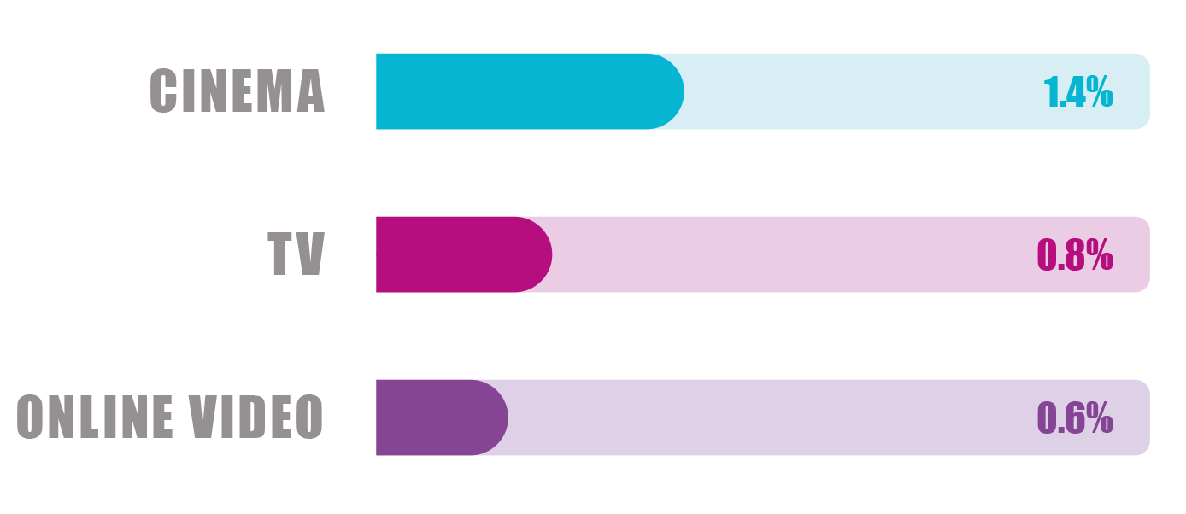
BRAND difference
The engaging, comparatively clutter-free environment provided by cinema helps deliver strong impact on brand difference
AV Contribution to Brand Difference
AV Channel
Impact
per person
Average
Spend (£m)
Average
Frequency
0.41
1.8
1.89
10.0
0.37
5.0
Source: Kantar CrossMedia Database, European data
Difference metric: different to others, sets trends
Cinema: 30 | TV: 102 | Online Video: 64
Notes:
When it comes to brand difference no media has a greater impact than Cinema – it delivers a 2.3% contribution per person reached versus the next best performing channel (Magazines at 1.5%). The engaging, comparatively clutter free environments that these channels provide are the perfect canvas, offering advertisers creative freedom and a sense of “premium” that can also help them land a sense of trust and quality alongside their own communications.

Slide 15

Cinema turns audiences into customers
“I’ve considered every option” - Skyfall
Notes:
The metrics that we’ve covered so far all help brands begin to stand out from the crowd. However the next step on from this – consideration – is arguably the most crucial of them all.
After all someone can be aware of your brand and still not buy your product. It’s therefore essential for advertisers to drive consideration to place themselves in the strongest possible position to convert into sales.
Media selection is then key to ensure that persuasive and engaging messaging is reaching the right people, in the right mindset and making an impact that’s going to drive the brand to the top of the consideration shortlist.

Slide 16
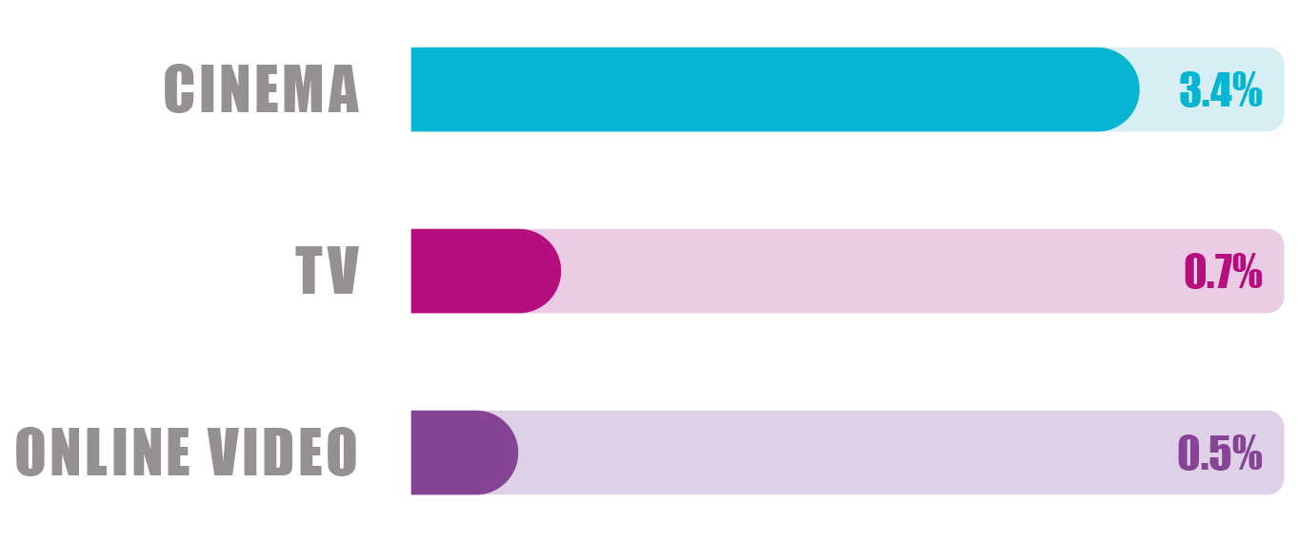
BRAND consideration
Of the AV channels, cinema delivers the biggest impact per person reached on this crucial metric.
AV Contribution Brand Consideration
AV Channel
Impact
per person
Average
Spend (£m)
Average
Frequency
0.41
1.8
1.89
10.0
0.37
5.0
Source: Kantar CrossMedia Database, European data
Very/Quite likely Consideration scores
Cinema: 58 | TV: 229 | Online Video: 110
Notes:
We’ve seen across the other metrics how all media channels are able to influence core brand-building pillars so it follows that are also capable of contributing towards consideration.
Cinema and magazines offer advertisers the opportunity to reach attentive audiences who, on the whole, have paid to engage with content they have an interest in. Factor in a strong creative and it’s no surprise that a compelling message, reaching the right people, can make such a significant contribution to brand consideration levels.
Higher reach media such as TV and OOH do deliver a contribution towards consideration but comparatively aren’t quite as strong. Advertising has to work harder in these environments to engaged and grab someone’s attention, so it’s more of challenge to contribute to consideration.

Slide 17

Cinema wins influential fans for brands
“What do you recommend?” – The World’s End
Notes:
The final key metric is Brand Recommendation – one of the most influential touchpoints in informing the decision-making process that we go through as consumers.
In a world where people are becoming more skeptical and less trusting of brand messaging receiving a recommendation is a substantial factor in deciding which brands we should give our time and money to.
Winning brands are those that are able to build a loyal fanbase who will happily spread the word – think about the power of the Beliebers, tirelessly working to support and promote the brand that is Justin Bieber. If a brand can create a fanbase it becomes a great asset to leverage as part of campaigns.
Technology brands in particular are quite good in this area – think about Apple which has cultivated a strong sense of loyalty among its customers. They will happily promote the products, talk about new launches and all at no cost to the brand.
In terms of which channels can help drive talkability and recommendation…

Slide 18
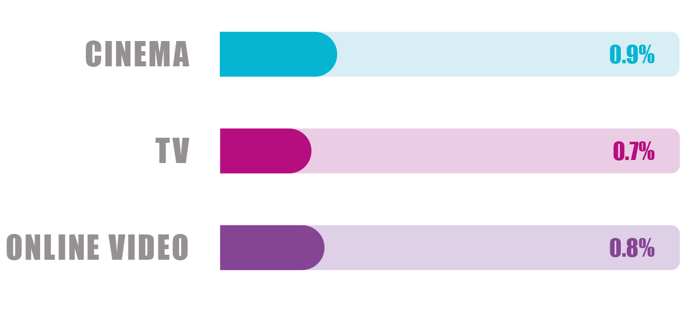
BRAND recommendation
All three AV channels can help brands drive recommendation all delivering average contributions of a similar level per person reached.
AV Contribution to Brand Recommendation
AV Channel
Impact
per person
Average
Spend (£m)
Average
Frequency
0.41
1.8
1.89
10.0
0.37
5.0
Source: Kantar CrossMedia Database, European data
How likely are you to recommend ‘Brand X’ to friends or family?
Cinema: 26 | TV: 106 | Online Video: 39
Notes:
Magazines and cinema again prove their worth, delivering the biggest contributions per person reached towards recommendation at 1.5% and 1.3% respectively. All other channels do, on average, contribute to recommendation but to a lesser degree.
Both cinema and magazines provide advertisers the opportunity to target audiences who are socially savvy and happy to talk about the brands they’ve experienced or heard about. The ad break is part of the cinemagoing experience for many so it’s no surprise it gets them talking – especially when a brand or campaign ignites their interest.
An example of a campaign currently running in cinemas that taps in to the idea of buzz and talkability is this campaign from YouTube…

Slide 19

“BRACE FOR IMPACT”
CHESLEY SULLENBERGER, SULLY
Notes:
So we’ve seen throughout the presentation that all media channels can play a valuable role on the media plan to ultimately help create powerful brands and within this cinema remains unbeatable across the majority of metrics – advertisers should view the channel not as a ‘nice to have’ but as a ‘must have’ addition to their media mix.

Slide 20
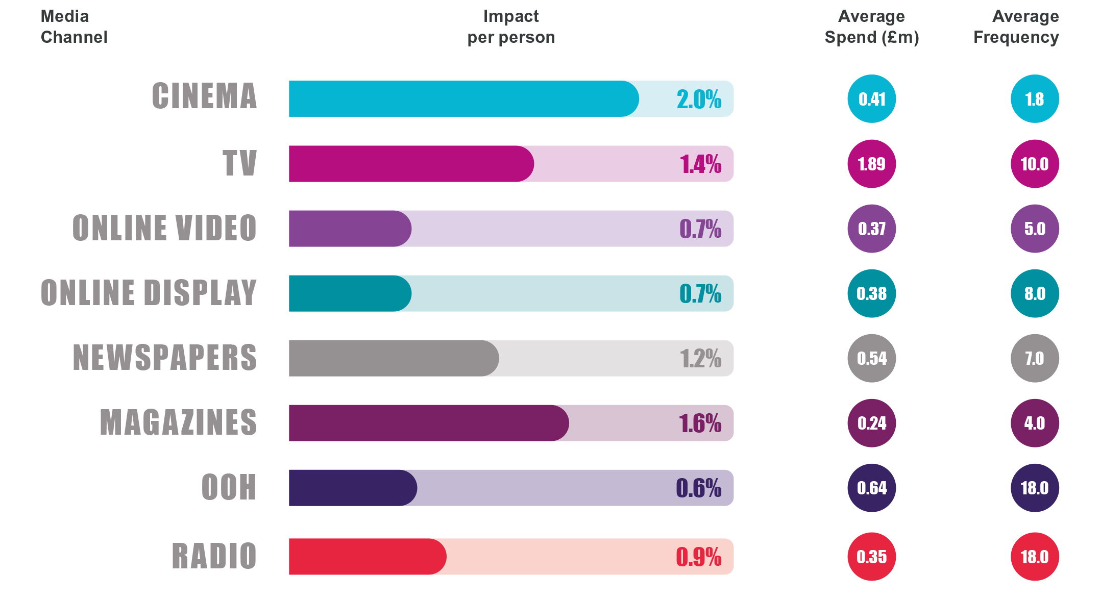
TOTAL BRAND KPI
Cinema, magazines and TV are the biggest contributors across the key brand-building pillars
Source: Kantar CrossMedia Database, European data
Cinema: 71 | TV: 268| Online Video: 115 | Online Display: 232 |
Newspapers: 76 | Magazines: 53 | OOH: 163 | Radio: 78
Notes:
Looking at an average across the core awareness, engagement and consideration measures we see that cinema delivers the biggest contribution, per person reached, of all media channels to the metrics that are going to help build stronger brands.

Slide 21
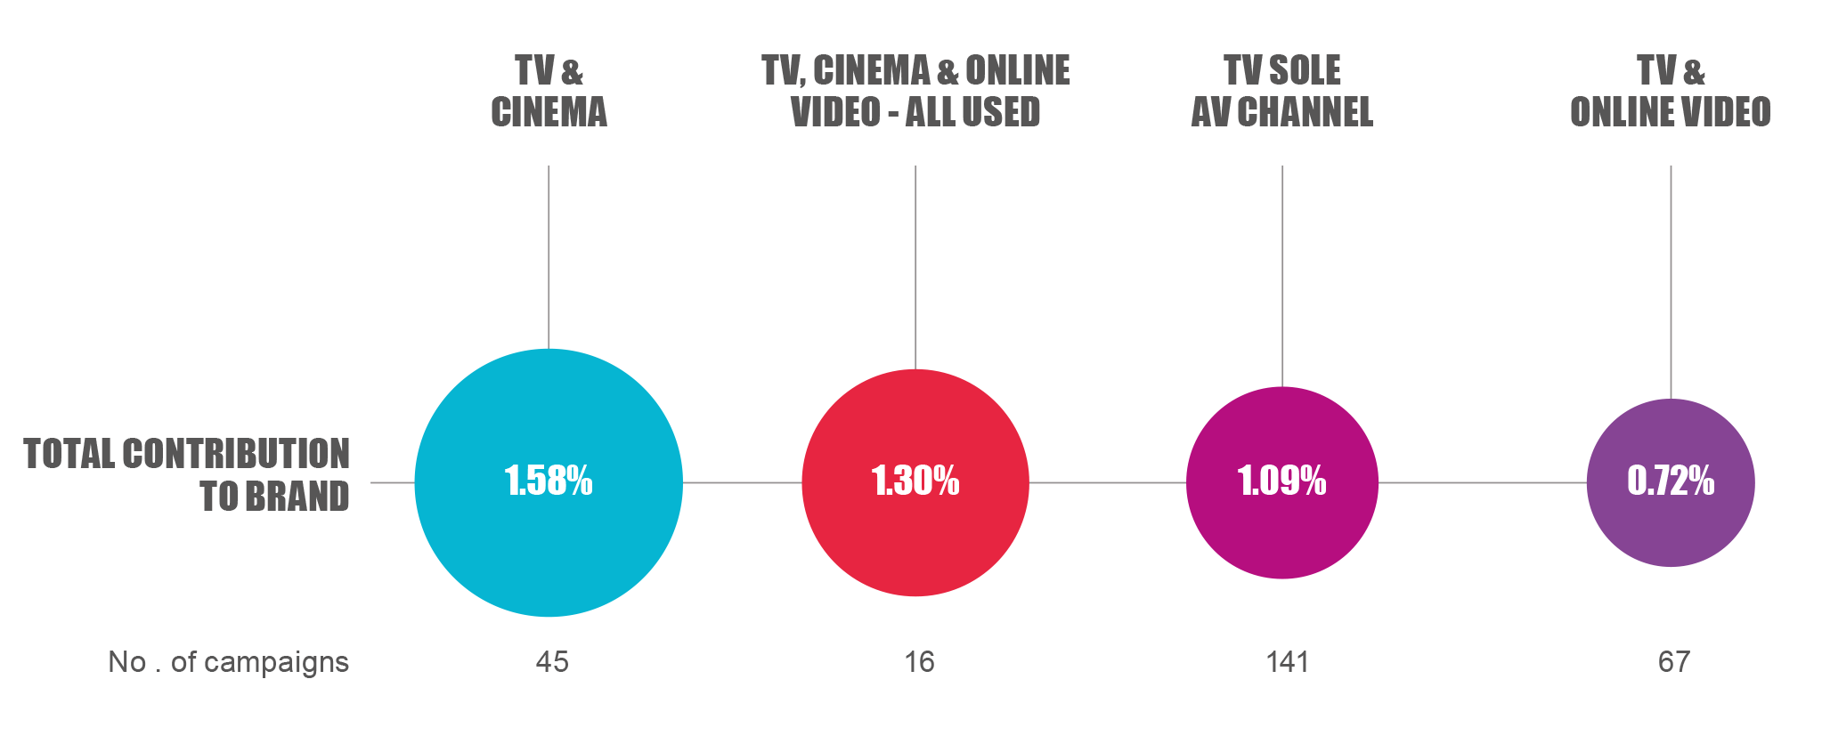
THE IMPACT OF AV CHANNELS
Analysis demonstrates how adopting a multi-screen strategy that has cinema in the mix can have the greatest influence and contribution towards brand building metrics.
Source: Kantar CrossMedia Database, European data
Online video includes VOD
Notes:
On average, Telecoms brand see a return of £3.29 for every £1 spent on cinema.
This is the second biggest return of all channels, behind only Magazines at £5.68.
From an AV perspective, cinema delivers £1.75 more than VOD and almost a £1 more than TV per pound invested.

Slide 22
Five key takeaways
1. CINEMA MAKES BRANDS
MEMORABLE
2. CINEMA CREATES
A BRAND
LOVE STORY
3. CINEMA MAKES BRANDS FEEL DIFFERENT
4. CINEMA TURNS AUDIENCES INTO CUSTOMERS
5. CINEMA WINS INFLUENTIAL FANS
FOR BRANDS
Notes:
So to summarise, cinema can play a key role in the media mix and delivers strong contributions towards Brand Awareness, Love, Difference, Consideration and Recommendation – helping brands become stronger and more powerful as a result.

Slide 23
implications
Cinema can deliver significant impact for brands and should be an essential part of the AV mix. These results can help inform the planning of your next campaign in three ways:
1
2
3
CINEMA SHOULD BE INCLUDED ON EVERY BRAND’S AV SCHEDULE
CINEMA SHOULD BE PLANNED AS ‘APPOINTMENT TO VIEW’ PROGRAMMING
Maximise
cinema
creativity

Slide 24
Thank you
Notes:
Thank you very much for your time today.
Does anybody have any questions they’d like to ask?

