Slide 1
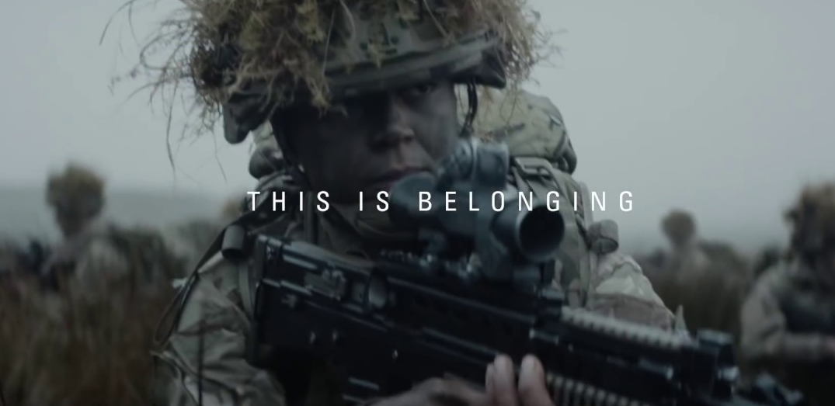
CASE STUDY – THE BRITISH ARMY
‘This is Belonging - 2018’
Background
In 2018, amidst diminishing recruitment levels and traditional stereotypes of masculinity, the British Army wanted to attract a broader range of new soldiers from a variety of backgrounds. The Army wanted to show it is a modern organisation that is changing to reflect the diverse Britain it represents – it is open to everyone, regardless of race, religion, gender or sexuality.
Plan
‘Having my Voice Heard’ was the latest creative of the Army's wider ‘This is Belonging’ recruitment initiative. The 40” copy closely followed a young, black, female Captain in action, leading and instructing her platoon of troops.
Cinema’s young, highly engaged and captive audience made it a must have for the Army. The ad contained no dialogue, meaning it needed to immerse audiences to effectively communicate its emotive message. The recent introduction of 4DX technology to UK cinemas provided a perfect creative fit, enabling the Army to drive awareness, message take-out and consideration in a unique, engaging and clutter free environment.
A bespoke advert was created and played out before a variety of 4DX titles including Black Panther, Ready Player One and Tomb Raider, each over indexing for the 16-24 audience. A Youth AGP was also bought ensuring the campaign maximised its reach within cinema.
Cinema accompanied TV, Outdoor, Online and Radio as part of national media campaign.
Campaign Details
Sector | Government | Media Agency | Carat
Target Audience | 16-24 Adults | Creative Agency | Karmarama
Package | Youth AGP & 4DX Films | Duration | 40”

Slide 2
CASE STUDY – THE BRITISH ARMY
‘This is Belonging - 2018’
+91% Uplift
x2
Uplift
x9
Uplift
Significant uplift in unprompted comms awareness:
4DX exposed are 91% more likely to be aware of The British Army advertising vs. control
4DX exposed = 84%, 2D cinema exposed = 54%. Control = 44%
Significant uplift in consideration:
4DX exposed are over 9x more likely to consider joining the Army vs. control (2 ½ x more likely than 2S exposed)
Extremely likely: 4DX = 46%, 2D cinema exposed = 18%, Control = 5%
Driving key perceptions further:
4DX exposed are 34% more likely to agree soldiers in the ‘British Army feel like they belong’ and 77% more likely to agree that ‘Being in the British Army empowers you’ vs. control
Top 3 agree: Cinema Top 3 agree (10 point scale) - 4DX exposed = 62%, 2D cinema exposed = 43%, Control = 35%
SUMMARY
The immersive nature of 4DX helped the Army achieve greater campaign cut through and effectively drive awareness, land key messages and increase audience consideration.
Source: DCM / The British Army. Conducted by; Differentology, January - March 2018. Base: 16-34 adults.
Agree statements out of 10

