Slide 1
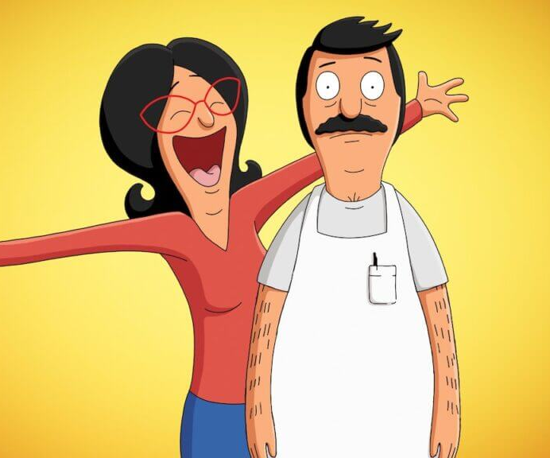
bob’s Burgers
An animated sensation comes to cinemas
Release Date
27 May
Cast
H. Jon Benjamin, Kristen Schaal, Dan Mintz
Director
Louren Bouchard, Bernard Derriman (Feature Debut)
Recommended if you like
x
Reasons to buy into
x
Key audience info
x
Est. DCM admissions
x
Feature-length adaptation of the much-loved animated TV show.
Plan your campaign

