Slide 1
BAFTA’s
BEST OF BRITISH
ODEON Partnership Opportunity

Slide 2
BAFTA’s Best of British @ ODEON Cinemas
A NEW CINEMA SUB BRAND CHAMPIONING BRITISH FILM & PROVIDING EXPOSURE FOR THE FILMMAKERS OF TOMORROW
Notes:
All elements on this page (not including the logo) should be 0.50cm away from each other

Slide 3
BAFTA’s Best of British @ ODEON Cinemas
An opportunity to partner with two icons of the British film industry
WE MAKE MOVIES BETTER BY CREATING INSPIRING ENTERTAINMENT EXPERIENCES FOR EVERY GUEST
CHAMPION THE ARTS, INDUSTRY AND TALENT; INSPIRE NEW AND UNHEARD VOICES TO BECOME THE FUTURE OF FILM
Notes:
All elements on this page (not including the logo) should be 0.50cm away from each other

Slide 4
BAFTA’s BEST OF BRITISH
BAFTA & ODEON are collaborating on an exciting new sub brand, and partnership opportunity, that celebrates British film making in all its guises. From Actors and Directors through to British storytelling, Best of British will shine a light on Britain's rich history in film making whilst also providing a short film platform for the talent of tomorrow.
Best of British will be a national program of films across ODEON’s estate, curated by ODEON and BAFTA’s film teams. The screenings will be held every two weeks at the same time on the same day to aid the audience journey & establish viewing habits.
Promotion for this exciting new sub brand will be conducted across ODEON’s on & off screen channels including screentime trailering, web and social plus BAFTA’s social channels, all of which the partner will be include on.
Best of British will initially run for 6 months starting in April 2025.
Notes:
The line underneath the header should be 0.50cm away from the header
The sub header is 0.50cm beneath the line
The copy should then be 1cm away from the sub header

Slide 5
BAFTA’s Best OF BRITISH
BAFTA & ODEON’s film teams will curate a program that celebrates the best of British Film Making old and new. Films could include:
Conclave
Rye Lane
1917
Trainspotting
Ex Machina
Saltburn
Notes:
The line underneath the header and the body copy should be 0.50cm away from each other

Slide 6
Short Films
Short films play a huge part in the film industry. They offer a unique space for creative experimentation, allowing filmmakers to tell concise, impactful stories with less production pressure, often featuring fresh ideas and perspectives, while also serving as a valuable tool for developing skills and showcasing talent to potential collaborators on larger projects.
Best of British will offer an incredible big screen platform for some of the best British shorts, which will play out ahead of each ‘Best of British’ feature.
The short films will be hand picked by BAFTA from its list of previous BAFTA winners and nominee’s.
Example Short Films:
Jellyfish & Lobster – 2024 Best Short Film
An Irish Goodbye – 2023 Best Short Film
Crab Day – 2024 Best Animated Short
The Boy, The Mole, The Fox and The Horse – 2023 Best Animated Short
Notes:
The line underneath the header should be 0.50cm away from the header
The sub header is 0.50cm beneath the line
The copy should then be 1cm away from the sub header

Slide 7
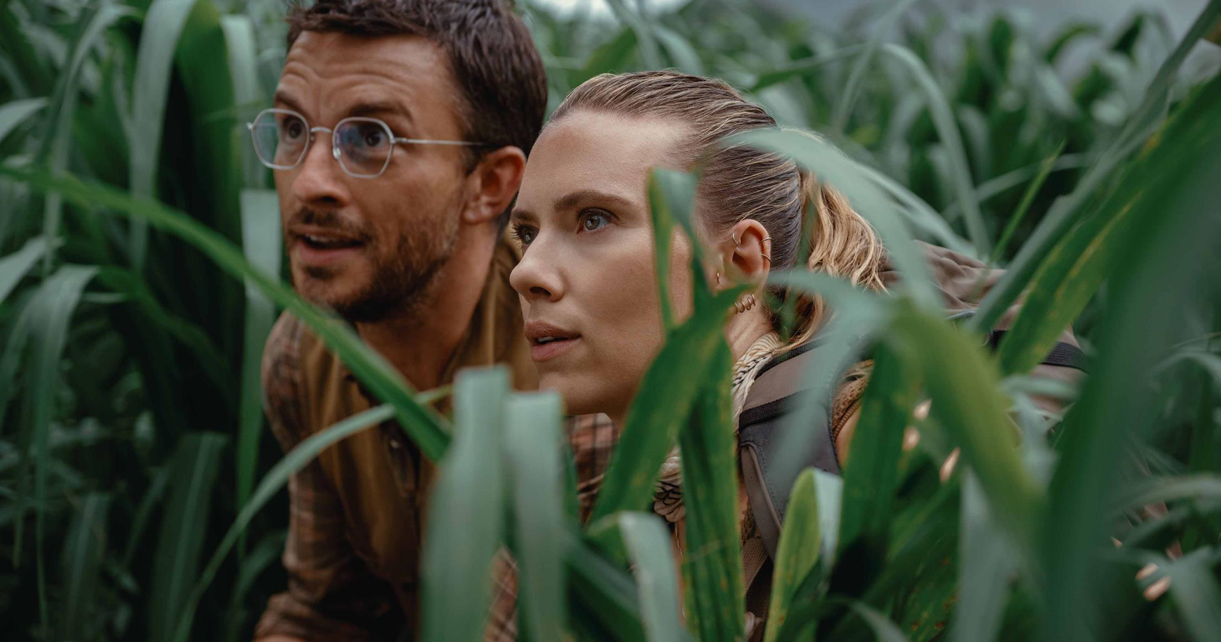
abc1 – THE LIKELY AUDIENCE FOR BAFTA’s BEST OF BRITISH
Affluent cinemagoers are more likely to be in market for new tech, a holiday and innovative household items.
xx
55% agree they like innovative cars
(Index: 195)
‘I buy new products before most of my friends’
(Index: 235)
55% plan to book a holiday in the next year
(Index: 105)
‘I'm always looking for new ideas to improve my home’
(Index: 145)
‘I spend a lot of money on toiletries and cosmetics for personal use’
(Index: 163)
‘I like innovative household devices and appliances’
(Index: 151)
Beauty and styling products help me feel good about myself
(Index: 132)
More likely to be interested in innovations in cosmetics
(Index: 210)
Notes:
The line underneath the header should be 0.50cm away from the header
The sub header is 0.50cm beneath the line
The copy should then be 1cm away from the sub header

Slide 8
6-month Partnership Assets & Budget
On Screen – ODEON Only
30” Brand Ad – ABC1 Adults AGP across ODEON Estate, 7.5m Admissions*
30” Best Of British co-branded trailer in all ABC1 Adult films, 7.5m Admissions*
60” Gold Spot in all Best of British films, Admissions TBC
Online www.odeon.co.uk
Dedicated Best of British landing page - cobranded.
2 weeks inclusion in home & cinema page Carousel – cobranded.
CRM
1 x launch mailer - cobranded
6 x newsletter inclusions - cobranded
6 x Whats On mailer inclusions - cobranded
ODEON App push notifications - cobranded
Social
6 x social posts (facebook, Instagram, twitter)
Tickets
- 50 complimentary tickets per month to Best Of British screenings for brand to distribute.
Budget - £527k net + £50k production*
Total Admissions + Impressions – 12.6m*
*Please see accompanying media plan for full detail
Notes:
The line underneath the header should be 0.50cm away from the header
The sub header is 0.50cm beneath the line
The copy should then be 1cm away from the sub header

