Slide 1
AWARDS SEASON
2023

Slide 2
ENGAGE THE PUREST UPMARKET AUDIENCE IN MAINSTREAM ENTERTAINMENT

Slide 3
AWARDS SEASON 2023
At the start of every new year, the world of film transforms. Focus shifts towards more artistic and thought-provoking titles, in celebration of the craft of film making.
Film titans and new comers from across the industry come together to exhibit their best work at the cinema in hope of success at the Awards Season. The quality of content is second to none, generating buzz across the world as millions tune in to experience the best in film.
As the world of film transforms, so too does the make-up of the cinema audience. The Awards Season attracts an even more upmarket and discerning audience to the cinema – perhaps the purest upmarket audience in mainstream entertainment.
The Awards Season Sponsorship offers the partner brand an exclusive opportunity to create fame in line with this year’s greatest content and the upmarket audience that consumes it.
The Sponsorship package is carefully selected based on industry tips, and early critic reviews from film festivals such as TIFF and LFF. Your brand would buy into a premium position across these films with options to either run in the Gold Spot (the final commercial message before the film) or the Silver Spot (the final message before the trailers).
Our work with brands in recent years has demonstrated that contextually relevant messaging unlocks disproportionate shifts in key brand metrics, allowing advertisers to make the most of their cinema campaigns. The Awards season package is an opportunity for your brand to add to the audience’s experience through bespoke content created by DCM Studios to engage and excites audiences before the incredible films begin.

Slide 4
THE AWARDS SEASON PACKAGE
The perfect platform to shift perceptions of your brand, create fame, and to engage an upmarket audience
ENGAGE AN UPMARKET AUDIENCE
ALIGN WITH HIGH QUALITY CONTENT
THE PERFECT PLATFORM
Engage an ABC1 audience across a breadth of high quality titles.
The predicted ABC1 profile for the Awards Season package based on 8 awards hopefuls is 78%.
Build an association between your brand and high quality, artistic and culturally significant moments in film.
The Awards Season represents the best in film, and is a powerful platform to shift perceptions of your brand.
Cinema’s ability to grab and hold attention is unmatched, which, combined with the impactful nature of the big screen means that cinema is the perfect platform to tell stories and build an emotional connection with your customers.

Slide 5
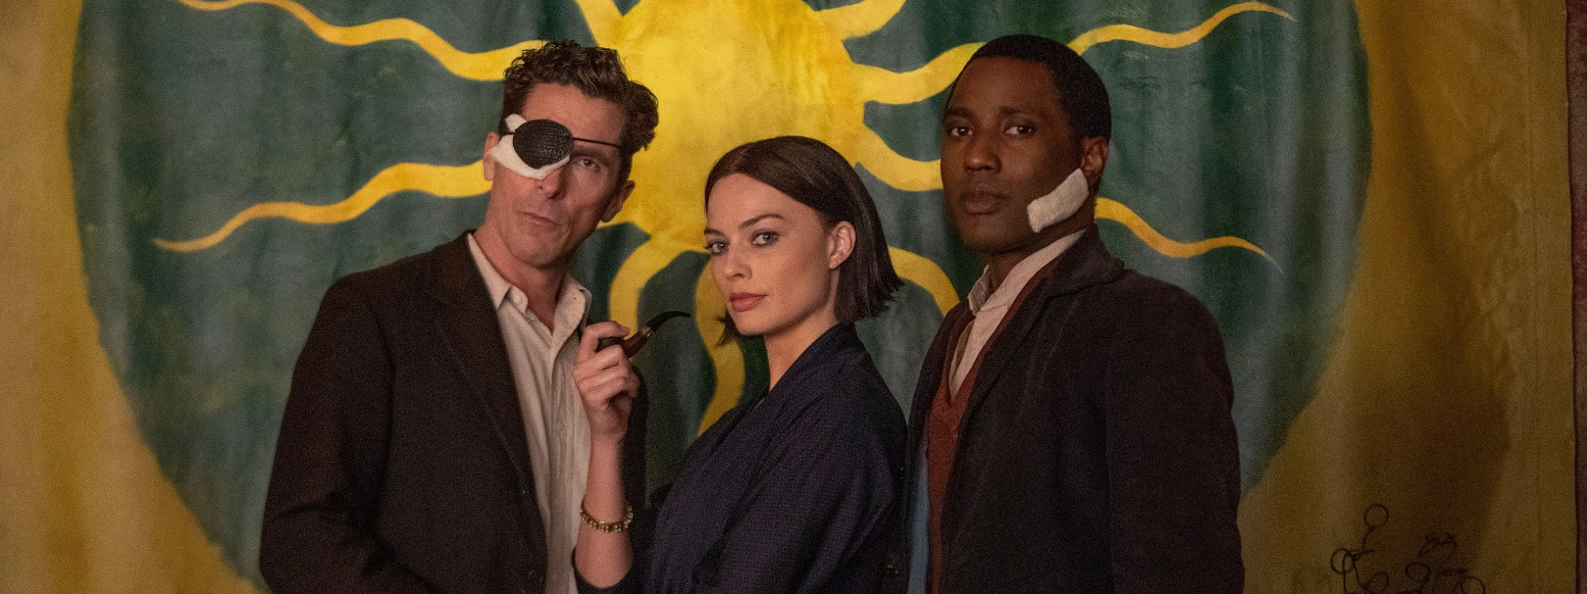
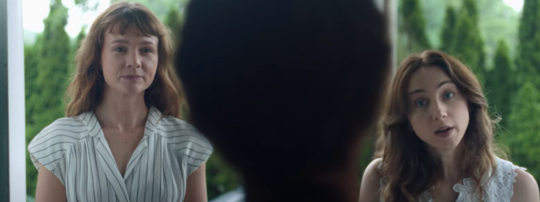
THE AWARDS BUZZ…
With strong competitors both in-front and behind the camera, this awards season is one with an emphasis on the artistry of film
With cinema coming back into full swing, the Academy Awards are as competitive as ever with titles across the UK and US all contending for awards. Across all the competition comes a theme of a love of the arts, be it music, writing, or especially cinema.
Films focusing on cinema document the history of film through the creation of their own mythologies, such as 1930s Hollywood drama Babylon and Empire of Light, a love story that is both about and takes place in a cinema in the 1980s. Similarly from prolific director Steven Spielberg comes The Fabelmans, an autobiographical adaptation of his childhood and burgeoning interest in film. These films will make up a large bulk of the admissions.
With an emphasis on music comes Whitney Houston musical biopic I Wanna Dance With Somebody and TAR, which follows the rise of a renowned orchestra conductor as played by two-time Academy Award winner Cate Blanchett. Also releasing is She Said, an adaptation of the Pulitzer Prize-winning article by the two female journalists who exposed Harvey Weinstein.
Elsewhere, acclaimed director David O’Russell also returns to the big screen with Amsterdam, starring an equally acclaimed cast that is sure to dazzle. Debuting earlier this year at the Sundance Film Festival to glowing reviews is Bill Nighy-led Living.
Amsterdam - 4 Nov
Living - 11 Nov
She Said - 18 Nov

Slide 6
REACHING AN UPMARKET CINEMA AUDIENCE
Awards Season delivers a higher share of affluent ABC1 cinemagoers vs. the average film profile, with a predicted average at 78% across these 8 titles
Average %
Cinema goers ABC1 Adult Profile:
55%
SOURCE: FILM MONITOR DATA 2021
TOUCHPOINTS 2020 ‘Have been to the cinema in the last 12 months’.

Slide 7
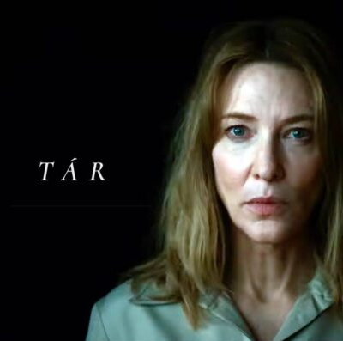
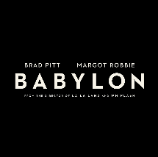
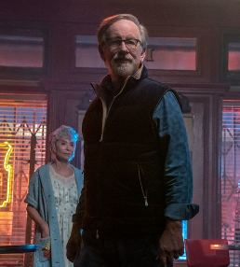
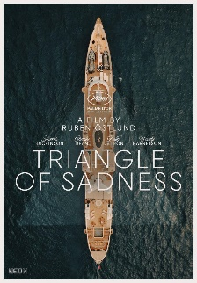
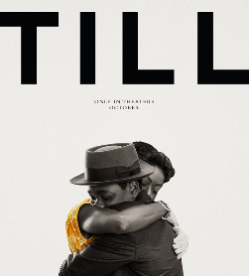
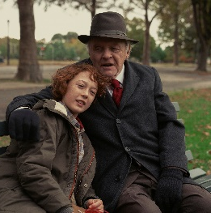
AWARD TITLES Q4 2022 & Q1 2023
Banshees of Inisherin
21st Oct
Living
11th Nov
Empire Of Light 13th Jan
Women Talking 10th Feb
Aftersun
18th Nov
Tar
20th Jan
OCT
NOV
DEC
JAN
FEB
MAR
Babylon 20th Jan
Amsterdam
4th Nov
She Said 25th Nov
I Wanna Dance With Somebody 23rd Dec
The Fablemans
27th Jan
Decision To Leave
18th Oct
Till
13th Jan
Triangles of Sadness
28th Oct
Armageddon Time 18th Nov

Slide 8
GOLD OPTION
(7 FILMS, 23/12 ONWARDS)
ADMISSIONS: 4.7m
RATECARD MEDIA: £1.6m

Slide 9
SILVER OPTION
(7 FILMS, 23/12 ONWARDS)
ADMISSIONS: 5.4m
RATECARD MEDIA: £1.5m

Slide 10
GOLD OPTION
(14 FILMS, 17/10 ONWARDS)
ADMISSIONS: 5.7m
RATECARD MEDIA: £2m

Slide 11
SILVER OPTION
(14 FILMS, 07/10 ONWARDS)
ADMISSIONS: 6.2m
RATECARD MEDIA: £1.9m

Slide 12
SUPPORTING INFO

Slide 13
CINEMA’S ABILITY TO GRAB AND HOLD ATTENTION IS UNMATCHED ACROSS THE MEDIA LANDSCAPE
ATTENTION COMBINED WITH A HIGH IMPACT FORMAT ALLOWS ADVERTISERS TO CREATE EMOTIONAL CONNECTIONS TO SHIFT KEY BRAND METRICS
BRANDS THAT GO ONE STEP FURTHER, LANDING THEIR MESSAGE WITH CONTEXTUAL RELEVANCE UNLOCKS EVEN GREATER SHIFTS IN BRAND PERCEPTIONS

Slide 14
CINEMA’S ABILITY TO GRAB AND HOLD ATTENTION IS UNMATCHED
A far greater proportion of your ad will be watched in cinema vs. views on other channels.
24” of a 30” advert is viewed in cinema versus 14” of a 30” on TV.
Average view time in seconds:
LUMEN NORMS
81% OF TOTAL
ATTENTION
80% OF TOTAL
ATTENTION
46% OF TOTAL
ATTENTION
28% OF TOTAL
ATTENTION
30% OF TOTAL
ATTENTION
31% OF TOTAL
ATTENTION
12% OF TOTAL
ATTENTION
13% OF TOTAL
ATTENTION
7% OF TOTAL
ATTENTION
Source: Lumen Attention Research Project April 2022 / Onscreen Ad Impressions: Cinema Ads = 1,347 | Norms Source: TV data = Tvision / YouTube, Facebook, OOH, Display data = Lumen Research

Slide 15
The DEPTH OF VISUAL attention PAID to cinema ads is unmatched
Cinema delivers significantly longer cumulative viewership vs other AV formats
Cinema ads
YouTube Non-Skippable 15/20”
TV 30”
YouTube 6s Bumper
FB Infeed

Slide 16
CINEMA DELIVERS significant uplifts across KEY brand metrics
Tapping into our cinema effectiveness databank of 54 campaigns measured by Differentology we can see cinema’s impact on key brand metrics
AD AWARENESS +17%
BRAND PERCEPTIONS
+19%
CONSIDERATION+16%
RECALL
+50%
BETTER BRAND IMPRESSION +25%
INTENTION TO ACT
+23%
Source: Source: Differentology, databank of 54 cinema campaign effectiveness studies. Uplifts between those exposed to the ad in cinema vs. those not exposed to ad in cinema (Demographically matched groups). Top 3 agree scores reported for perceptions, consideration and brand impression

Slide 17
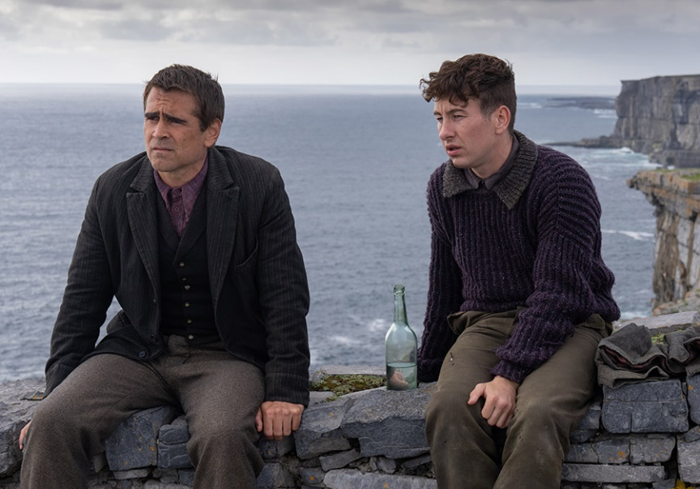
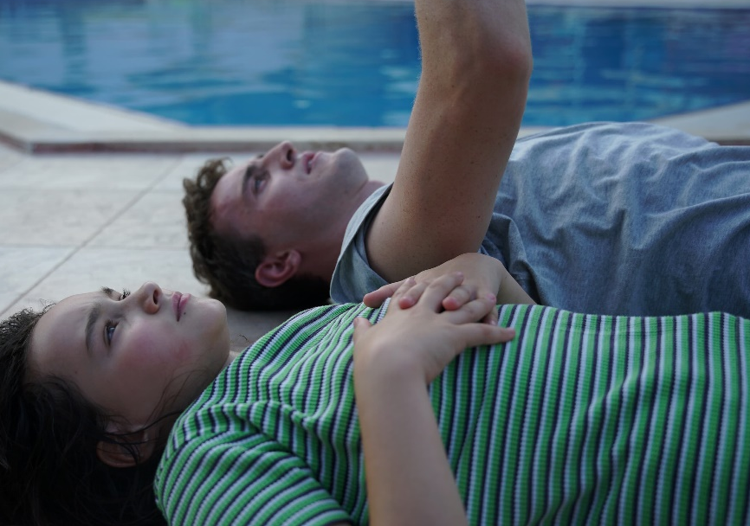
CINEMA IS THE BEST PLACE FOR BESPOKE CONTENT
RICH FILM CULTURE
UNIQUE AUDIENCE MINDSET
UNRIVALLED VIEWING EXPERIENCE
Film is a culture in itself.
There is a wealth of cultural stimulus and emotion for brands to riff off with bespoke and contextually relevant content.
The cinema audience come to be entertained.
The cinema audience have an open mindset. They want to be entertained, by the film, the trailers, and the advertisers.
Cinema provides the best viewing experience.
This is the purest video format ever invented, delivering a high quality viewing experience to an attentive audience. Cinema is truly unrivalled by any other media format.

Slide 18
CONTEXTUALLY RELEVANT CONTENT ENHANCES THESE SHIFTS IN BRAND METRICS
Meta-analysis of 22 recent cinema campaigns & 7 contextual/bespoke campaigns
Quality Brand Perceptions
Brand Consideration
+38%
+55%
+20%
+33%
Source: Differentology data bank. Meta-analysis consists of 22 campaigns and 7 bespoke campaigns.

Slide 19
FILM CONTENT
SOME OF THE HIGHLIGHTS

Slide 20
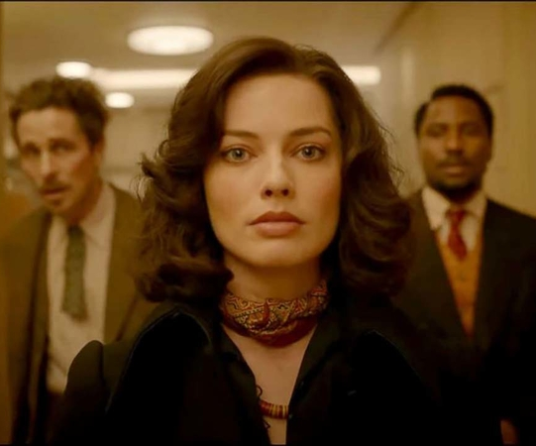
Amsterdam
An incredible story with an even more incredible cast
Release Date
4th November
Cast
Christian Bale, Margot Robbie, John David Washington, Robert De Niro
Director
David O’Russell (Silver Lining’s Playbook, American Hustle)
Est. DCM admissions
703k
Based on an unbelievable true story, three friends in the 1930s become suspects in a murder investigation and go on to uncover one of the most outrageous plots in American History. It features a stacked cast with 16 Oscar nominations between them, and its leads Christian Bale, John David Washington, and Margot Robbie are some of the most celebrated actors of the last decade. Director David O'Russell alone has 5 Oscar nominations, leading us to believe this could be the season he wins.

Slide 21
Living
An adaptation of a classic
Release Date
11th November
Cast
Bill Nighy, Aimee Lou Wood, Tom Burke
Director
Oliver Hermanus (Beauty, Moffie)
Est. DCM admissions
255k
An adaptation of the classic Japanese film Ikiru, Bill Nighy stars as a banker faced with his own mortality as he questions what makes a life worth living. First premiering at the 2022 Sundance Film Festival, with critics Peter Bradshaw calling it a “gentle, exquisitely sad film” and Peter Debruge saying it is “undeniably moving”. With Nighy as a two-time BAFTA award winner, it seems likely that he will once again be nominated for an award with them.

Slide 22
SHE SAID
The incredible true story behind the start of the #MeToo movement
Release Date
18th November
Cast
Carey Mulligan, Zoe Kazan, Patricia Clarkson
Director
Maria Schrader (Love Life, Unorthodox)
Est. DCM admissions
402k
Based on the true story of the two Pulitzer-prize winning New York Times journalists who
exposed one of Hollywood's greatest cover-ups; Harvey Weinstein. Carey Mulligan, Oscar
nominee for fellow feminist film Promising Young Woman, stars alongside Zoe Kazan as
the film depicts the beginning of the #MeToo movement and the decades of trauma
that led to it. Following in the footsteps of Bombshell, which won one Oscar and received
three nominations, She Said is almost certain to be nominated.

Slide 23
I wanna dance with somebody
The late musical icon Whitney Houston is immortalized in film
Release Date
23rd December
Cast
Naomi Ackie, Stanley Tucci, Ashton Sanders
Director
Kasi Lemmons (Talk To Me, Harriet)
Est. DCM admissions
1m
Based on the incredible life of one of the best-selling musicians of all time, Whitney Houston, Naomie Ackie stars as the film documents her rise to stardom. The screenplay is written by Academy Award Nominee Anthony McCarten, who received the nomination for another acclaimed musical biopic, Bohemian Rhapsody. It’s received approval from the Houston estate ability to use all of her music including the titular song and Grammy-winning “I Will Always Love You” and to be an honest and empathetic depiction of the star that’s sure to stir awards buzz.

Slide 24
Empire Of Light
A love letter to cinema that must be seen on the big screen
Release Date
13th January
Cast
Olivia Colman, Michael Ward, Colin Firth, Toby Jones
Director
Sam Mendes (Spectre, Skyfall, 1917)
Est. DCM admissions
2m
A tale of romance in 1980s Margate at a beautiful old cinema, this film will truly be a love letter to the movies. It stars Academy Award winner Olivia Colman as a woman who works at the cinema box office but does not watch the movies themselves, instead observing the audience and how film allows them to feel big emotions that they don’t get to experience in their daily life. It’s directed, written, and produced by Sam Mendes, who has won an incredible 12 Oscars, as well as received 33 nominations, and his exceptional talent is sure to create another incredible film.

Slide 25
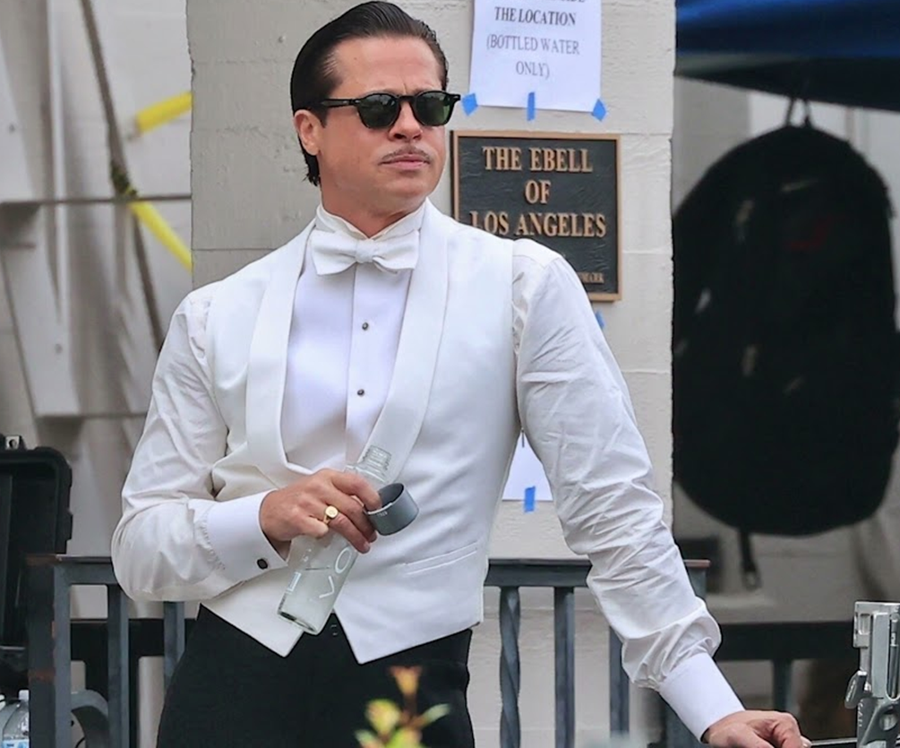
Babylon
An all-star casts brings silent film back to life
Release Date
20th January
Cast
Brad Pitt, Margot Robbie, Tobey Maguire
Director
Damien Chazelle (La La Land, Whiplash)
Est. DCM admissions
1.5m
A 1930s drama about the greatest transitional stage in the movies: the fall of silent films and the rise of talking pictures. It features a large ensemble cast, led by Brad Pitt as an aging actor and Margot Robbie as rising starlet Clara Bow, and its previews have already begun to garner awards buzz. Damien Chazelle directs, and as the youngest director to win an Academy Award at age 32 for La La Land, it's easy to see Babylon earning even more nominations for him.

Slide 26
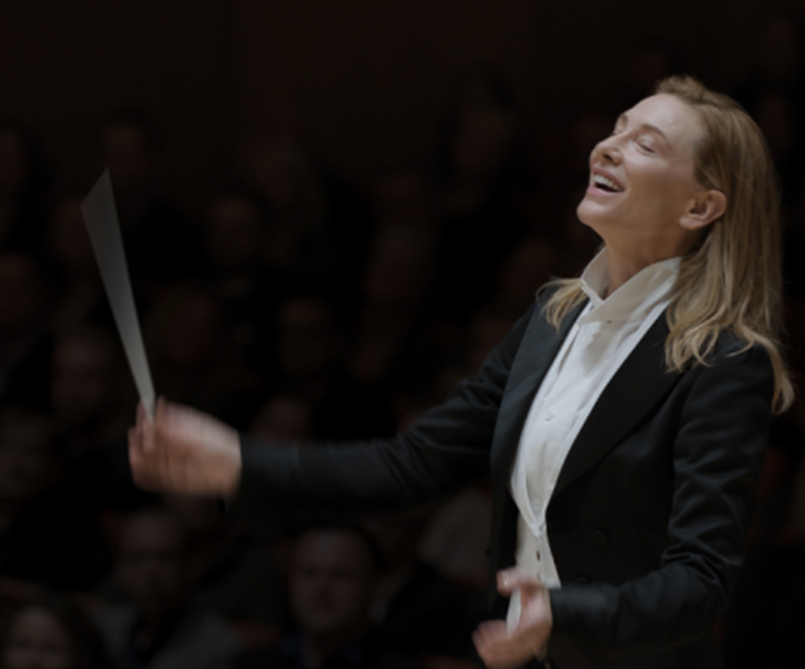
TAR
An intense tale of success already competing at festivals
Release Date
20th January
Cast
Cate Blanchett, Mark Strong, Noemie Merlant
Director
Todd Field (In The Bedroom, Little Children)
Est. DCM admissions
50k
Director Todd Field, who has previously received 8 Academy Award nominations, returns behind the camera for the first time in 16 years to direct the ominous story of a fictional female orchestra conductor whose career begins to unravel when elements seem to conspire against her. The plot is currently still shrouded in mystery, but it will premiere in competition at the Venice International Film Festival. Renowned actress and two-time Oscar Winner Cate Blanchett stars, and this could be the role to snag her another

Slide 27
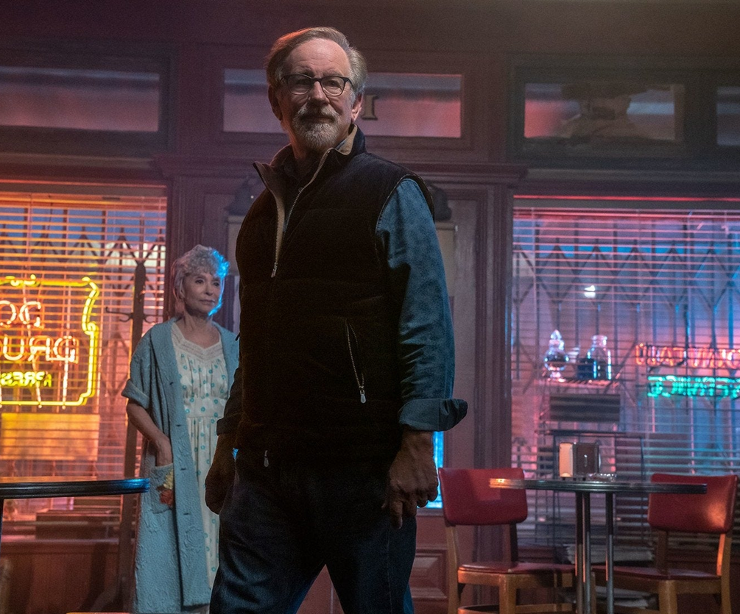
The fabelmans
A movie a lifetime in the making
Release Date
27th January
Cast
Michelle Williams, Paul Dano, Seth Rogen
Director
Steven Spielberg (Indiana Jones, Jurassic Park, Jaws)
Est. DCM admissions
703k
Iconic director Steven Spielberg's next picture is a semi-autobiographical depiction on his childhood in post-WWII Arizona. As one of the most decorated filmmakers in Hollywood, a movie reflecting on what led him to making numerous timeless films is sure to garner awards buzz. While not much is known about the film yet, Spielberg being one of his generations' best storytellers could lead him to winning awards about his own origin story.

Slide 28
THANK YOU!

