Slide 1
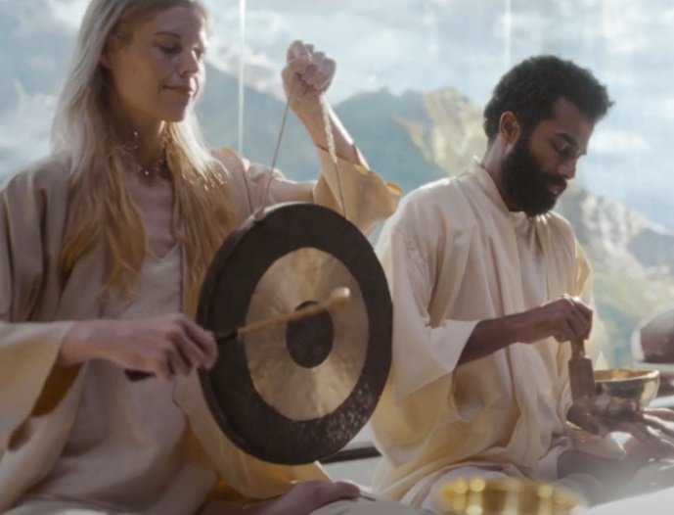
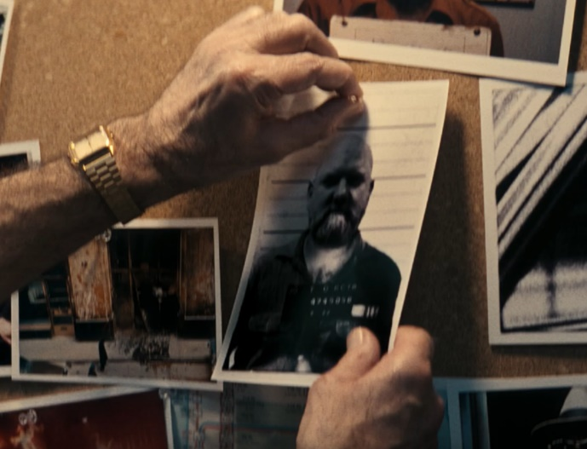
AUDIBLE
DCM AWARDS NOMINEE
Best Long-Term Use of Cinema
‘There’s more to imagine when you listen’’
Background
Audible aimed to increase subscriptions during a time of increasing financial pressure by aligning itself with major cultural moments to reinforce its position as a premium entertainment platform.
Plan
Audible launched the campaign with the Awards Season package, positioning itself alongside the most premium films of the year. The campaign continued into the year, accessing top performing films that amplified the message, ensuring wide-reaching impact.
Results
Cinema improved brand love by +12% and consideration by +20%
Audible saw an uplift in non-member visits by +37% and encouragingly a +25% increase in Audible trials.
Notes:
Source: DCM / AUDIBLE

Slide 2


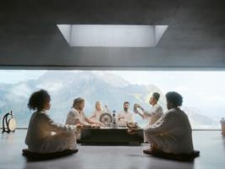
AUDIBLE
DCM AWARDS NOMINEE: Best Long-Term Use of Cinema
MEDIA AGENCY | TARGET | BUYING ROUTE | COPY LENGTH
Wavemaker | 18-34 | Film Packs | 40”
‘There’s more to imagine when you listen’’
BACKGROUND
As the leader in audio storytelling, Audible aimed to increase & sustain subscriptions during a time of increasing financial pressure. With a rich library of original productions featuring cinematic soundscapes, A-list talent, and immersive narratives, Audible wanted to align itself with major cultural moments to reinforce its position as a premium entertainment platform.
PLAN
Audible knew that aligning itself with the power of the big screen would be thematically relevant and enhance the impact of the campaign. Audible strategically linked its brand to cinema’s most premium period, the awards season, positioning itself alongside culturally relevant film releases. The campaign continued into the year, accessing top performing films that would amplify the message, ensuring wide-reaching impact.
RESULTS
Audible benefitted from long-term cinema presence, which ultimately reinforced quality and premium associations, leading to consideration and action:
BOOSTED BRAND INTEREST
Cinema improved brand love by +12% and ad awareness by +3%
INCREASED ACTION & INTENT
Those who saw the ad in the cinema saw a 20% increase in brand consideration. Audible saw an uplift in non-member visits by +37% and encouragingly also saw a +25% increase in Audible trials
Notes:
Source: DCM / AGE UK

