Slide 1
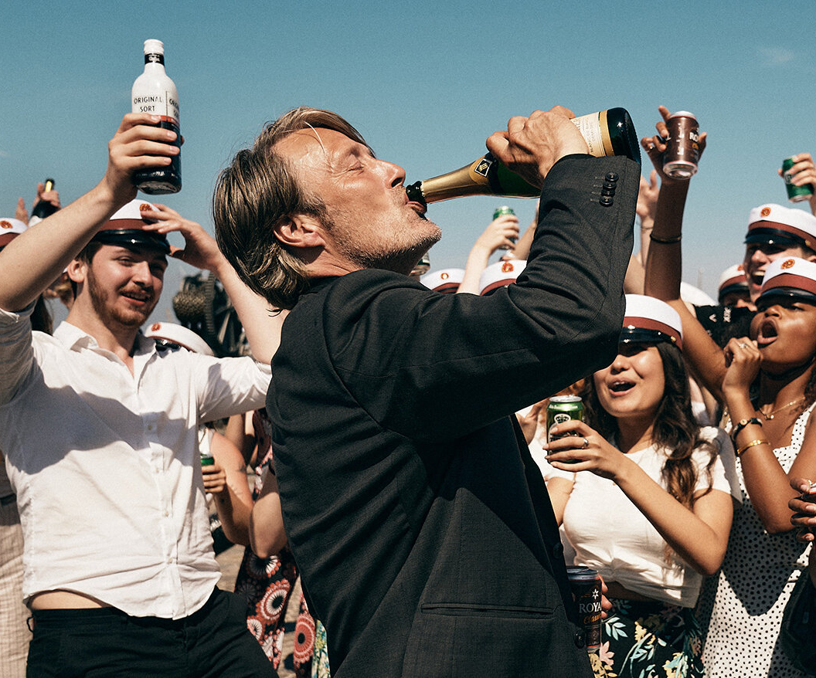
Another Round
A woozy, Award-winning European drama
Release Date
2 July 2021
Cast
Mads Mikkelsen, Thomas Bo Larsen, Magnus Millang
Director
Thomas Vinterberg (Far From the Madding Crowd)
Recommended if you like
The Hunt
Reasons to buy into
This drama has already acclaimed critical and audience praise from a variety of festivals, and has been nominated for Best International Film and Best Director at the upcoming Oscars.
Key audience info
ABC1 Men Index: 170
Est. DCM admissions
21k
Four former high-school teachers test a theory that they will improve their lives by maintaining a constant level of alcohol in their blood.
Plan your campaign

