Slide 1
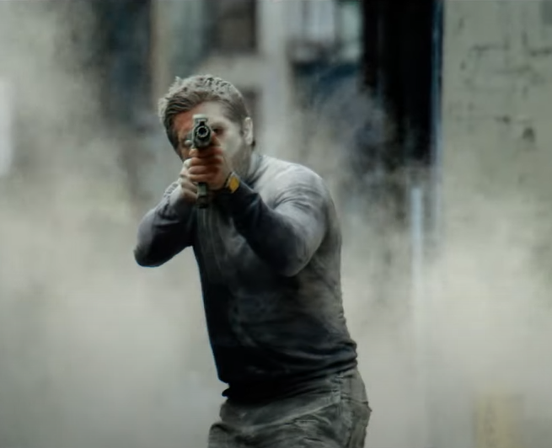
Ambulance
Action. Thrills. Bay-hem is back!
Release Date
25 March
Cast
Jake Gyllenhaal, Eliza Gonzalez, Garret Dillahunt
Director
Michael Bay (Transformers: The Last Knight)
Recommended if you like
Mile 22
Reasons to buy into
Michael Bay is one of the most successful action directors of the past twenty years, turning bombastic spectacle into box office gold.
Key audience info
16-34 Men: 268
Est. DCM admissions
351k
Two robbers steal an ambulance after their heist goes awry.
Plan your campaign

