Slide 1
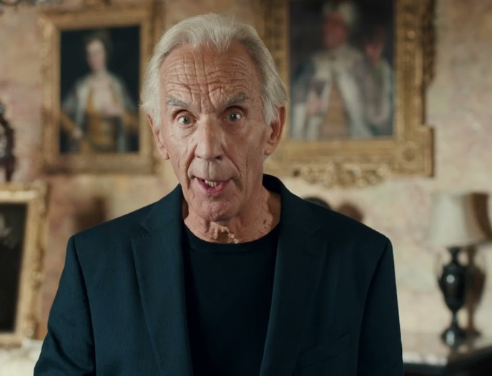
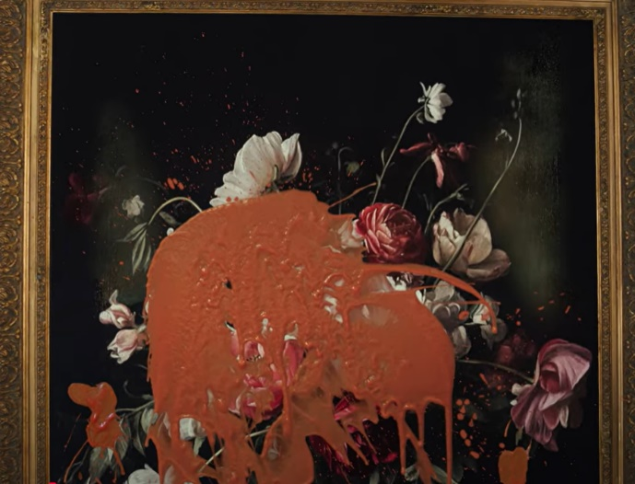
AGE UK
DCM AWARDS NOMINEE
Best 'Marketing for Good'
‘Let's Change How We Age’
Background
Age UK set out to spark a bold national conversation: “Let’s change how we age.” with the goal of reframing perceptions of ageing, building emotional resonance, and inspiring action.
Plan
Age UK ran in relevant premium films after identifying cinema as the ideal platform to support a campaign designed to challenge mindsets, elevate societal perceptions and spark reflection.
Results
Age UK achieved its highest ever semi-prompted awareness at 43%.
The campaign helped prime audiences for action, contributing to a 204% uplift in CRM donations.
Notes:
Source: DCM / AGE UK

Slide 2


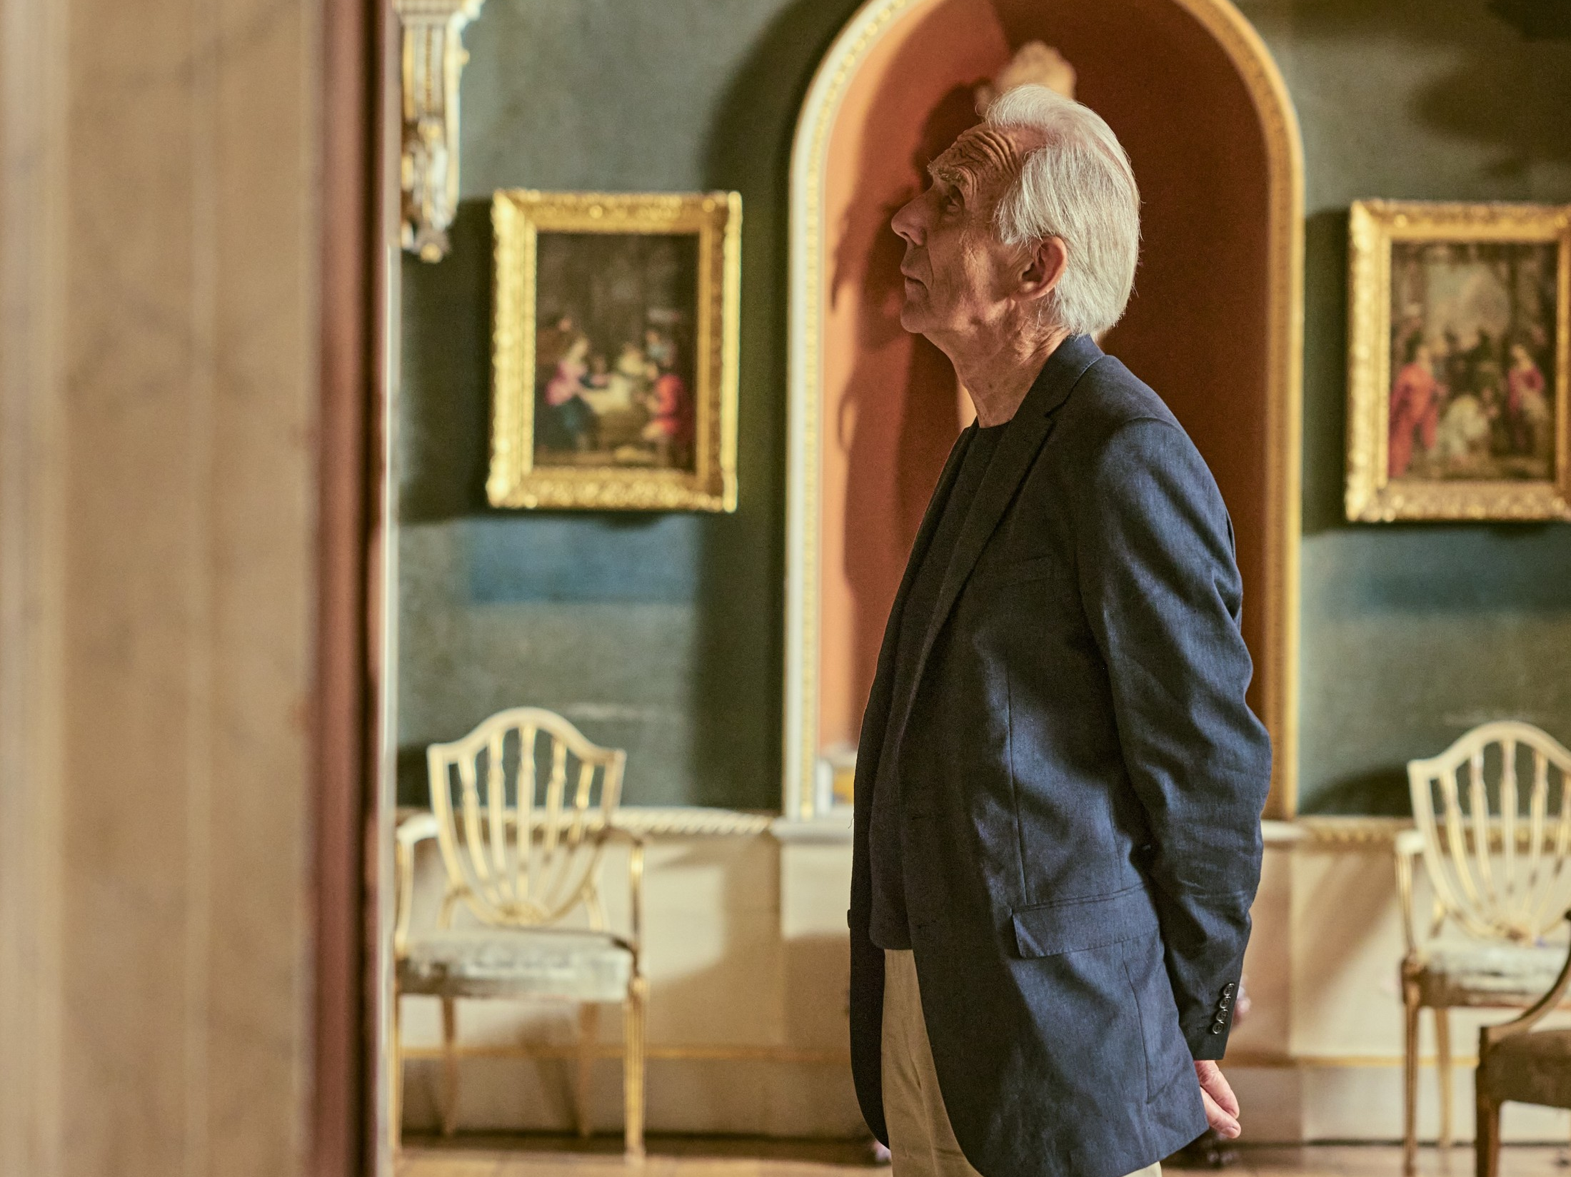
AGE UK
DCM AWARDS NOMINEE: Best 'Marketing for Good'
MEDIA AGENCY | TARGET | BUYING ROUTE | COPY LENGTH
MGOMD | Adults 16+ | Film Packs | 30”
‘Let's Change How We Age’
BACKGROUND
Age UK set out to spark a bold national conversation: “Let’s change how we age.” with the goal of reframing perceptions of ageing, building emotional resonance, and inspiring action.
PLAN
Age UK wanted a premium, culturally resonant space to deliver its 30” emotionally powerful creative copy in. Cinema was ideal platform to support a campaign designed to challenge mindsets, elevate societal perceptions and spark reflection.
The Age UK ad ran in relevant, quality films (Paddington in Peru, Small Things Like These and Anora) and was complemented by digital and OOH to add further scale. In addition to the cinema campaign, Age UK also ran across TV, BVOD, YouTube.
RESULTS
Cinema was pivotal in amplifying the emotional weight of the Age UK campaign, extending reach in a premium setting, and shifting perception and behaviours.
BOOSTED AWARENESS
Age UK achieved its highest ever semi-prompted awareness at 43%.
EMOTIONAL ENGAGEMENT SPIKED
Record scores were seen for agreement in “a cause I believe in” outperforming competitor charities.
BOOSTED DONATIONS & ACTION
The campaign helped prime audiences for action, contributing to a 204% uplift in CRM donations.
Notes:
Source: DCM / AGE UK

