Slide 1
Abc1 adults
How best to utilise cinema to reach an engaged affluent audience

Slide 2
The abc1 audience
Cinema gives brands the opportunity to engage a consumer heavy, online, discerning audience who tend to opt for a more premium lifestyle.
Demographics
A highly affluent audience
Lifestyle
Culture-centric and quality-driven
Media habits
More fragmented media consumption
 | Non-cinemagoing ABC1 | Cinemagoing ABC1
16-34 | 25% | 33%
£50k+ HH income | 22% | 30%
Children in HH | 29% | 36%
I tend to go for premium rather than standard goods and services (41% agree, Idx: 141)
I try to keep up with developments in technology (56% agree, Idx: 123)
I would be prepared to pay more for environmentally friendly products (49% agree, Idx: 155)
Source: GB TGI Dec 2024. ABC1 cinemagoers who have visited in the last week. Index vs. avg. GB adult

Slide 3
70% OF ABC1 ADULTS ARE CINEMAGOERS
Source: TGI GB Dec 2024
Notes:
Statements or numbers on this slide should be short and concise

Slide 4
The Cultural resonance of the classic pEAK tv is declining yoy
While still popular, the cultural resonance and ratings – particularly for ABC1 audiences - of the usual TV bankers is declining
2024 vs 2023 top episode impacts
-16%
Impacts
-12%
ABC1s
-31%
Impacts
-28%
ABC1s
Source: BARB via Adwanted Connected. Episodes between 1 Jan 2023 – 31 Mar 2024 calculated using relative difference between 2024 & 2023 impacts

Slide 5
cinemagoers are younger & more UPMARKET VS. TV, bvod & svod
Cinema is a great complement to TV & online video campaigns providing a more affluent, younger skewing audience
% of audience who are ABC1
GB Population
% of audience who are 16-34
Source: GB TGI Oct 2024- ‘Been to the cinema in the last week’ /
Channels watched in the last week’ / Instagram, Facebook, TikTok & YouTube = Used in last 7 days

Slide 6
Cinema provides a more premium offering
Cinema is the most efficient platform for targeting ABC1 Adults across the full year, with the film slate holding a higher ABC1 profile vs the GB avg.
54% of the GB population are ABC1
Source: DCM Planner. TGI GB July 2024: ABC1 Profile, Index vs avg. GB adult

Slide 7
Premium advertising: Cinema IS KEY FOR reinforcing quality perceptions
Cinemagoers are significantly more likely to perceive the advertising they see on the big screen as premium vs. other AV channels including TV and online video.
‘The advertising is premium…’ top 3 scores indexed vs cinema
Source: FAME 2022,. Base: All Cinemagoers 15+

Slide 8
THE abc1 AUDIENCE
Frequent affluent cinemagoers are more likely to be in market for new tech, a holiday and innovative household items.
55% agree they like innovative cars
(Index: 195)
‘I buy new products before most of my friends’
(Index: 235)
55% plan to book a holiday in the next year
(Index: 105)
‘I'm always looking for new ideas to improve my home’
(Index: 145)
‘I spend a lot of money on toiletries and cosmetics for personal use’
(Index: 163)
‘I like innovative household devices and appliances’
(Index: 151)
Beauty and styling products help me feel good about myself
(Index: 132)
More likely to be interested in innovations in cosmetics
(Index: 210)
Source: TGI Dec 2024
Target: Heavy ABC1 cinemagoers. Index vs. average GB adult.
Notes:
Statements or numbers on this slide should be short and concise

Slide 9
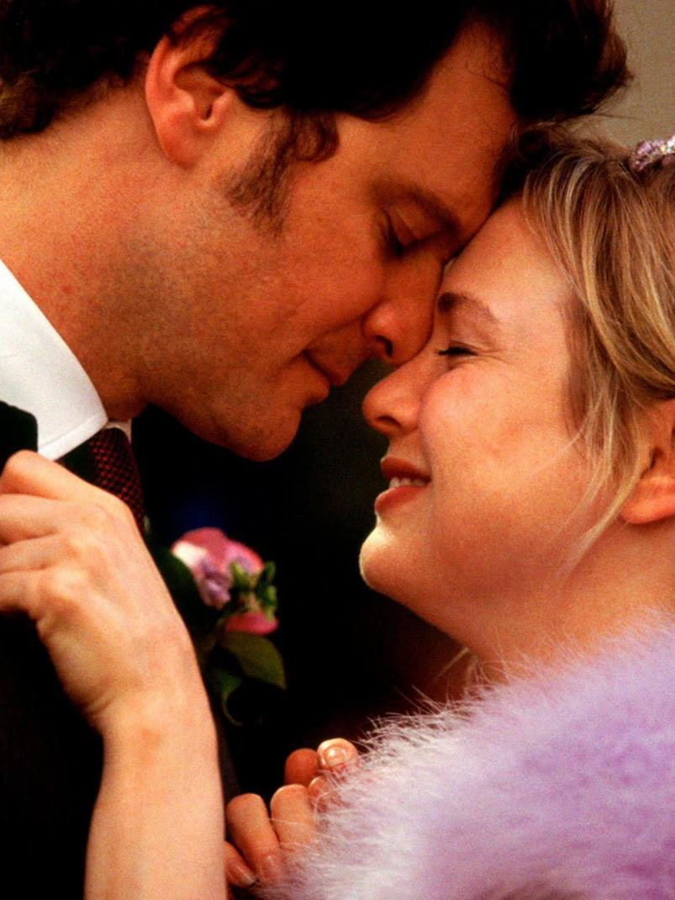
Bridget jones: MAD ABOUT THE BOY
The fourth in the series of one of the greatest British romantic comedies
RELEASE DATE | EST. INDUSTRY ADMISSIONS | GENRE | HFSS BRANDS | ALCOHOL/GAMBLING BRANDS
14 Feb 2025 | 4.3m | Romantic comedy | Yes | Yes
SYNOPSIS
Bridget Jones: Mad About the Boy is an upcoming romantic comedy film that returns us to the life of one of the most iconic British comic creations
CAST
Renée Zellweger, Emma Thompson, Hugh Grant, Leo Woodall
THE DCM TAKE
Nearly a decade has passed since we last encountered our endearingly chaotic heroine, Bridget Jones, in all her dishevelled charm. Bridget Jones is poised to return to the screen in Mad About The Boy, which is the fourth instalment in the Bridget Jones' Diary franchise. This film is expected to draw from Helen Fielding's 2013 novel and it’s believed that the film will focus on Jones' pivot to online dating and her dalliance with a suitor 28 years her junior, who will be played by Leo Woodall (The White Lotus, One Day).
Scheduled to release on Valentine's Day 2025, this film presents an excellent opportunity for travel, food, and retail brands, strategically timed to maximise reach towards ABC1 Women.
 | Adults (16+) | 16-34 Ads | Female Houseperson with Children | 16-34 Women | ABC1 Women
REACH | 7.9% | 10% | 12.2% | 16.8% | 17.1%
IMPACTS | 4.2m | 1.6m | 1.2m | 1.3m | 2.5m
TVRS | 8.7 | 10.8 | 13 | 18 | 19
Source: DCM, based on forecast industry admissions and comparative film profile

Slide 10
Mickey 17
On a planet far, far away…
RELEASE DATE | EST. INDUSTRY ADMISSIONS | GENRE | HFSS BRANDS | ALCOHOL/GAMBLING BRANDS
31 January 2025 | 727k | Science Fiction | Yes | Yes
SYNOPSIS
A disposable employee is sent on a human expedition to colonize the ice world Niflheim. After one iteration dies, a new body is regenerated with most of his memories intact.
CAST
Robert Pattinson, Steven Yeun, Mark Ruffalo, Toni Collette, Naomi Ackie
THE DCM TAKE
From visionary Bong Joon-Ho comes his newest film, an English-language science fiction based on a novel. With it being a 6 year gap since his previous film, Parasite, which won an astounding 6 Oscars and was the first foreign-language film to win the Oscar for Best Picture, it’s been long-awaited and hotly anticipated. Starring Robert Pattinson as an expendable worker (The Batman, Tenet) and Mark Ruffalo (Poor Things, Avengers) as a maniacal leader, we anticipate it to be another awards season leader from Joon-Ho.
 | Adults (16+) | ABC1 Adults | ABC1 Men | 16-34 Adults | 16-34 Men
REACH | 1.5% | 1.9% | 2.8% | 2.9% | 3.9%
IMPACTS | 727k | 515k | 365k | 454k | 312k
TVRS | 2 | 2 | 3 | 3 | 4
Based on industry admissions and comparative film profile

Slide 11
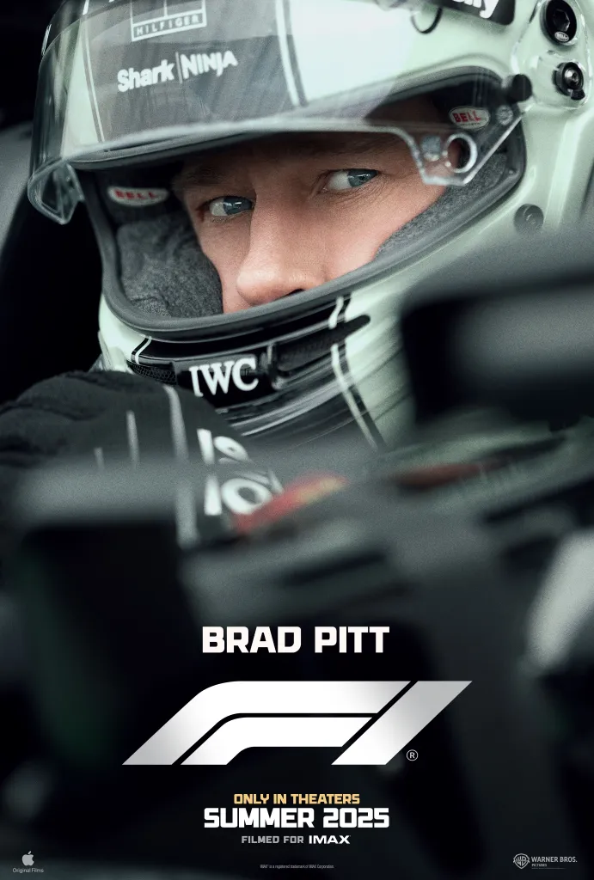
F1
It’s lights out, and away we go!
RELEASE DATE | EST. INDUSTRY ADMISSIONS | GENRE | HFSS BRANDS | ALCOHOL/GAMBLING BRANDS
27 June 2025 | 3m | Sport/Action | Yes | Yes
SYNOPSIS
A former driver finds himself back in action when he returns to Formula 1 racing to take on the sport's top competition.
CAST
Brad Pitt, Damson Idris, Kerry Condon, Tobias Menzies, Javier Bardem, Sarah Niles
THE DCM TAKE
Coming from the same director as Top Gun: Maverick, the highest-grossing film of 2022 and the 13th most successful film of all time worldwide, F1 is anticipated to have a similar feel both in its thrilling action sequences and overall cinematic impact, attracting cinephiles and F1 fans alike. Recognising the value of a cinematic event to fully capture the film's scale and appeal, Warner Bros. acquired the theatrical distribution rights from Apple, ensuring the film receives the high-profile, big-screen release it deserves before it eventually becomes available on Apple TV+, mirroring what we have seen in the past with successful films like Killers of the Flower Moon (2023). Made in collaboration with Formula 1 and the F1 community, the film is expected to be exhilarating, immersive and true to the sport, making it likely to resonate strongly with a young male audience - an ideal fit for sports, active & leisure brands.
We've already seen significant interest, with the Gold Spot already secured…
 | Adults 16+ | 16-34 Adults | 16-34 Men | ABC1 Adults | ABC1 Men
REACH | 5.2% | 6.0% | 8.2% | 6.5% | 8.3%
IMPACTS | 2.7m | 997k | 695k | 1.9m | 1.2m
TVRs | 5.6 | 6.5 | 8.9 | 7.2 | 9.3
Source: DCM, based on forecast industry admissions and comparative film profile

Slide 12
The Fantastic Four: First Steps
The first film to kick off MCU Phase 6
RELEASE DATE | EST. INDUSTRY ADMISSIONS | GENRE | HFSS BRANDS | ALCOHOL/GAMBLING BRANDS
25 July 2025 | 2.4m | Superhero/Action | Yes | No
SYNOPSIS
A mysterious portal pulls four misfits into the Overworld, a bizarre, cubic wonderland that thrives on imagination. To get back home, they'll have to master the terrain while embarking on a magical quest with an unexpected crafter named Steve.
CAST
Pedro Pascal, Vanessa Kirby, Joseph Quinn, Ebon Moss-Bachrach
THE DCM TAKE
The Fantastic Four: First Steps kicks off Phase 6 of the MCU, providing a fresh new take on the familiar narrative, with the original film releasing exactly 20 years ago. Featuring a star-studded cast, this film offers a fresher, more upmarket tone compared to many previous MCU films. It was revealed earlier this year that the film would be a period piece set in the 1960s within an alternate universe, giving it more of an authentic and refreshing aesthetic that is likely to attract a wider range of audiences. Despite it differing from other MCU films, it was confirmed at the San Diego Comic-Con in July 2024, that the cast would reprise their roles in Avengers: Doomsday (2026) and Avengers: Secret Wars (2027), starring alongside Robert Downey Jr. as Dr. Doom, emphasising the significance of The Fantastic Four: First Steps within the MCU timeline.
 | Adults (16+) | ABC1 Adults | 16-34 Adults | 16-34 Men
REACH | 4% | 5% | 8% | 10%
IMPACTS | 2m | 1.3m | 1.2m | 825k
TVRS | 4 | 5 | 8 | 11
Source: Based on industry admissions and comparative film profile

Slide 13
Maximise your campaign with abc1 skewing major releases
Across the slate in 2025, the cinema audience is a more efficient affluent-skewing buy than many major peak TV spots.
54% of GB population are ABC1
Sources: Adwanted Connected, top rating shows (top episodes for each series), 26 Dec 2023 – 31 Jan 2024
% of (4+) audience that are ABC1. Films based off of comparative film profiles. GB % from Film Monitor

Slide 14
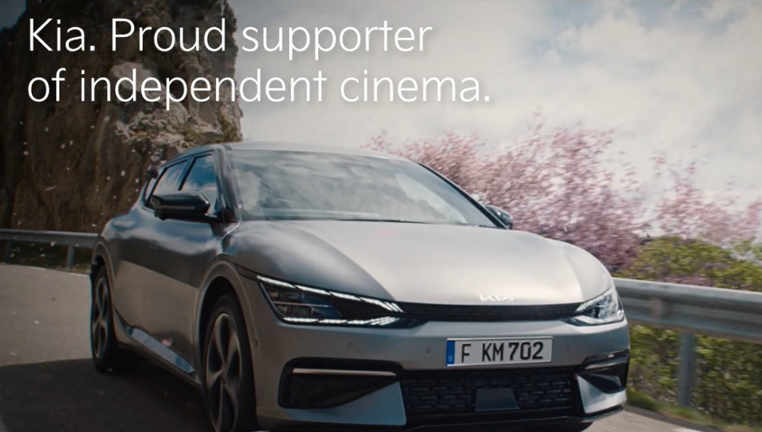
Cinema DELIVERS POSITIVE OUTCOMES FOR targeting ABC1s
Looking at our brand lift study databank, it’s evident that cinema drives significant uplifts for your key brands metrics across the full funnel.
Meta-analysis of 27 cinema campaigns: Average uplifts seen from Control (unexposed to cinema ad) vs Test (exposed to cinema ad)
+58%
Recall
+32%
Birds Eye
Kia looked to showcase the brand’s innovative credentials in a premium environment as part of a new brand identity launch, promoting both the EV6 and Niro EV to help cement itself as a leader in the electrified market.
Running from April 2022 – May 2023, Kia took on an annual residency as the Gold Spot across all independent cinemas on the DCM estate, launching several creatives as part of its ‘Movement that Inspires’ campaign.
Comparing results from those who were exposed to the advert in the cinema in Wave 1 (2022) to Wave 2 (2023), consideration of Kia had increased by 8%, positive impression jumped by 9% and spontaneous awareness of Kia as an ‘electric car brand’ has increased by 14%. Overall, their consistent presence in the Gold Spot has helped keep Kia at cinemagoers’ front of mind with long-term, low frequency exposure.
Ernest Jones wanted to tell a story that expressed its luxury credentials on a wider national level, driving mass reach but with a proximity focus to support the key outlets. So, they chose cinema to prioritise targeting in a premium environment that provides content that influences and creates emotional connections.
The brand also saw the benefit of DCM’s Cinemapper planning tool that meant the campaign could target cinemas in proximity to its stores and inspire cinemagoers to visit their local Ernest Jones.
Nationally, the campaign ran in cinema sites that were within a 20-minute drive time of an Ernest Jones store. Ernest Jones handpicked House of Gucci as the perfect film fit for its campaign, aligning with the brand’s luxury credentials.
Selecting cinema locations near Ernest Jones stores delivered an exceptional uplift in sales performance, demonstrating the power of cinema as both a brand-building and sales-driving platform.
Perceptions
+14%
Action Intended
Source: Differentology Cinema Effectiveness Databank (2016 – 2024). Meta-analysis consists of 27 cinema campaigns that all targeted ABC1. Uplifts based on relative difference between Control (unexposed to ad) vs Test (exposed to ad). Results for all respondents

Slide 15
The benefit of Premium positions for premium Brands
Placing your ad in the premium position delivers an uplift in brand recall vs. appearing ‘in reel’ - 10% for Bronze Spot, 70% for Silver Spot and 2x for the Gold Spot
2x uplift from ‘in-reel’ access
Prompted brand recall, based on 4 studies conducted by eworks, 2022
Results indexed to ‘in reel’ ad average

Slide 16
What can Cinema add to your ABC1 ADS media plan?
Starting with cinema allows you to engage an audience when they’re in a positive and receptive mindset and most willing to pay attention to ads.
POSITIVE MOOD
PAY MORE ATTENTION TO ADS
QUALITY SIGNAL
70%
agree they feel either relaxed, happy, excited, engaged or attentive when watching adverts in the cinema¹
80%
DCM & Lumen’s ‘Centre of Attention’ research, shows that 24 seconds of a 30”, and 48 seconds of a 60” ad (80% of your ads) are watched by the audience – significantly higher than vs other platforms²
46%
rank cinema as the most premium platform making it the best way to signal to an affluent audience that your product is high quality and premium.³
Source: 1. FAME 2022. ABC1 Adults who are heavy cinemagoers. 2. Centre of Attention Research, Lumen & DCM 2022. 3. Differentology 2022 – 2023. Respondents were asked ‘Please can you rank the following in order of how premium you perceive them’. Sample: 7,000 cinemagoers across 14 research projects

Slide 17
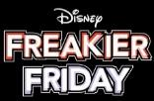
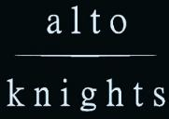
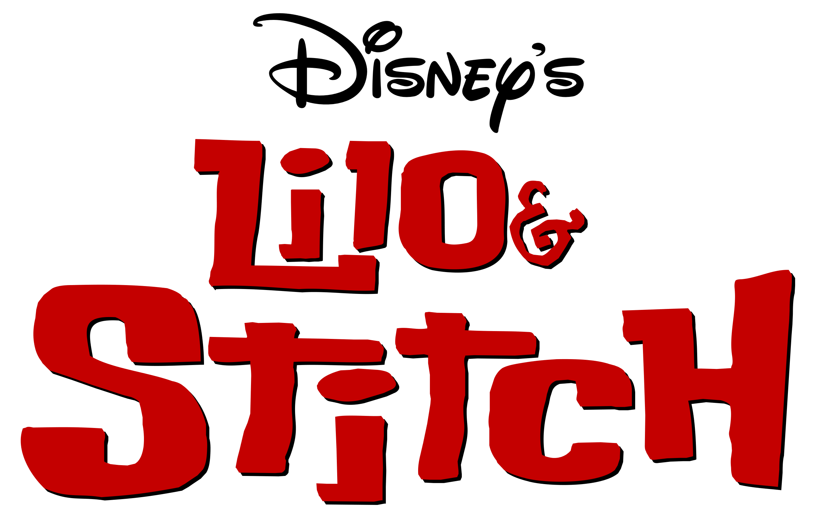
FILM SLATE 2025
TRON
ARES
Insidious (Sequel)
VICIOUS
JAN
Feb
Mar
APR
MAY
JUN
JUL
AUG
SEPT
OCT
NOV
DEC
28 Years Later

