Slide 1
START WITH CINEMA: NEW MESSAGE
Why you should start with cinema in your AV mix when launching a new message

Slide 2
Using cinema to help launch A NEW MESSAGE
Audience fragmentation and increased levels of distraction have made it more challenging than ever to launch a new message. Whether it’s a new strapline, brand focus or the task of changing deep-rooted assumptions about your brand it’s key to identify the channels that can deliver valuable audience reach and attention.
We believe that cinema can play a crucial role at this ‘must-win moment’ for your brand. A trusted environment for ads where audiences (specifically, young ads) are more receptive than anywhere else to advertising messages and willing to give them far greater levels of attention - cinema is a compelling addition to the mix.
The following slides are designed to help show you why we believe cinema is must-have as part of a successful AV launch plan when you’re trying to land a new message.
Notes:
Features
1. Extra film filter allows bespoke audience targeting
2. Can be bought on a national or regional basis
3. Bar sponsorships are available, with 30% of our sites
featuring a bar on the premises
4. Comic book / action hero type releases will not be
included in these packages regardless of profile
5. £65 fixed CPT

Slide 3
Make sure your message reaches everyone
Cinema is a great complement to TV & online video campaigns providing a more affluent, younger skewing audience
GB Average
% of audience who are ABC1
Average Age
Source: GB TGI Apr 2023 -‘Been to the cinema in the last week’ /
Channels watched in the last week’ / Instagram, Facebook & YouTube = Used in last 7 days

Slide 4
MAXIMISE REACH OF YOUR MESSAGE BY STARTING WITH CINEMA
Redistributing weight from linear TV into cinema can increase total campaign weight for key audiences, particularly 16-34s
90% HPCH REACH
48% 1634 REACH
93% HPCH REACH
59% 1634 REACH
= HPCH UPLIFT: 3 PTS
= 1634 UPLIFT: 11 PTS
Source: IPA TouchPoints Channel Planner, Informed by ‘typical’ channel shares & pricing. Precise reach subject to final channel mix & spend.

Slide 5
STARTING WITH CINEMA IS ESSENTIAL FOR MAXIMISING ATTENTION
Cinema delivers unbeatable level of attention to ads, making it a crucial additional to the AV plan to help ensure your message lands properly.
Source: Lumen

Slide 6
If you want cost-effective attention, start with cinema
Cinema’s unbeatable level of attention to ads means when you adjust 16-34 CPMs for attentive seconds its one of the most cost-effective AV channels for reaching this key audience
Source: DCM has applied Lumen Attention data to estimated industry 16-34 CPMs to calculate aCPM
Cinema CPM based on 16-34 AGP
Notes:
One challenge we hear from agencies and clients is that cinema is too expensive, and if you look at it purely through a lens of CPTs, you can understand where that challenge stems from.
But we know that not all impacts are made equal. Although some channels can offer cheaper impacts, a lot of that delivery can often go unnoticed.
We know the importance and effectiveness of attention to deliver uplift against key brand metrics.
And we have applied Lumen Attention data to estimated industry 16-34 CPMs to calculate an Attentive CPM, and again, cinema outperforms linear TV, OOH, digital display, and Facebook, whilst being comparable to YouTube and Instagram, so really impressive numbers.
We can therefore quite confidently counter the premium price challenge, and demonstrate that if you want cost-efficient attention, you need to start with cinema.

Slide 7
TRUSTED ENVIRONMENT: Cinema IS KEY FOR LAUNCHING your message WITH TRUST
Cinema is the AV channel that audiences trust the most in terms of advertising – offering brands a positive environment where audiences are most receptive to your brand’s message
‘I trust the advertising in…’ scores indexed vs cinema
Source: IPA Touchpoints 2022. Base: All Adults 15+
‘I trust the advertising in…’ - % agree

Slide 8
TAP INTO THE EMOTIONAL EXPERIENCE & PLAN FOR POSITIVITY USING CINEMA
Going to the cinema is a positive experience for people and as Hearst’s research has shown reaching people in a positive mindset can have a significant benefit for brands
% of time spent in a good mood
Impact of positive mindset on response to advertising
18%
35%
Increase in brand favourability
Increase in purchase intent
Source: IPA TouchPoints. Good mood = 7+ on ten point scale | Hearst – Power of Positivity

Slide 9
Cinema ads are the advertising format 16-34s are most RECEPTIVE towards
Independent research from Kantar found that traditional AV ad formats are preferred by all generations but specifically cinema rates well amongst young audiences – making it the best place to start your campaigns with a positive impression.
Gen Z
16-19 year olds
Gen Y
20-34 year olds
Gen X
35-49 year olds
Cinema ads | 44% | 34% | 31%
TV ads | 14% | 23% | 33%
Video ads (laptop/PC) | -24% | -20% | -33%
Video ads (mobile) | -26% | -26% | -33%
Source: Kantar – AdReaction Study
‘How would you describe your attitude towards each of the following formats of advertising? - % net positive ’

Slide 10
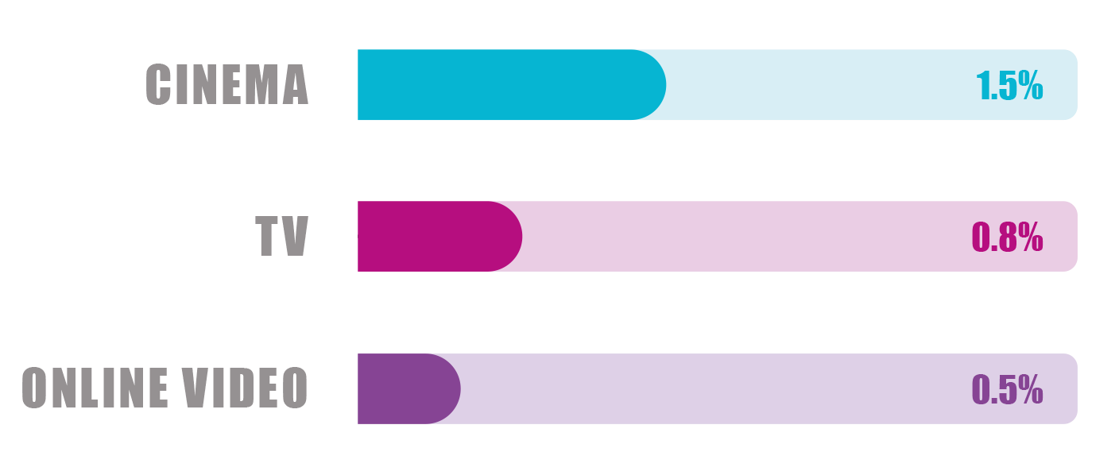
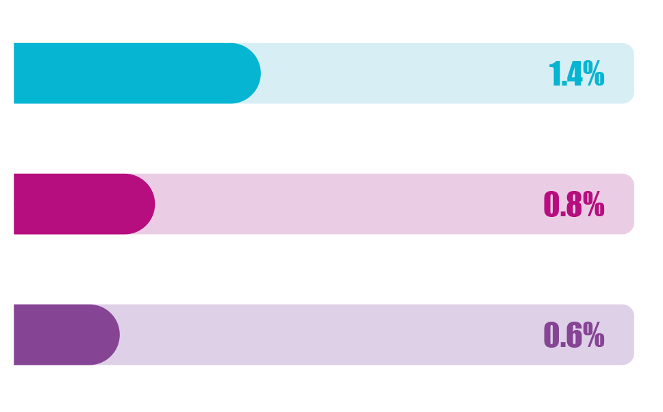
Cinema efficiently contributes towards connecting with your brand & message
Cinema delivers significantly more impact per person reached on metrics that are important when trying to land a new message (brand difference) or get audiences to reappraise how they feel about your brand (brand love).
AV Contribution to Brand Love
AV Contribution to Brand Difference
AV Channel
Impact
per person
Avg
Freq
Impact
per person
1.8
10.0
5.0
Source: Kantar CrossMedia Database, European data
Love metric: Love, meets needs
Cinema: 42 | TV: 122 | Online Video: 55
Notes:
So which channels are best placed to shift this hugely important brand metric?
As you can see all channels can contribute but it’s AV channels and in particular Cinema and TV that are the clear leaders in helping grow brand love.
Nothing is more emotional than great AV content and both channels provide advertisers the chance to tell compelling stories that emotionally engage audiences and create this sense of ‘love’. Factor in the well-targeted audience, high quality experience and positive mind-set you’re in when you’re about to watch a new film and you can understand why cinema is so well placed to drive this particular metric.

Slide 11
KANTAR RECOMMENDs including/upweighting cinema FOR more effective campaigns
Analysis of over 1,000 campaigns from Kantar’s CrossMedia database recommends brands should upweight cinema for campaigns that are specifically looking to achieve awareness, association and motivation goals.
 | TV | Facebook | OOH | YouTube | Cinema | News-brands | POS | Online display | Magazines
AWARENESS
ASSOCIATION
MOTIVATION
What has worked in the past
 | Major channel
 | Minor channel
Recommendations
 | Channel to downweight
 | Channel to upweight
Source: Kantar/SAID Business School/University of Oxford, WARC Article

Slide 12
CINEMA HELPS DELIVER SUCCESS AS PART OF MESSAGE-LED CAMPAIGN LAUNCHES
Recent launches that started with cinema as part of the AV mix and the latest uplifts from the DCM databank for new message campaigns
DCM DATABANK – NEW MESSAGES
+20%
BRAND PERCEPTIONS (AGREE)
+43%
POSITIVE BRAND IMPRESSION
+87%
EXTREMELY LIKELY TO CONSIDER
Source: DCM/Differentology, average relative uplifts, exposed to cinema vs. not exposed to cinema

Slide 13
CASE STUDIES
Brands have seen great success when starting with cinema in the AV mix to launch a new message
Kia
IKEA
BAFTA
Movement That Inspires
Year of Sustainability
Behind Every BAFTA
Kia was looking for the opportunity to showcase their innovative credentials in a premium environment as part of a new brand identity and product launch of the new EV6 and Niro.
Kia bought into the annual Independent Gold Spot in addition to partnering with Picturehouse to launch several creatives as part of its ‘Movement that Inspires’ campaign.
This long-term campaign saw significant uplifts across its first year with key messaging cutting through more for cinemagoers vs. control – ‘leader in electric vehicles’ (+24%) and ‘innovative brand’ (+37%).
Association of Kia with the key ‘movement that inspires’ message increased across the campaign, with a 14% uplift in association seen from Wave 1 to Wave 2
IKEA wanted to make sustainability the brand's core focus and singular central message across all of its advertising.
To inspire behavioural change, IKEA needed a contextual environment that could create a deeper emotional connection and contribute towards the campaign’s broad scale – making Cinema a perfect fit.
The campaign was hugely successfully, delivering over £180m incremental revenue and exceptional ROI.
Cinema was proven to be the top channel for efficiently delivering penetration compared to the other media and driving brand desire. On this metric cinema delivered a 7% contribution despite only accounting for 1.2% of the overall media spend, four times more effective than the next best channel.
BAFTA and DCM partnered on a cinema campaign designed to promote a new message to inspire and ignite the next generation of creative talent.
The ‘Behind Every BAFTA’ ad, produced by DCM Studios and narrated by double BAFTA-award winning Big Zuu, showcased the diverse range of skills and knowledge that goes into making award-winning films, games and television.
Overall, the results highlight how promoting a new message in the high attention environment of cinema can deliver key campaign KPIs, with 42% considering a career in the screen industries and those who were exposed to the ad in the cinema saw a +32% uplift in having a ‘much better impression of BAFTA’.

Slide 14
Thank you
Please speak to your DCM rep for more information and costings for starting with cinema

