Slide 1
CINEMA: AN ACCOUNTABLE MEDIUM
Why brands can trust cinema

Slide 2
WHY YOU CAN TRUST CINEMA
Since becoming a fully digital operation in 2012 DCM offer an accountable and transparent process
1. INFORMED
FORECASTS
2. DAILY
UPDATES
3. TICKET SALES REPORTED
We forecast admissions for each film, forming the basis of our buying routes. Over 5 years’ worth of admissions data is used to inform average footfall by site and screen predictions
Cinemas update us daily on what movies they plan to show over the 7-14 days, by site, date and time so we can schedule adverts against them
Box office ticket sales are delivered directly from the cinema’s in house POS system or web portal to our Data Warehouse
4. ACCOUNTABLE REPORTING
5. INDEPENDENT CORROBORATION
If a film starts outside of its allocated time band, is cancelled, or is shown without our prior knowledge, these admissions are automatically detected and discarded. We only report admissions for films that have a live and accountable playlist and then allocate these to campaigns.
Each week, ComScore who independently measure 95% of worldwide box office data, collect admissions and report these to our campaign management team. This data is used to corroborate our own admissions, ensuring transparency

Slide 3
FORECASTING ADMISSIONS
Various factors are considered when making informed decisions about how many admissions a film could deliver
When is the film being released? Time of year is often a good indicator to the likely performance of the film during the time of the market
Is the film getting a ‘Saturation’ release (in 250+ screens)? If a film has a Saturation release it has a good chance of delivering in excess of 150k admissions. ‘Wide’ releases will likely play in 100-250 screens) and ‘Limited’ releases will likely appear in less than 100 screens.
Which studio is distributing the movie in the UK? This can be a good indicator of whether film is likely to have big marketing power behind it and the ability to cross the £10m box office mark (c.1m DCM admissions).
What have similar films and other works of the featured directors / lead actors achieved at the UK box office?
What are DCM’s major exhibitor partners (Cineworld, Odeon and Vue) predicting? Liaising with each exhibitor’s expert film booking teams allows DCM to sense-check forecasts
Once a total admissions forecast has been set DCM’s system will then use historic admissions data to automatically calculate likely site by site share of the admissions across the DCM estate.

Slide 4
audience profile of new theatrical releases
Using audience profile data from the CAA Film Monitor survey, DCM can help you identify which films are the best fit for the campaign’s target audience
FILM MONITOR
COMPARATIVES FOR UPCOMING RELEASE
EXAMPLE: 16-24 WOMEN
Film Monitor is an online face-to-face survey independently run by Kantar on behalf of the Cinema Advertising Association
Bi-weekly survey will amass a nat.rep sample of c.24,000 respondents (aged 7+) across a calendar year
Presented with a list of c.20 recent cinema releases and asked which they have seen in the cinema recently.
Film Monitor will collect audience profiles for c.100 theatrical releases that account for 88% of all UK admissions*
Every new major theatrical release is given a ‘comparative title’.
This will be a film released in the last couple of years (that has a robust Film Monitor audience profile) that is a good proxy for the upcoming release and its likely audience demographics.
For films that are sequels/part of a franchise selecting a comparative is quite obvious (e.g. ‘A Quiet Place’ is the comparative for ‘A Quiet Place: Part II’). For others, the selection of a comparative will be based on the BBFC certificate and influenced by genre and factors including director, lead actor/actress and audience trends.
Using comparatives helps inform which buying routes a film will be part of and allows DCM advise brands on which upcoming films best suit their needs -e.g. for brands targeting 16-24 women A Quiet Place: Part II and In The Heights are perfect picks.
A Quiet Place: Part II
Comparative: A Quiet Place
23% 16-24 Female
16-24 Female Index: 366
In The Heights
Comparative: Crazy Rich Asians
26% 16-24 Female
16-24 Female Index: 380
*Based on Film Monitor 2019

Slide 5
PREDICTING REACH, FREQUENCY AND TVRS for UPCOMING FILMS
DCM’s planning system collates together admissions forecasts by film/buying routes, comparative film demographic profiles and this is fused with RSMB’s gold standard coverage and frequency model.
ADMISSIONS FORECAST
COMPARATIVE FILM DEMO. PROFILE
CAMPAIGN LENGTH
RSMB GOLD STANDARD REACH & FREQUENCY MODEL
Coverage and frequency calculations are based on 1) The predicted audience demo profile (based on Film Monitor profile of the allocated comparative title) 2) Admissions forecast for the upcoming release(s) and 3) Campaign length
The gold standard RSMB model used by DCM to calculate C&F is based on 52 weeks of recency and frequency data from the CAA’s Film Monitor survey – and allows DCM to provide accurate C&F/TVR estimates for every campaign

Slide 6
How we collect, verify and report admissions
Cinemas update us daily on what movies they plan to show over the next week (with specific showing dates and times) and we schedule ads against these showings
Point of sale ticket information gets sent to our ‘data warehouse’ by cinema, screen, showing and ticket type
DCM corroborates this with Comscore to ensure accuracy and transparency

Slide 7
How we collect, verify and report admissions
Data is then matched to campaign playlists in our scheduling system, Accord
Any film showings we can not match (e.g. a showing we didn’t have prior knowledge of) or where any issues have occurred (e.g. cancelled) has its admissions automatically detected and discarded.
Admissions are only reported for films that have a live and accountable playlist and these are then allocated to the campaigns featured.

Slide 8
How we collect, verify and report admissions
Weekly campaign performance report sent by DCM sales team to agencies & clients
Detailed spot by spot breakdown can be supplied if required by clients or econometric agencies

Slide 9
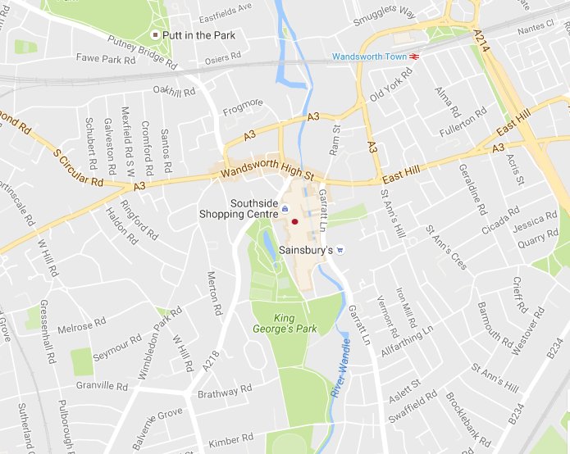
Detailed spot by spot breakdown SPREADSHEET can be supplied FOR EVERY CAMPAIGN
Cineworld Wandsworth
Screen | Date | Time | Actual | Movie
2 | 23/02/19 | 20:00 | 111 | On The Basis Of Sex
2 | 23/02/19 | 17:10 | 89 | On The Basis Of Sex
4 | 23/02/19 | 13:40 | 75 | Lego Movie 2, The
4 | 23/02/19 | 21:50 | 45 | Happy Death Day 2U
5 | 23/02/19 | 20:50 | 47 | Vice
8 | 23/02/19 | 17:50 | 78 | Instant Family
8 | 23/02/19 | 14:50 | 76 | Instant Family
9 | 23/02/19 | 18:10 | 71 | Alita: Battle Angel
10 | 23/02/19 | 20:10 | 79 | Alita: Battle Angel
11 | 23/02/19 | 19:20 | 85 | Instant Family
12 | 23/02/19 | 20:20 | 106 | Green Book
12 | 23/02/19 | 14:40 | 79 | Kid Who Would Be King, The
14 | 23/02/19 | 14:30 | 68 | How To Train Your Dragon: The Hidden World (2D)
14 | 23/02/19 | 19:40 | 48 | Mary Queen Of Scots

Slide 10
Calculating c&F and TVRS for CINEMA (post-release)
FINAL
ADMISSIONS
CAA FILM MONITOR PROFILE
KANTAR GB UNIVERSES
Fast & Furious: Hobbs and Shaw
DCM Admissions (7 days): 981,128
Film Monitor Profile (16-34 %): 48.76%
= 478,398 16-34 DCM admissions
Kantar 16-34 Universe: 15,296,622
(16-34 Admissions / 16-34 Universe * 100)
= 3.13 16-34 DCM TVRs
EXAMPLE
A film’s final admissions
figure (DCM
or Industry):
7 days
28 days
60 days
A film’s final
CAA Film
Monitor profile that provides demographic breakdown
of the cinema audience
Cinema C&F
and TVRs are calculated
based on Kantar’s GB universes

Slide 11
TOP 2019 RELEASES: 16-34 TVRs
16-34 TVRs
AVENGERS: ENDGAME 34
JOKER 29
THE LION KING 23
TOY STORY 4 21
CAPTAIN MARVEL 17
STAR WARS: THE RISE OF SKYWALKER 16
SPIDER-MAN: FAR FROM HOME 15
FROZEN II 13
ALADDIN 13
JUMANJI: THE NEXT LEVEL 11
Based on 60-day full industry admissions and final CAA Film Monitor audience profile

Slide 12
INDEPENDENT preshow AUDITS

Slide 13
INDEPENDENT PRESHOW AUDITS
Background and Methodology
BACKGROUND
The Cinema Advertising Association (CAA) engaged Assosia, a trusted retail research and quality assurance specialist, to undertake monthly audits that would capture presence during various intervals of the preshow experience.
Assosia act as a third party independent agency on behalf of clients to provide unprejudiced and impartial auditing information.
Assosia is considered one of the leading authorities for retail research by many media channels including the BBC, The Guardian, The Telegraph, as well as numerous radio stations.
METHODOLOGY
Assosia auditors visit selected cinemas monthly across the UK over a weekend (Friday, Saturday and Sunday) to review the pre-reel experience and collate presence throughout the reel data.
Auditors arrive to sit in the auditorium at least 15 minutes prior to the film start time. They are briefed to collect the following information for each screening:
Number of cinemagoers present during the pre-reel
Number of cinemagoers present during the bronze spot
Number of cinemagoers present during the silver spot
Number of cinemagoers present during the gold spot
Number of cinemagoers present for the film
The auditor will leave the showing once the film has begun.
Monthly audit data has been collated annually with results published highlighting the annual averages (% of total audience present) for the different stages of the ad reel.

Slide 14
PRESENCE DURING PRESHOW RESULTS
The latest ‘presence during preshow’ figures from independent audits conducted by Assosia
1.
DCM
OPENING IDENT
2.
BRAND
ADS
3.
BRONZE
SPOT
4.
DCM
CLOSING
IDENT
5.
SILVER SPOT
6.
FILM
TRAILERS
7.
GOLD
SPOT
8.
FILM
83%
of cinemagoers seated during the commercial ad reel
92%
of cinemagoers seated when the Bronze Spot begins
94%
of cinemagoers seated when the Silver Spot begins
100%
of cinemagoers seated when the Gold Spot begins
Source: Assosia, 2018

Slide 15
Presence of audience through the preshow
The percentage of the cinemagoing audience who are present during the commercial ad reel has actually increased in the last 5 years
 | 2014 | 2015 | 2016 | 2017 | 2018
Commercial Ad Reel | 72% | 76% | 77% | 83% | 83%
Bronze Spot | 86% | 87% | 89% | 91% | 92%
Silver Spot | 89% | 93% | 93% | 94% | 94%
Gold Spot | 100% | 100% | 100% | 100% | 100%
Source: Assosia

Slide 16
SUMMARY: WHY CINEMA PROVIDES THE BEST AV EXPERIENCE for brands
Full
(big) screen
Sound
(always) on
Viewed by humans
Shared
viewing
Brand safe quality films &
pre-cleared advertising
Robust processes & reporting

