Slide 1
Long Term Brand Partnership Opportunity
CINEWORLD 4DX
2019
Notes:
All elements on this page (not including the logo) need to be 1cm apart

Slide 2
THE UK’S MOST
EXCITING, STIMULATING &
IMMERSIVE
CINEMA EXPERIENCE…
Notes:
The line should be 1cm below the statement text and never placed above the statement text

Slide 3
What is 4DX?
A truly 360° 3D Cinematic, Immersive Experience
Providing a revolutionary cinematic experience which stimulates all five senses, 4DX includes high tech motion seats and special effects including wind, fog, lightning, bubbles, water, rain and even scents.
These effects work in perfect synchronicity with the action unfolding on screen, creating the most unmissable and exhilarating cinema viewing experience yet. The films play out in both 2D and 3D.
4DX has to be experienced first hand to be believed; please contact DCM for a 4DX showcase & screening.
Notes:
The line underneath the header should be 0.50cm away from the header
The sub header is 0.50cm beneath the line
The copy should then be 1cm away from the sub header

Slide 4
What is 4DX?
360° 3D cinematic, immersive experience
Motion seats
Wind effect
Bubbles
Strobe lights
Fog
Scent/Smell
Vibration
Burst of air
Fade mists
Notes:
The line underneath the header should be 0.50cm away from the header
The sub header is 0.50cm beneath the line
The copy should then be 1cm away from the sub header

Slide 5
Innovation driven by Hollywood
4DX now partners with all major Hollywood distributors on over 40 titles per year, working collaboratively with them to enhance and deliver enabled content in the post-production period.
Marvel
Horror
DC
Family
Intergalactic blockbusters
Bond!
Notes:
The line underneath the header and the body copy should be 0.50cm away from each other

Slide 6
THE CINEWORLD AUDIENCE
Demographics
Lifestyle
Media habits
Younger-skewing affluent audience.
Tech savvy and early adopters
Subscriptions & broad entertainment channels
 | Regular Cineworld cinemagoer | Average UK adult profile
15-34 | 41% | 31%
35-54 | 37% | 32%
55+ | 23% | 38%
ABC1 | 56% | 56%
> £40k HHC Inc. | 33% | 28%
I make sure I have the most up-to-date mobile on the market (Index: 148)
I like to buy new gadgets & appliances (Index: 110)
Currently own a smart home speaker, smart watch or 4K TV (Index: 124)
Source: GB TGI March 2021 + IPA TouchPoints 2020
Cineworld = Cinema most visited often
Index vs. average GB adult

Slide 7
4DX Audience Behaviors vs Average Cinemagoers
56/44%
Male/Female
58%
16-34 years
x3
Average group size
67%
Book in advance
72%
Would come again
65%
Willing to pay more
X2
Prepared to travel twice as far
Source: Cineworld survey of 16+ age group 2019

Slide 8
LOCATIONS & FUTURE PLANS
2020
Future locations
Aberdeen
Basildon
Birmingham Broad Street
Bracknell
Cardiff
Crawley
Castleford
Didsbury
Edinburgh
Glasgow Renfrew Street
Ipswich
London - Enfield
London – Leicester Square
London - 02
London – Wandsworth Middlesbrough
Milton Keynes
Rushden Lakes
Sheffield
Stevenage Telford
Broughton Cheltenham Ashton under Lyne
Wolverhampton Plymouth
London - Feltham Ashford Newport Nottingham Poole
Contact your DCM rep to map these sites to local retail locations.
* 4DX is also in non-DCM cinemas – Newcastle Upon Tyne and Dublin.
Notes:
The line underneath the header should be 0.50cm away from the header
The sub header is 0.50cm beneath the line
The copy should then be 1cm away from the sub header

Slide 9
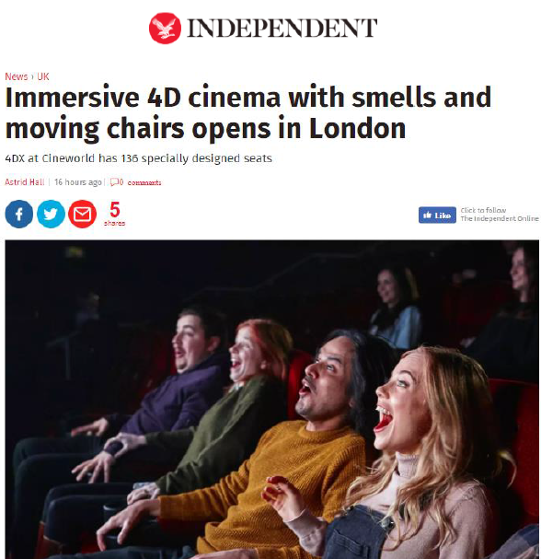
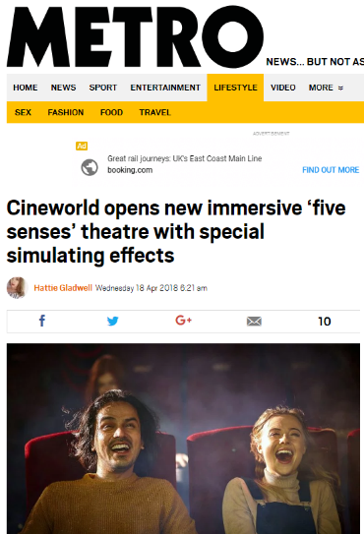
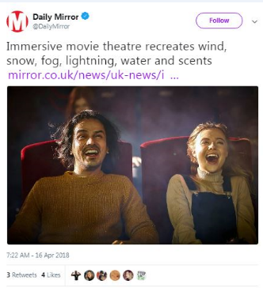
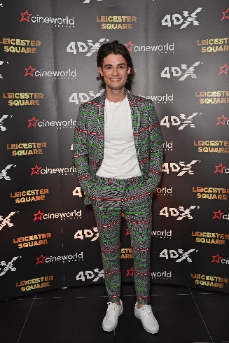
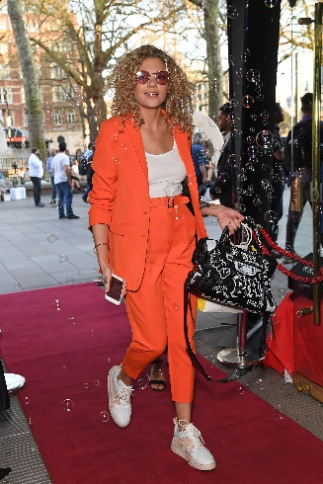
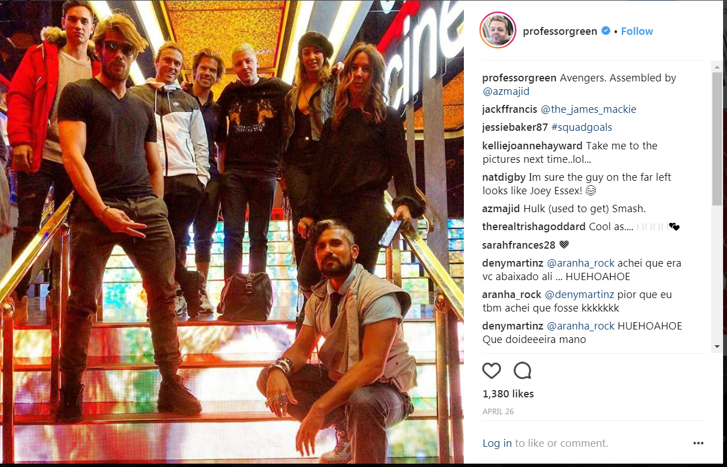
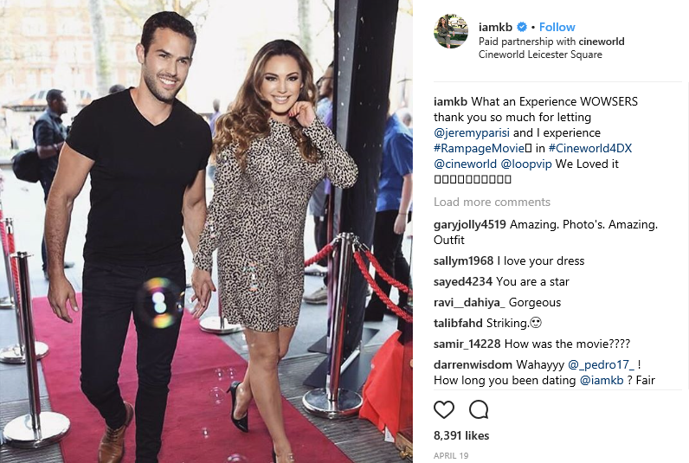
4DX IN THE NEWS

Slide 10
YOUR BRAND & THE UK’S BIGGEST CINEMA CHAIN
Beyond the 4DX Partnership – what else in store for the UK’s biggest cinema brand…
Cineworld is the UK’s largest exhibitor by admissions, and is indeed part of a global network of cinemas spanning Eastern Europe, the UK and the US.
Combining huge customer numbers and a global approach, Cineworld is using its expertise to pioneer technology in its UK-wide estate. Through new and exclusive development of the in-auditorium screen experience as well as their foyer spaces, a trip to Cineworld is a trip to the cutting edge of cinema.
In screen, Cineworld has exclusive distribution rights of two cutting edge technologies; 4DX and Screen X, two technologies that look to enhance film-viewing beyond the traditional already immersive cinema environment.
On top of this, Cineworld’s foyers are some of the most visually striking in the country with a heightened sensory experience delivered through impressive large format digital screens, panels & rotundas as well controlled lighting all combining to help drive excitement for customers before, during and after the film.

Slide 11
THE PACKAGE

Slide 12
AN EXCLUSIVE UK FIRST OPPORTUNITY:
IMMERSE YOUR BRAND AS PART OF THE FULL 360° 4DX EXPERIENCE

Slide 13
BECOME THE LONG TERM BRAND PARTNER OF 4DX AS IT CONTINUES TO GROW AND THRILL AUDIENCES ALL OVER THE UK
Notes:
The line should be 1cm below the statement text and never placed above the statement text

Slide 14
PACKAGE OVERVIEW – 12 Months
Incredible reach on screen, online and in foyer
Screentime
42m admits
Includes 15m admissions offered as added value!
Online
30m online impressions
DOOH & Foyer
17m

Slide 15
ON SCREEN
BRAND AV
Co-branded AV
60” BRAND AD – GOLD SPOT
Plays out before all 4DX films in GOLD SPOT position.
On average 40 films per year… and growing!
30” Brand Ad – ADDED VALUE
Up to 15m admissions to be used during the package (outside of Q4) by the brand in Cineworld cinemas during the sponsorship period.
Screentime to be used in reel only.
Element offered as added value.
10” co branded end card added to Cineworld 4DX Ad
Runs outside of standard reel, in Cineworld marketing section of the reel around the trailers.
Scheduled across surrounding Cineworld sites to promote attendance at nearby 4DX sites.
Cineworld to produce, working with brand on guidelines.
Notes:
The line underneath the header should be 0.50cm away from the header
The sub header is 0.50cm beneath the line
The copy should then be 1cm away from the sub header

Slide 16
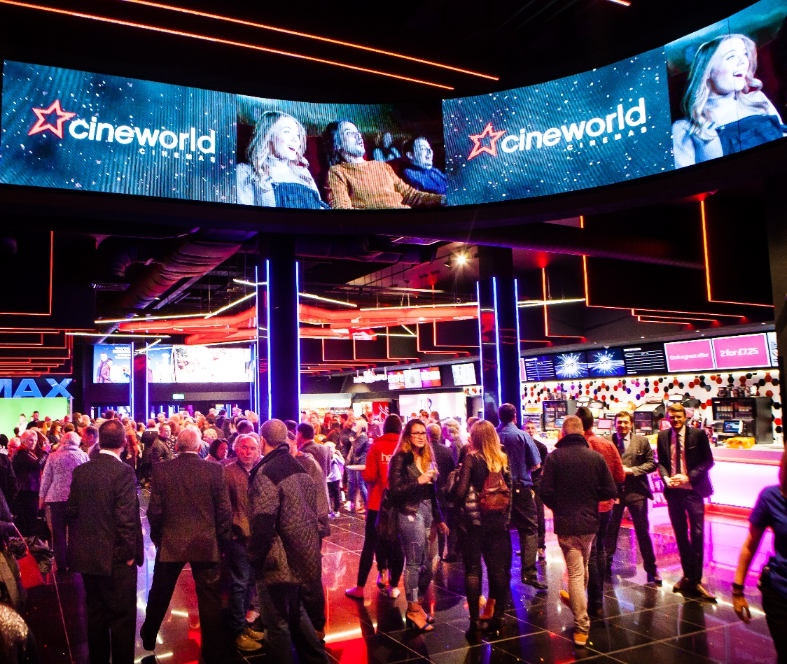
FOYER
Brand led, and co-branded ownership of some of the UK’s most futuristic cinema spaces.
DIGITAL OOH
Largest format digital outdoor creative in UK cinema.
- 30” Brand creative running across ceiling rotundas.
- Co-branded 30” 4DX Ad running across ceiling rotundas
- Co-branded Cineworld 4DX posters on 6 sheets.
SIGNAGE
- Permanent 4DX plus brand signage in foyers.
Notes:
The line underneath the header should be 0.50cm away from the header
The sub header is 0.50cm beneath the line
The copy should then be 1cm away from the sub header

Slide 17
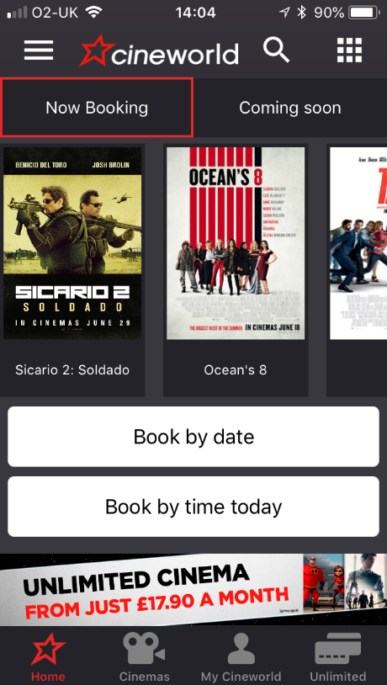
ONLINE
Far reaching ownership of Cineworld online channels
Cineworld Home Page
Co-branded Cineworld 4DX banner across desktop, mobile and app.
4DX Home Page
Co-branded Home Page banner and brand content on page welcoming customers to 4DX.
ECRM
Co-branded banner included in 1 x 4DX solus email sent per quarter to database of circa 1.8m.
Notes:
The line underneath the header should be 0.50cm away from the header
The sub header is 0.50cm beneath the line
The copy should then be 1cm away from the sub header

Slide 18
OTHER ADDITIONAL VALUE ACTIVATIONS THROUGHOUT THE PARTNERSHIP…

Slide 19
PREVIOUS CAMPAIGN EXAMPLES AND CASE STUDIES

Slide 20
SKODA 4DX PARNTERSHIP – POLAND

Slide 21
Forza horizon 3 CAMPAIGN
BEST MOMENT: The Audience Had Their Breath Taken Away As The 4X4 Leaps Through The Air.
Notes:
The line underneath the header should be 0.50cm away from the header
The sub header is 0.50cm beneath the line
The copy should then be 1cm away from the sub header

Slide 22
Call of duty: Ww2 CAMPAIGN
BEST MOMENT: The Audience Felt Every Bullet And Explosion As The Marines Charge The Beach On D Day.
Notes:
The line underneath the header should be 0.50cm away from the header
The sub header is 0.50cm beneath the line
The copy should then be 1cm away from the sub header

Slide 23
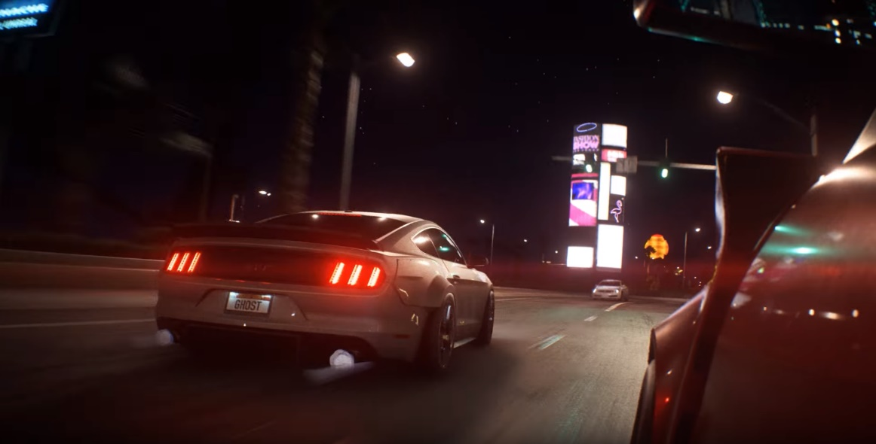
Need for speed: payback CAMPAIGN
BEST MOMENT: The Audience Felt Every Bullet And Explosion As The Marines Charge The Beach On D Day.
Notes:
The line underneath the header should be 0.50cm away from the header
The sub header is 0.50cm beneath the line
The copy should then be 1cm away from the sub header

Slide 24
CINEMA
VISUALS

Slide 25
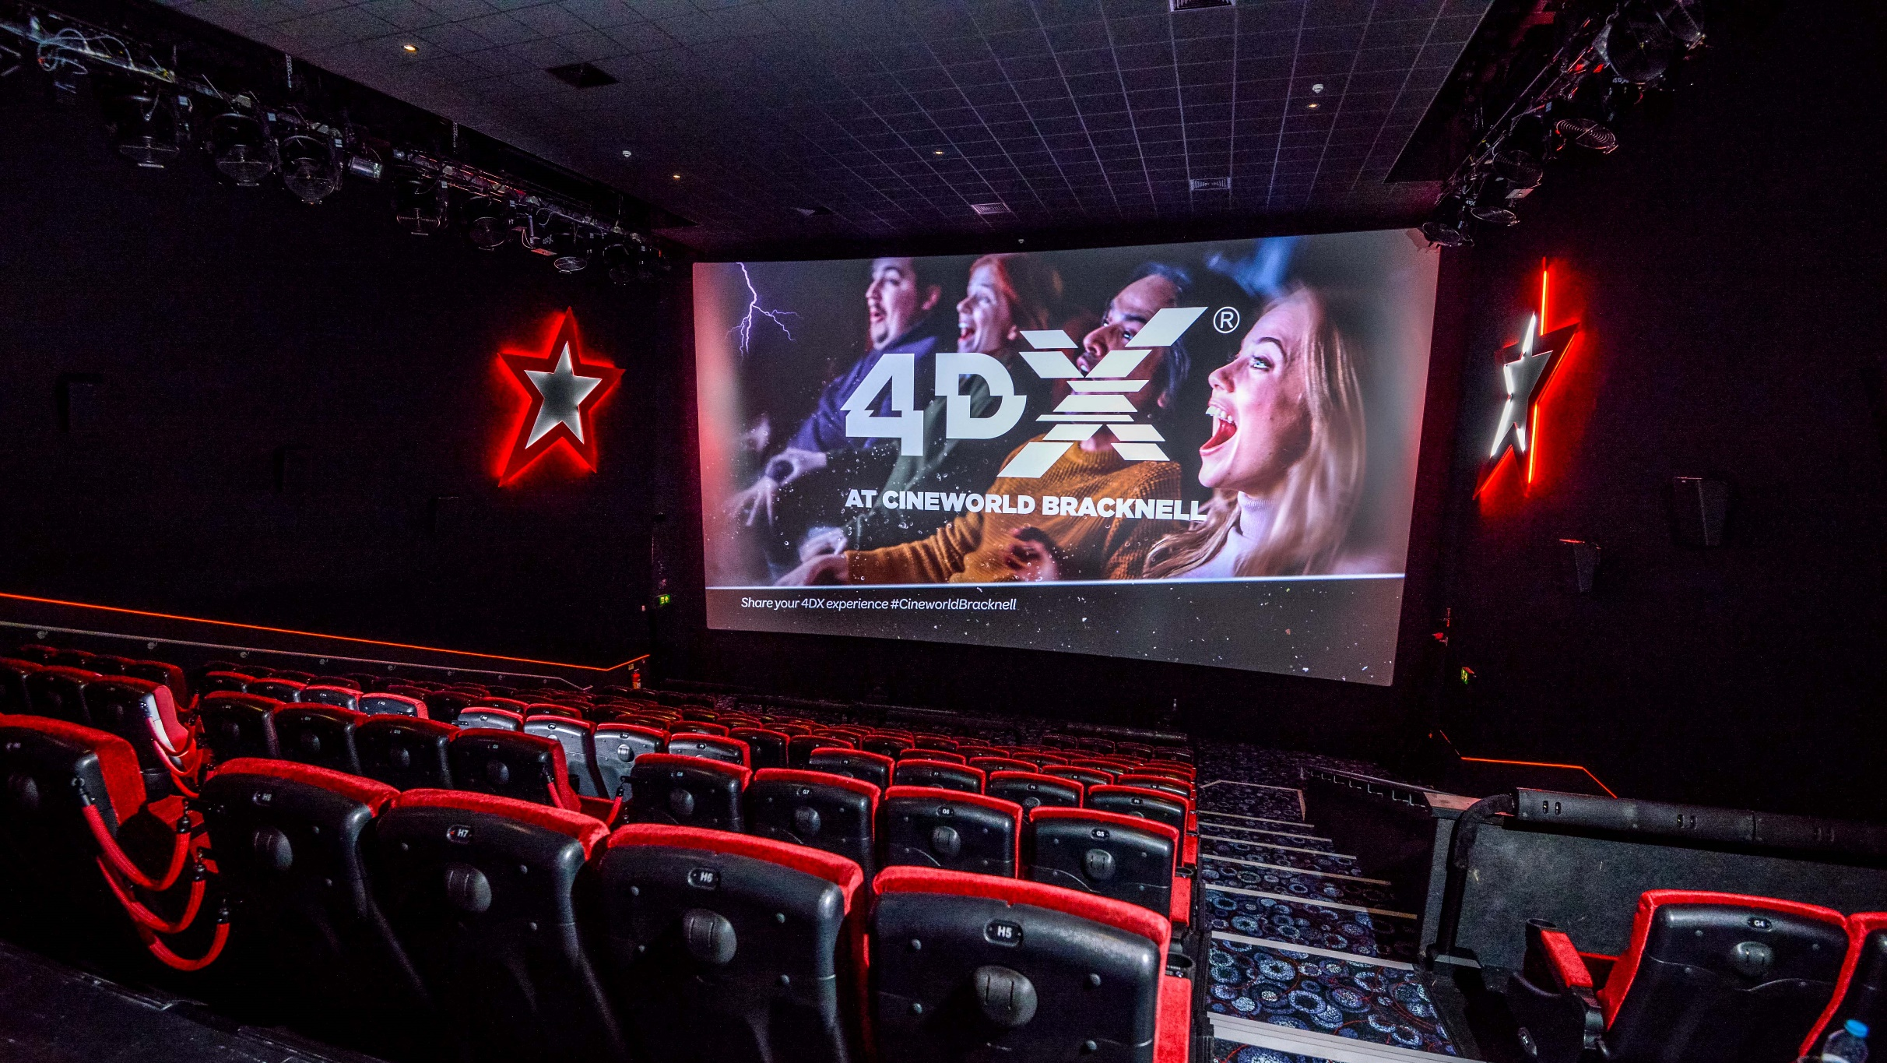

Slide 26
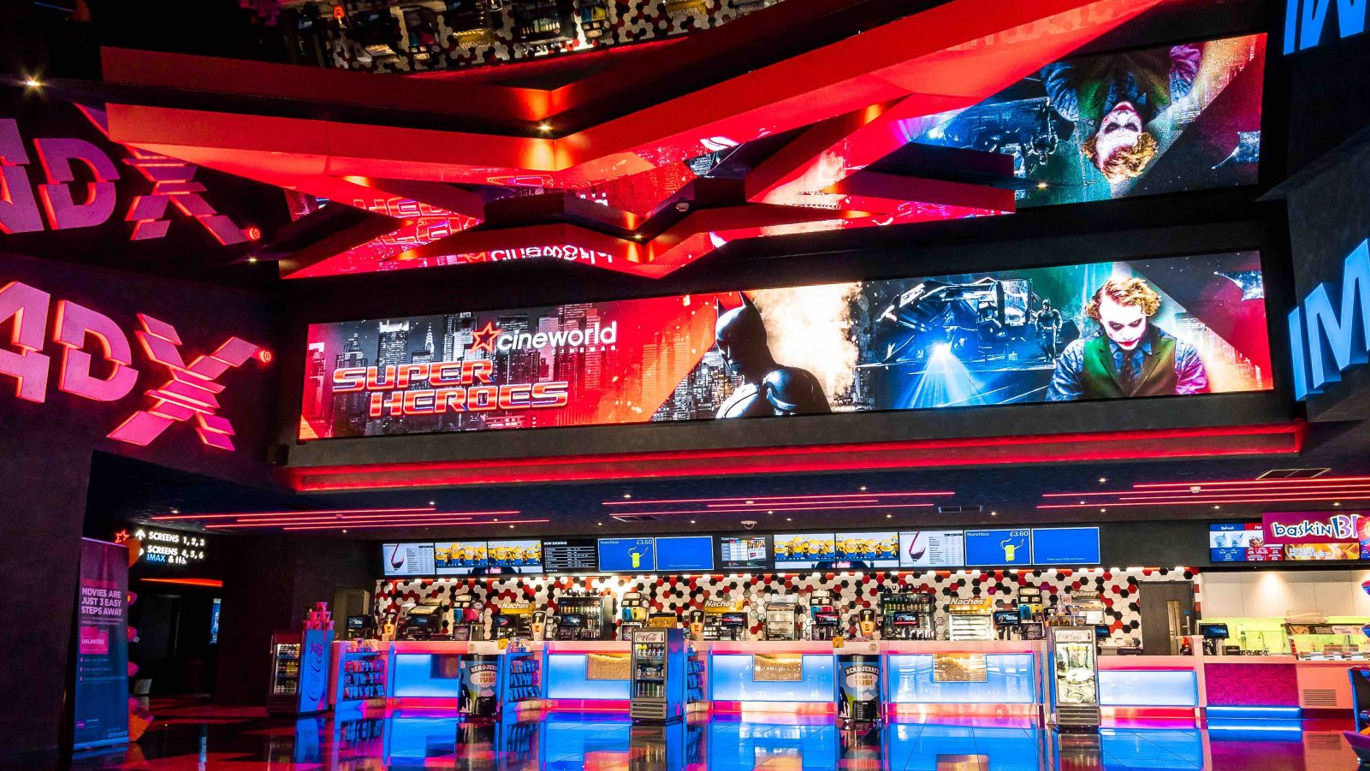

Slide 27
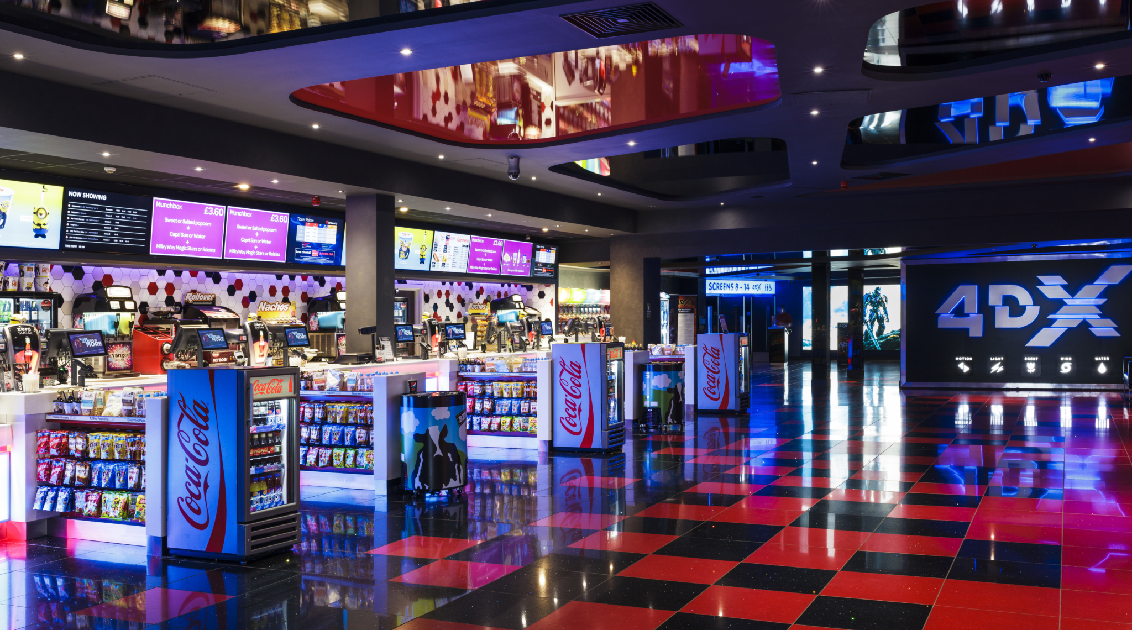

Slide 28
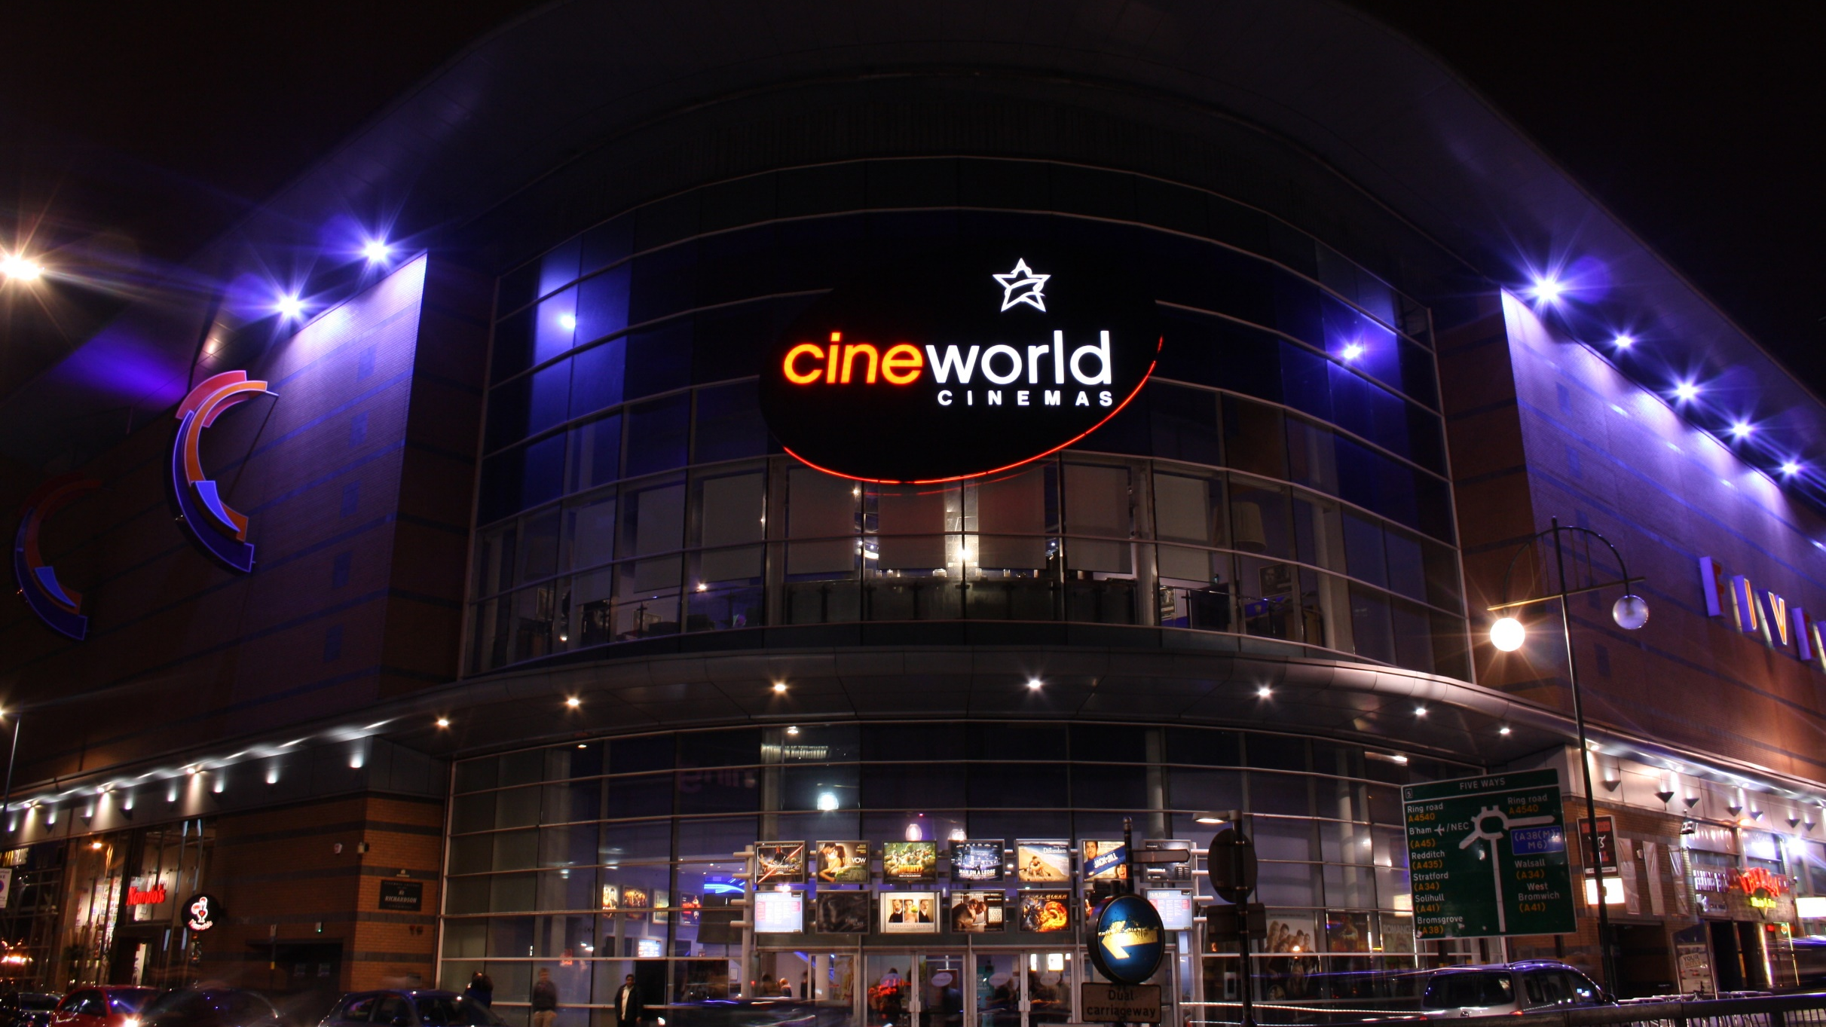

Slide 29
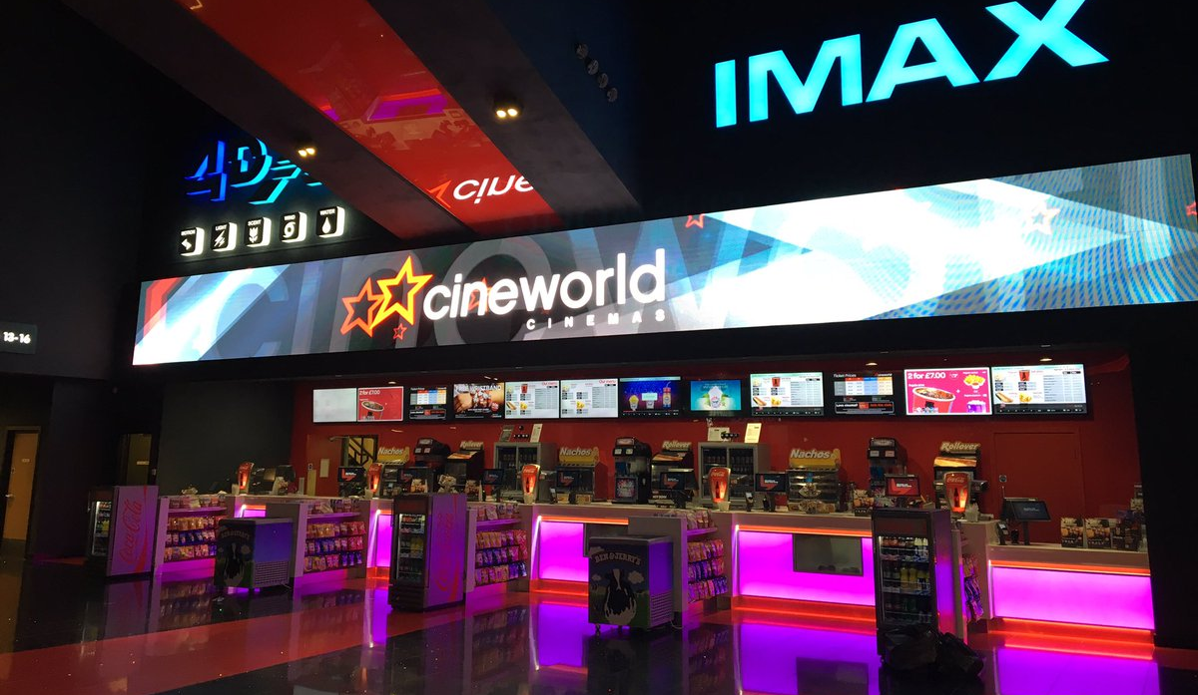

Slide 31
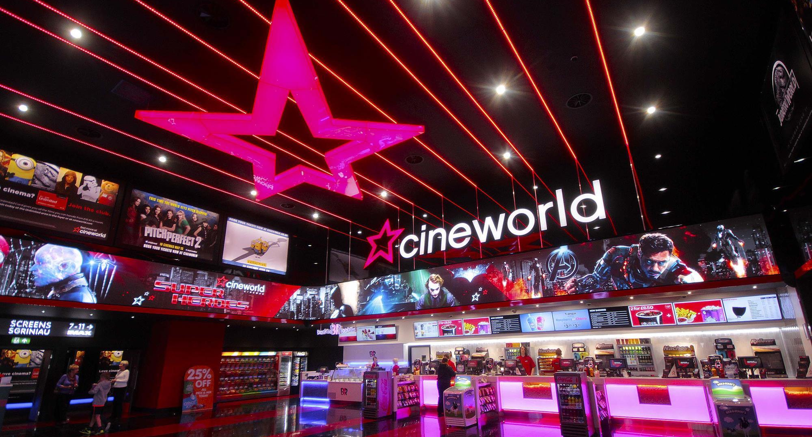

Slide 32
THANK YOU

