Slide 1

CINEWORLD – 4DX

Slide 2
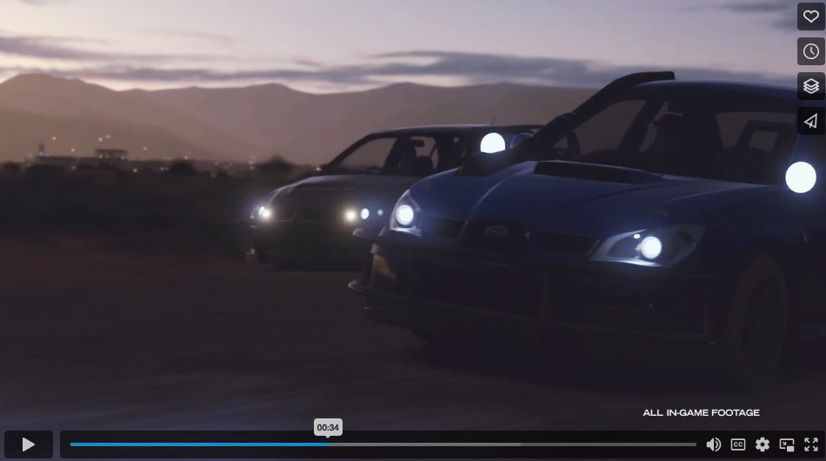
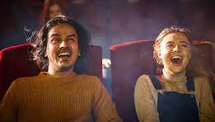
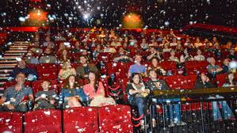
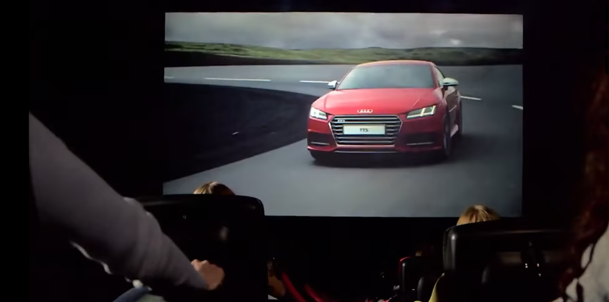





Cineworld – 4dx
A multi-sensory & immersive cinema experience
SUMMARY
Providing a revolutionary cinematic experience which stimulates all five senses, 4DX includes high tech motion seats and special effects including wind, fog, lightning, bubbles, water, rain and even scents.
These effects work in perfect synchronicity with the action unfolding on screen, creating the most unmissable and exhilarating cinema viewing experience yet. The films play out in both 2D and 3D.
4DX has to be experienced first-hand to be believed; please contact DCM for a 4DX showcase & screening
KEY BENEFITS:
BRAND OBJECTIVES - AWARENESS
Reach a young and engaged audience with an immersive cinema viewing experience
CLICK HERE FOR CASE STUDIES
CLIENTS:
Production | Exhibitor | Sites
8 weeks + | Cineworld | 35

Slide 3





CONTEXTUALLY RELEVANT CONTENT ENHANCES THESE SHIFTS IN BRAND METRICS
Meta-analysis of 22 recent cinema campaigns & 7 contextual / bespoke campaigns
Quality Brand Perceptions
Brand Consideration
+38%
+55%
+20%
+33%
Source: Differentology data bank. Meta-analysis consists of 22 campaigns and 7 bespoke campaigns.
Notes:
And research into our work with brands over recent year has demonstrated this.
The information in these charts has been taken from 22 recent cinema campaigns and 7 campaigns which have used bespoke content.
And the results are clear to see…
Standard Cinema advertising offers brands a way to boost key metrics.
But, there is an incremental benefit. An extra level brands can unlock through bespoke content

