Slide 1

START WITH CINEMA: NEW PRODUCT
Why you should start with cinema in your AV mix when launching a new product

Slide 2
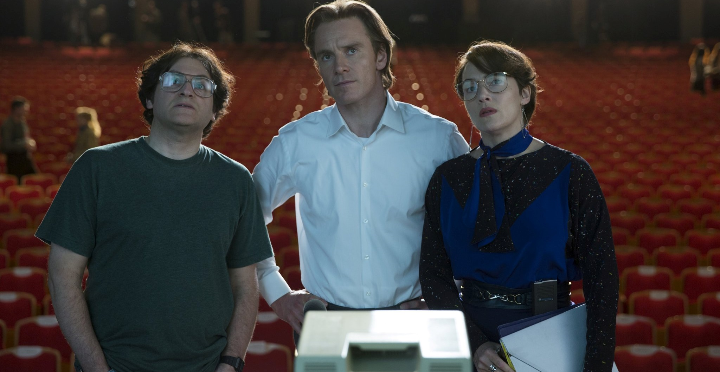
TO LAUNCH A NEW PRODUCT EFFECTIVELY, START WITH CINEMA
It’s a challenging time to launch a new product – media has fragmented significantly; audiences are increasingly distracted and developing trust and buzz at speed is arguably harder than it's ever been.
We believe that cinema can play a crucial role at this ‘must-win moment’ for your brand. The powers of the big screen and the surrounding environment have only gotten stronger as the media landscape has changed – unbeatable levels of attention, an upmarket, young-skew audience and premium environment – cinema delivers a combination of unique factors that cannot be replicated singularly by another channel.
The following slides are designed to help show you why we believe cinema is must-have as part of a successful AV launch plan for a new product.
Notes:
Features
1. Extra film filter allows bespoke audience targeting
2. Can be bought on a national or regional basis
3. Bar sponsorships are available, with 30% of our sites
featuring a bar on the premises
4. Comic book / action hero type releases will not be
included in these packages regardless of profile
5. £65 fixed CPT

Slide 3
MAXIMISE AV REACH BY STARTING WITH CINEMA
Redistributing weight from linear TV into cinema can increase total campaign weight for key audiences, particularly 16-34s
90% HPCH REACH
48% 1634 REACH
93% HPCH REACH
59% 1634 REACH
= HPCH UPLIFT: 3 PTS
= 1634 UPLIFT: 11 PTS
Source: IPA TouchPoints Channel Planner, Informed by ‘typical’ channel shares & pricing. Precise reach subject to final channel mix & spend.

Slide 4
STARTING WITH CINEMA IS ESSENTIAL FOR MAXIMISING ATTENTION
Cinema delivers unbeatable level of attention to ads, making it a crucial additional to the AV plan of any new product launch.
Source: Lumen

Slide 5
If you want cost-effective attention, start with cinema
Cinema’s unbeatable level of attention to ads means when you adjust 16-34 CPMs for attentive seconds its one of the most cost-effective AV channels for reaching this key audience
Source: DCM has applied Lumen Attention data to estimated industry 16-34 CPMs to calculate aCPM
Cinema CPM based on 16-34 AGP
Notes:
One challenge we hear from agencies and clients is that cinema is too expensive, and if you look at it purely through a lens of CPTs, you can understand where that challenge stems from.
But we know that not all impacts are made equal. Although some channels can offer cheaper impacts, a lot of that delivery can often go unnoticed.
We know the importance and effectiveness of attention to deliver uplift against key brand metrics.
And we have applied Lumen Attention data to estimated industry 16-34 CPMs to calculate an Attentive CPM, and again, cinema outperforms linear TV, OOH, digital display, and Facebook, whilst being comparable to YouTube and Instagram, so really impressive numbers.
We can therefore quite confidently counter the premium price challenge, and demonstrate that if you want cost-efficient attention, you need to start with cinema.

Slide 6
TRUSTED ENVIRONMENT: Cinema IS KEY FOR LAUNCHING WITH TRUST
Cinema is the AV channel that audiences trust the most in terms of advertising – offering brands a positive environment where audiences are receptive to brand messaging
‘I trust the advertising in…’ scores indexed vs cinema
Source: IPA Touchpoints 2022. Base: All Adults 15+
‘I trust the advertising in…’ - % agree

Slide 7

Cost signalling: cinema can help drive premium perceptions for new products
Investing in a premium channel such as cinema helps signal to the audience that your brand is also high quality and can also help validate price premium too for higher end products.
Signalling can be a valuable aspect to consider as part of media planning – where someone sees your brand can impact their perceptions of the product and message.
Cinema can be a key signal for brand health and quality because its seen by the audience to be a premium experience, and so they can also begin to associate this perception with the brands who appear on screen.
Perceptions of cinema as a more expensive form of advertising can mean that they believe brands advertising there are in positions of financial strength or have significant confidence in their product (and its quality).

Slide 8
KANTAR RECOMMENDs including/upweighting cinema FOR more effective campaigns
Analysis of over 1,000 campaigns from Kantar’s CrossMedia database recommends brands should upweight cinema to achieve awareness, association and motivation goals, all key during the launch of a new product.
 | TV | Facebook | OOH | YouTube | Cinema | News-brands | POS | Online display | Magazines
AWARENESS
ASSOCIATION
MOTIVATION
What has worked in the past
 | Major channel
 | Minor channel
Recommendations
 | Channel to downweight
 | Channel to upweight
Source: Kantar/SAID Business School/University of Oxford, WARC Article

Slide 9




CINEMA HELPS DELIVER SUCCESS AS PART OF THE PRODUCT LAUNCH PLAN
Recent launches that started with cinema as part of the AV mix and the latest uplifts from the DCM databank for new product campaigns
DCM DATABANK: NEW PRODUCTS
+35%
“FOR PEOPLE LIKE ME”
+25%
LIKELY TO CONSIDER
+13%
INTEND TO ACT
Source: DCM/Differentology, average relative uplifts, exposed to cinema vs. not exposed to cinema

Slide 10

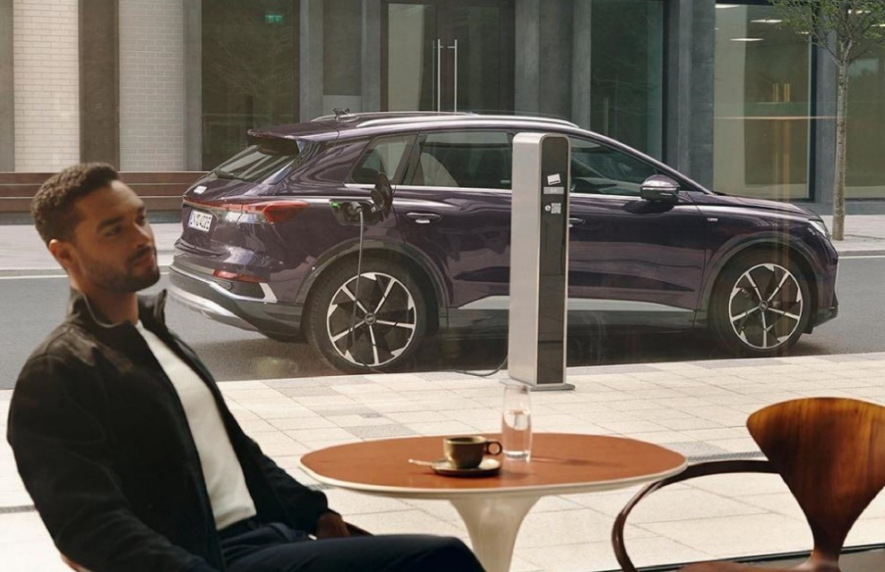

CASE STUDIES
Brands have seen great success when starting with cinema in the AV mix to launch a new product
L’Oreal
Audi
Prime Video
Prada Paradoxe
e-tron
The Devil’s Hour
Billed as Prada's new signature feminine fragrance, L'Oreal wanted to ensure the launch campaign reflected the stature and prestige of the product.
Cinema was therefore a great fit for the brand, with the campaign film running in titles that would efficiently deliver against a female audience.
Adding cinema to the mix delivered significant success with uplifts seen in awareness of the Prada Paradoxe fragrance (+45%), agreement that Prada Paradoxe ‘is sophisticated and aspirational’ (+36% uplift) and consideration of buying the scent was also 28% higher among the group exposed to the ad in cinema too.
Audi wanted to be on the front foot and establish its credentials as a leader in the electric vehicle market by promoting both its Q4 e-tron and e-tron GT models.
Gold Spots in major blockbusters were picked out, to run as part of a broader AV mix (TV, BVOD, Social, Online), adding premium associations and an upmarket audience skew to the plan.
Cinema helped deliver increases in awareness for both models featured across the campaign, with an average uplift of 14% vs control.
Cinema also helped drive top end consideration. The cinema exposed group were 32% more likely to be ‘extremely likely’ to consider Audi if they were buying an electric car vs. control.
Prime Video worked with DCM Studios to create a high impact, disruptive launch campaign for its new psychological thriller series The Devil’s Hour.
Disrupting the cinema reel by running 3 bespoke 10” blipverts, the main 30” ad, and a ‘takeover’ of the DCM closing ident delivered prominence for the show in an already high attention environment.
This high frequency approach to cinema worked very well for Prime Video. Awareness of The Devil’s Hour show increased by +56% vs control, recall of the in-reel advertising was +25% vs. DCM benchmark and consideration to watch the show was +1-5% vs. those who hadn’t seen the cinema ads too.

Slide 11

Thank you
Please speak to your DCM rep for more information and costings for starting with cinema

