Slide 1
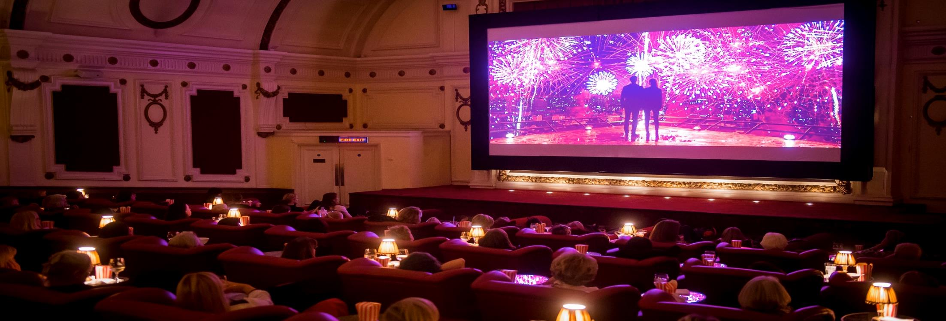
Dcm independent CINEMAs
Offering a premium experience for a discerning, affluent audience

Slide 2


DCM’S INDEPENDENT PARTNERS
+ 169 INDEPENDENT CINEMAS

Slide 3
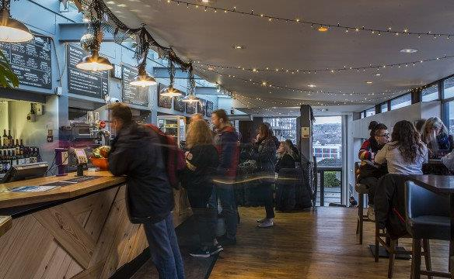
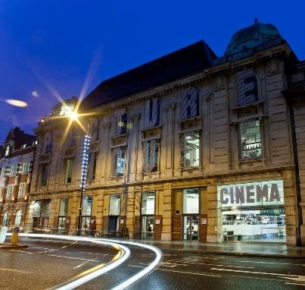
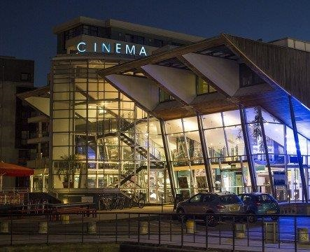

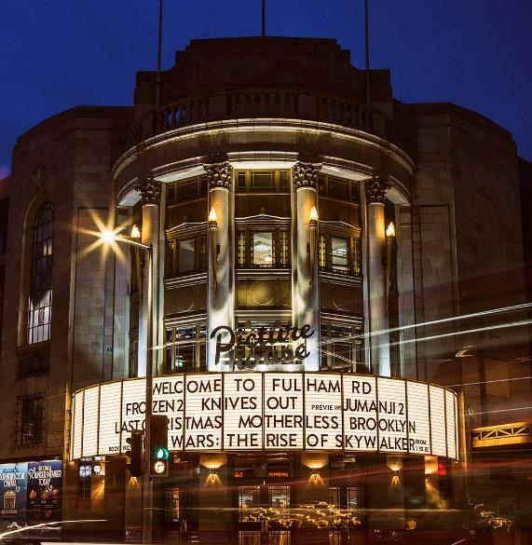
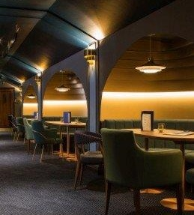
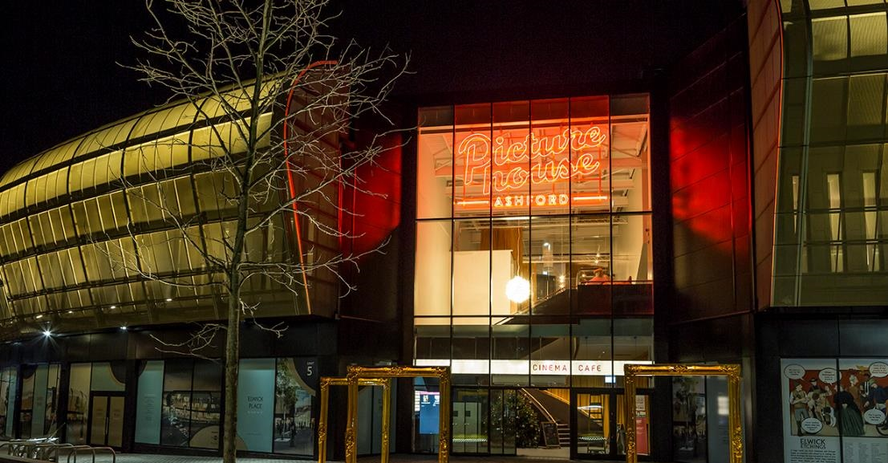

Slide 4
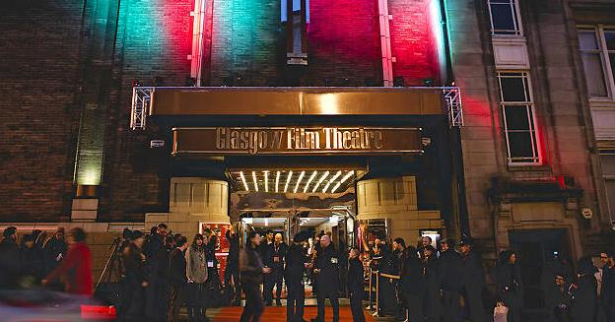
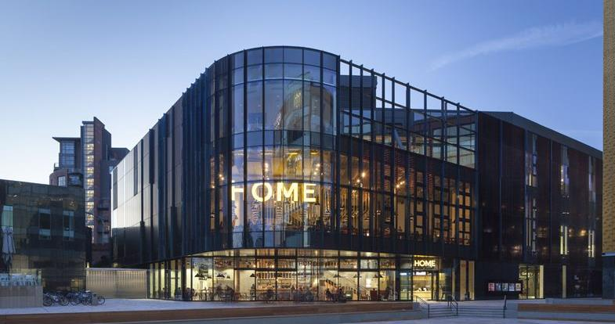
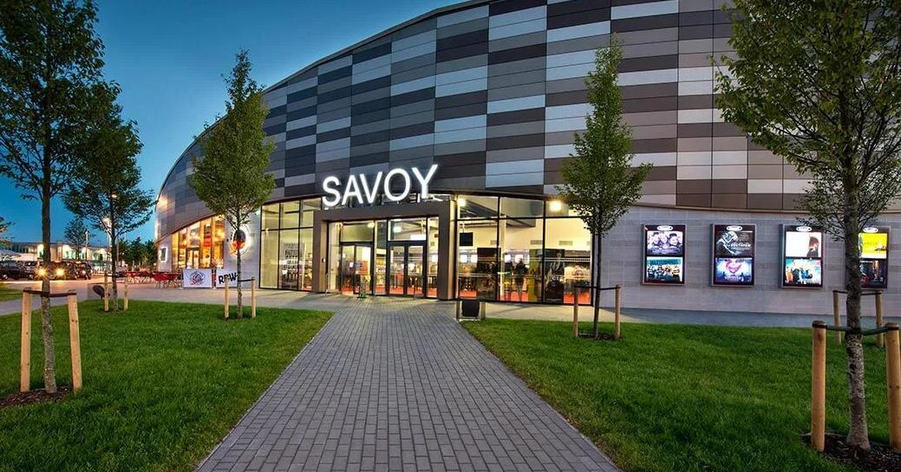
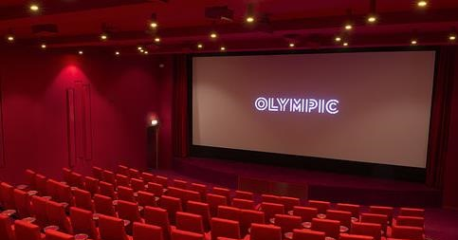
DCM
INDEPENDENTS

Slide 5
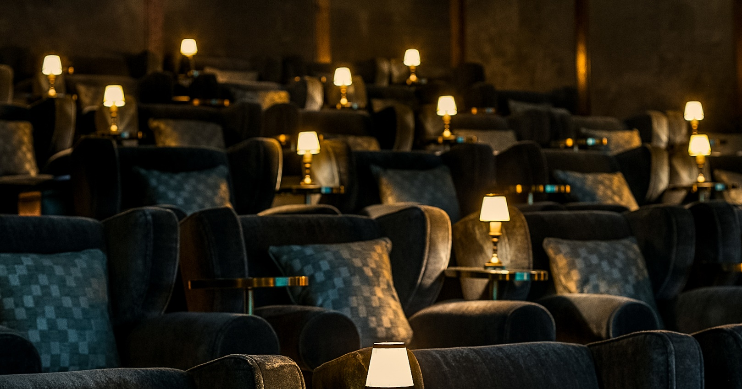
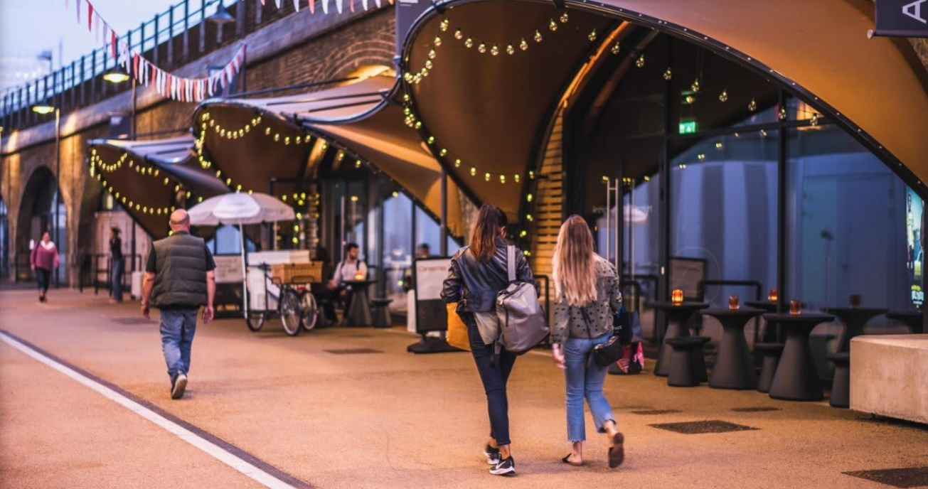
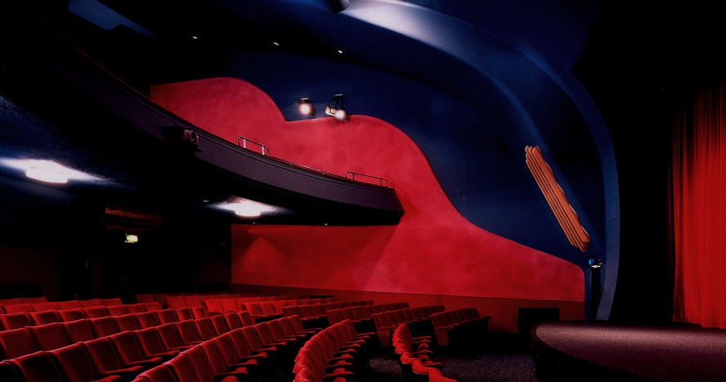
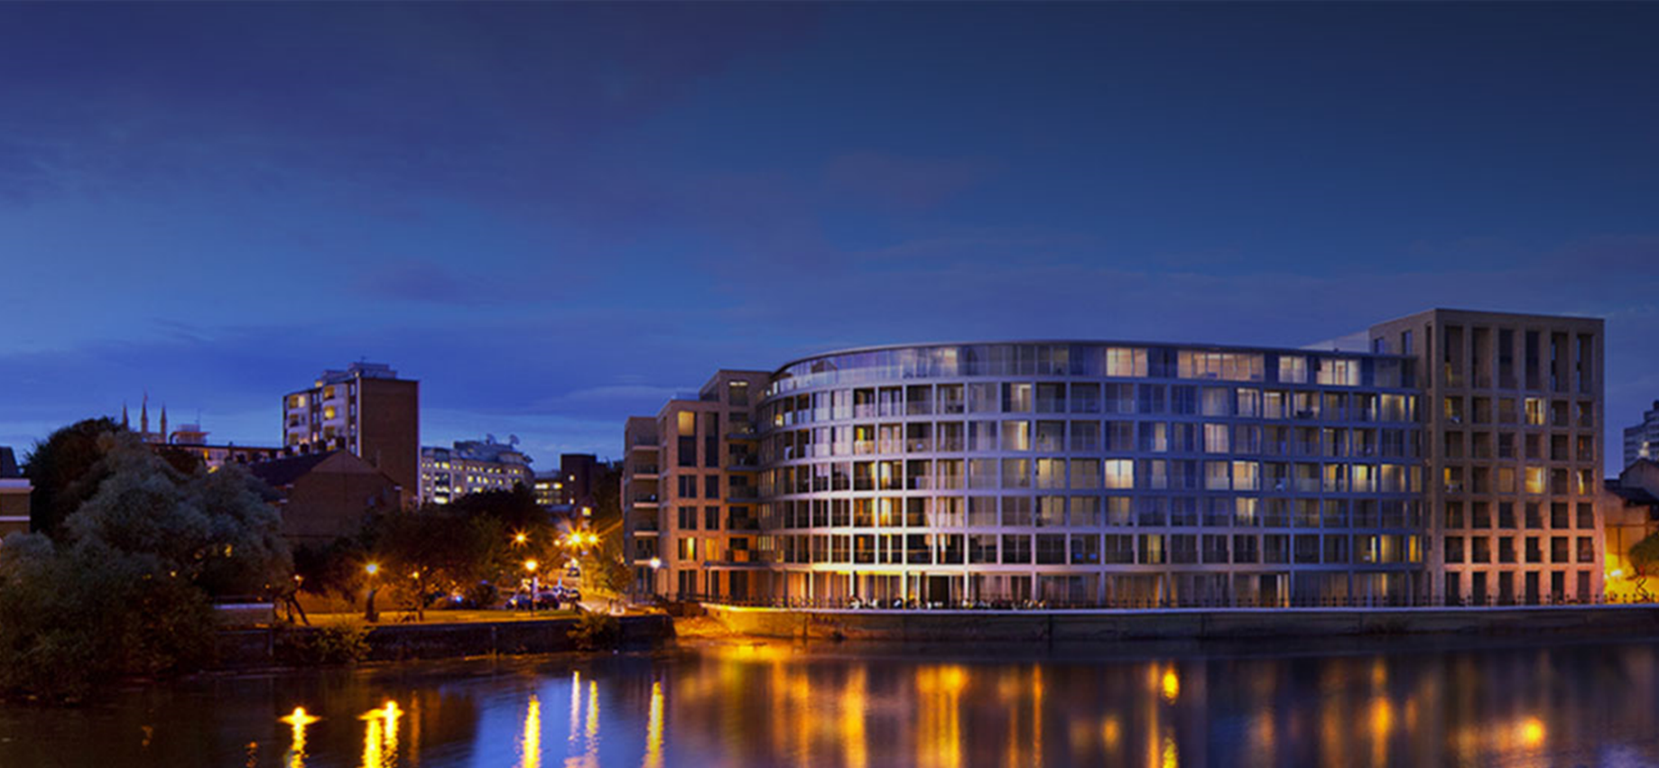
LATEST ADDITIONS: LONDON
Electric White City
Archlight, Battersea
Rio Dalston
Riverside Hammersmith

Slide 6
Independent cinema HAS BEEN thriving IN THE UK
Independent cinema was experiencing significant growth in the UK pre-pandemic
Independent cinemas are broadening
what they offer and taking a more
­fundamental role in communities.
    Ben Luxford, British Film Institute (BFI)
There is definitely a rise in boutique cinemas – they are tapping into a slightly different audience.
    Nigel Parson, Leisure Analyst,
    Canaccord Genuity
Indie ­theatres are the new big thing. It’s looking like a
new golden age.
    Nada Farhoud, The Mirror
Independent cinema has never known a time like it, Indie theatres are reinventing themselves as the new entertainment hubs on
the high street – eating into the market share of in-home
rivals such as Netflix and Amazon Prime.
Rob Walker, The Guardian
We’re comfortable. We’re part of the neighbourhood, nice food and drink. And a big plus for us is the depth and range of our programming.
Clare Binns, Picturehouse

Slide 7
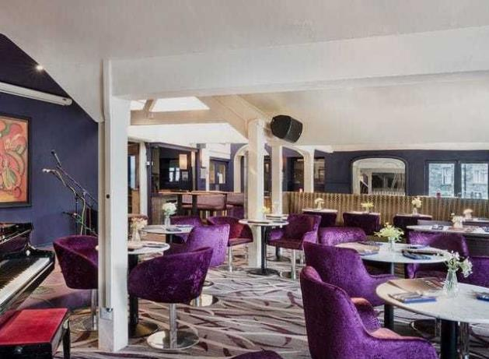
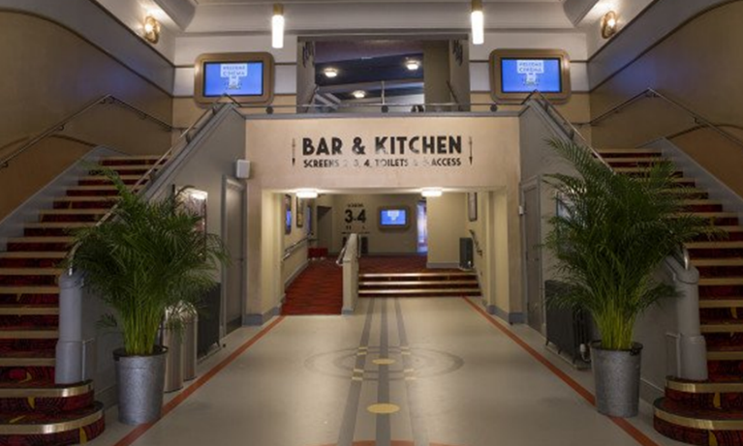
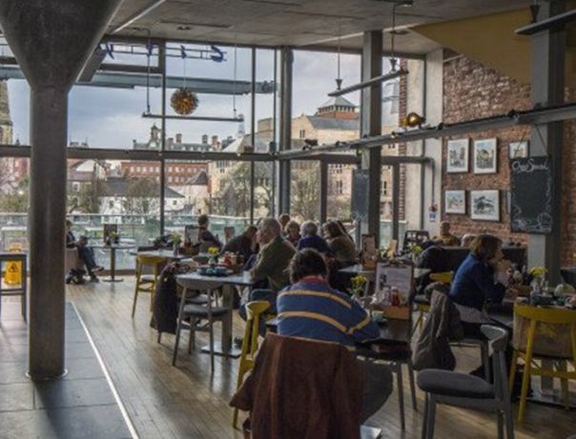
THE QUALITY EXPERIENCE IS A KEY DRIVER FOR Independent cinema
Atmosphere
Index: 159
Great customer
service
Index: 166
Café, bar or
restaurant to enjoy
as well as the film
Index: 160
Membership /
Loyalty card:
Index: 152
Source: FAME 2019. Reasons for cinema choice vs. average GB cinemagoer

Slide 8
INDEPENDENT CINEMAGOERS
ARE 25% MORE LIKELY TO BE
HEAVY CINEMAGOERS
Source: GB TGI Q3 2020 (Apr 2019 – Mar 2020).
Base: Been to an Independent or Picturehouse cinema in last 12 months
Index vs. Multiplex cinemagoers.

Slide 9
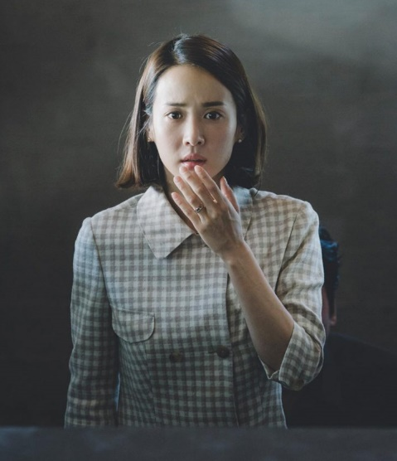
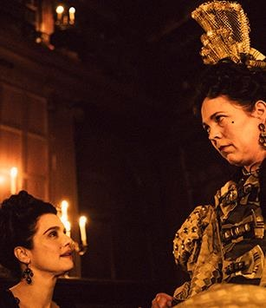

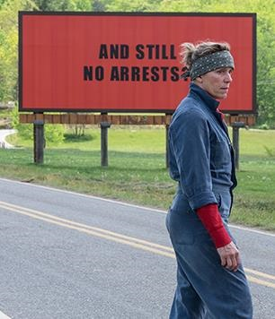
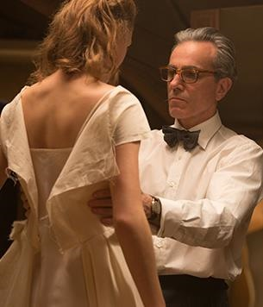
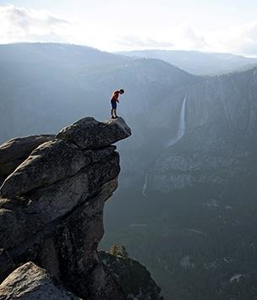
Academy award winners DRAW IN THE CROWDS TO INDEPENDENT CINEMAS…
Independents deliver 15% of all DCM admissions, but often a far higher proportion of Oscar winning movies
Parasite
The Favourite
39% of DCM admissions
Call Me By Your Name
32% of DCM admissions
71% of DCM admissions
Three Billboards Outside Ebbing, Missouri
Phantom Thread
Free Solo
62% of DCM admissions
73% of DCM admissions
33% of DCM admissions
Source: DCM admissions data.

Slide 10
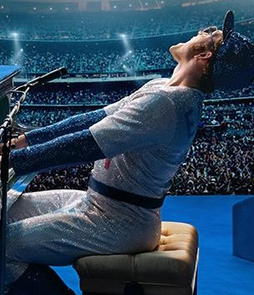

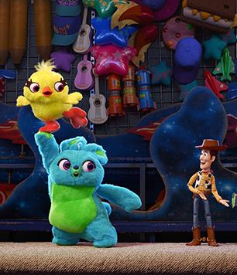
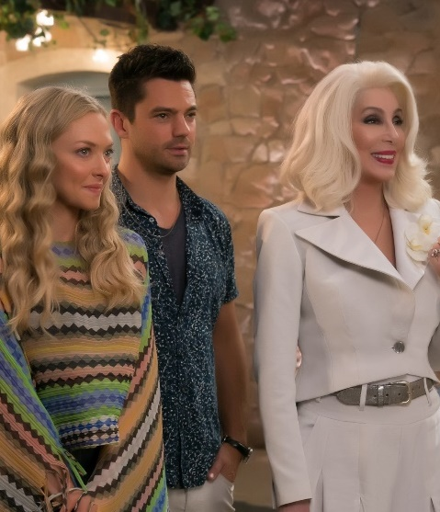


…But they ALSO ENJOY blockbusters TOO
Independent cinemagoers also seek out quality blockbuster entertainment across the year
Rocketman
Star Wars: The Rise of Skywalker
Index: 224
Toy Story 4
Index: 135
Index: 165
Mamma Mia: Here We Go Again
Knives Out
Tenet
Index: 198
Index: 189
Index: 185
Source: GB TGI.. Base: Picturehouse or Independent Cinemagoers (Most Often). Q: Films Seen in Last 6 Months.

Slide 11









THE Independent AUDIENCE
Independent cinema gives brands the opportunity to engage a discerning, affluent audience
Demographics
Independents attracts an affluent audience
Lifestyle
Heritage and quality are key choice drivers
Media habits
Enjoy a range of premium media outlets
 | Independent cinemagoer | Average GB adult profile
15-34 | 28% | 31%
35-54 | 32% | 30%
55+ | 43% | 38%
AB | 36% | 26%
£50k HH Income | 21% | 16%
I pay attention to where the products I purchase are made/grown (Index: 140)
It’s worth paying extra for quality goods (Index: 115)
I buy Fair Trade products when available (Index: 133)
Source: GB TGI March 2021 (Feb 2020 – Jan 2021)
Curzon, Picturehouse or Independent = Cinema most visited often
Index vs. average GB adult

Slide 12
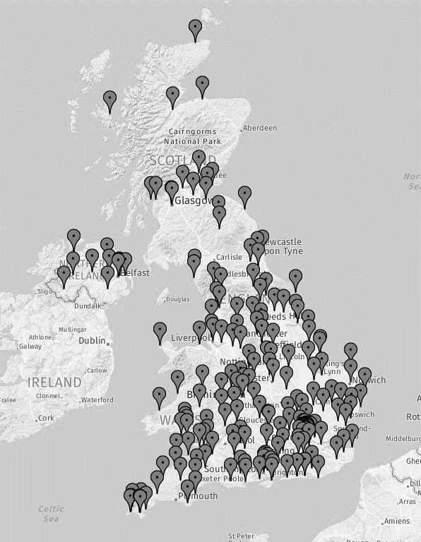
DCM’S INDEPENDENT CINEMAS OFFER BRANDS NATIONAL COVeRAGE
Number of independent cinemas on a high street,
retail park or in a shopping centre
42% of independent cinemagoers
go shopping, or for food and drink after their cinema trip
Sources: DCM Cinemapper & FAME 2019
Notes:
52% of multiplexes in high street or shopping centre

Slide 13

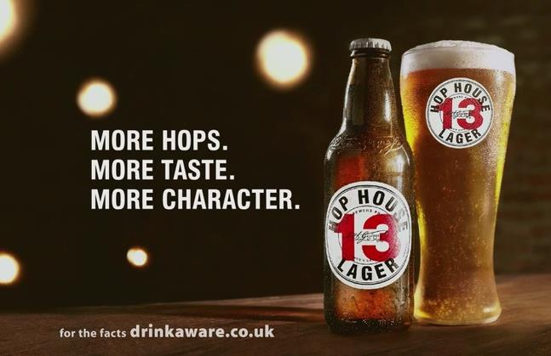

INDEPENDENT CINEMA CAMPAIGN SUCCESSES
Max Factor
Get The Look @ Boutique cinemas
Hop House 13
Discover Tuesdays @ Picturehouse
Volkswagen
Independent cinema sponsorship
Max Factor became the first ever partner of DCM’s flagship boutique estate cinemas. Alongside screentime activity running across all titles in these cinemas the partnership also extended to off-screen activations including exclusive premiere events, online & social media presence and competitions.
The cinema activity helped re-affirm Max Factor’s association with Hollywood glamour and re-enforced perceptions of quality. The tutorial creatives also helped drive consideration of Max Factor’s key products and ultimately helped drive sales:
Healthy Skin Harmony saw 3.5% value sales growth when the foundation category is in overall decline and Max Factor was the number 1 selling brand in Boots across the key December period.
Hop House 13 became the headline partner of Picturehouse’s ‘Discover Tuesdays’ – encouraging consumers to discover Guinness’ lager for the first time alongside a new film.
‘Hop House 13’ owned Discover Tuesdays as part of a year-long partnership incorporating a 30” on-screen advert, in foyer activations, bar stocking, online banners, social media and newsletter branding.
The results proved significant for Hop House 13 - across the 12 month partnership almost 35,000 units were sold across Picturehouse’s 23 cinemas.
Volkswagen supported independent cinema for over a decade; a partnership that has delivered clear long-term benefit by establishing a strong bond between the brand and a business critical audience.
When the sponsorship began, 29% of those exposed said that they would consider a Volkswagen in the future - within three years this had more than doubled, reaching 64% (Source: CAA 2007).
Those exposed to the campaign are twice as likely to consider Volkswagen as their number one choice than those who aren’t (Source: Hall & Partners 2014).
As well as shifting brand perceptions and consideration metrics the sponsorship has also helped sell more cars. VW’s market share has grown by 22% in the 10 years from 2004 (7.1% to 8.7% in 2014).
Notes:
52% of multiplexes in high street or shopping centre

Slide 14
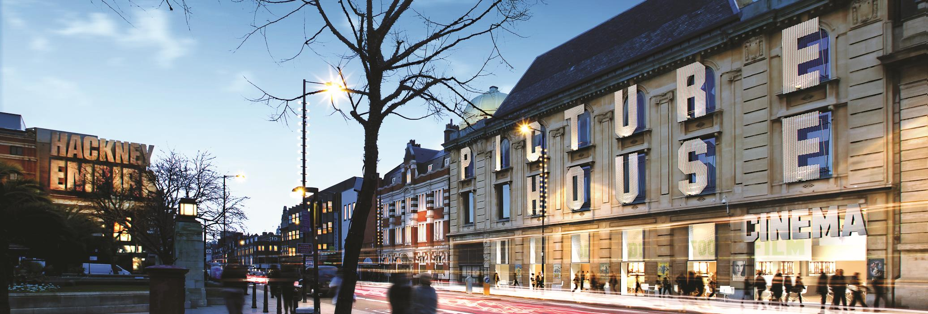
THANK YOU

