Slide 1


























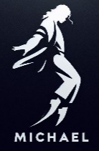




FILM SLATE 2025
TRON
ARES
Insidious (Sequel)
VICIOUS
JAN
Feb
Mar
APR
MAY
JUN
JUL
AUG
SEPT
OCT
NOV
DEC
28 Years Later

