Slide 1

Our cinemas
Digital Cinema Media (DCM) represents over 80% of the UK cinema marketplace

Slide 2
the numbers
UK CINEMA
4,543
838
    screens
    sites
Digital Cinema Media: 79% of UK admissions
P&D: 21%
Pearl & Dean
is the only other
major competitor
3,500
520
    screens
    sites
Source: UK Cinema Association, IHS, CAA, 2020

Slide 3




DCM: OUR CINEMA PARTNERS
PLUS 160+ INDEPENDENT CINEMAS

Slide 4
THE DCM ESTATE
INDIES
SITES | 101 | 112 | 87 | 27 | 169
SCREENS | 1074 | 896 | 834 | 98 | 475

Slide 5
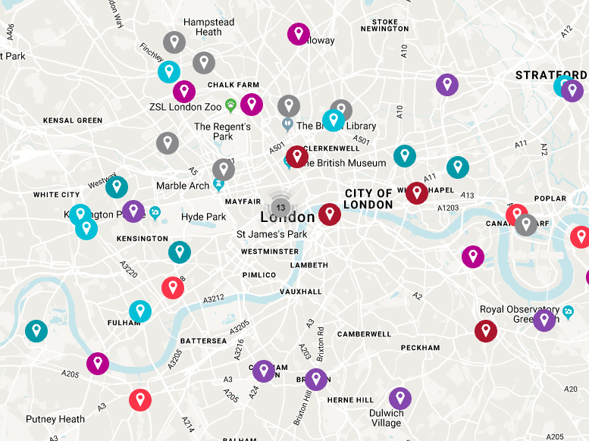
Investment in cinemas is continuing with 100 new screens across the UK
Including the below in London alone…
ODEON Leicester Sq. (3)
Marble Arch (5)
Cineworld Hounslow (10)
Picturehouse Ealing (8)
Finsbury Park (9)
Independents Battersea (3)
Dalston (2)
Hammersmith (2)
White City (3)

Slide 6
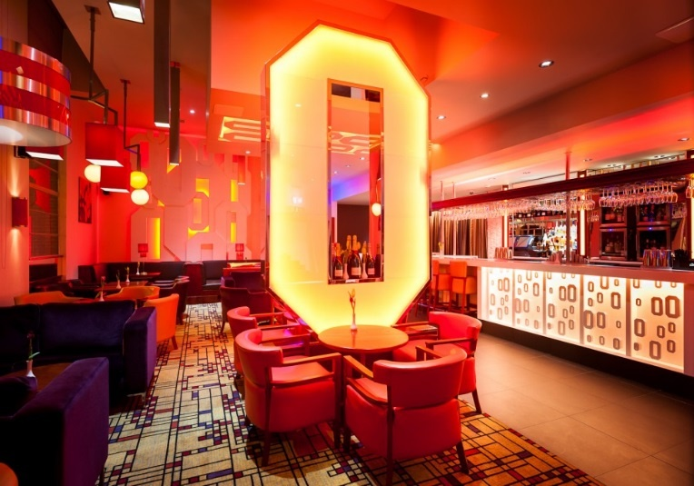
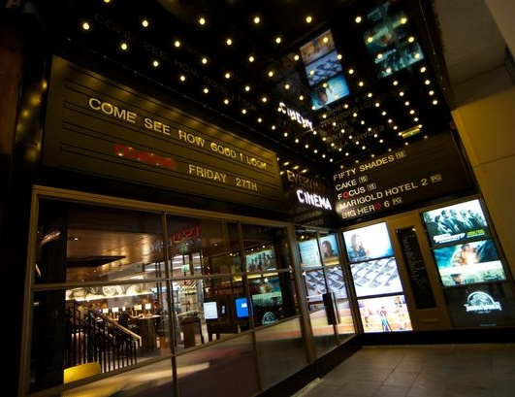
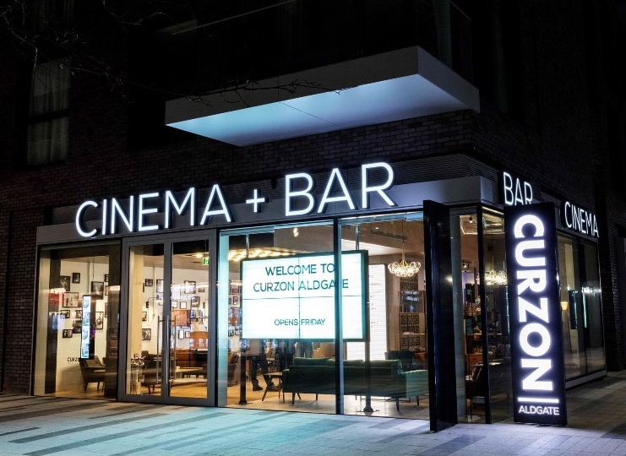

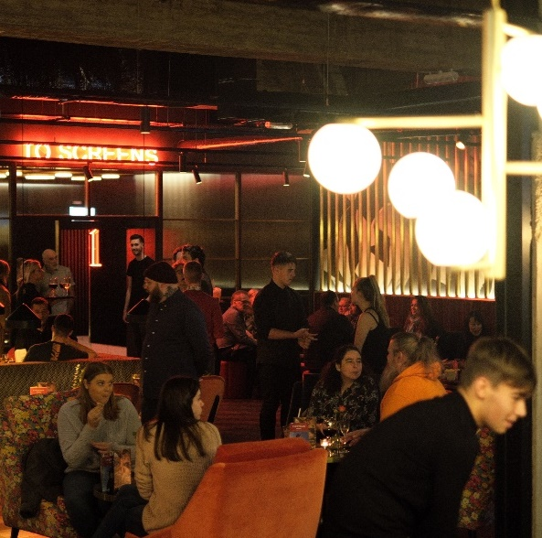
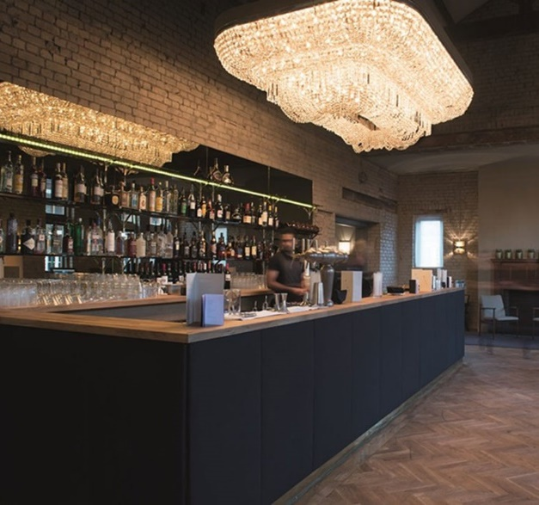
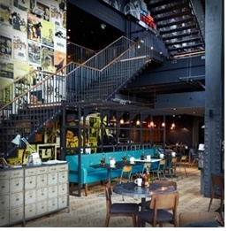
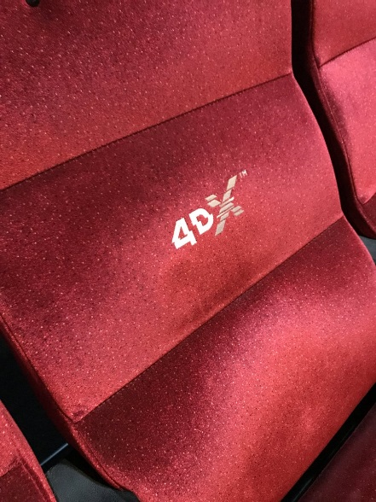
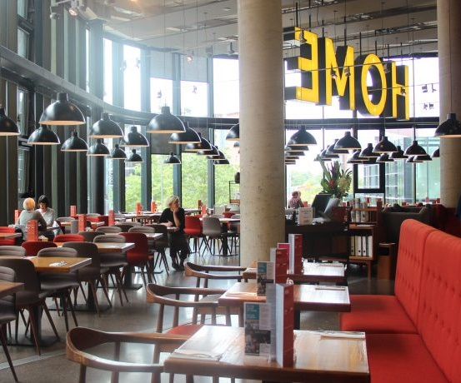
The Cinema experience IS more than just the film
Our exhibitors are world leaders in ensuring their cinemas provide a luxurious and innovative experience for audiences.

Slide 7

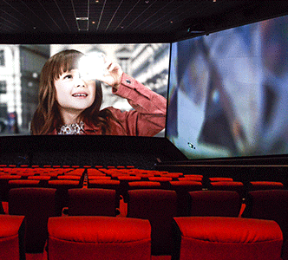
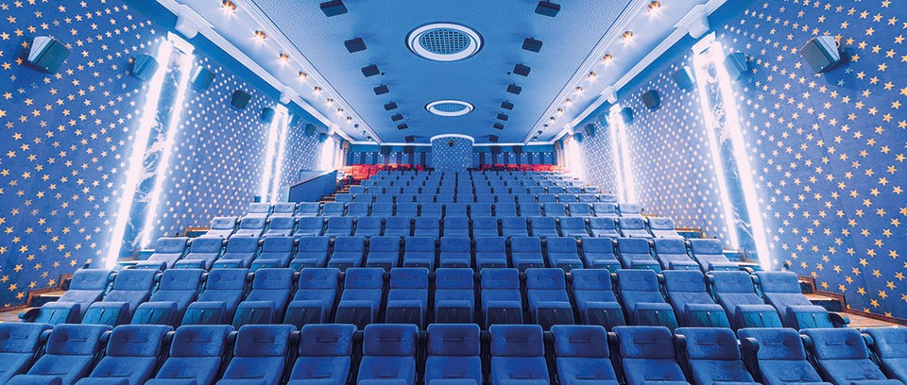



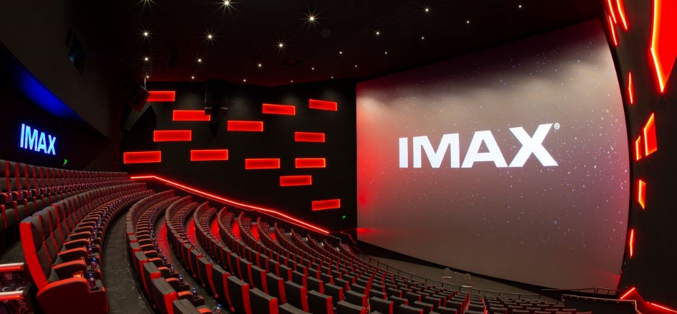
OUR CINEMAS ARE ALWAYS LOOKING To invest in new TECH to enhance the experience
Dolby Atmos expands on existing surround sound systems by adding height channels, allowing sounds to be interpreted as three-dimensional objects – fully enveloping audiences in the soundscape of the film. Installed in over 60 screens so far, brands can upgrade their ad to take advantage of this stunning audio in cinema.
4DX is extreme sensory cinema. With stimulating effects like water, wind, scent and strobe lighting, that thrill you in your moving seat 4DX is the most exhilarating way to watch a film.
4DX screens can be found in 35 Cineworld sites across the UK with plans to continue rolling out more in future.
Brands can ‘4DX’ their own ads to fully immerse the audience in the ad and maximise the impact of creative amongst a young thrill-seeking audience.
Case study from the British Army available on dcm.co.uk
Screen X is a state-of-the-art atmospheric experience that uses twelve additional projectors to extend the film out onto the side walls of the screening room and surround the audience in their seats with 270° projection. Extending the film beyond the audience’s peripheral vision brings them closer to the action than ever before.
Screen X can be found in 23 Cineworld sites across the UK with plans to increase this further. Brands can showcase their own ads in Screen X format – see a case study from Halifax on dcm.co.uk
IMAX screens stretch from floor to ceiling and from wall to wall, creating a picture so big it feels like you’re inside the film but yet still being able to see every detail in stunning high-resolution. Available for brands to upgrade their ads to IMAX and showcase in over 40 cinemas.

Slide 8
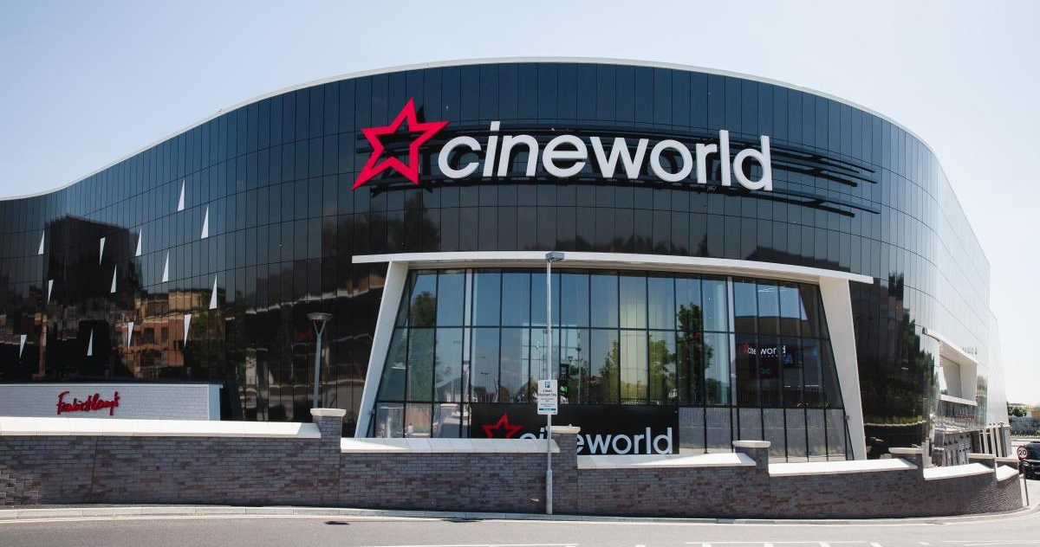
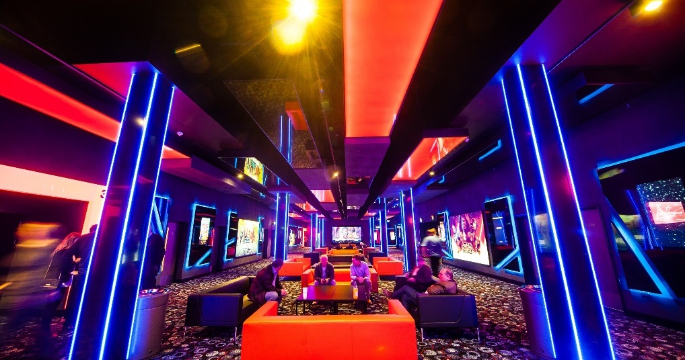
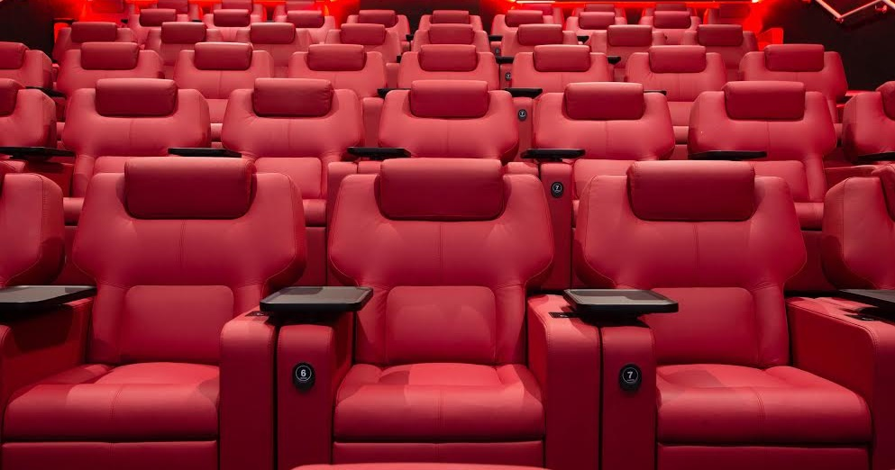
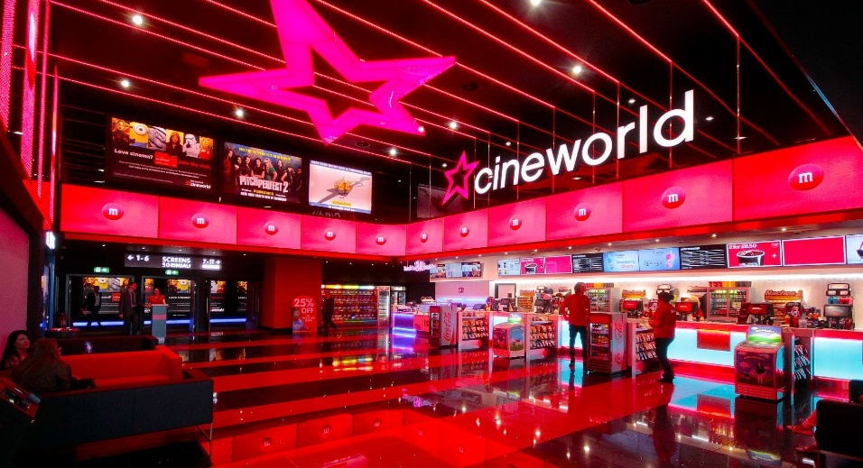

Slide 9
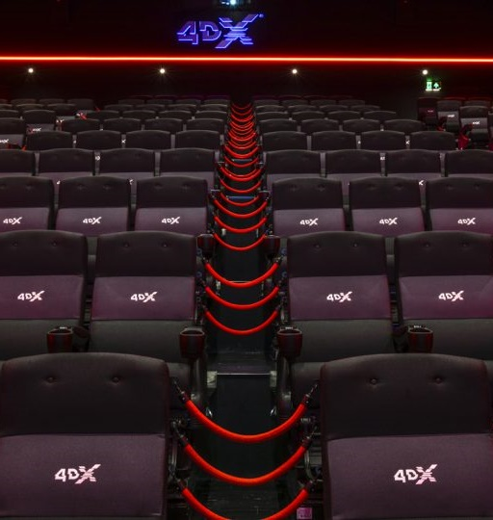
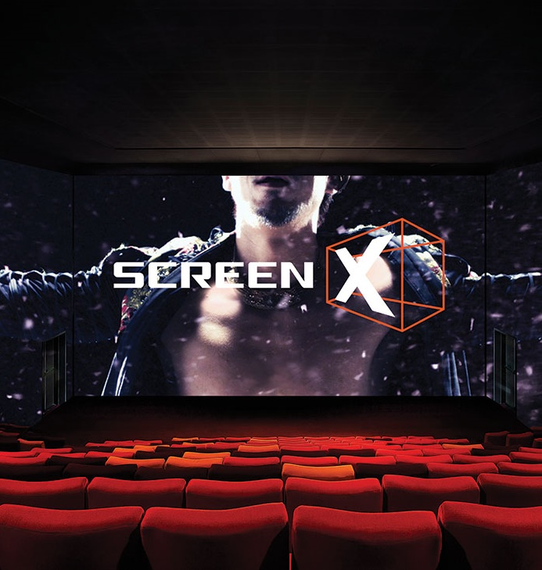

Slide 10
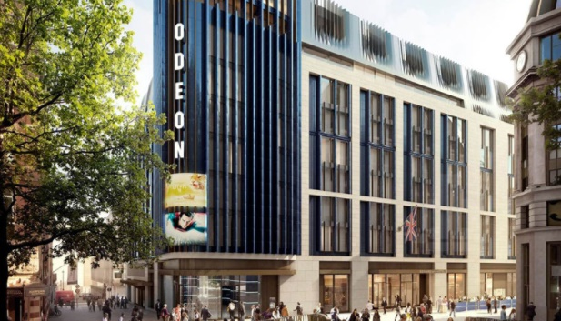
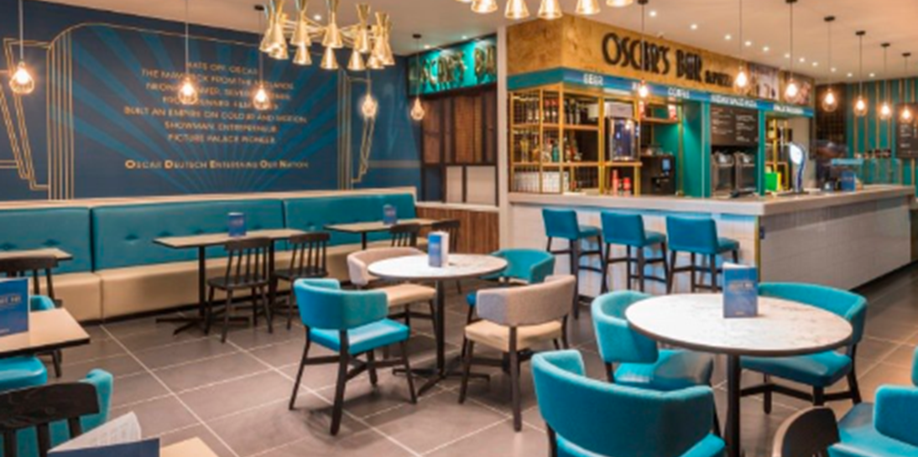
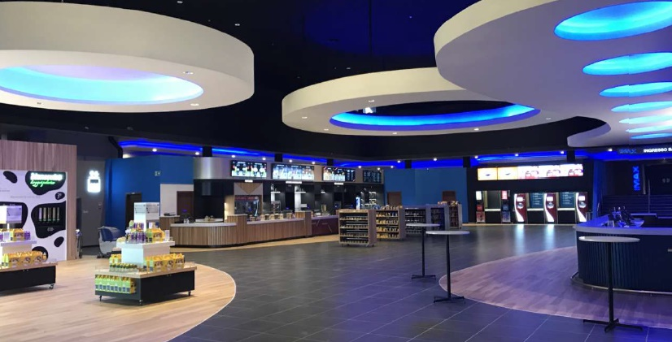


Slide 11
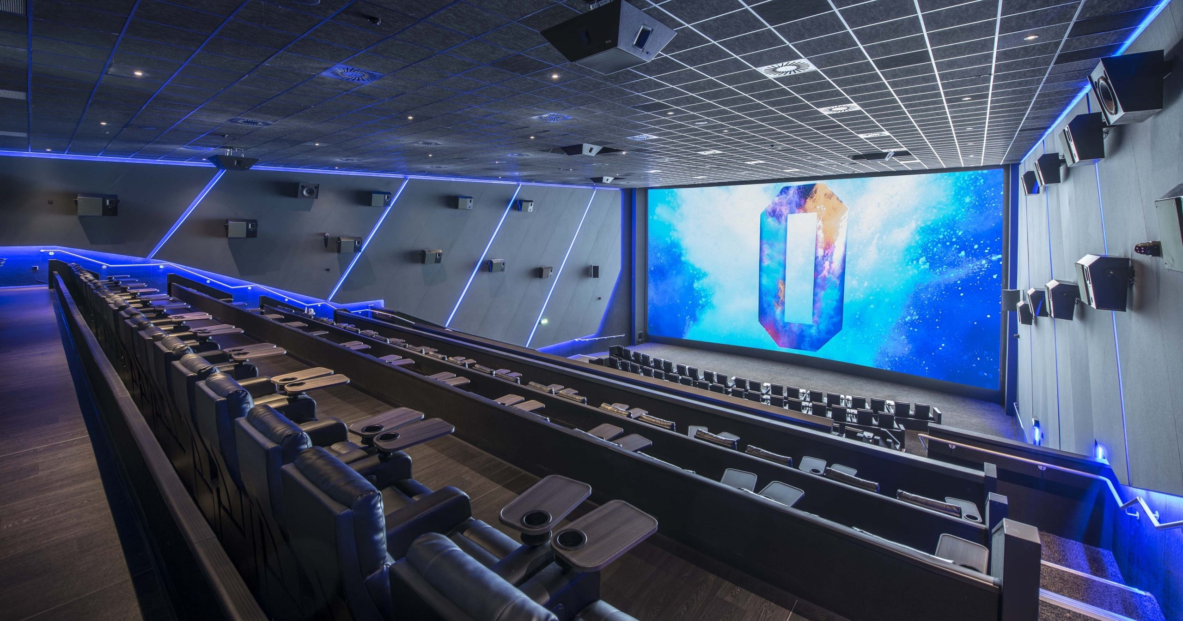
Odeon luxe

Slide 12
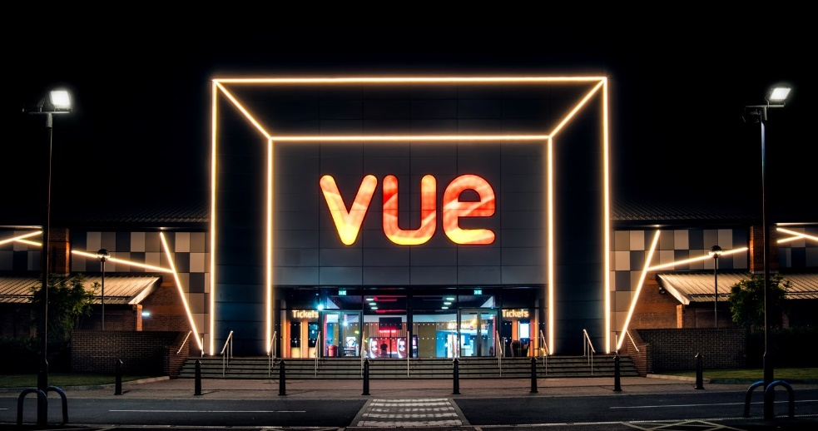
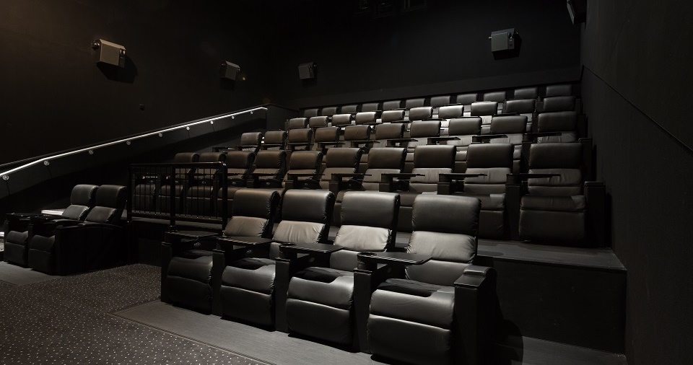

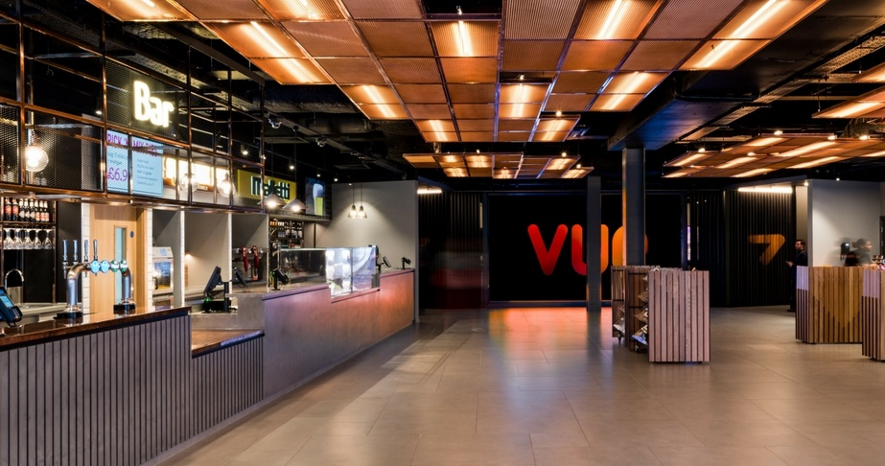
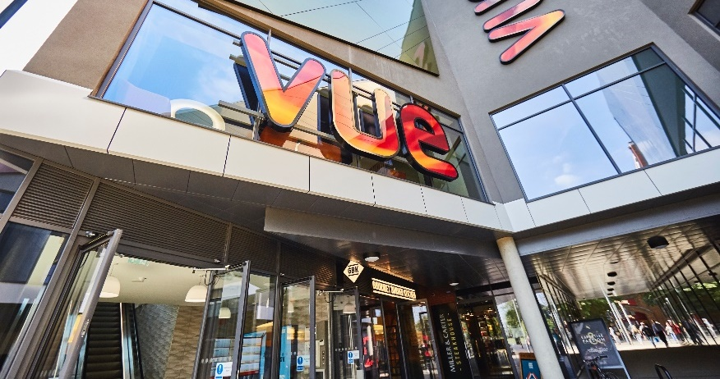

Slide 13
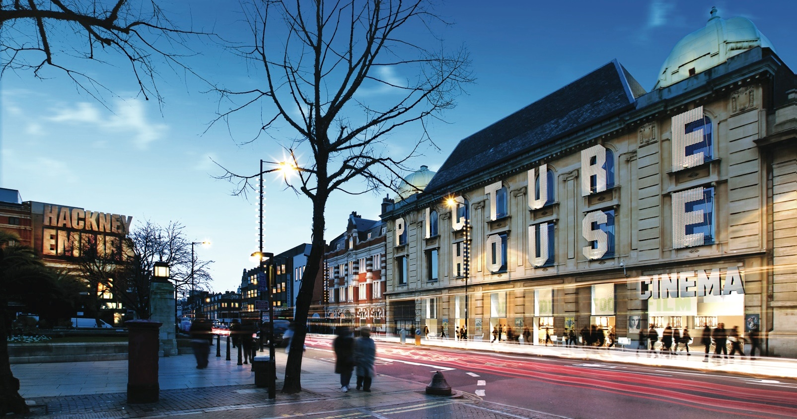
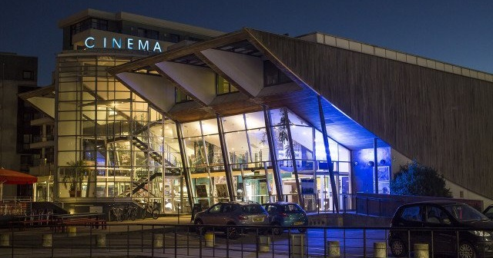

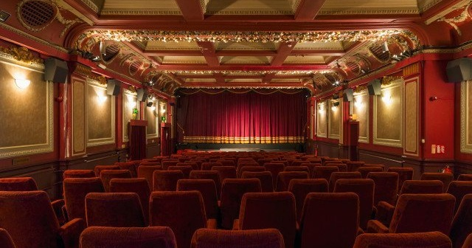
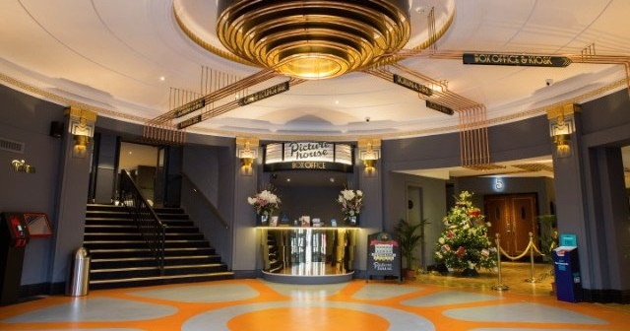

Slide 14



























DCM: OUR INDEPENDENT CINEMA PARTNERS
Graves
Cumbernauld

Slide 15
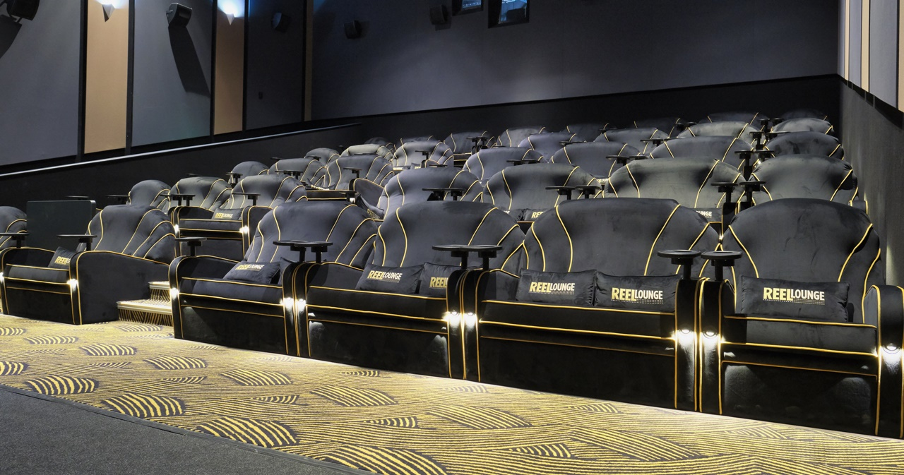
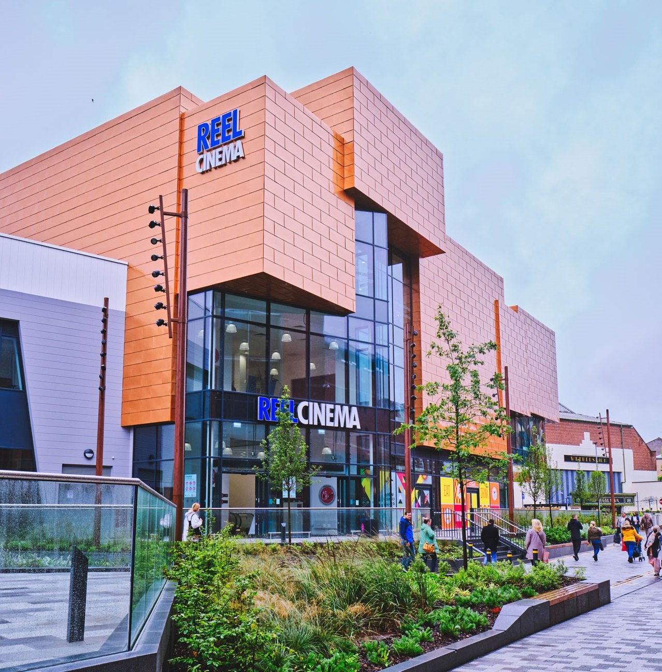
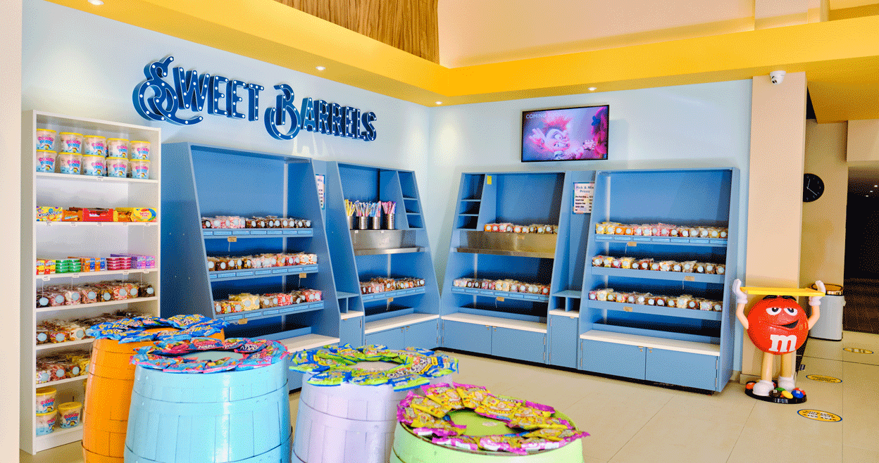

Slide 16
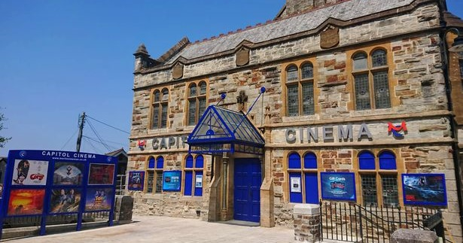
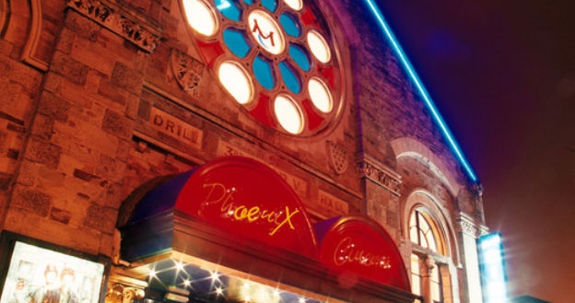
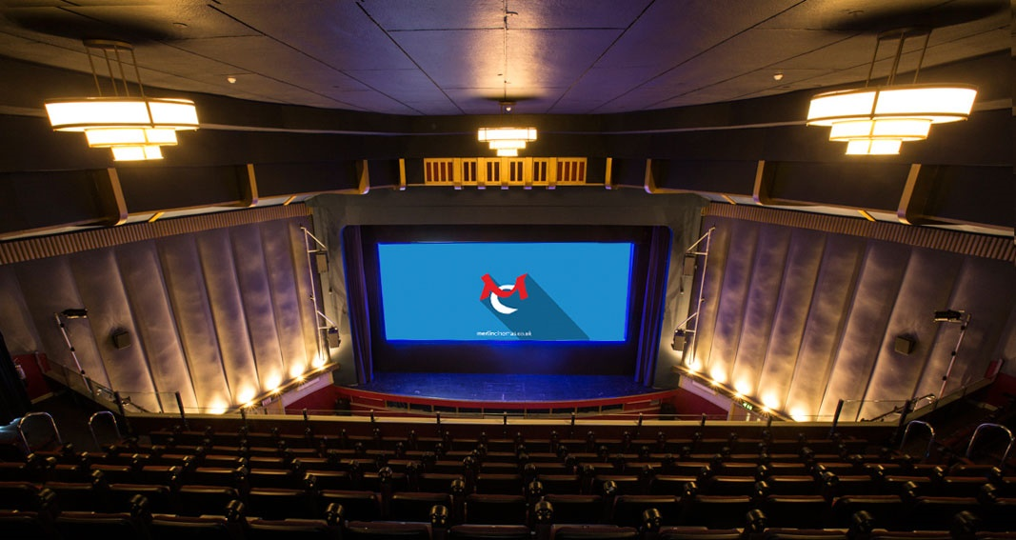
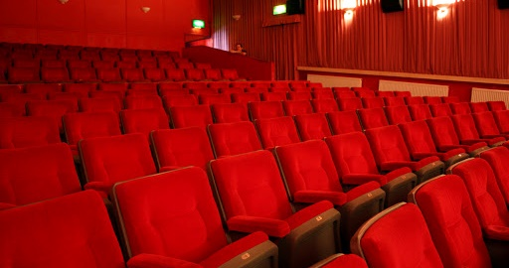

Slide 17
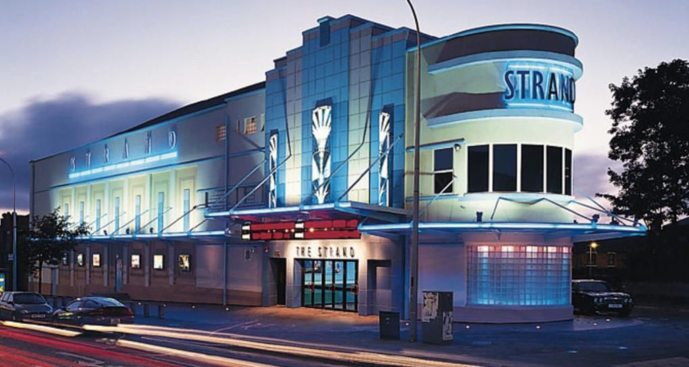
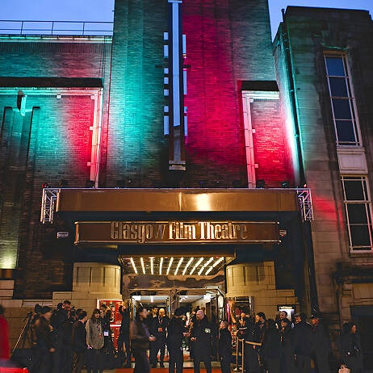
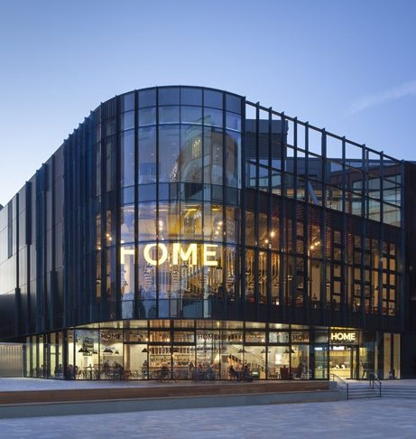
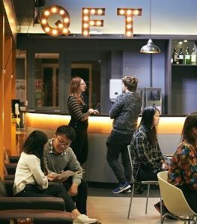
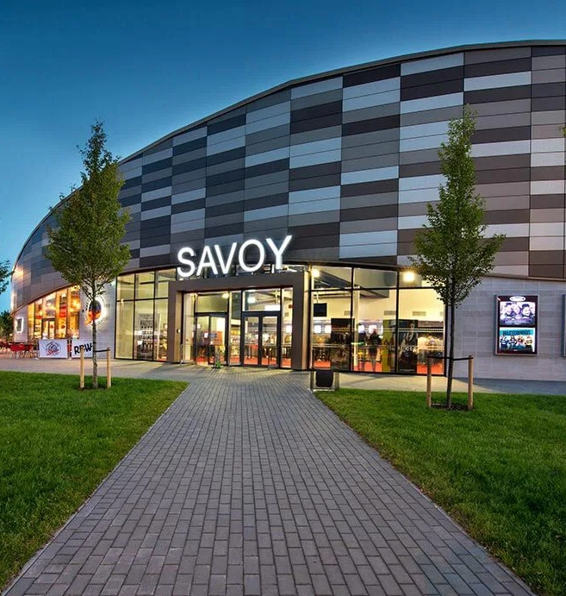
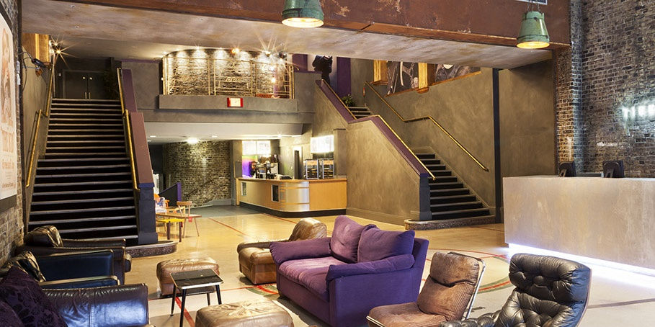
DCM
INDEPENDENTS

Slide 18
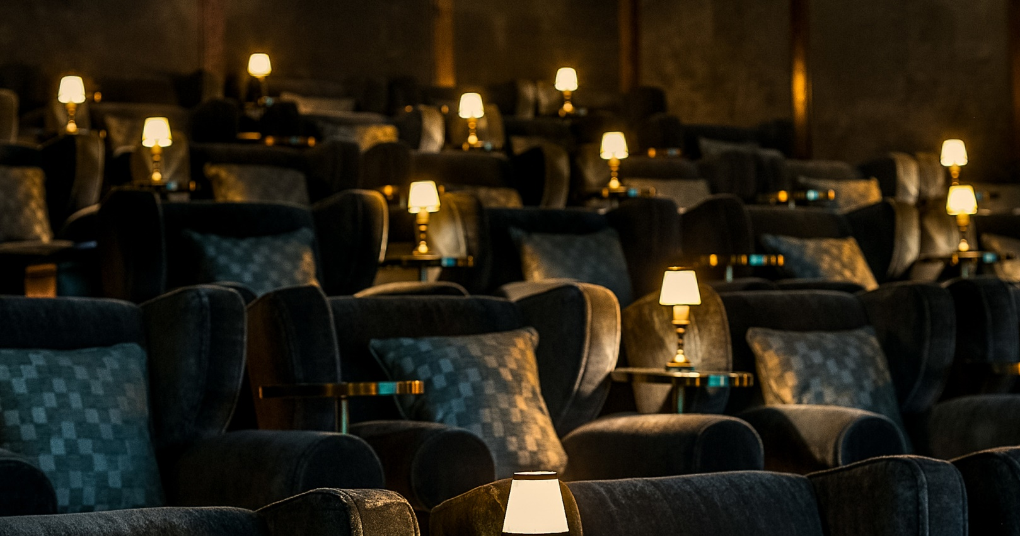
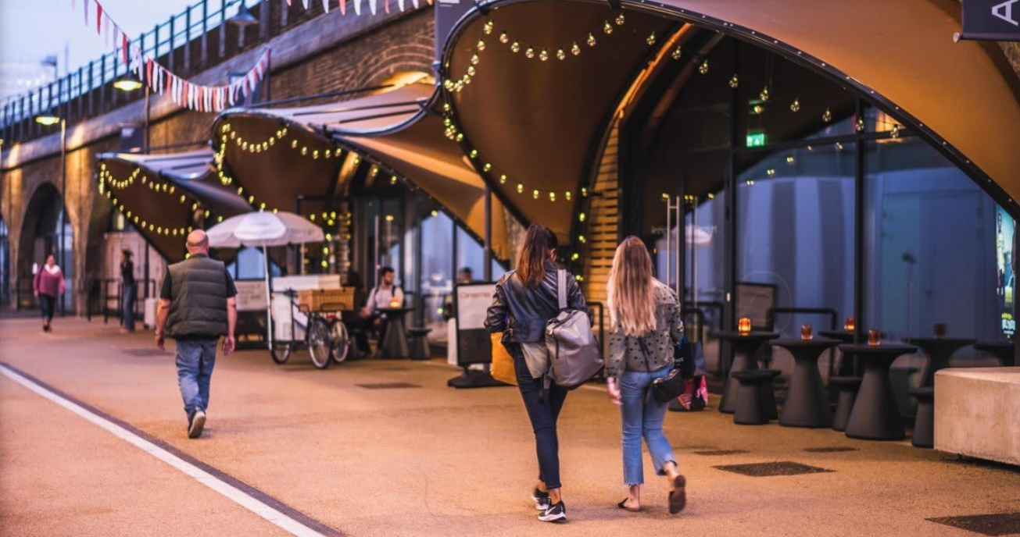
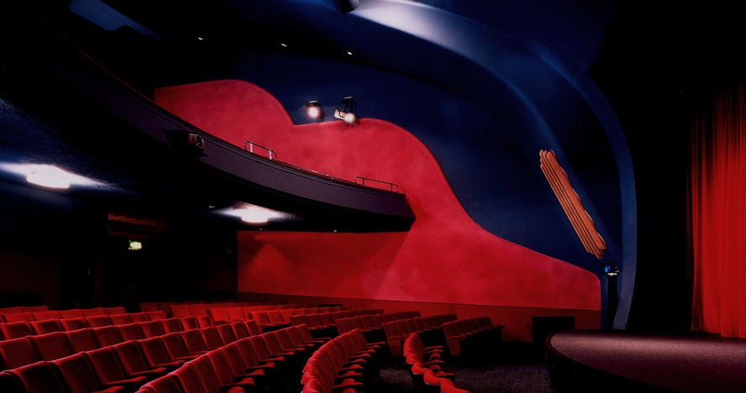
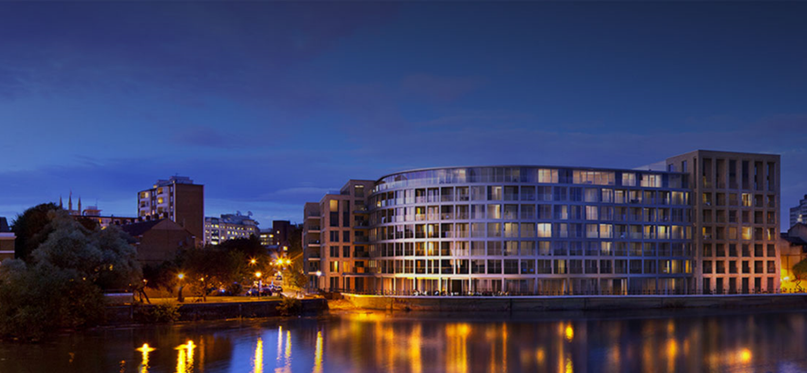
LATEST ADDITIONS: LONDON
Electric White City
Archlight, Battersea
Rio Dalston
Riverside Hammersmith

