Slide 1
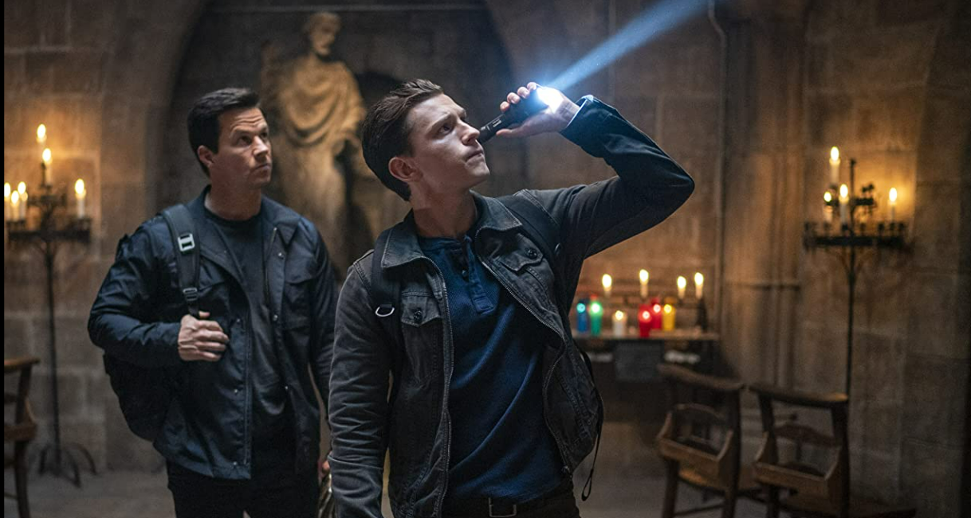
16-34 men

Slide 2
16-34 Men want to be the first
Audience snapshot
WHO ARE THEY?
WHY CINEMA?
KEYWORDS
Early Adopters
Want the buy the latest products first
Need to stay updated
They love the hype and the conversation
Want to watch the latest films first
The only place to watch the latest blockbusters
Opening Week Audience
Appointment to View
Shared Experience

Slide 3
1634 Men MEDIA CONSUMPTION: A SUMMARY
With a decline in broadcast TV use, young men are more likely to be seeking out easily accessible and short-form content
78%
16 hours
Of young men are cinemagoers
Where they are 61% more likely to be heavy cinemagoers vs the avg. UK adult
On average of TV viewed per week
5 hours less than the avg. UK adult
68%
7 hours
On average of social media used per day (TikTok, Facebook, Instagram, Twitter, Snapchat etc)
2 hours more than the avg. UK adult
Of young men are heavy users of online video platforms (i.e. Netflix, BBC iplayer, Youtube)
5% increase if they are also cinemagoers
(Index: 172)
Source: TGI GB 2022. Target: 16-34 Men. Index vs the avg. UK adult

Slide 4
The fight for attention
Younger adults are 2x more likely than the avg. UK adult to pay attention to adverts when shown in the cinema
Which adverts do you pay the most attention to?
Source: TGI GB 2022, 16-34 Men. Index vs avg. UK adult

Slide 5
Positivity drives attention to adverts
Cinema engages a young audience when they’re in a positive and receptive mindset and most willing to pay attention to ads.
42%
65%
More likely recommend brands when advertised at the cinema than in other places (e.g. TV, Social Media)
Agree that advertising in the cinema is trustworthy
^{Index: 121}
47%
51%
More likely to search for more information about the advertising seen in the cinema after watching the film
Agree that they are less distracted watching ads in the cinema than elsewhere
^{Index: 109}
Sources: FAME 2021, 16-34 Men Index vs all respondents
Notes:
The anticipation and excitement means cinema is perfect environment to reach young men as they’re receptive and open to brand advertising

Slide 6
The hype & shared experience of cinema
16-34 audience want to see the latest films first, ensuring they don’t miss the out on what their friends are talking about, and the cinema is all about the collective experience of watching it together & discussing it after on social media
37% watch a new film on it’s opening night
Index:135
79% More likely to visit the cinema with a group of friends (5-6 people)
77% purchase food/drink on the same day after watching a film in the cinema
(Index: 168)
2x more likely to post a TikTok about their cinema trip/ the film than the avg. UK adult
Source: FAME 2021. 1634 Men. Index vs all adults

Slide 7
Young MALES want to see the latest blockbusters first
Young men come out early and make up the majority of the audience in a blockbuster's opening week.
% of the viewing audience that are young males
Males account for 15.4% of the adult population
Source: FAME 2021. Target: 16-34 Men. How Long After the Cinema Release Date Did You See The Film?
Film Monitor Data 2022 W1
Notes:
So we can infer that even though men will be prioritising the world cup, they are also more likely to watch new releases in the first two weeks and with the plethora of films we have coming out at the end of the year, brands will be able to access them in the right way.

Slide 8
Brands can reach young men before they decide to purchase
Younger men are more likely to be inspired to buy products after watching their film, especially in groups of friends
After the film they are more likely to…
2x
2x
60%
More likely to get fast food/takeaway immediately after
More likely to go online shopping immediately after
Go out for a meal
(Index: 184)
54%
68%
93%
Shop on the high street
Check mobile phone to browse or check social media
(Index: 142)
More likely to go to a pub/bar after visiting the cinema
98% OF DCM CINEMAS ARE WITHIN ONE MILE OF A RETAIL LOCATION
Source: FAME 2021, 16-34 Men Index vs All Adults

Slide 9
Cultural moments of 2022
Brands can benefit by reaching young men in highly anticipated films before & after big events in 2022, where they will be in groups of friends experiencing the shared moments and hype of a new film
FIFA World Cup 2022
Young men don’t like missing out on shared experiences with their friends, and they are likely to trust brands shown in the cinema…
64%
Of those who are planning to watch the FIFA World Cup are male¹
65%
Agree that advertising in the cinema is trustworthy²
2x
More likely to go to the cinema in a group of 7+ people²
45%
More likely to definitely agree that they ‘feel left out if my friends are talking about a film I haven’t seen’²
Source: 1 TGI GB 2022. Target: Likely to be watching the FIFA World Cup this year.
2 FAME 2021 Target 16-34 Men

Slide 10
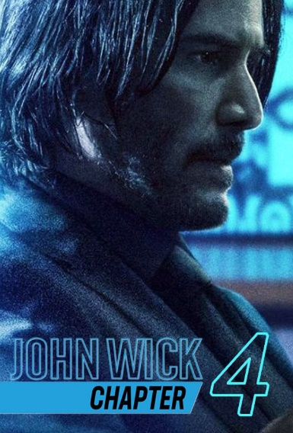
Engage your 16-34 men audience in the COMING months
An exciting slate will continue to draw young audiences to the cinema this year
Black Adam
16-34 Men Index: 130
21 Oct 2022
Black Panther: Wakanda Forever
16-34 Men Index: 131
11 Nov 2022
Avatar: The Way of Water
16-34 Men Index: 123
16 Dec 2022
Shazam: Fury of the Gods
16-34 Men Index: 128
17 March 2022
Kraven The Hunter
16-34 Men Index: 133
13 Jan 2023
Ant-Man And The Wasp: Quantumania
16-34 Men Index: 137
17 Feb 2023
Aquaman 2
16-34 Men Index: 130
16 December 2023
John Wick: Chapter 4
16-34 Index: 362
24 March 2023
Fast & Furious 10
16-34 Men Index: 251
19 May 2023
Oppenheimer
16-34 Men Index: 161
21 July 2023
Index vs. % of 16-34 adult in GB population.
Based on comparative film profiles.

Slide 11
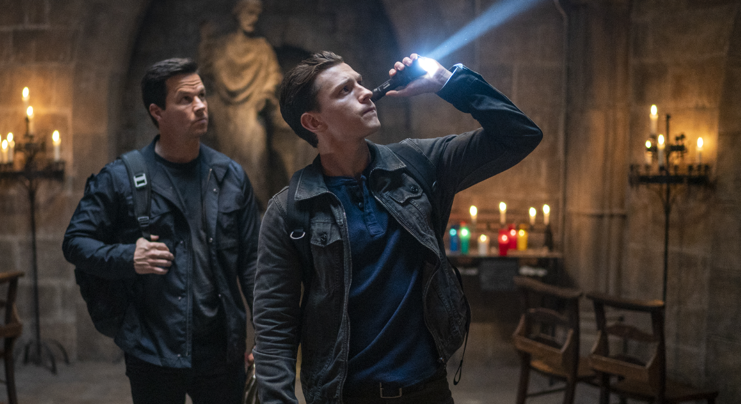
First to watch and first to buy
It’s not just seeing the latest movies that they love being first at – young male heavy cinemagoers want to be the first in line for new products, developments and experiences
74% like to treat themselves to new things
they don’t need
(Index 103)
Early Adopters:
They are 2x more likely
to ‘buy new products before their friends’
(Index 230)
70% ‘keep up to date with developments in technology’
(index 135)
‘I’m tempted to buy products
I’ve seen advertised’
(Index 150)
‘It is important my household is
equipped with the latest technology’
(Index 181)
2x more likely to keep up with developments
in the video game industry
(index 285)
69% love to buy new
gadgets and appliances
(index 166)
‘I like innovative cars’
(Index 192)
Source: TGI 2022
Target: 16-34 Men who are heavy cinemagoers. Index vs. average GB adult who are cinemagoers

