Slide 1
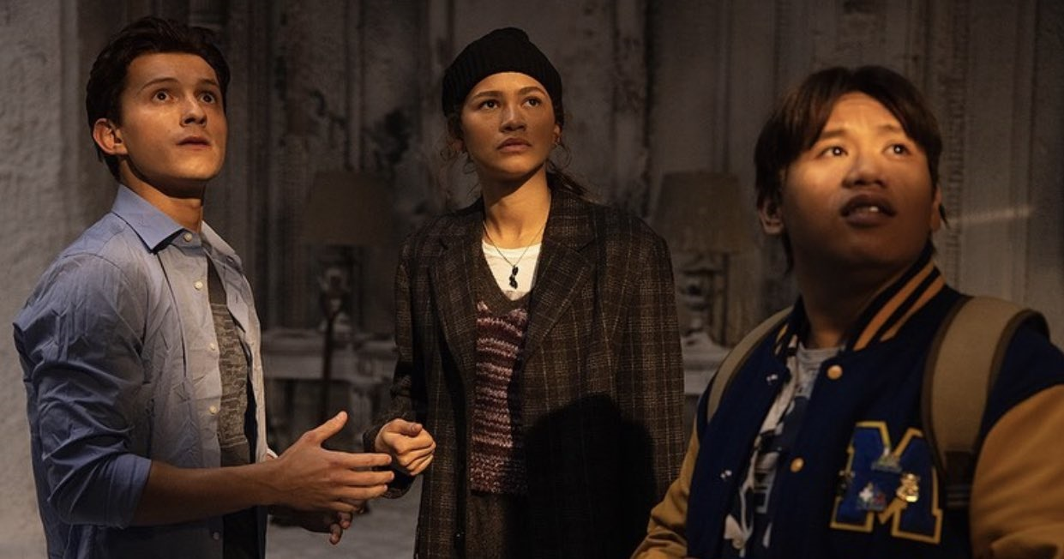
The 16-34 audience

Slide 2
80% of 1634s
are cinemagoers
Source: TGI GB April 2022

Slide 3
16-34 adults: their online video world
Younger adults video consumption is becoming more fragmented, driving the decline of TV viewing YoY
Average % share of video time per day¹
16-34s
Average time spent watching TV per day YoY²
16-34s
Source: 1 Thinkbox A Year in TV 2021 – 2022
2 IPA Touchpoints 2018/2019/2020/2021. Target: 1634 adults

Slide 4
16-34 adults: their av world
Light TV viewers are using subscription services more frequently to create their own content viewing schedules and therefore becoming harder to reach & engage – but they are more likely to be cinemagoers
62%
of 16-34s are light commercial TV viewers
12% more likely than the average UK adult
74%
pay a monthly subscription for Netflix, Amazon Prime or Disney+
5% higher than the average UK adult
86%
of 1634s who pay for a SVOD service are cinemagoers
18% uplift from those who don’t pay for an SVOD service
.
Source: TGI GB 2022.- 16-34 adults index vs All Adults

Slide 5

Positivity & engagement drives attention to adverts
Cinema engages a young audience when they’re in a positive and receptive mindset and most willing to pay attention to ads.
54%
93%
More likely to enjoy seeing an advert in the cinema than on TV¹
More likely to trust the adverts seen in the cinema²
47%
41%
More likely to recommend brands seen advertised in the cinema compared to any other platform e.g. TV or social media³
More likely to get to the cinema in time to watch the adverts and trailers¹
Sources: 1. TGI GB 2022 index vs all respondents
2. IPA Touchpoints 2021, Index vs All Adults
3. FAME 2021, Index vs all respondents

Slide 6
The fight for attention
Younger adults are more likely to pay attention to adverts when shown in the cinema, followed by Internet & OOH
Source: TGI GB 2022, Index vs avg. UK adult

Slide 7
Positive attitudes towards the cinematic experience
In addition to paying more attention, younger adults feel more positive reasons for going to the cinema compared to other top performing media
Source: TGI GB 2022, Index 1634 adults who have visited a cinema in the past year vs all adults

Slide 8
The hype & shared experience of cinema
16-34 audience want to see the latest films first, ensuring they don’t miss the out on what their friends are talking about, and the cinema is all about the collective experience of watching it together.
50%
60%
“I feel left out if my friends are talking about a film I have not seen”
(Index: 129)
Watch a new film on its opening night
(Index: 129)
Source: FAME 2021. How long after the release date did you watch your last film at the cinema?
Index vs. average UK cinemagoer (7+).

Slide 9
16-34s want to see the latest blockbusters first
16-34s come out early and make up the majority of the audience in a blockbuster's opening week.
28% of GB population are 16-34s
Source: FAME 2021
Film Monitor Data 2022 W1

Slide 10


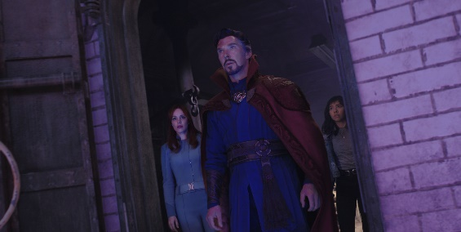
Top genres and post-film actions across a young audience
Younger adults are more likely to be inspired to buy products after watching their film
  What do they watch?
Horror
^{(Index: 188)}
Action & Adventure
^{(Index: 123)}
Superhero
^{(Index: 178)}
  After the film they are more likely to…
  180
  176
  151
  Get fast food/takeaway
  Online shopping
  Go out for a meal
98% OF DCM CINEMAS ARE WITHIN ONE MILE OF A RETAIL LOCATION
Source: TGI GB 2022, Index 1634 adults vs all adults
FAME 2021, Index vs all respondents

Slide 11








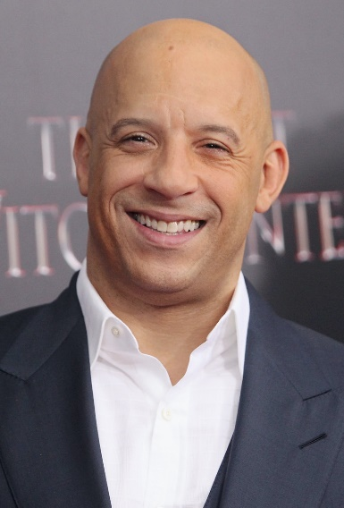

KEY 16-34 LAUNCH OPPORTUNITIES
An exciting slate will continue to draw young audiences to the cinema across the next few months
Don’t Worry Darling
16-34 Index: 174
23 Sept 2022
Black Adam
16-34 Index: 192
21 Oct 2022
Black Panther: Wakanda Forever
16-34 Index:
11 Nov 2022
Matilda
16-34 Index: 147
2 Dec 2022
Avatar: The Way of Water
16-34 Index: 147
16 Dec 2022
Shazam: Fury of the Gods
16-34 Index: 167
17 March 2023
Babylon
16-34 Index: 176
20 Jan 2023
John Wick: Chapter 4
16-34 Index: 239
24 Mar 2023
Fast & Furious 10
16-34 Index: 210
19 May 2023
Insidious 5
16-34 Index: 284
7 Jul 2023
Index vs. % of 16-34 adult in UK population.
Based on comparative film profiles.

Slide 12




Top films to access across both genders
Females are more likely to pay attention to adverts in the cinema and males are more likely to purchase food or drink after
36%
58%
77%
79%
More likely to shop offline/online immediately after visiting the cinema
Of 1634 women agree that going to the cinema is a great way to spend quality time with family and friends
Of 1634 men purchase food/drink on the same day after watching a film in the cinema
^{(Index: 168)}
More likely to visit the cinema with a group of friends (5-6 people)
1634 Women
1634 Men
M3gan
^{(Index: 300)}
The Hunger Games: The Ballad Of Songbirds And Snakes
^{(Index: 216)}
John Wick: Chapter 4
^{(Index: 361)}
Guardians Of The Galaxy Vol. 3
^{(Index: 207)}
Source: FAME 2021. Target: 16-34 W0men & 16-34 Men. Index vs All Adults

Slide 13
What can Cinema add to your 16-34 media plan?
Cinema engages a young audience when they’re in a positive and receptive mindset and most willing to pay attention to ads.
Positive mood
Receptive to ads
Pay more attention to ads
83% of 16-34s report in the IPA TouchPoints survey that they’re in an above average mood while visiting the cinema
Kantar’s AdReaction study found that of all ad formats 16-34s were most receptive towards cinema ads
DCM’s Mission 16-34 research found that 66% of 16-34s agree that they ‘pay more attention to ads in cinema than elsewhere’
Sources: IPA TouchPoints 2021, Kantar Ad Reaction & Mission 16-34 (1,000 16-34s)

Slide 14
Cinema DELIVERS POSITIVE OUTCOMES FOR BRANDS
Cinema helps create a better impression of your brand and lands messaging more convincingly with 16-34s than other channels.
Meta-analysis of 12 cinema campaigns
16-34 audience results
‘Better impression’
‘Rational’
brand perceptions
‘Emotional’
brand perceptions
+30%
+42%
+60%
Meta-analysis consists of 12 campaigns from finance, travel, entertainment & leisure, FMCG and charity sectors
Uplifts based on results for 16-34 audience only.
Notes:
We wanted to go one step further and prove that cinema’s positive attributes and unique environment actually do pay off for brands too amongst the 16-34 audience.
Differentology undertook a meta-analysis of 12 campaigns that they had measured the effectiveness of amongst the 16-34 audience across the last 18 months and found that those exposed to cinema were 30% more likely to have been left with a positive impression of the brand as a result of the campaign.
Furthermore, the highly attentive audience in cinema makes it the perfect environment for landing brand messages – results of the meta-analysis highlight that being exposed to cinema led to a 42% increase in rational brand perception agreement and 60% uplift in emotional brand perception agreement.
Highlighting the valuable role that cinema can play in both communicating key messages and positively engaging the 16-34 audience with brands.

Slide 15

16-34 HEAVY CINEMAGOERS: in market
Heavy cinemagoing 16-34s are more likely to have a positive outlook on the year and be planning big purchases.
Planned ‘big purchases’ for 2022…
148
Plan to buy a car
157
Plan to buy smart home tech
127
Passionate about travelling
157
‘I am tempted to buy clothes I’ve seen advertised’
109
Plan to buy mobile phone
2X
More likely to plan to buy a games console
68%
Like to try out new food products
70%
Like to try new alcoholic drinks
Source: TGI GB April 2022
Target: 16-34 heavy cinemagoers. Index vs. average GB adult who are cinemagoers

