Slide 1

TARGET
16-34 MEN
IN MARCH
Notes:
Statements or numbers on this slide should be short and concise

Slide 2
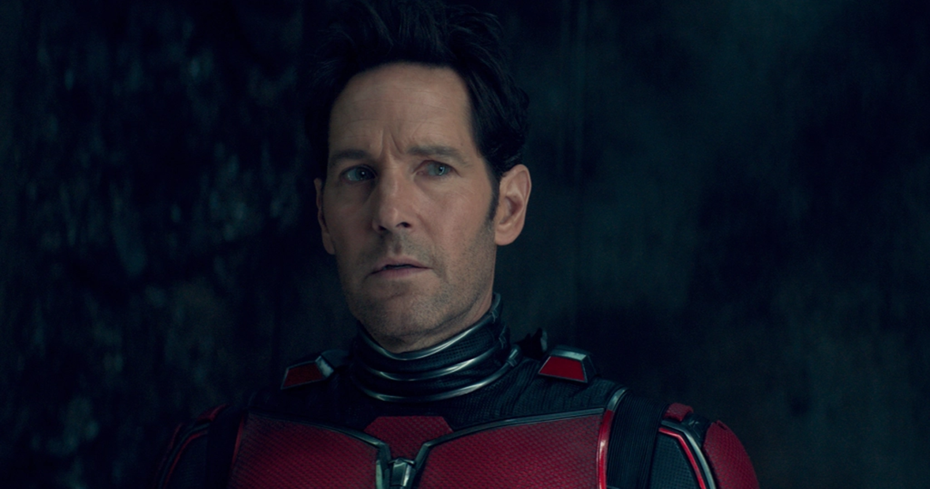
Ant-man and the wasp: quantUmania
EST. INDUSTRY ADMISSIONS | GENRE | HFSS BRANDS | ALCOHOL/GAMBLING BRANDS
3.2m | Superhero | Yes | No
17 Feb 2023
Index: 225
SYNOPSIS
Ant-Man and the Wasp, along with Hank Pym and Janet Van Dyne, end up in the Quantum Realm. Interacting with strange creatures they will embark on an adventure that goes beyond the limits of what they thought was possible...
16-34 Men Reach: 12%
16-34 Men Impacts: 1.1m
16-34 Men TVRS: 15.1
Source: DCM Planner, Index vs 16-34 Men

Slide 3
Ant-Man and the Wasp: Quantumania TVR CURVE
Based on current forecasts we estimate that Ant-Man And The Wasp: Quantumania will deliver over 14 16-34 Men TVRs
Source: CAA C+F Planner. Predicted industry admissions.

Slide 4
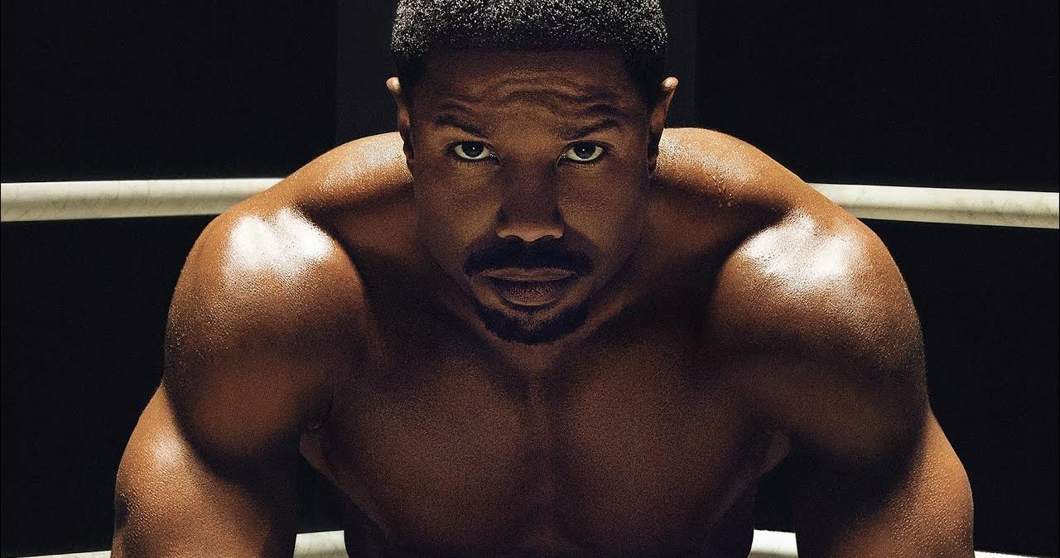
Creed III
EST. INDUSTRY ADMISSIONS | GENRE | HFSS BRANDS | ALCOHOL/GAMBLING BRANDS
1.2m | Drama, Sport | Yes | Yes
3 Mar 2023
Index: 310
SYNOPSIS
Still dominating the boxing world, Adonis Creed is thriving in his career and family life. When Damian, a childhood friend and former boxing prodigy resurfaces after serving time in prison, he's eager to prove that he deserves his shot in the ring.
16-34 Men Reach: 6%
16-34 Men Impacts: 553k
16-34 Men TVRS: 7.1

Slide 5
Creed III: TVR CURVE
Based on current forecasts we estimate that Creed III will deliver 7 16-34 Men TVRs
Source: CAA C+F Planner. Predicted industry admissions.

Slide 6

65
EST. INDUSTRY ADMISSIONS | GENRE | HFSS BRANDS | ALCOHOL/GAMBLING BRANDS
919k | Sci-Fi, Thriller | Yes | Yes
10 Mar 2023
Index: 256
SYNOPSIS
After a catastrophic crash on an unknown planet, pilot Mills quickly discovers he's actually stranded on Earth -- 65 million years ago. Now, with only one chance at a rescue, Mills and the only other survivor, Koa, must make their way across an unknown terrain riddled with dangerous prehistoric creatures.
16-34 Men Reach: 4%
16-34 Men Impacts: 332k
16-34 Men TVRS: 4.2
Source: DCM Planner, Index vs 16-34 Men

Slide 7
65: TVR CURVE
Based on current forecasts we estimate that 65 will deliver 4 16-34 Men TVRs
Source: CAA C+F Planner. Predicted industry admissions.

Slide 8
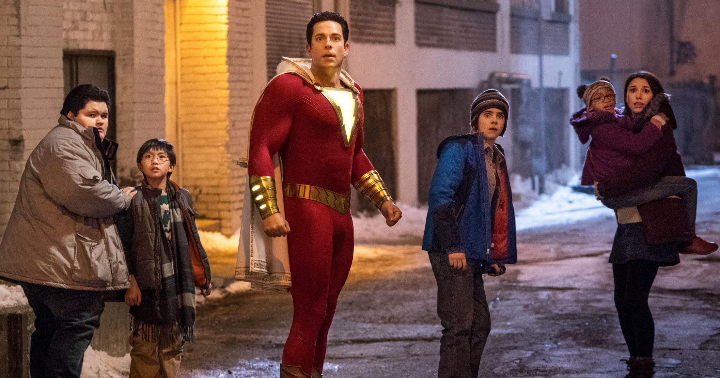
SHAZAM! fury of the gods
EST. INDUSTRY ADMISSIONS | GENRE | HFSS BRANDS | ALCOHOL/GAMBLING BRANDS
1.8m | Superhero | Yes | No
17 Mar 2023
Index: 210
SYNOPSIS
Continues the story of teenage Billy Batson who, upon reciting the magic word "Shazam!" is transformed into his adult superhero alter ego, Shazam. Shazam takes on the villainous Hespera and Kalypso, daughters of the Greek titan Atlas.
16-34 Men Reach: 7%
16-34 Men Impacts: 564k
16-34 Men TVRS: 5.7
Source: DCM Planner, Index vs 16-34 Men

Slide 9
SHAZAM! fury of the gods: TVR CURVE
Based on current forecasts we estimate that Shazam will deliver 4 16-34 Men TVRs
Source: CAA C+F Planner. Predicted industry admissions.

Slide 10

John wick: chapter 4
EST. INDUSTRY ADMISSIONS | GENRE | HFSS BRANDS | ALCOHOL/GAMBLING BRANDS
1.5m | Action | Yes | Yes
24 Mar 2023
Index: 361
SYNOPSIS
With the price on his head ever increasing, legendary hit man John Wick takes his fight against the High Table global as he seeks out the most powerful players in the underworld, from New York to Paris to Japan to Berlin.
16-34 Men Reach: 9%
16-34 Men Impacts: 772k
16-34 Men TVRS: 9.9

Slide 11
John wick: chapter 4: TVR CURVE
Based on current forecasts we estimate that John Wick will deliver 4 16-34 Men TVRs
Source: CAA C+F Planner. Predicted industry admissions.

Slide 12
The hype & shared experience of cinema
Young men want to see the latest films together, ensuring they don’t miss the out on what their friends are talking about, and the cinema is all about the collective experience of watching it together.
143
“I feel left out if my friends are talking about a film I have not seen”
153
“A Lot Of My Friends Ask My Advice About Films”
117
“I Love The Hype Surrounding Big Film Releases At The Cinema ”
Source: FAME 2021. Target 16-34 Men who are heavy cinemagoers. Index vs avg. GB cinemagoer

Slide 13
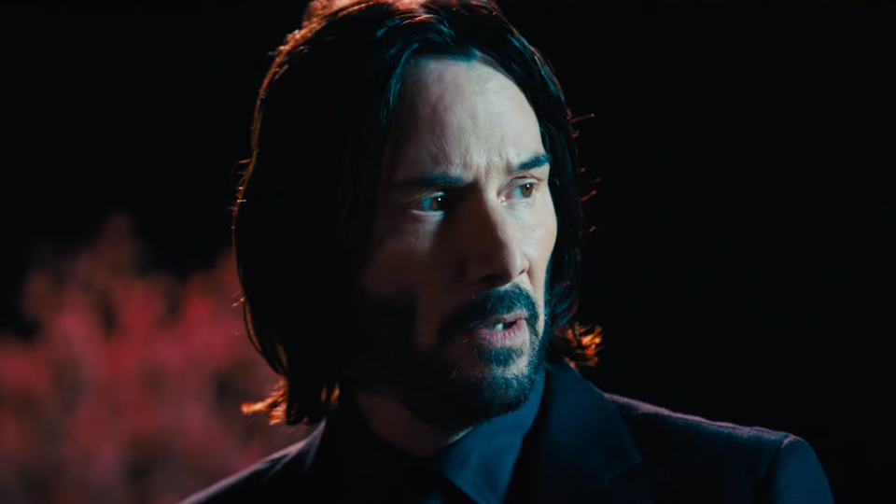
16-34 Men: in market for
Category Insights
50%
More Likely To Agree They Try To Keep Up With Developments In Technology”
56%
More Likely To Agree They Are Tempted To Buy Products I’ve Seen Advertised
4x
More Likely To Intend To Spend £45k Or More On A Car Purchase In Next 24 Months
2x
More Likely To Agree They Buy New Products Before Most
Of My Friends
52%
More Likely To Agree They Would Pay More For An Enhanced Viewing Experience (e.g. 3D, 4D, IMAX Etc.)
(Index: 126)
88%
More Likely To Agree They Like Innovative Cars”
27%
More Likely To Intend To Purchase Personal Smart Tech Or For The Home
Source: TGI GB Nov 2022, 16-34 Men who are heavy cinemagoers. Index vs GB average

