Slide 1
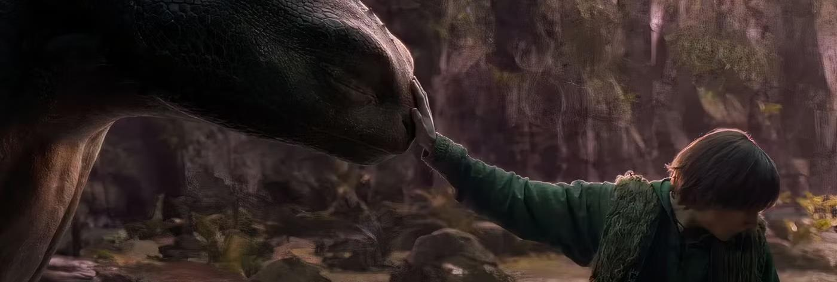
The 16-34 men audience
How brands can reach young males using cinema

Slide 2



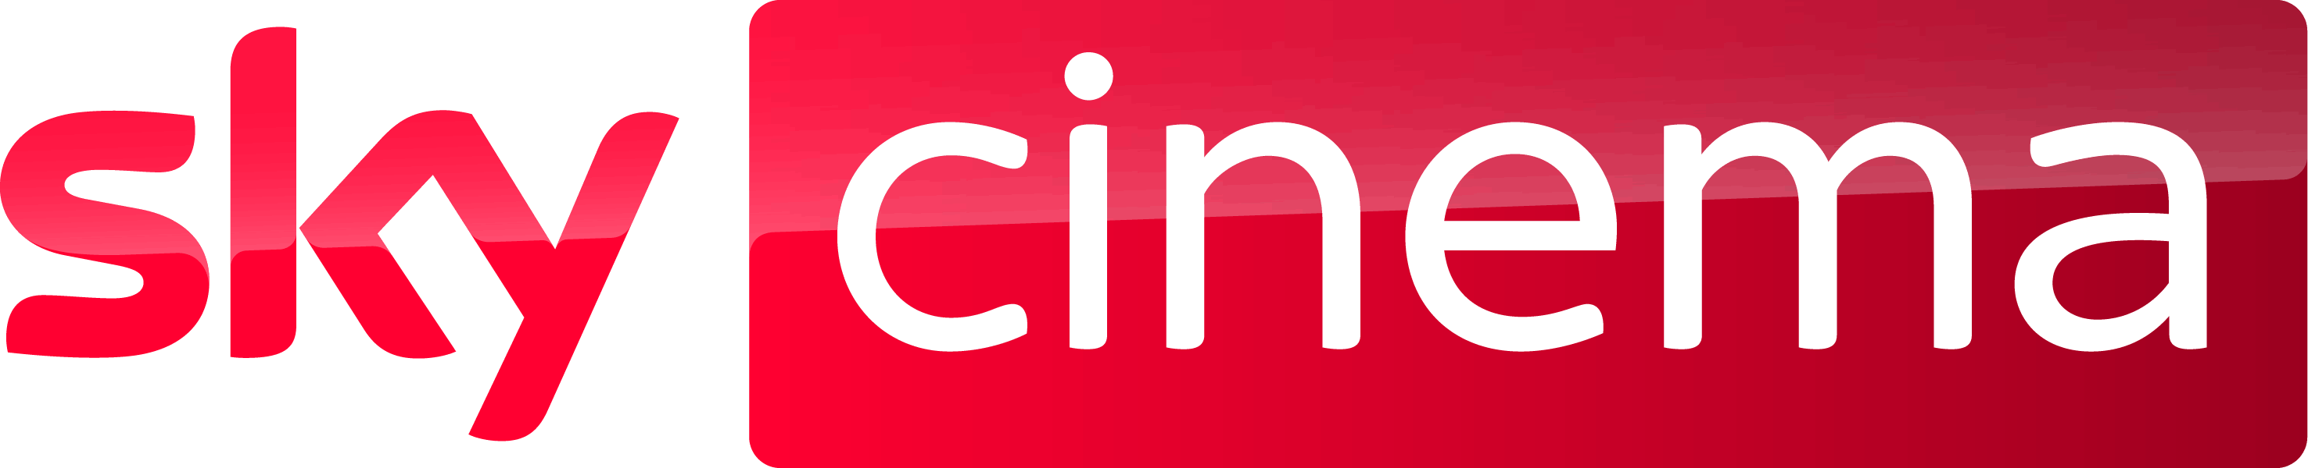




Young male cinemagoers are more affluent CONSUMERS
16-34 men are using subscription services to create their own entertainment viewing schedules and therefore are becoming harder to reach & engage on linear – but cinema retains its appeal.
Demographics
A highly affluent audience
Lifestyle
Culture-centric and quality-driven
Media habits
More fragmented media consumption
 | Non-cinemagoing 16-34 men | Cinemagoing 16-34 men
ABC1 | 54% | 62%
£40k+ HH income | 31% | 35%
Children in HH | 40% | 48%
‘I love anything new’ (Index: 130)
‘I like to buy products from companies who give something back to society ’ (60% agree, Idx: 116)
‘I am interested in the arts’ (Index: 107)
Source: GB TGI Dec 2024. 16-34 male cinemagoers. Index vs. avg. GB adult

Slide 3
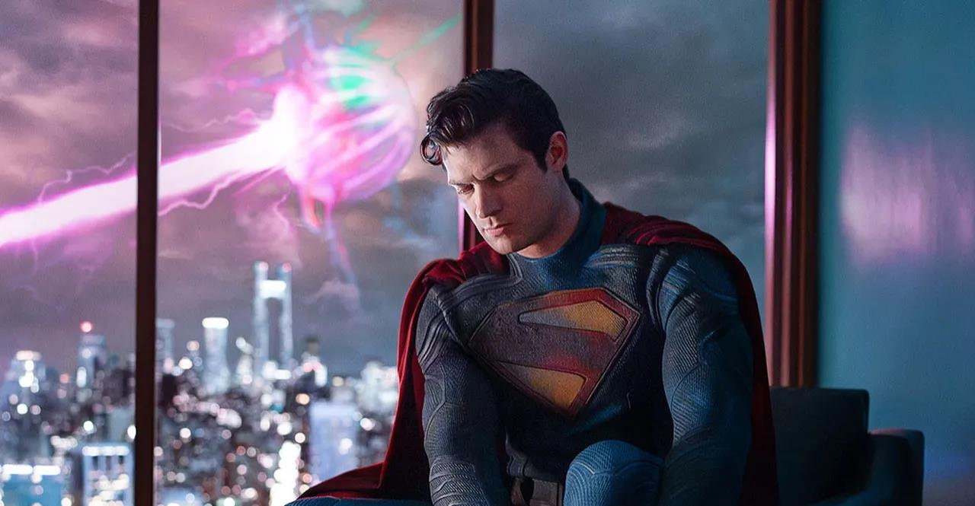
70% OF 16-34 MEN
ARE CINEMAGOERS
Source: TGI GB Dec 2024
Notes:
Statements or numbers on this slide should be short and concise

Slide 4
In the ERA OF ‘social media’, people are spending more time ALONE
But cinema is there to relieve the disconnection in society, being a large part of people's community & cultural life, helping them feel less alienated from eachother.
Mean hours per day spent alone
“I feel distant from other people”
(60% agree)
“There is no sense of community anymore”
(56% agree)
Time spent alone since 2014 has increased by:
+47%
“Cinema helps people feel less isolated and cut-off”
(63% agree)
“Cinema helps bring the community together”
(55% agree)
Source: IPA TouchPoints 2014-2023. DCM/Burst Your Bubble 2024
Base: 16-34 (n=479).

Slide 5
Young men want to see the latest blockbusters first
16-34 men come out early and make up the majority of the audience in a blockbuster's opening week, in addition to making up the most of films overall audience even longer than a month after it’s release.
“I Feel Left Out If My Friends Are Talking About A Film I Have Not Seen”
(Index: 108)
“A Lot Of My Friends Ask My Advice About Films”
(Index: 117)
Visit The Cinema With 5 Or More People
(Index: 159)
15% of population are 16-34 men
Source: FAME 2023. Target: 16-34 men. Index v avg. GB adult
Notes:
And whilst being the most sociable, cinema also provides the most culturally relevant content, where 16-34s come out early and make up the majority of the audience in a blockbuster's opening week
And just looking at the overall sample, if we cut the data by those who pay for 5 or more streaming services, they are 21% more likely than the avg. adult to watch a film on its opening weekend and those who went with 5+ other people, likely a big group of friends or a large family, they are 52% more likely than the avg. GB adult to watch a film on its opening weekend.
So why do young adults, those with more streaming services and those that go in large groups, tend to watch a film on its opening weekend?

Slide 6
THE CULTURAL RELEVANCE OF CINEMA
16-34 men are an audience who hotly anticipate content and don’t want to miss out on anything, in addition to being passionate about the quality of content they watch.
TRENDS & STYLES
INFLUENCERS
CULTURE CENTRIC
EARLY ADOPTERS
“Movies give me ideas about style, fashion
and music”
(49% agree, Index: 109)
“A lot of my friends ask my advice about films”
(43% agree, Index: 117)
“I love the hype around big film releases at the cinema”
(57% agree, Index: 104)
“I love new products & tech, and I am always the first to try them”
(30% agree, Index: 164)
Source: FAME 2023. Target: 16-34 men. Index v avg. GB adult

Slide 7
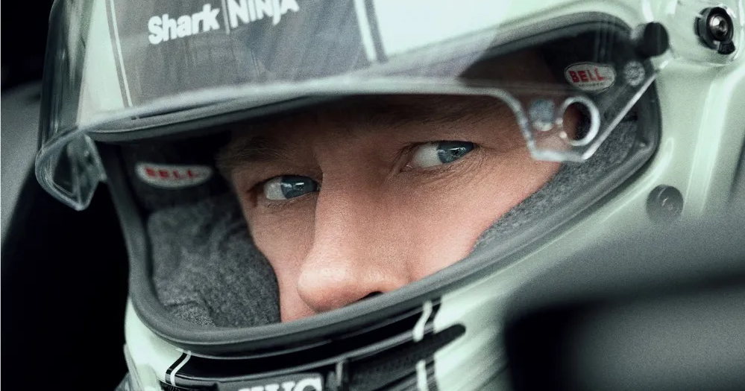
THE young male AUDIENCE
Tech enthusiasts and car lovers
‘I like innovative household devices / appliances’
(Index: 127)
‘I buy new products before most of my friends’
(Index: 194)
‘I love to buy new gadgets and appliances’
(Index: 146)
‘I like to keep up with the latest fashion trends ’
(Index: 164)
‘I like innovative cars’
(Index: 177)
2x more likely to intend to purchase a games console
‘I'm always looking for new ideas to improve my home’
(Index: 117)
‘It is important my household is equipped with the latest technology’
(Index: 156)
Source: TGI Dec 2024
Target: 16-34 cinemagoers. Index vs. average GB adult.
Notes:
Statements or numbers on this slide should be short and concise

Slide 8

A complete unknown
The first biographical drama of 2025
RELEASE DATE | EST. INDUSTRY ADMISSIONS | GENRE | HFSS BRANDS | ALCOHOL/GAMBLING BRANDS
17 Jan 2025 | 1.2m | Biopic / Drama | Yes | Yes
SYNOPSIS
A young Bob Dylan shakes up his act on the folk music scene by going electric and siring rock as the voice of a generation.
CAST
Timothée Chalamet, Edward Norton, Elle Fanning, Monica Barbaro
THE DCM TAKE
From the director of the Johnny Cash biographical drama Walk the Line (2005) comes a new Bob Dylan biopic, set in the transformative vibrancy of the 1960s and starring Timothée Chalamet as the lead, who is hot off the huge box office success of Wonka and Dune Part II. James Mangold’s screenplay focuses on the revolutionary controversy surrounding the switch to electrically amplified instrumentation – so we can expect an iconic depiction of this era fuelled by Mangold’s versatile and bold direction. Following the success of recent musical biopics like Elvis (2022) and Back to Black (2024), we’re witnessing a resurgence in the genre, with several more on the horizon, including Better Man (2024) about Robbie Williams, and Michael (2025), the upcoming Michael Jackson biopic.
Releasing at the start of the year, commencing the 2025 awards season, this film is perfectly positioned for advertisers looking to reach an upmarket audience and associate their brands with a premium, affluent environment.
 | 25-44s | ABC1 Adults | ABC1 Men | ABC1 Women
REACH | 2.4% | 3.0% | 3.3% | 2.7%
IMPACTS | 410k | 826k | 448k | 378k
INDEX | 115 | 142 | 158 | 127
Source: DCM, based on forecast industry admissions and comparative film profile

Slide 9
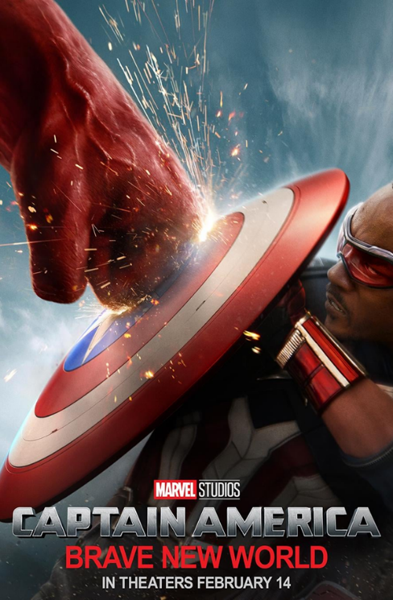
Captain America: brave new world
The fourth instalment in the Captain America film series
RELEASE DATE | EST. INDUSTRY ADMISSIONS | GENRE | HFSS BRANDS | ALCOHOL/GAMBLING BRANDS
14 Feb 2025 | 1.8m | Superhero/Action | Yes | No
SYNOPSIS
Sam finds himself in the middle of an international incident after meeting with President Thaddeus Ross. He must soon discover the reason behind a nefarious global plot before the true mastermind has the entire world seeing red.
CAST
Anthony Mackie, Harrison Ford, Danny Ramirez
THE DCM TAKE
Since his debut in Captain America: The Winter Soldier, fans have eagerly awaited Anthony Mackie’s Sam Wilson to take centre stage and Brave New World marks his first solo outing as Captain America. The franchise has consistently performed well at the UK box office, averaging £20 million per film, with the last instalment, Civil War, achieving an impressive £37 million and a 90% rating on Rotten Tomatoes. Despite having a gap since the 2016 release, the popularity of the 2021 Disney+ miniseries The Falcon and The Winter Soldier shows us that the demand for this franchise remains strong.
Strategically timed to release on Valentines Day, Captain America Brave New World will be an efficient way for brands to reach couples and groups of young adults.
 | Adults (16+) | 16-34 Adults | 16-34 Men
REACH | 3% | 6% | 8%
IMPACTS | 1.5m | 1m | 644k
TVRS | 4 | 7 | 8
Source: Based on industry admissions and comparative film profile

Slide 10

MINECRAFT
Be there or be square!
RELEASE DATE | EST. INDUSTRY ADMISSIONS | GENRE | HFSS BRANDS | ALCOHOL/GAMBLING BRANDS
4 April 2025 | 3m | Adventure / Comedy | Yes | No
SYNOPSIS
A mysterious portal pulls four misfits into the Overworld, a bizarre, cubic wonderland that thrives on imagination. To get back home, they'll have to master the terrain while embarking on a magical quest with an unexpected crafter named Steve.
CAST
Jason Momoa, Jack Black, Emma Myers, Danielle Brooks, Jennifer Coolidge
THE DCM TAKE
Since its first teaser trailer release, Minecraft has drawn significant attention from fans on social media, eager to see how the game's blocky visuals and open-world charm will translate to the big screen. With it’s cast including popular actors like Jason Momoa and Jack Black involved, the film is expected to blend humour with the game’s pixelated charm, using CGI to bring its unique visuals to life. As video game adaptations rise in popularity, films like The Super Mario Bros. Movie (2023), Sonic the Hedgehog (2020), and Five Nights at Freddy’s (2023) have paved the way for Minecraft's fresh take on the genre.
Strategically timed to release before the Easter school holidays, Minecraft will be an efficient way for brands to reach younger audiences and families.
 | Adults (16+) | HP+CH | 16-34 Adults | 16-34 Men | Children 7-15
REACH | 4% | 6% | 7% | 7% | 11%
IMPACTS | 2.2m | 1m | 1m | 608k | 766k
TVRS | 5 | 7 | 7 | 8 | 12
Source: Based on industry admissions and comparative film profile

Slide 11

Mickey 17
On a planet far, far away…
RELEASE DATE | EST. INDUSTRY ADMISSIONS | GENRE | HFSS BRANDS | ALCOHOL/GAMBLING BRANDS
18 Apr 2025 | 727k | Science Fiction | Yes | Yes
SYNOPSIS
A disposable employee is sent on a human expedition to colonize the ice world Niflheim. After one iteration dies, a new body is regenerated with most of his memories intact.
CAST
Robert Pattinson, Steven Yeun, Mark Ruffalo, Toni Collette, Naomi Ackie
THE DCM TAKE
From visionary Bong Joon-Ho comes his newest film, an English-language science fiction based on a novel. With it being a 6 year gap since his previous film, Parasite, which won an astounding 6 Oscars and was the first foreign-language film to win the Oscar for Best Picture, it’s been long-awaited and hotly anticipated. Starring Robert Pattinson as an expendable worker (The Batman, Tenet) and Mark Ruffalo (Poor Things, Avengers) as a maniacal leader, we anticipate it to be another awards season leader from Joon-Ho.
 | Adults (16+) | ABC1 Adults | ABC1 Men | 16-34 Adults | 16-34 Men
REACH | 1.5% | 1.9% | 2.8% | 2.9% | 3.9%
IMPACTS | 727k | 515k | 365k | 454k | 312k
TVRS | 2 | 2 | 3 | 3 | 4
Based on industry admissions and comparative film profile

Slide 12
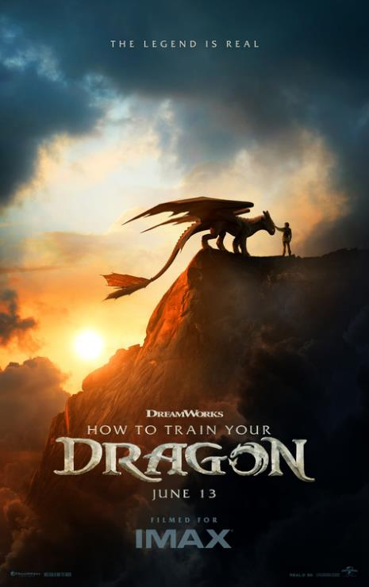
HOW TO TRAIN YOUR DRAGON
A live action remake of the DreamWorks timeless classic
RELEASE DATE | EST. INDUSTRY ADMISSIONS | GENRE | HFSS BRANDS | ALCOHOL/GAMBLING BRANDS
13 June 2025 | 1.8m | Adventure / Comedy | Yes | No
SYNOPSIS
Follows a young Viking as he aspires to hunt dragons, and how he becomes unexpectedly a friend of a young dragon.
CAST
Mason Thames, Nico Parker, Peter Serafinowicz, Gerard Butler
THE DCM TAKE
The writer and director of the How to Train Your Dragon trilogy is returning to lead the next instalment in the franchise, following its success, with all three films collectively grossing £65 million. Having expanded into three TV series, theme park attractions, and the live show How to Train Your Dragon on Ice, the franchise has proven its enduring appeal among audiences. The first film earned both Oscar and BAFTA nominations, cementing its place as an iconic animated saga back in 2010. With live-action remakes of animated classics on the rise, following the success of Beauty & The Beast, Cinderella, The Lion King and Aladdin, fans have Lilo & Stitch and Snow White to look forward to in addition to How To Train Your Dragon in 2025.
Releasing on the 13 June this film will be a perfect way to reach young men, attracted by their nostalgia for the franchise, and in a time where there’s no major sporting events on commercial TV.
 | Adults (16+) | 16-34 Adults | 16-34 Men | ABC1 Adults | ABC1 Men
REACH | 2.8% | 5% | 7.3% | 3.3% | 4.2%
IMPACTS | 1.4m | 899k | 612k | 922k | 595k
TVRS | 3 | 6 | 8 | 3 | 5
Source: Based on industry admissions and comparative film profile

Slide 13
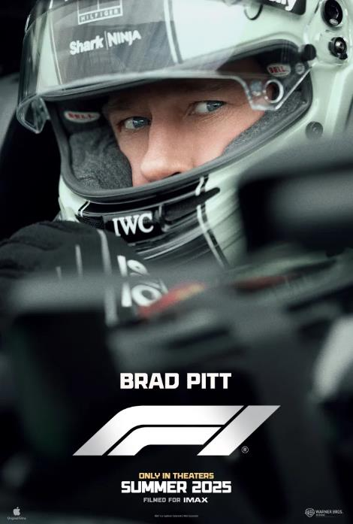
F1
It’s lights out, and away we go!
RELEASE DATE | EST. INDUSTRY ADMISSIONS | GENRE | HFSS BRANDS | ALCOHOL/GAMBLING BRANDS
27 June 2025 | 3m | Sport/Action | Yes | Yes
SYNOPSIS
A former driver finds himself back in action when he returns to Formula 1 racing to take on the sport's top competition.
CAST
Brad Pitt, Damson Idris, Kerry Condon, Tobias Menzies, Javier Bardem, Sarah Niles
THE DCM TAKE
Coming from the same director as Top Gun: Maverick, the highest-grossing film of 2022 and the 13th most successful film of all time worldwide, F1 is anticipated to have a similar feel both in its thrilling action sequences and overall cinematic impact, attracting cinephiles and F1 fans alike. Recognising the value of a cinematic event to fully capture the film's scale and appeal, Warner Bros. acquired the theatrical distribution rights from Apple, ensuring the film receives the high-profile, big-screen release it deserves before it eventually becomes available on Apple TV+, mirroring what we have seen in the past with successful films like Killers of the Flower Moon (2023). Made in collaboration with Formula 1 and the F1 community, the film is expected to be exhilarating, immersive and true to the sport, making it likely to resonate strongly with a young male audience - an ideal fit for sports, active & leisure brands.
We've already seen significant interest, with the Gold Spot already secured…
 | Adults 16+ | 16-34 Adults | 16-34 Men | ABC1 Adults | ABC1 Men
REACH | 5.2% | 6.0% | 8.2% | 6.5% | 8.3%
IMPACTS | 2.7m | 997k | 695k | 1.9m | 1.2m
TVRs | 5.6 | 6.5 | 8.9 | 7.2 | 9.3
Source: DCM, based on forecast industry admissions and comparative film profile

Slide 14
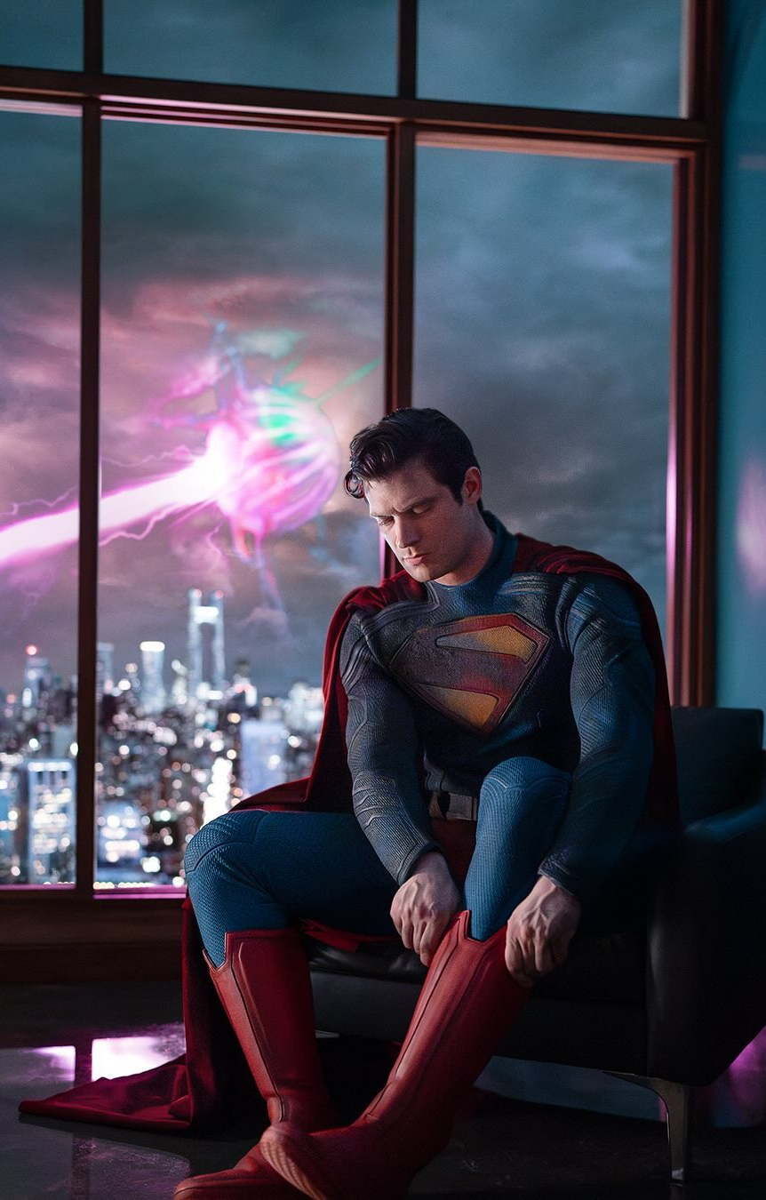
superman
A reboot of the most iconic superhero
RELEASE DATE | EST. INDUSTRY ADMS | GENRE | HFSS BRANDS | ALCOHOL/GAMBLING BRANDS
11 July 2025 | 2.4m | Action / Adventure | Yes | No
SYNOPSIS
Superman embarks on a journey to reconcile his Kryptonian heritage with his human upbringing as Clark Kent.
CAST
David Corenswet, Rachel Brosnahan, Nicholas Hoult, Edi Gathegi, Anthony Carrigan, Nathan Fillion
THE DCM TAKE
Early last year, the DC Universe (DCU) announced a bold new strategy, describing it as a ‘broad but not blanket reset’ of the previous DC Extended Universe (DCEU). This ambitious direction involves a 10-year plan, structured into multiple chapters of interconnected storytelling with the first chapter, titled Gods and Monsters, kicking off with Superman. The teaser trailer shattered records, reaching over 250 million views within its first 24 hours, holding the title of the most-viewed trailer in the history of both DC and Warner Bros. The trailer shows the first glimpse of David Corenswet as the new Man of Steel, Nicholas Hoult as Lex Luthor and teased appearances of other characters set to populate this reimagined story. Releasing in summer of 2025, Superman will be an efficient way for brands to reach young males during a time there are no major sporting events on.
 | Adults (16+) | 16-34 Adults | 16-34 Men | ABC1 Adults | ABC1 Men
REACH | 3.9% | 5.6% | 7.3% | 4.7% | 6.8%
IMPACTS | 2m | 910k | 610k | 1.3m | 968k
TVRS | 5 | 6 | 8 | 5 | 7
Source: Based on industry admissions and comparative film profile

Slide 15
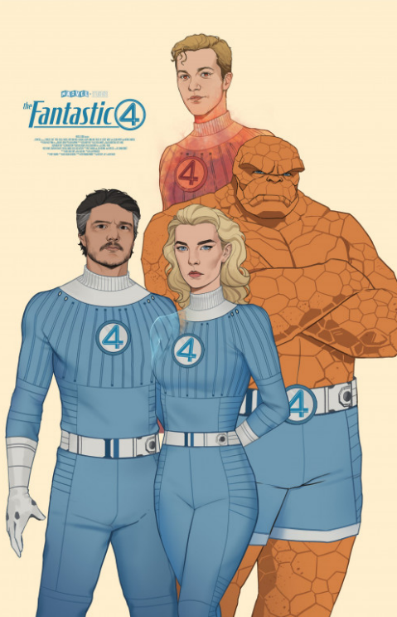
The Fantastic Four: First Steps
The first film to kick off MCU Phase 6
RELEASE DATE | EST. INDUSTRY ADMISSIONS | GENRE | HFSS BRANDS | ALCOHOL/GAMBLING BRANDS
25 July 2025 | 2.4m | Superhero/Action | Yes | No
SYNOPSIS
A mysterious portal pulls four misfits into the Overworld, a bizarre, cubic wonderland that thrives on imagination. To get back home, they'll have to master the terrain while embarking on a magical quest with an unexpected crafter named Steve.
CAST
Pedro Pascal, Vanessa Kirby, Joseph Quinn, Ebon Moss-Bachrach
THE DCM TAKE
The Fantastic Four: First Steps kicks off Phase 6 of the MCU, providing a fresh new take on the familiar narrative, with the original film releasing exactly 20 years ago. Featuring a star-studded cast, this film offers a fresher, more upmarket tone compared to many previous MCU films. It was revealed earlier this year that the film would be a period piece set in the 1960s within an alternate universe, giving it more of an authentic and refreshing aesthetic that is likely to attract a wider range of audiences. Despite it differing from other MCU films, it was confirmed at the San Diego Comic-Con in July 2024, that the cast would reprise their roles in Avengers: Doomsday (2026) and Avengers: Secret Wars (2027), starring alongside Robert Downey Jr. as Dr. Doom, emphasising the significance of The Fantastic Four: First Steps within the MCU timeline.
 | Adults (16+) | ABC1 Adults | 16-34 Adults | 16-34 Men
REACH | 4% | 5% | 8% | 10%
IMPACTS | 2m | 1.3m | 1.2m | 825k
TVRS | 4 | 5 | 8 | 11
Source: Based on industry admissions and comparative film profile

Slide 16

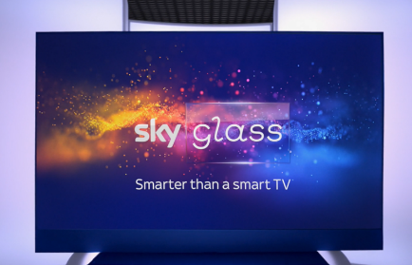
Cinema DELIVERS POSITIVE OUTCOMES FOR technology BRANDS
Looking at our brand lift study databank, it’s evident that cinema drives significant uplifts for your key brands metrics across the full funnel.
Meta-analysis of 6 cinema campaigns: Average uplifts seen from Control (unexposed to cinema ad) vs Test (exposed to cinema ad)
+29%
Recall
+54%
Whirlpool Hotpoint
Sky Glass
Despite being an already salient brand within its own market, Hotpoint struggled to convert their strong brand awareness into consideration and preference.
Knowing that cinema offers an immersive environment that delivers impactful attention, Hotpoint introduced cinema within the wider AV media plan buying into 3 different buying routes, running a 30” version of the copy in an AGP, and the 60” version across a Silver (Furiosa) & Gold Spot (If) to maximise engagement & reach an ABC1 audience.
Cinema helped to significantly improve several of Hotpoint’s core brand metrics, with the campaign driving the desired bottom funnel conversion metrics like consideration and improved perceptions that ultimately led to purchase intent.
After a successful product launch in 2022 that drove mass awareness to Sky Glass and its credentials as an industry leading premium viewing experience product, Sky wanted to shift its focus this time to driving consideration to purchase.
Sky wanted to take advantage of the 60” spot that afforded the time to communicate multiple key features including the 4K screen & sound bar, delivered in an immersive and engaging environment alongside a slate of films that helped to align Glass with a high-quality cinematic experience.
The inclusion of cinema as part of the AV mix was essential in not only helping deliver an impressive consideration uplift but doing so with cost-efficiency compared to other key channels used across the campaign.
Recommendation
+20%
Perceptions
Source: Differentology Cinema Effectiveness Databank (2016 – 2024). Meta-analysis consists of 6 Technology campaigns. Uplifts based on relative difference between Control (unexposed to ad) vs Test (exposed to ad). Results for all respondents

Slide 17
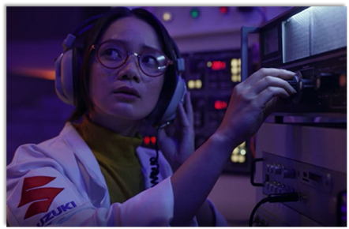
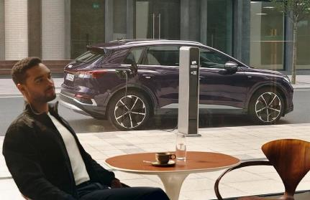
Cinema DELIVERS POSITIVE OUTCOMES FOR automotive BRANDS
Looking at our brand lift study databank, it’s evident that cinema drives significant uplifts for your key brands metrics across the full funnel.
Meta-analysis of 10 cinema campaigns: Average uplifts seen from Control (unexposed to cinema ad) vs Test (exposed to cinema ad)
+76%
Recall
+49%
Suzuki
Audi
With the launch of its new 'Good Different' brand campaign, Suzuki wanted to celebrate how its cars are different from everything else on the market, so they launched with a Family & ABC1 AGP to access top performing films across an upmarket audience.
The campaign was successful in driving significant uplifts across Suzuki’s brand metrics, including a +69% uplift in unpromoted awareness and +88% uplift in consideration.
The campaign also helped drive opinions of Suzuki, where we saw an +109% uplift from those who were exposed to the ad in the cinema compared to those who weren’t for having a ‘much better impression’
Audi wanted to be on the front foot and establish its credentials as a leader in the electric vehicle market by promoting both its Q4 e-tron and e-tron GT models.
Gold Spots in major blockbusters were picked out, to run as part of a broader AV mix (TV, BVOD, Social, Online), adding premium associations and an upmarket audience skew to the plan.
Cinema helped deliver increases in awareness for both models featured across the campaign, with an average uplift of 14% vs control.
Cinema also helped drive top end consideration. The cinema exposed group were 32% more likely to be ‘extremely likely’ to consider Audi if they were buying an electric car vs. control
Ad Awareness
+75%
Recommendation
Source: Differentology Cinema Effectiveness Databank (2016 – 2024). Meta-analysis consists of 10 Automotive campaigns. Ad Awareness based on ‘prompted’ question. Uplifts based on relative difference between Control (unexposed to ad) vs Test (exposed to ad). Results for all respondents.

Slide 18

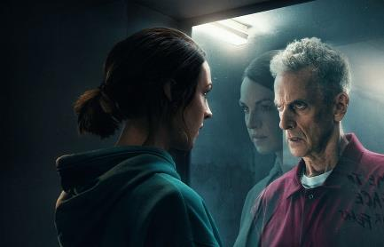
Cinema DELIVERS POSITIVE OUTCOMES FOR entertainment & leisure BRANDS
Looking at our brand lift study databank, it’s evident that cinema drives significant uplifts for your key brands metrics across the full funnel.
Meta-analysis of 17 cinema campaigns: Average uplifts seen from Control (unexposed to cinema ad) vs Test (exposed to cinema ad)
+53%
Recall
+49%
Pure Gym
Amazon Prime
Puregym aimed at expanding reach to potential customers, driving awareness, consideration to sign up and strengthen perceptions surrounding value for money and overall quality.
Knowing how cinema is beneficial in providing incremental reach to a more engaged audience, on top of an existing AV plan Puregym bought into film packs across Dec 23 – Feb 24 that would index strongly towards their target audience of 18-34s, giving them access to Wonka, Aquaman & The Lost Kingdom, Next Goal Wins and Night Swim.
Exposure to the ad in the cinema was found to significantly increase Puregym’s target audiences core brand metrics and cinema was successful in helping to significantly boost lower funnel metrics including overall conversion & consideration to join a Puregym
Prime Video worked with DCM Studios to create a high impact, disruptive launch campaign for its new psychological thriller series The Devil’s Hour.
Disrupting the cinema reel by running 3 bespoke 10” blipverts, the main 30” ad, and a ‘takeover’ of the DCM closing ident delivered prominence for the show in an already high attention environment.
This high frequency approach to cinema worked very well for Prime Video. Awareness of The Devil’s Hour show increased by +56% vs control, recall of the in-reel advertising was +25% vs. DCM benchmark and consideration to watch the show was +1-5% vs. those who hadn’t seen the cinema ads too.
Recommendation
+20%
Perceptions
Source: Differentology Cinema Effectiveness Databank (2016 – 2024). Meta-analysis consists of 17 Entertainment & Leisure campaigns. Uplifts based on relative difference between Control (unexposed to ad) vs Test (exposed to ad). Results for all respondents

Slide 19
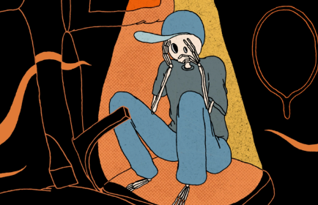
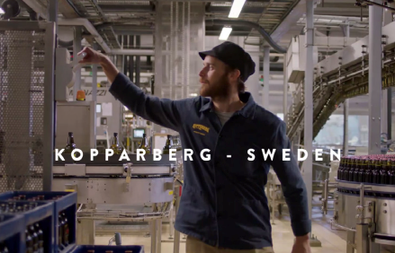
Cinema DELIVERS POSITIVE OUTCOMES FOR alcohol BRANDS
Looking at our brand lift study databank, it’s evident that cinema drives significant uplifts for your key brands metrics across the full funnel.
Meta-analysis of 2 cinema campaigns: Average uplifts seen from Control (unexposed to cinema ad) vs Test (exposed to cinema ad)
+56%
Recall
+15%
Beavertown
Kopparberg
Beavertown wanted to showcase its 180” creative to an engaged 18+ audience who drink premium beer and saw the benefit of cinema as the perfect platform for longer storytelling and reaching a more affluent audience.
Looking to launch at the start of October, Beavertown bought the Gold Spot in The Exorcist: Believer, a perfect contextual match for the beer brand to associate with a horror genre classic reboot that would draw in audiences in the run up to and on Halloween.
Running the long-form animation in the Gold Spot was successful in driving impression metrics for Beavertown, with positive shifts seen across consideration (+27%), recommendation (+25%) and Halloween association (+85%) metrics.
The idea was to combine the power of cinema and mobile to drive cinemagoers to their nearest Mitchell & Butler pub to end their night with a few Kopparbergs and do so without affecting the long-term brand building strategy.
The campaign delivered an incremental 23,096 customers to M&B venues with audiences exposed to the ads being 33% more likely to visit a participating pub.
Cinema also helped deliver on Kopparberg’s wider objectives – increasing the preferred metric from 50% to 57% amongst 18-44s and becoming the #2 brand (just behind Smirnoff) for 18-24s in terms of penetration across the alcohol category.
Perceptions
+52%
Recommendation
Source: Differentology Cinema Effectiveness Databank (2016 – 2024). Meta-analysis consists of 2 Alcohol campaigns. Uplifts based on relative difference between Control (unexposed to ad) vs Test (exposed to ad). Results for all respondents

Slide 20















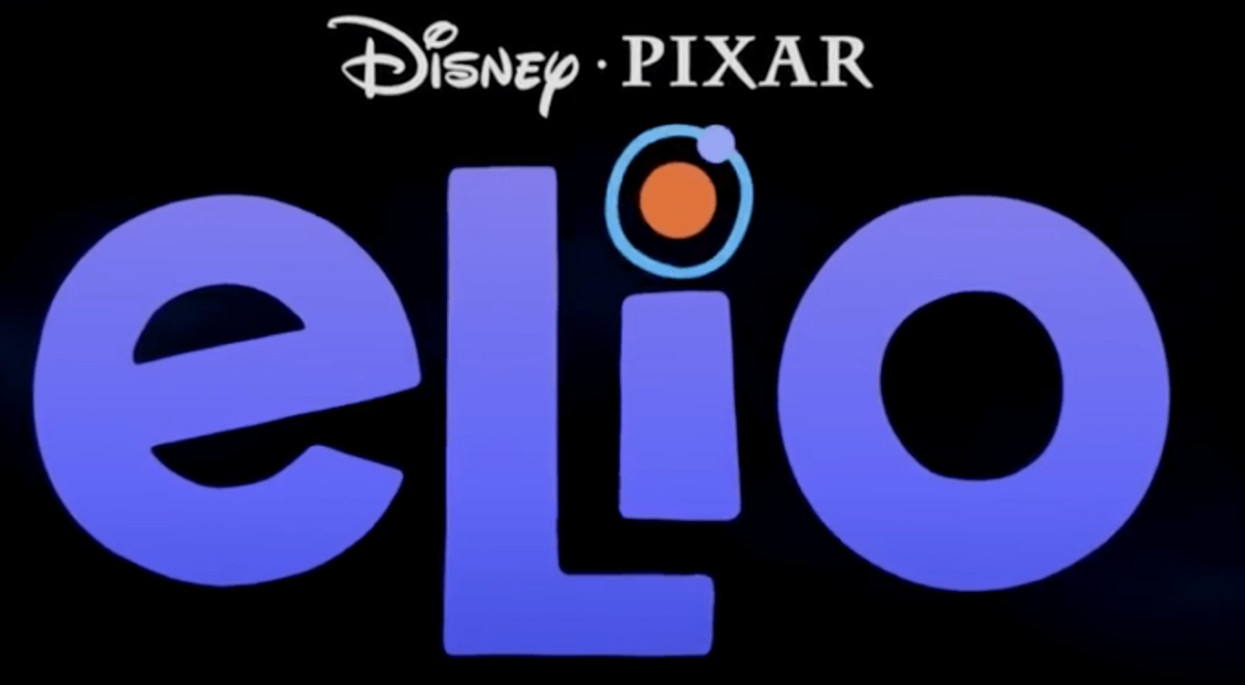















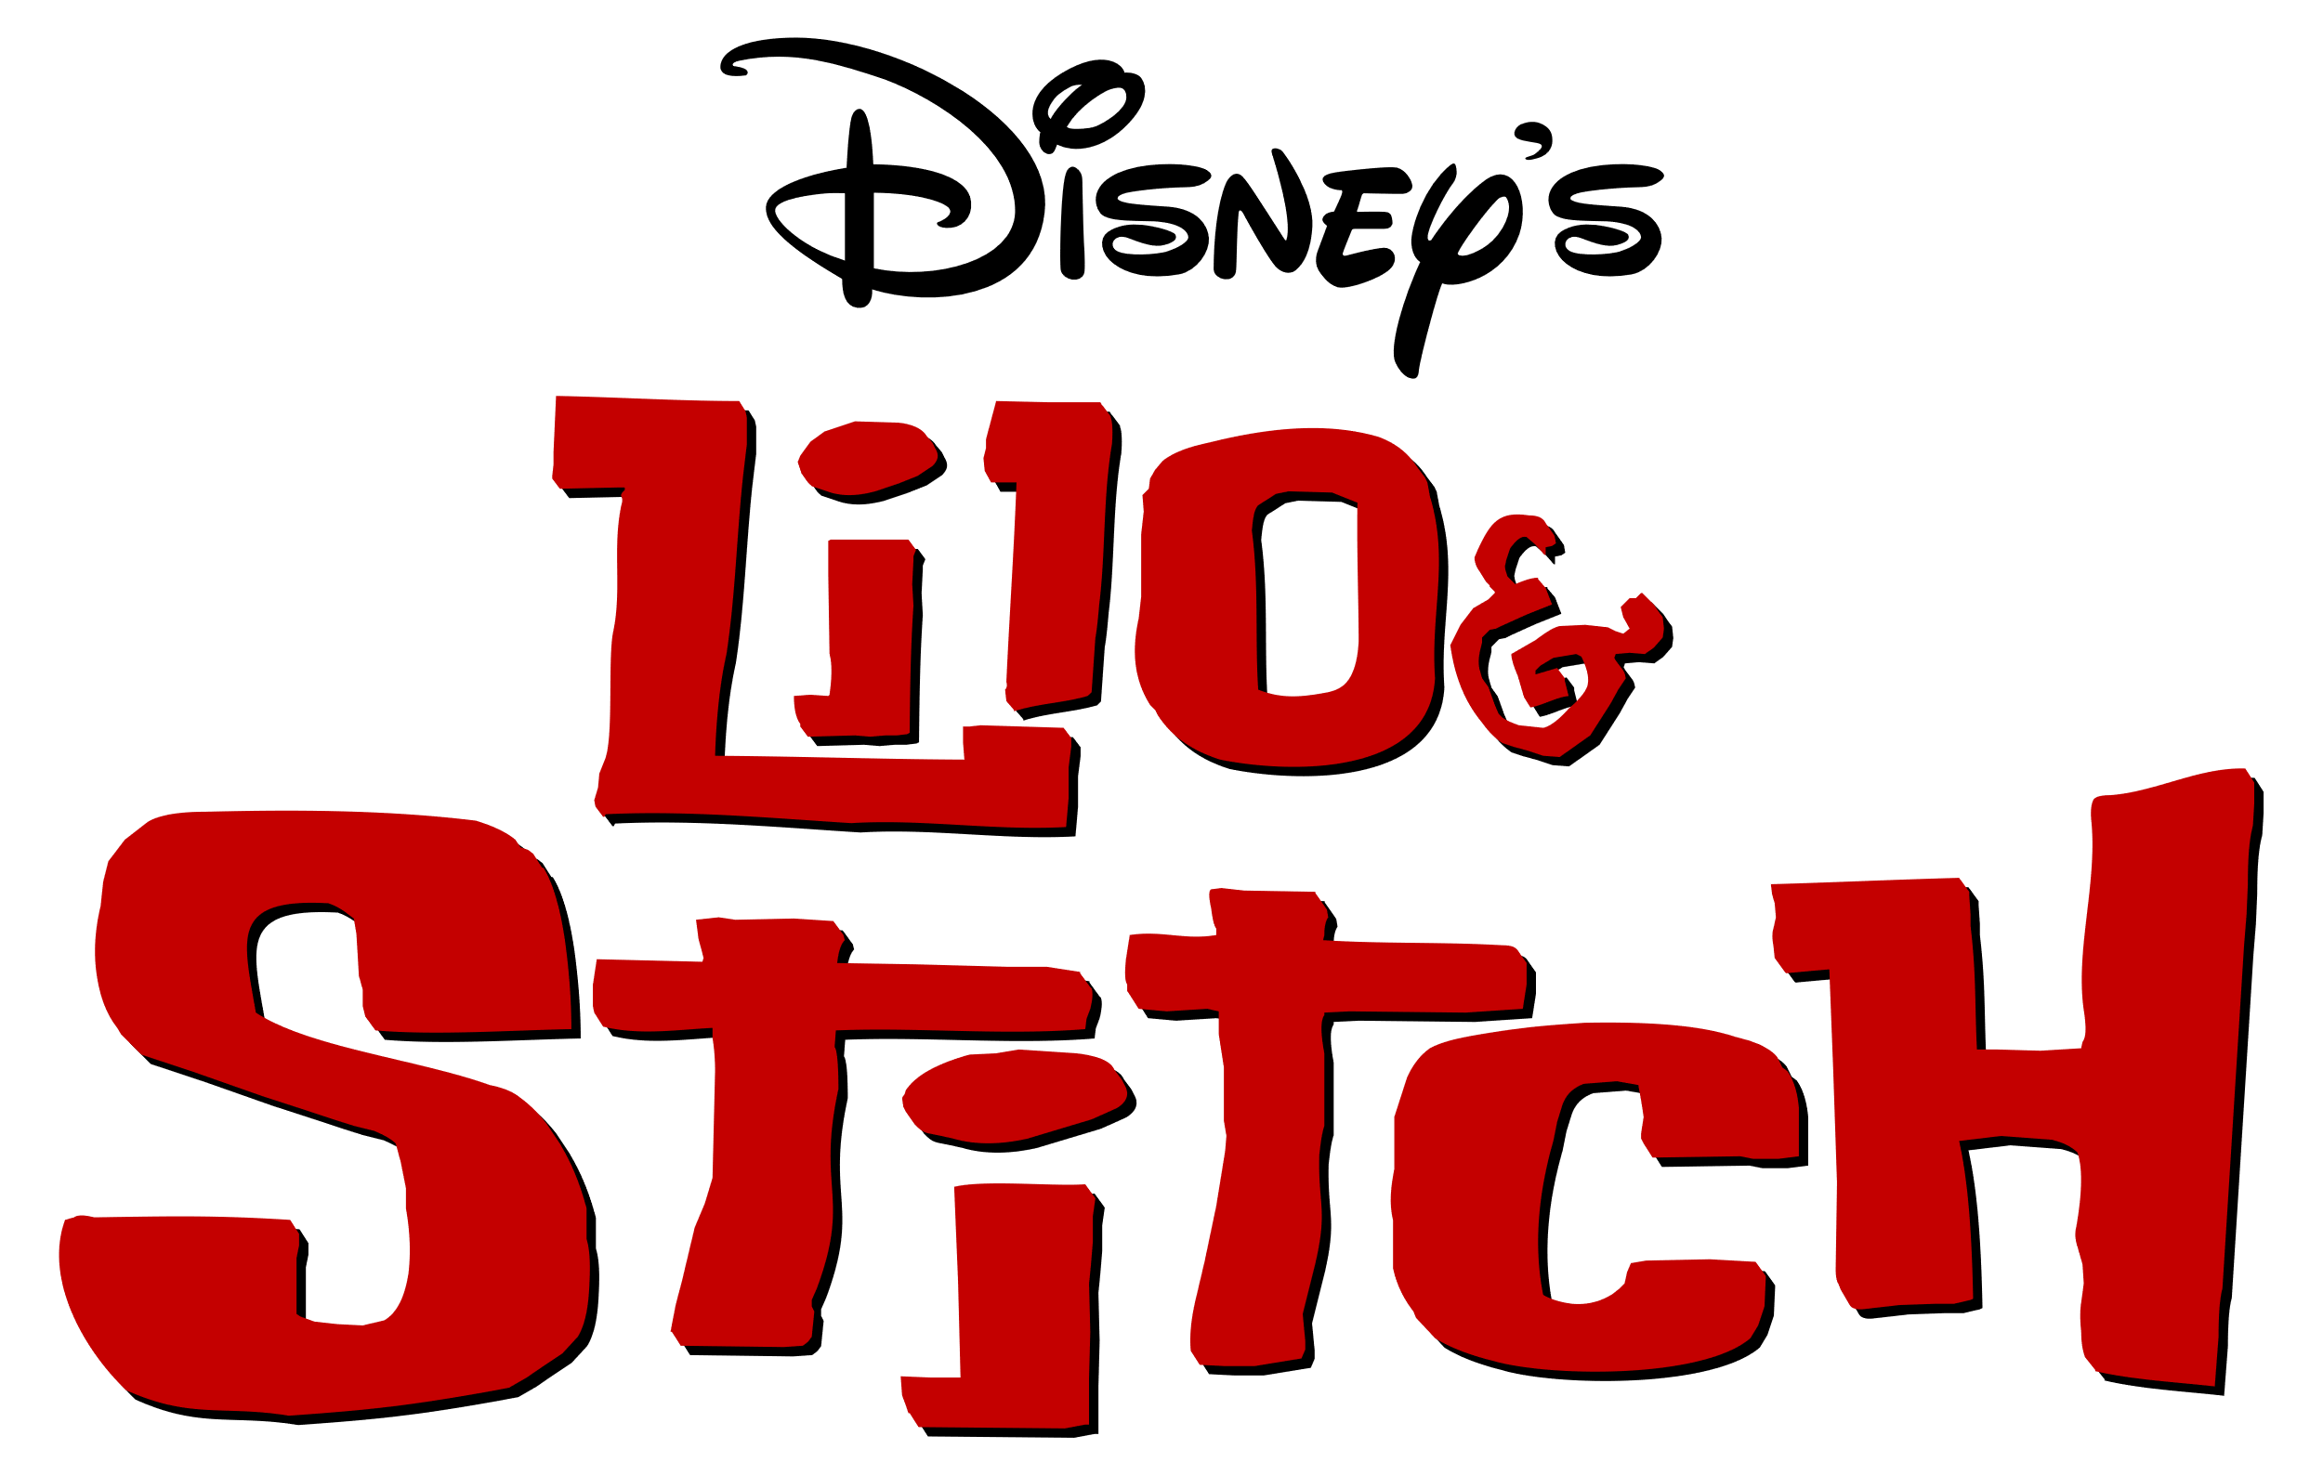
FILM SLATE 2025
TRON
ARES
Insidious (Sequel)
VICIOUS
JAN
Feb
Mar
APR
MAY
JUN
JUL
AUG
SEPT
OCT
NOV
DEC
28 Years Later

