Slide 1
2022 CINEMA UPDATE
The latest on the UK cinema marketplace

Slide 2
2021 CINEMA ADVERTISING HEADLINES
After a strong bounce-back in 2021, cinema revenue will continue to grow significantly across 2022 closing in on 2019’s peak.
2021 Top advertisers included…
(+123% YOY)
(+88% YOY)
Sources: The Drum, DCM & WARC

Slide 3
TV’s SURGE IN SPEND FROM ONLINE BORN BUSINESSES is EXTENDING TO CINEMA
Having established themselves with AV campaigns on TV, many online-born businesses are now also extending AV schedules to include the big screen
Streaming Platforms
Price Comparison Websites
Social Media
Food Delivery
Online Marketplaces
Exercise
Used Cars
Gambling

Slide 4
2021 CINEMA IN THE UK – THE NUMBERS
£556.9m
497
74m
UK Box Office grew by 88% vs. 2020
Number of titles released was up 12% YOY and only -20% down on 2019’s peak
Industry admissions up by 68% YOY
Source: Comscore

Slide 5
2021 - uk cinema admissions by month vs pre pandemic
Gradual growth, with spikes around October and December, meant that we were back to c. 80% of pre-pandemic admissions levels by the end of 2021
2019
2021
UK Cinema Admissions:
2019 - 176m
2020 – 44m
2021 – 74m (+68% YoY)
Source: DCM

Slide 6
UK TOP FILMS 2021
Incredible performances from No Time To Die and Spider-Man: No Way Home lead the 2021 UK box office
No Time To Die
£96.5m
Spider-Man: No Way Home
£74.8m
Dune
£21.8m
Shang Chi And The Legend of the Ten Rings
£21m
Peter Rabbit 2
£20.4m
Black Widow
£18.8m
Venom: Let There Be Carnage
£18.0m
Free Guy
£16.8m
Fast & Furious 9
£16.4m
Eternals
£14.8m
Source: Comscore. 1 Jan 2021 – 6 Jan 2022 box office.

Slide 7
CINEMA’S POST-PANDEMIC AUDIENCE is PROFILING YOUNGER
Based on the opening seven months, 38% of cinema’s returning audience are 16-34, up 8% vs the pre-pandemic profile.
Source: CAA Film Monitor Q4 2021 vs 2019
Cinemagoers – reported visiting the cinema in the last six months

Slide 8
The older audience are returning for the right film
No Time To Die’s audience is very similar to SPECTRE’s
Source: CAA Film Monitor

Slide 9
RETURNING CINEMAGOERS HAVE LOVED BEING BACK
What did you enjoy about the experience of being back at the cinema?
“The atmosphere of a cinema is unbeatable. The comfy chairs and massive screens and big speakers. No annoying family members asking questions and trying to speak during the film. Also I’ve missed Tango ice blasts and slushies!”
“Feeling the movie through your body. The surround sound is something I missed so much, it adds another dimension”
“The whole cinema experience, getting ready to go, deciding what to watch, eating takeout before film starts, ordering treats and snacks and drinks in the cinema with the film, big screen and sound, and after meal after cinema experience”
“Being immersed in the film and not having the distractions of life. That feeling when you go back into the sunlight and it’s like you’ve been in a different world”
“It was amazing, I had forgotten what being in a cinema was like, I loved it so much and I can’t wait to go back later this month!!”
“Dark room, great sound, adverts, trailers and properly focussing on a film. Great atmosphere and experience”
Source: Differentology/DCM
Quotes selected from 500 cinemagoers who visited a DCM cinema in June/July 2021

Slide 10
uk cinema audience will continue to return in 2022
With the impressive slate for this year lined up, we are forecasting 2022 to reach 80% of the record breaking 2019 admission level.
Source: Comscore. 2022: DCM Forecast

Slide 11
PREDICTED TOP FILMS – 2022 UK BOX OFFICE
Returns to Pandora, Wakanda and Gotham City are forecast to deliver 2022’s biggest hits at the UK box office
Avatar 2
£70m
Black Panther: Wakanda Forever
£45m
The Batman
£45m
Thor: Love and Thunder
£40m
Jurassic World: Dominion
£35m
Top Gun: Maverick
£30m
Doctor Strange In The Multiverse of Madness
£30m
Mission: Impossible 7
£25m
Fantastic Beasts: The Secrets of Dumbledore
£25m
Downton Abbey: A New Era
£21m
Source: DCM Predictions, Jan 2022

Slide 12
2022 FILM SLATE
JAN
FEB
MAR
APR
MAY
JUN
JUL
AUG
SEP
OCT
NOV
DEC

Slide 13
2022 - uk cinema admissions forecast vs 2019
Across the year admissions are anticipated to round out at c.80% of 2019’s total.
2019
2022
UK Cinema Admissions:
2019: 176m
2020: 44m
2021: 74m
2022(f): 145m
Source: DCM

Slide 14
2022 NON-BARTER TITLES
We will not accept barter on these designed non-barter films across the year
Jurassic World: Dominion
Thor: Love and Thunder
Black Panther: Wakanda Forever
Avatar 2
10 June
8 July
11 November
16 December

Slide 15
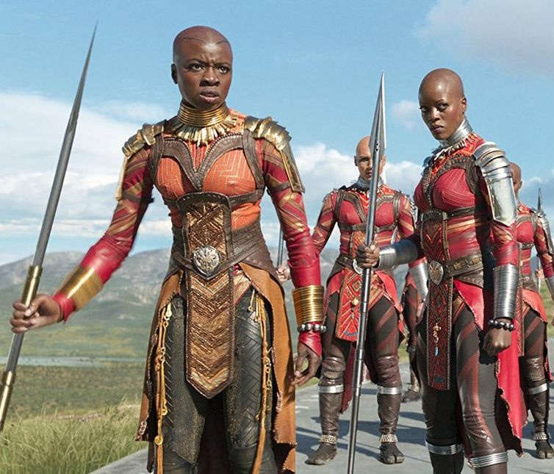
2022 top 10 16-34 BLOCKBUSTER forecasts
2022 will be a huge year at cinema with the return of some of the biggest franchises of all time
 | Industry Admissions | 16-34 TVRs
Black Panther: Wakanda Forever November | 5.7m | 23
The Batman March | 5.6m | 21
Thor: Love & Thunder July | 5.1m | 20
Doctor Strange In The Multiverse Of Madness May | 3.9m | 15
Jurassic World: Dominion June | 5.1m | 15
Top Gun: Maverick May | 4.4m | 14
Avatar 2 December | 4.9m | 13
Fantastic Beasts: Secrets of Dumbledore April | 3.2m | 11
The Flash November | 2.6m | 9
Morbius April | 1.9m | 8
Source: DCM. 2022 calendar year admissions and TVRs.

Slide 16
CINEMA HELPS DELIVER MORE OF THE KEY 16-34 AUDIENCE FOR YOUR PLANS
Investment across March can deliver incremental reach to TV+BVOD campaigns among the pivotal 16-34 audience
Adding the 16-34 AGP to your March plan adds reach…
Key 16-34 titles…
58%
65%
TV + VOD ONLY
4 weeks
16-34 Adults
250 commercial TVRs
3m VOD impressions
No cinema
TV + VOD + CINEMA (£360K*)
4 weeks
16-34 Adults
250 TVRs
3m VOD impressions
2.3m cinema admissions (19.7 TVRs)
+7% exclusive reach
Source: IPA Touchpoints Channel Planner & DCM Aston Campaign Planner.
16-34 adults AGP – March 2022. *No agency discount applied to cinema budget.

Slide 17
THE LATEST ON CINEMAGOERS
Insight from research conducted by Old Salt and Little Wing

Slide 18
cinemagoers feel MORE liberated, empowered and Ambitious
Cinemagoers – who are typically younger – are coming out of the last few years feeling inspired to pursue their ambitions and with a greater sense of self-belief
% agree…
‘I worry about other people’s opinions less now than I did before the Coronavirus pandemic’
‘I feel more inspired to pursue my ambitions now than I did before the Coronavirus pandemic’
‘I have more self-belief now than I did before the Coronavirus pandemic’
Cinemagoers
Cinemagoers
Cinemagoers
All adults
All adults
All adults
Source: Old Salt & Little Wing. How much do you agree, or disagree with each of the following statements?
All adults (n=1,007), cinemagoers (n=342). Arrows indicate significant statistical difference

Slide 19
Our top ambitions relate to improving quality of life & how we spend our time
Travelling ranks higher than ‘time with loved ones’ for cinemagoers whose top ambitions are less likely to have changed since the pandemic
All adults top 5 personal ambitions
Cinemagoers top 5 personal ambitions
#1
More time doing things that make me happy
#1
More time doing things that make me happy
#2
More time with loved ones
#2
Saving money
#3
Improving my physical health
#3
Improving my mental health
#4
#4
Saving money
Travelling
#5
Improving my mental health
#5
Improving my physical health
Source: Old Salt & Little Wing. All adults (n=1,007), cinemagoers (n=342)
From the following list, please tell us your top five ambitions at this moment in time?
Looking at this list again, which, if any of these ambitions are more important to you now, than they were before the Coronavirus pandemic?

Slide 20
cinemagoers are more likely to feel extrinsic & social goals are more important
Cinemagoers are significantly more likely to agree that balance, financial and career progression and socialising are all even more important to them now.
% who say each is more important now vs before the pandemic
Source: Old Salt & Little Wing. All adults (n=1,007), cinemagoers (n=342)
Would you say you value the following things more, less or the same now compared to how much you valued them before the Coronavirus pandemic?
Arrows indicate significant difference vs average at 95% confidence limit

Slide 21
3 IN 5 ARE MORE DISCERNING WITH MONEY NOW BUT BRANDS REMAIN IMPORTANT
Cinemagoers are more in tune with brands, keen to engage with shaping their offering, place more importance on ethical and environmental concerns and they’re aware that they’re influenced by brands too.
Source: Old Salt & Little Wing. All adults (n=1,007), cinemagoers (n=342)
Please tell us how much you agree, or disagree, with each of the following statements about brands / To what extent, if at all, do each of the following influence how you define the goals and ambitions you’re working towards?

Slide 22
cinema ads reign supreme for attention and positivity
Cinema has a clear advantage for brands offering a format where its regular users are far more likely to feel positive towards the ads they see and the amount of attention they pay to them.
% of all monthly users of each format who feel positive towards ads
% of all monthly users of each format who pay attention to ads
Source: Old Salt
Typically, how much attention do you pay to the adverts in the following places on a scale of 1 to 5, where 1 is no attention at all and 5 is full undivided attention?
How would you describe your attitude towards each of the following formats of advertising on a scale of 1 to 5 where 1 is very negative and 5 is very positive? Chart shows proportion scoring 4-5 out of 5.

Slide 23
CINEMA ALSO COMES OUT ON TOP FOR THE 16-34 audience
16-34 monthly users of each channel are more likely to be positive/attentive to the ads – with cinema yet again coming out a clear first.
% of 16-34 monthly users of each format who feel positive towards ads
% of 16-34 monthly users of each format who pay attention to ads
Source: Old Salt
Typically, how much attention do you pay to the adverts in the following places on a scale of 1 to 5, where 1 is no attention at all and 5 is full undivided attention?
How would you describe your attitude towards each of the following formats of advertising on a scale of 1 to 5 where 1 is very negative and 5 is very positive? Chart shows proportion scoring 4-5 out of 5.

Slide 24
WATCH THIS SPACE FOR MORE ON ATTENTION IN CINEMA LATER IN 2022…

