Slide 1
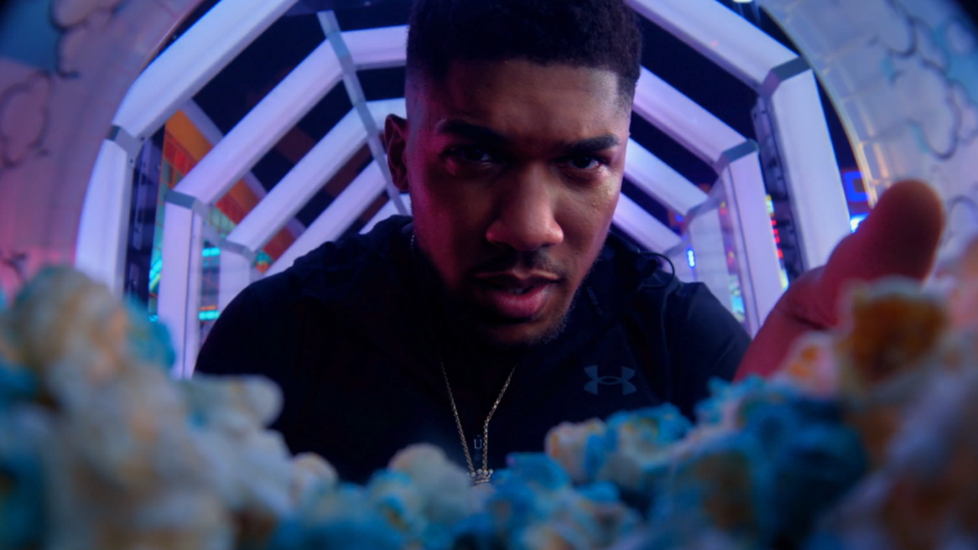
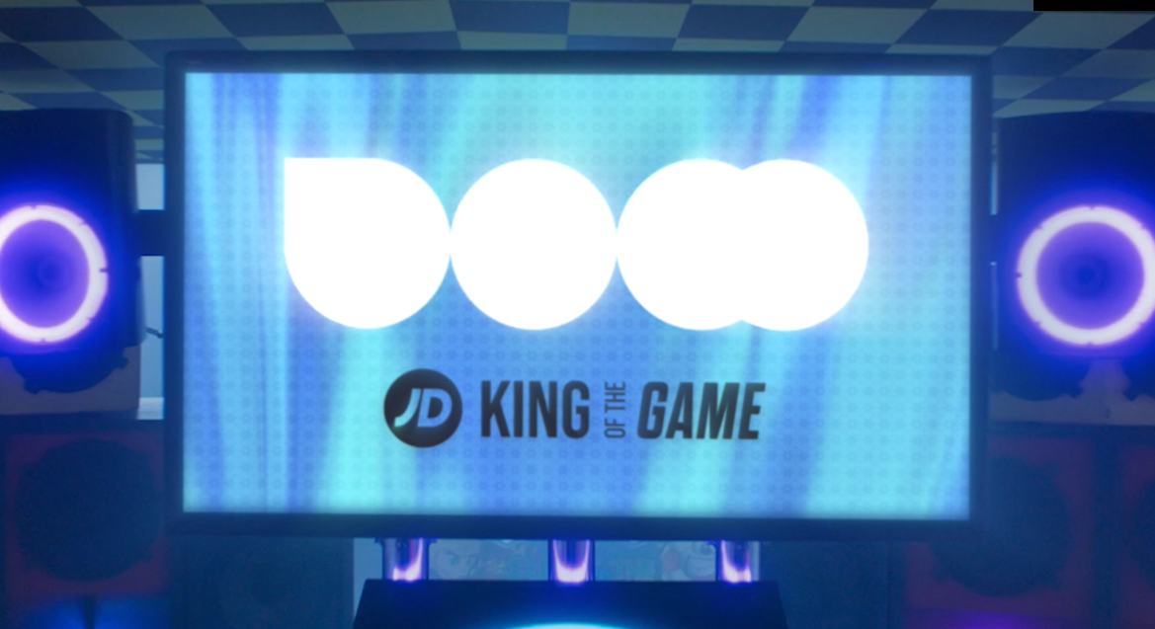
JD sports
King of the Game
Sector | Target Audiences | Package | Copy Length
Entertainment & Leisure | 16-24 | Black Panther: Wakanda Forever | 120”, 30”, Opening & Closing Bespoke Idents
Background
JD Sports wanted to really cut through with its young and diverse audience and make an impact at a key time of year for the business. With 16-24 linear TV viewing declining and prices going up, JD Sports was looking to diversify its AV mix and reach the audience away from the clutter and distraction of online/social media environments.
Whilst the World Cup was on TV, JD Sports was looking for another big cultural moment for its audience, that it could align with and achieve greater share of voice. With its mid-November release, Black Panther: Wakanda Forever was the perfect launch moment for the Christmas campaign, with cinema allowing the brand to showcase the ad in the highest-quality environment.
Plan
Having identified the right film, JD Sports wanted to understand ways of maximising presence in reel. Collaborating with Smart Media and the DCM Studios team, two branded idents were created to run alongside the main brand ad. The bespoke idents used footage from the original ad starring Antony Joshua, with the aim of ultimately boosting frequency of the JD Sports brand and cut through within the reel.
JD Sports also decided to run the full hero 120” ad in cinema during the opening week of the film and using DCM’s proximity planning tool Cinemapper tool ran this activity in cinemas closest to JD Sport’s top-performing stores. After the opening week, all cinemas would revert to showing the 30” ad to keep cover building in the run up to Christmas, alongside a wider AV mix that included TV, BVOD, Social, Online and OOH.

Slide 2
JD sports
King of the Game
Call to Action
Summary
The ‘King of the Game’ campaign delivered incredibly positive results for JD Sports within the target 16-24 audience in the run up to the key Christmas sales period. The addition of cinema to the brand’s AV mix was a success with exposure in high attention, premium environment delivering important incremental gains across many key brand metrics and ultimately driving intention.
Exposure to the campaign in cinema helped drive action too. The top claimed actions included visiting the JD Sports website, buying products from JD Sports and mentioning the brand to family/friends.
Awareness
JD Sports is already an incredibly salient brand with awareness >95% among 16-24s and the campaign cut through well across all channels.
76% of Control respondents said they’d seen advertising recently – while exposure to the 120” ad in cinema during the opening week helped increase this to 81%.
Recall
Recall of the ‘King of Games’ ad peaked at 70% for cinemagoers, an uplift of +17% vs. control and well ahead of DCM benchmarks (48%)
Perceptions
The target 16-24 audience have high agreement scores across all the measured perceptions. Exposure to the 120” ad and idents worked particularly well at driving incremental gains on key metrics including:
JD Sports is ‘relevant to me and aligns with my interests in culture, music and sport’ (75% agree, +3% vs Control)
JD Sports has a premium in-store shopping experience (79% agree, +3% vs Control)
JD Sports has a premium online shopping experience (78% agree, +4% vs Control)
Consideration
Consideration of JD Sports is very high, with exposure to the 120” ad in cinema again delivering incremental gain (+3%), pushing consideration levels to 95% amongst 16-24s
Source: DCM / JD Sports. Conducted by; Differentology, November 2022.
Results base: 16-24s. Uplifts are test (exposed to ad in cinema) vs control (not exposed to ad in cinema)

