Slide 1
BUILDING BOX OFFICE BRANDS IV
MISSION 16-34
LAUNCH, LAND, IMPACT
Notes:
Mission 16-34: Launch, Land, Impact is the fourth edition of DCM’s industry-leading Building Box Office Brands series.
Created in partnership with independent insight and strategy agency Differentology, the study explores the different roles that AV media play in the lives of young people and how cinema helps brands launch and land their messages with impact.

Slide 2
THE APPROACH
EXPLORE
AV HABITS
DEFINE
CINEMA EXPERIENCE
QUANTIFY
KEY THEMES
15 participants were recruited from across the UK (Birmingham, Edinburgh, London & Manchester)
They took part in a 5-day online community designed to capture AV habits and explore the role of different content
12 participants were invited to the cinema where they were exposed to a typical 11-min ad reel in-situ
They took part in 90 minute focus group designed to unearth the specifics of the cinema experience and define the impact of cinema advertising
Nationally representative sample of 1,000 16-34s completed a 15 minute survey designed to further understand and quantify the themes discovered in the Explore & Define stage
Differentology also undertook a meta-analysis of 12 cinema ad effectiveness projects to understand the average uplifts delivered by cinema.
Notes:
Differentology undertook a three-stage approach to tackle our objectives of understanding AV consumption and cinema’s role within this for the 16-34 audience:
EXPLORE: All participants aged 16-34, consumed the full range of AV channels (TV, VOD, Online video) and go to the cinema at least 3 times a year (to capture the spectrum of cinemagoing rather than just the heaviest cinemagoers)
DEFINE: 12 participants were exposed to a typical 11-min ad reel in a cinema and then discussed the cinema experience, advertising and some broader cinema journey topics in a 90 minute focus group.
QUANTIFY: Having unearthed key themes in the two qualitative stages of the project we wanted to understand the scale of these and so commissioned Differentology to run a survey amongst 1,000 nationally representative 16-34s. To investigate the impact of cinema amongst this audience Differentology also undertook a meta-analysis of 12 cinema ad effectiveness projects they’d run to reveal average uplifts on key brand metrics.

Slide 3
7 IN 10
16-34s FEEL ‘HOUNDED BY ADVERTISING’
Q. To what extent do you agree or disagree with the following statements? (10 point scale – top 5 responses shown)
Base: 1000 ‘16-34s’
Notes:
Our research has highlighted a key challenge for advertisers trying to positively engage the 16-34 audience. Audiences are increasingly feeling bombarded by the amount of advertising they are being exposed to – specifically online advertising which people in our focus groups referred to as ‘hounding’ them.
It’s this perception of overwhelming amounts of targeted advertising driving this tech-savvy audience to install ad blockers (40% of 16-34s have ad blocker software on a device they own) and adds to the attractiveness of services such as Netflix and Spotify Premium that provide quality content with no ads.
So our industry has created a challenge for itself - how do you actually positively engage with this key audience when they’re now feeling hounded by advertisers and actively seeking ways to minimize the amount of advertising they’re seeing, in most contexts.

Slide 4
CINEMA OCCUPIES A UNIQUE ROLE IN THE WORLD OF AV
Top 3 associations by platform
LIVE TV
Fill time | 30%
Background viewing | 26%
Comforting | 18%
VOD
Binge viewing | 27%
Fill time | 25%
Quality content | 19%
YOUTUBE
Fill time | 43%
Helps me escape | 28%
Binge viewing | 27%
SOCIAL VIDEO
Fill time | 38%
Low Attention | 27%
Spontaneous | 20%
CINEMA
Shared experience | 37%
High attention | 34%
Quality content | 31%
Q. Which of the following words and phrases do you associate with […]?
Bold text indicates where a phrase was most frequently associated
Base: 1000 ‘16-34s’
Notes:
Across the first two qual phases we collated a list of different phrases and descriptions of the different viewing experiences people had with the different AV media. In the survey to 1,000 16-34s we asked them to select which descriptors they most associated with viewing content on each of the AV platforms.
This slide highlights the Top 3 phrases selected for each AV platform and showcases the unique position that cinema occupies in the AV landscape.
At a basic level, Live TV, VOD, YouTube and videos on social are broadly seen as ways to fill time with some slight differences for each platform:
Live TV provides a comforting accompaniment.
VOD is the place to binge on favourite shows.
YouTube is a temporary escape from other tasks (e.g. popping to YT for a quick video to distract yourself from work)
Videos on Social Media are far more spontaneous and often given less attention.
Whereas, Cinema is perceived as a shared experience, highly attentive and providing quality content – offering something unique to audiences and highlights why cinema remains in such strong health with the 16-34 audience.

Slide 5
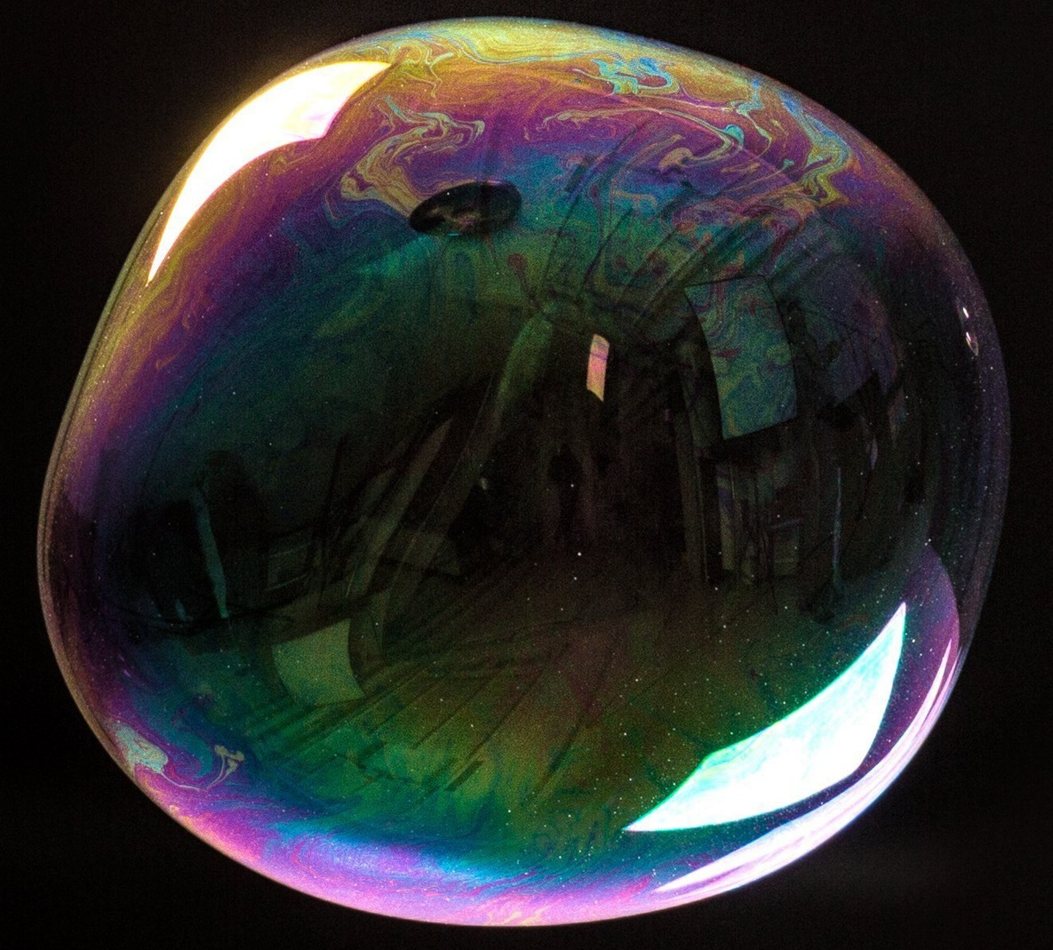
Cinema ads HELP bring the viewer into a ‘bubble’
72% OF 16-34s AGREE
THAT “CINEMA IS A BUBBLE WHERE THE OUTSIDE WORLD CAN’T INTRUDE”
66% OF 16-34s AGREE
THAT “I PAY MORE ATTENTION TO ADS IN CINEMA THAN ELSEWHERE”
70% OF 16-34 ‘AD AVOIDERS’ AGREE
THAT “I TALK TO THE PEOPLE I GO TO THE CINEMA WITH ABOUT THE ADS (WHILST WATCHING THEM)”
Q. To what extent do you agree or disagree with the following statements? (10 point scale – all ‘agree’ responses shown)
Base: 1000 ‘16-34s’, 176 ‘16-34 Ad Avoiders’
Notes:
In the focus groups one cinemagoer referred to experience of entering the screen as entering into a “bubble” – and almost three quarters of the 16-34 audience agree that a trip a cinema places them into a bubble where the outside world can’t intrude.
This true escapism is welcomed by the audience and the benefit for advertisers is that cinema ads are actually seen as part of the experience – that cinemagoers pay attention to and often actually engage with, talking to their friends/family/partner about them while they’re watching.

Slide 6
Brands can benefit from a transfer of positive attributes
ADS MAKE YOU FEEL MORE POSITIVE TOWARDS A BRAND
Cinema | 30%
TV | 25%
YouTube | 20%
Social Media | 17%
VOD | 8%
PREMIUM
Cinema | 48%
TV | 17%
YouTube | 16%
Social Media | 11%
VOD | 9%
TRUSTWORTHY ADS
Cinema | 36%
TV | 31%
YouTube | 16%
Social Media | 10%
VOD | 9%
% ranked first
Notes:
With this project we were interested in understanding how the perceptions of cinema and its unique environment could benefit advertisers. In the survey we asked 16-34s to rank each AV platform based on how premium they thought each was, and how trustworthy they thought the advertising on each was too.
Cinema was most likely to be seen as premium (almost half of 16-34s picked cinema as the most premium) and the AV platform with the most trustworthy advertising – with the traditional channels (TV and Cinema) being far more likely to be highly thought on this metric vs. online advertising formats.
We then asked them to rank each platform based on where they felt ads made them feel more positively towards a brand – and again cinema came out top, being selected most frequently as the best place for making them feel more positive towards a brand.
Cinema’s ability to engage the 16-34 audience with brand advertising is crucial for advertisers for creating the right impression and building a trusted brand that people will perceive as premium quality.

Slide 7
Cinema delivers at both an ‘emotional’ and a ‘rational’ level
Meta-analysis of 12 recent cinema campaigns
16-34 audience results
‘Better impression’
‘Rational’ brand perceptions
‘Emotional’ brand perceptions
+30%
+42%
+60%
Meta-analysis consists of 12 campaigns from finance, travel, entertainment & leisure, FMCG and charity sectors
Rational brand perceptions include: ‘is value for money;, ‘is good quality’, ‘is in convenient locations for me’
Emotional brand perceptions include: ‘is a brand I love’, ‘is a brand I’m passionate about, ‘is an inspirational brand’’. Top 3 agree scores for brand perceptions
Notes:
We wanted to go one step further and prove that cinema’s positive attributes and unique environment actually do pay off for brands too amongst the 16-34 audience.
Differentology undertook a meta-analysis of 12 campaigns that they had measured the effectiveness of amongst the 16-34 audience across the last 18 months and found that those exposed to cinema were 30% more likely to have been left with a positive impression of the brand as a result of the campaign.
Furthermore, the highly attentive audience in cinema makes it the perfect environment for landing brand messages – results of the meta-analysis highlight that being exposed to cinema led to a 42% increase in rational brand perception agreement and 60% uplift in emotional brand perception agreement.
Highlighting the valuable role that cinema can play in both communicating key messages and positively engaging the 16-34 audience with brands.

Slide 8
Key findings
The unique cinema experience creates an immersive, non-intrusive, ‘bubble’
of attention that no other AV format can provide.
Brands can benefit from a positive transfer of attributes that cinema possesses including being seen as premium and trusted.
The immersive ‘bubble’ of cinema is also the perfect environment to land key messages –both emotional & rational – and creating a better brand impression.

